Slide 1

Basic Introduction to Lisp
Based on Common Lisp
yujinglei_1222#yahoo.com.cn
gadmyth#gmail.com

Slide 2
Slide Context
For Who?
  Newbies for lisp
  With a little knowledge about lisp
For What?
  Basic lisp knowledge
  Not very deep topics
How?
  A lot of examples
  Run codes in Lisp Environment

Slide 3
Basic Introduction to Lisp
LISt Progressor (code ↔ data)
  (special-form data data data ….)
  (quote data data data data)
  (eval '(special-form data data data))
Major Lisp Dialect:
  Scheme, Common Lisp, Clojure(based on JVM)

Slide 4
Quote & Eval
cl-user> 2
  ;;; return 2, 2 is evaluated as 2
cl-user> a
  ;;; a is a variable with value “table”, will return “table”
cl-user> (quote a)
  ;;; quote makes a variable avoid evaluating, return A, also 'a makes the same effect
cl-user> (eval (quote a))
  ;;; return “table”

Slide 5
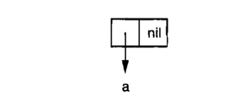
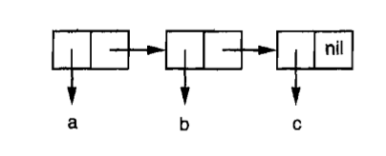
What is list?
List's Two Parts & List Constructor
  car, cdr, cons
  car → first, cdr → rest
  (cons [car part] [cdr part])
  (x . y) → (cons x y), '() → nil
  '(a) → (cons a nil), '(a b c) → (cons a (cons (b (cons c nil)))
  → (list a b c)

Slide 6
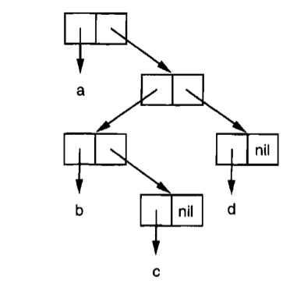
What is List?
Symbolic expression
  data S-exp = Atom | Cons (S-exp, S-exp)
  Atom: 1, 2, 3, t, nil → self evaluated
  Cons: (1 . 2)
S-expression forms AST
  Normal exp: 1 + 2 * (7 – 3)
  S-exp: (+ 1 (* 2 (- 7 3)))

Slide 7
Lisp Basic
Variable
  (defparameter *fruit* '(”apple” ”banana” ”orange”))
  (setf a ”aaaaaaaaaa”)
  (defvar *host* ”127.0.0.1”)
  (defconstant QWERTY 0)
Quote & back-quote – make list, define data
  '(1 2 3 4)
  `(1 2 3 ,a) ;;; a is 1024
  `(1 2 3 ,@rest) ;;; rest is '(4 5 6 7)

Slide 8
Function
Function definition
  Defun, Lambda
  Labels & flet
Function parameters
  Varying numbers of arguments
  Optional arguments
  Keywords arguments
Multiple returning value
Function as Data

Slide 9
Define a Function
(defun a ()
(format t ”~a, Hello, world!” a)) ;;; (setf a ”aaaaaaa”)
(let ((name ”Ted”))
(flet/label ((hello (n)
(format t ”Hello, ~a~%” n)))
(hello name)))

Slide 10
Functon Keywords
(defun foo
(&key ((:apple a)) ((:box b) 0) ((:cat c) 0 c-supplied-p))
(format t "apple:~a, box: ~a, cat: ~a, cat is setted? ~a~%" a b c c-supplied-p))
((:keyword alias) default-value [is-setted?])
Check the answer
  (foo)
  (foo :apple "ack")
  (foo :box 1001 :apple "ack")
  (foo :box 1001 :charlie 'yes :apple "ack")

Slide 11
Multiple Values & Binding
Input: Return Multiple Values
(values 1 2 3) ;; will return 1, 2 and 3
(floor 1.23) ;; will return 1 and 0.23
Output: Binding Multiple Values
(multiple-value-bind (f r) (floor 1.23)
(format t "~a r ~a~%" f r))

Slide 12
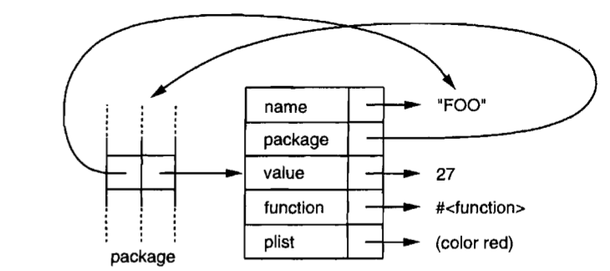
Symbol

Slide 13
Symbol
Example
  (defparameter makiyo "Beatiful girl")
  (format t "~a~%" (symbol-name 'makiyo))
  (format t "~a~%" (symbol-package 'makiyo))
  (defun makiyo ()
  (format t "Hi, my name is makiyo, I'm a beautiful girl!"))
  (format t "~a~%" (symbol-value 'makiyo))
  (format t "~a~%" (function makiyo)) ;;; you can use #'

Slide 14
Function as Data
Funcall, Apply
(defun f (a) (+ 1 a))
(funcall (function f) 4)
(defun g (a b) (+ 1 a) b)
(apply #'g (list 3 4)
(apply #'g 3 '(4))
High order functions
  map[car], reduce, filter, find, remove-if
  Complement,

Slide 15
High Order Functions
(find 20 '((a 10) (b 20) (c 30) (d 40)) :key #'cadr)
(remove-if-not #'alpha-char-p
#("foo" "bar" "1baz") :key #'(lambda (x) (elt x 0)))

Slide 16
Recursion in Lisp
S-exp makes recursion easy
  Count the number of a list
  (defun len! (lst)
  (if (null lst)
  0 ;;; nil list is zero length
  (+ 1 (len! (cdr lst)))))

Slide 17
Tail Recursion
If the lisp is soooooo long →stack overflow
Tail recursion
  (defun len! (lst)
  (labels ((len-! (li len) ;;; define the inner fn with a counter
  (if (null li)
  len ;;; returns the length
  (len-! (cdr li) (+ 1 len))))) ;;; recursive part
  (len-! lst 0)))

Slide 18
Macro
Macro expansion time/Compile time → runtime
Back-quote generating code
make program as data: list, `
program → data
(list 1 2 3 4) → '(1 2 3 4)
`(1 2 3 4) → '(1 2 3 4)
`(format t ”hello, world”) → '(format t ”hello, world”)

Slide 19
Macro
Macro expansion time/Compile time → runtime
Back-quote generating code
make program as data: list, `
program → data
(list 1 2 3 4) → '(1 2 3 4)
`(1 2 3 4) → '(1 2 3 4)
`(format t ”hello, world”) → '(format t ”hello, world”)

Slide 20
Macro
(defun fn (people)
(hello people))
(defun fn (people)
(format t “hello, ~a~%” people))
(hello people) → (format t “hello, ~a~%” people)
(defmacro hello (p)
`(format t ”hello, ~a~%” ,p))

Slide 21
Define your Macro
(if [condition]
([condition is true, do one thing])
([condition is false, do one thing else]))
Do more things when the condition is true
  Use progn wrapping out
  Define your own 'when' macro
You can also define unless
  Do more thing when the condition is false

Slide 22
Macro
  How to Use Progn:
  (if (= 3 (- 4 1))
  (progn
  (format t ”Yes, they are equal”)
  (expt 3 5))) ;;; will return 243
  Your When likes as this:
  (when [condition]
  ([do 1])
  ([do 2])
  ([do...])
  …...))

Slide 23
Macro
Implement 'When'
  (defmacro when1 (condition &body body)
  `(if ,condition
  (progn
  ,@body)))
Check Macro
  expand it and see what it is
  macroexpand & macroexpand-1

Slide 24
Pratical Use Of Macro
DSL (Domain Special Language)
  Define your own grammar
  Generate html
  AOP (Aspect Oriented Program)
AOP example (Macro is tricky)
  Print the name of every function
(defmacro defunction (name params &body body)
`(defun ,name ,params
(format t "** fn-name: ~a **~%" ',name)
,@body))

Slide 25
Macro
Too many ))))))))))))))))))).......
  Clojure: ->, -?>
  We “decrease” the number of ')' with macro
    Easy to read
  (defmacro -> (data &body body)
  `(reduce #'(lambda (val code)
  (apply (car code) val (cdr code)))
  ',body
  :initial-value ,data))

Slide 26
Macro
(-> 1
(+ 3)
(+ 5)
(* 6)) ;; will return 54
(* (+ (+ 1 3) 5) 6) ;; will return 54

Slide 27
To be Continued...
Collections (list, vector, string, array, hashtable)
Struct define
CLOS (MOP, OOP)
Format tricky, Loop tricky
CPS
Read Macro
Pattern Match in Common Lisp
REPL, Compling, Running, Evaluating...
…...

Slide 28
Q & A
Thank you!

