Slide 1

Setu
Cross-border wealth agent
Local interpretation. Exact calculations. Human control.
US and India financial documents
CMU Agentic AI Capstone
2026
Notes:
Setu is a local-first agent for someone who holds assets in both the United States and India. It reads several kinds of financial documents, creates one source-backed ledger, and explains the portfolio's value, return, risk, and missing information. Models interpret irregular documents, deterministic code protects financial truth, and the user resolves uncertainty.
Sources: ARCHITECTURE.md. Cover illustration generated for this presentation with no user data.

Slide 2
Financial truth is split across products
02
The same number can mean a balance, a market value, coverage, or an estimate
US brokerage
Indian bank and funds
Insurance
Normalize by source type
ONE
PORTFOLIO
Holdings
Cost basis
USD market value
Balances
Fund units
INR values
Coverage
Premiums
Fund or surrender value
Coverage is not asset value
A valid policy may have no stated current value
One extraction error can distort every later conclusion
Setu · CMU Agentic AI Capstone
Notes:
A cross-border investor may have a US brokerage account, a 401(k), Indian mutual funds and cash, and LIC or ULIP policies. Insurance is especially easy to misread. Ten million rupees of term coverage protects the family, but it is not a ten-million-rupee asset. An endowment policy can still be valid when its current surrender value is absent. Setu addresses both fragmented data and the reliability of the combined financial view.
Sources: ARCHITECTURE.md; SYNTHETIC_DEMO_SCENARIO.md

Slide 3
Grounded understanding with a hard action boundary
03
Setu explains a portfolio but cannot move money or invent unsupported values
SETU HANDLES
OUTSIDE THE BOUNDARY
Read investment, bank, and insurance PDFs
Normalize supported USD and INR values
Calculate net worth, ROI, allocation, and risk
Show provenance and missing evidence
Pause for review when evidence conflicts
No trading
No money movement
No market prediction
No tax advice
No guessed valuation
The result is decision support, not autonomous financial advice.
Setu · CMU Agentic AI Capstone
Notes:
The system turns supported PDFs into a normalized ledger and helps the user understand what is known, what it means, and what is missing. The capstone scope includes source-backed ROI, concentration, currency exposure, known premium commitments, and an explainable health diagnostic. It excludes outward financial actions and personalized tax or market advice. That boundary made the system testable and reduced the impact of a model mistake.
Sources: ARCHITECTURE.md

Slide 4
Models interpret, code verifies, humans decide
04
Two bounded paths share one deterministic ledger
LOCAL INGESTION GRAPH
PDF
Local extraction
Typed state
Reconcile
independent totals
SQLite ledger
Exact tools
Dashboard
embedded text
or OCR fallback
parser or Ollama
LangGraph
idempotent records
Decimal math
evidence and control
Human review
BOUNDED EXPLANATION LOOP
Typed question
Mask identifiers
Claude tool loop
3 read-only tools
Grounded answer
Claude cannot read PDFs or write to the ledger
Setu · CMU Agentic AI Capstone
Notes:
Setu has two related but separate paths. The ingestion path is a LangGraph state machine. PDF text stays local, and OCR runs only when embedded text is missing. Bank balances use a deterministic parser. Holdings and policies can use qwen2.5 through Ollama to produce typed records. Reconciliation independently checks totals and evidence. A mismatch retries once and then pauses for a human decision. Ask Setu is separate. Claude cannot read a PDF or write to the ledger. It can call only three read-only tools for FX, net worth, and portfolio analysis. Python and SQL calculate the answer, and Claude explains the returned JSON. Components communicate through typed state and tool results rather than free-form agent conversations.
Sources: ARCHITECTURE.md

Slide 5
Every displayed value stays tied to evidence
05
Provenance controls what enters the ledger and what remains in the portfolio
1
Classify
2
Extract
3
Validate
4
Persist
5
Calculate
Choose the document path
Keep supported fields only
Check schemas and totals
Hash, period, and source date
Use the latest active source
REVERSIBLE SOURCE CONTROL
ACTIVE
Linked records influence net worth, ROI, risk, and policy views
INACTIVE
Records stay in the ledger but leave every portfolio calculation
No deletion. No silent duplication. No unsupported value.
Setu · CMU Agentic AI Capstone
Notes:
Provenance is not just an audit column. Every persisted value keeps its statement and date. Duplicate files and repeated statement periods cannot silently increase net worth. The current portfolio uses the latest active snapshot for each account. In the dashboard, the user can deactivate a document. All records linked to that source immediately leave the calculation without being deleted. Reactivating it restores the evidence.
Sources: ARCHITECTURE.md; README.md

Slide 6
Failures made the design smaller and safer
06
Each difficult document removed an assumption from the architecture
EARLY DIRECTION
FINAL CHOICE
General LLM financial assistant
→
Local interpretation with deterministic finance
One generic statement extractor
→
Separate holdings, bank, and policy paths
RAG for safety-critical policy rules
→
Small versioned rule set; retrieval deferred
Full Tree of Thought and CrewAI
→
Bounded hypotheses inside LangGraph
Five broad agents
→
Fewer active roles with limited permissions
Setu · Architecture decisions recorded in DESIGN_EVOLUTION.md
Notes:
The design changed when realistic documents failed. A generic holdings extractor could not safely represent a bank certificate or distinguish insurance coverage from value. The final design uses document-specific handling over one ledger. I also chose not to implement the planned vector store for policy rules because the rule set was small and semantic retrieval could select a plausible but wrong rule. Full Tree of Thought and a generator-critic crew added more complexity than the problem required. Bounded hypotheses ranked by source authority preserved structured reasoning while remaining reproducible.
Sources: DESIGN_EVOLUTION.md

Slide 7
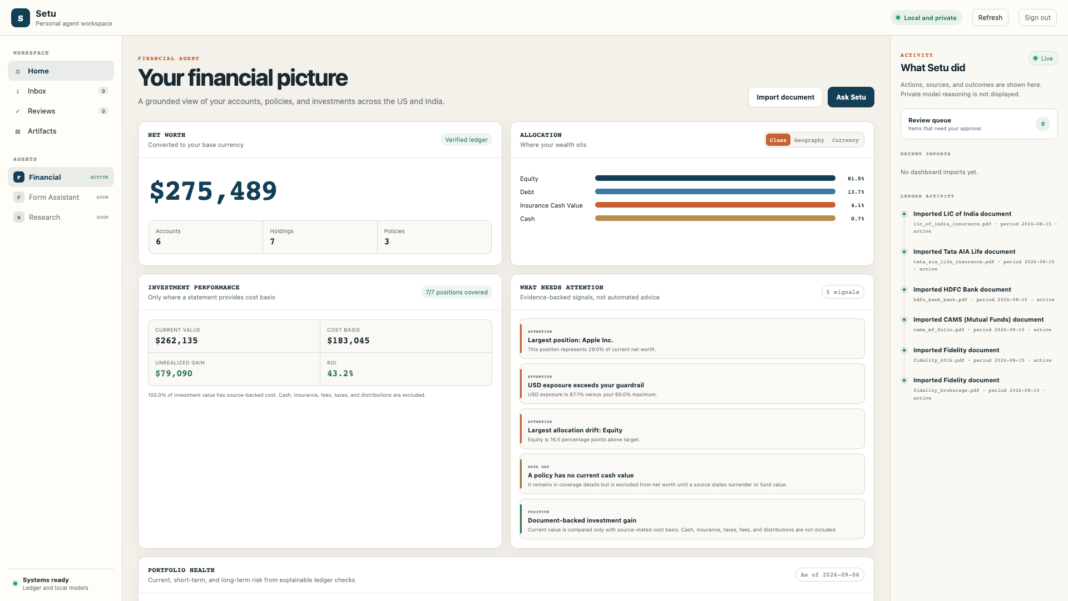
Six synthetic documents reveal more than net worth
07
Live demo uses only reproducible synthetic data
DEMO BASELINE
$275,488.50
Net worth
43.21%
Document-backed ROI
37 / 100
Health score
1 gap
LIC current value remains unknown
Deactivate fidelity_brokerage.pdf
$275,488.50 → $125,488.50
Notes:
I will start from the reproducible synthetic demo rather than personal data. It contains six source documents covering US brokerage and retirement accounts, Indian mutual funds and cash, Tata AIA insurance, and an LIC policy. The dashboard calculates 275,488 dollars and 50 cents of net worth. It includes the ULIP's stated fund value, excludes term coverage, and keeps the LIC current value unknown because no surrender value is stated. Investment value is 262,135 dollars and 20 cents against 183,045 dollars of source-stated cost, producing 43.21 percent ROI. I will open Portfolio health, then Data sources and deactivate fidelity_brokerage.pdf. Net worth falls to 125,488 dollars and 50 cents and returns exactly when I reactivate it.
Sources: SYNTHETIC_DEMO_SCENARIO.md; FINAL_DEMO.md. Screenshot captured from data/setu-demo.db on 2026-09-06.

Slide 8
The portfolio needs attention for different reasons
08
A deterministic score combines five visible checks across three time horizons
Equity allocation
85.0% vs 65.0% target
37
Largest position: Apple
30.3% of investable assets
OUT OF 100
USD exposure
87.1% vs 60.0% guardrail
Needs attention
Premium cash coverage
76.2% of known annual premiums
CURRENT elevated
SHORT TERM elevated
LONG TERM elevated
Setu · CMU Agentic AI Capstone
Notes:
These signals show why Setu adds more value than an asset inventory. The portfolio is equity-heavy, one stock is highly concentrated, USD exposure exceeds the user's declared guardrail, and known cash does not cover all annual policy premiums. Current risk, short-term liquidity risk, and long-term allocation risk are elevated for different reasons. The score is deterministic and each component is visible. It is a diagnostic rather than a market forecast or investment instruction.
Sources: SYNTHETIC_DEMO_SCENARIO.md

Slide 9
Evaluation supports specific, bounded claims
09
A known synthetic corpus tests extraction, reconciliation, exact math, and privacy boundaries
6 / 6
4 / 4
7 / 7
$0.00
0
0
✓
✓
✓
✓
✓
✓
Document
classification
Golden
reconciliation
Holdings and
cost basis
Net-worth
error
Unsafe term
valuations
Raw document
tools for Claude
110 regression tests passed
Synthetic baseline only. These results do not claim support for every institution or PDF layout.
Setu · CMU Agentic AI Capstone
Notes:
I evaluated the claims against a known synthetic corpus. The final live Ollama run classified all six documents, passed four golden reconciliations, and recovered all seven investment positions with cost basis. A planted mismatch triggered human review. Net worth matched independently generated ground truth exactly, term coverage never entered wealth, all three risk horizons were evaluated, and Claude's registry contained no raw-document tool. The full regression suite passed 110 tests. Six generated documents do not prove universal extraction accuracy. OCR logic is tested, but the recorded run does not cover a broad scanned-image benchmark.
Sources: docs/EVALUATION.md; docs/evaluation/final-evaluation.json

Slide 10
Reliable agents need controls around the model
Probabilistic models interpret and explain
Deterministic tools own financial truth
Human review owns unresolved evidence
github.com/gadodia/Setu
Next: broader anonymized corpus, dated market data, goals and liabilities, cited public retrieval
Notes:
Setu's main strength is the control system around the model: local processing, typed state, exact calculations, provenance, bounded tools, and human review. Its current limits are explicit, and the next work is to broaden evidence before adding autonomy. The public repository contains the code, architecture, synthetic demo, evaluation artifact, tests, and review instructions. My central lesson is that dependable agents come from clear boundaries between interpretation, truth, and action.
Sources: ARCHITECTURE.md; README.md. Cover illustration generated for this presentation with no user data.

