Slide 1
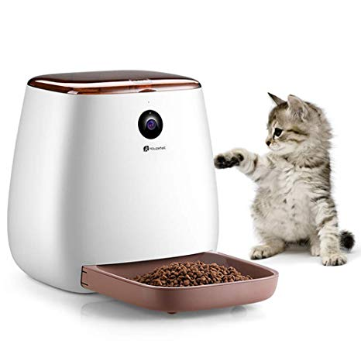
FeedSmart
Ebonie gadson
UMD Inst 346
Dr. frezzo
December 10, 2019

Slide 2
Table of Contents
Section 1: Problem and Proposed Solution
Section 2: Data
Section 3: Hardware
Section 4: Software
Section 5: Networking and Networking Devices
Section 6: Cloud
Section 7: Cybersecurity

Slide 3
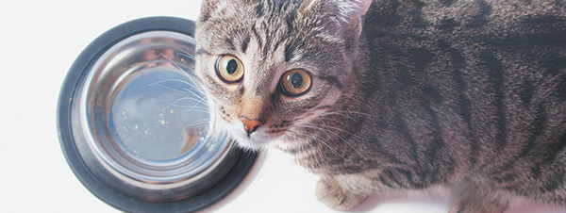
Problem & Proposed Solution

Slide 4
A smart home device that feeds your pet for you. A smart approach to feeding and managing your pet food.
- Ebonie gadson

Slide 5
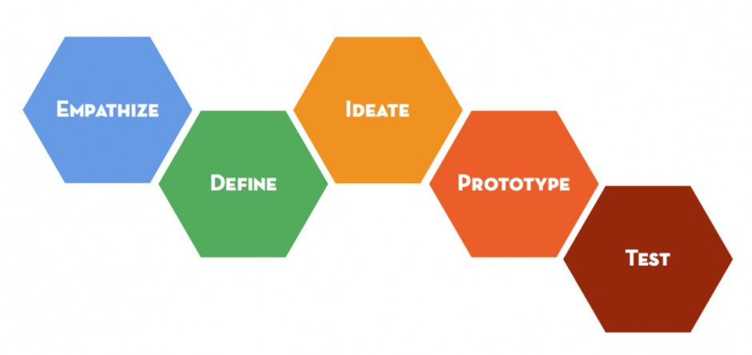
Design Process
Owners need to be able to track whenever their pets are eating and remember to feed them.
Packet tracer model that uses a smart door, motion detector, and webcam to feed pets
Conditions set that to where if a motion detector is turned on a door unlocks, and web cam is activated.
Humans are sometimes forgetful when it comes to feeding their pets.
A device that automatically fills food bowl whenever a pet is near the webcam

Slide 6

Data
Notes:
What types of data will the system be handling? What file formats? How much data? How fast will the data be accumulating? How will data storage be distributed among the mist/edge devices, the fog, and the cloud?

Slide 7
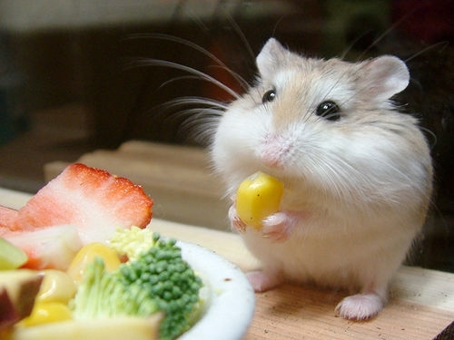
FeedSmart Data
Some data the FeedSmart will collect:
Webcam records and sends information to tablet and smart device on whether or not it is activated.
Format: [state] 0 = off, 1 = on
Door sends information to smart device on whether or not it is open.
Format: 0 – locked, 1 – unlocked
Motion detector records and sends information to tablet and smart device if it senses pet motion or not.
Format: [state] – HIGH = activated, LOW = inactive
This Photo by Unknown Author is licensed under CC BY-NC-ND

Slide 8
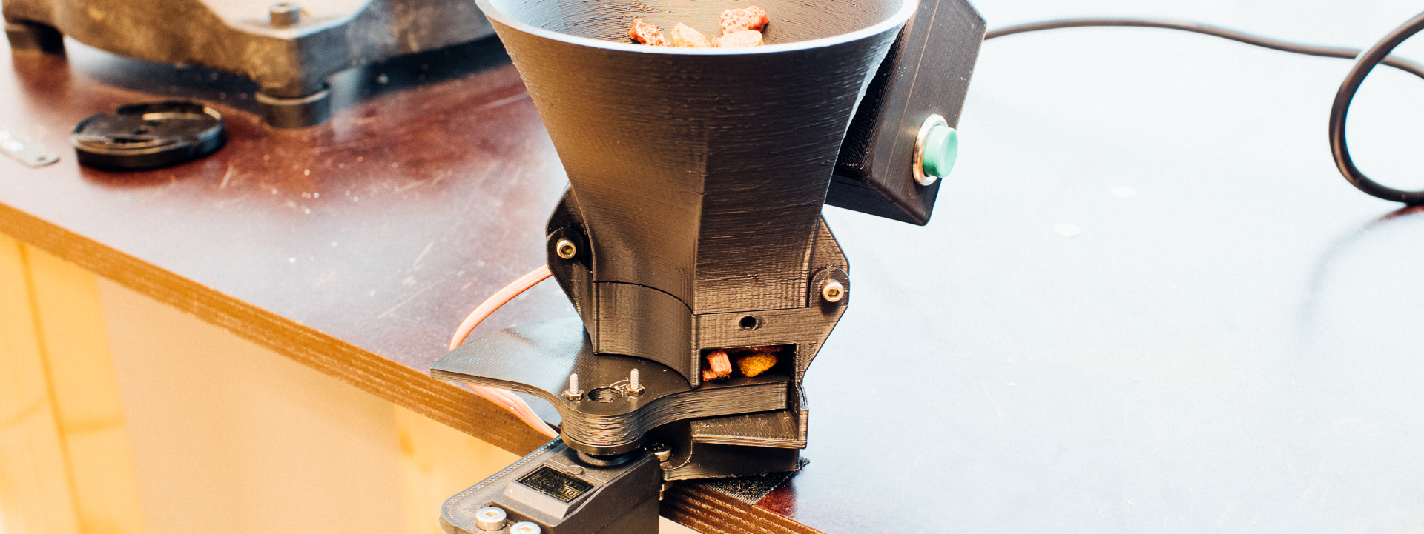
Hardware
Notes:
What locally running hardware will be required for your solution? What are the detailed specifications? What is a block diagram description of your system? What remotely running hardware will you need to run, or will you "rent" that in the form of cloud services?

Slide 9
Hardware Specifications
Server
Webcam
Motion Detector (pet movement detection)
Smart door (food is released from as the door opens)
Home router
Cell tower (remotely accessing)
Smart device (access IoT devices)
Tablet (access IoT devices)
PC
Cable modem

Slide 10
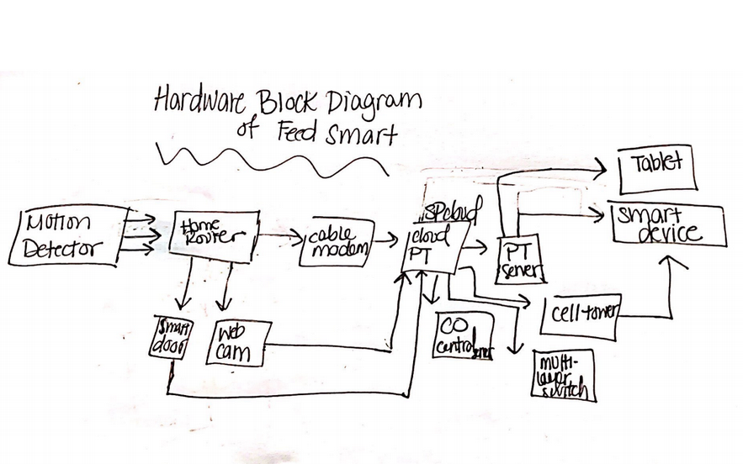
Block Diagram of FeedSmart

Slide 11

Software

Slide 12
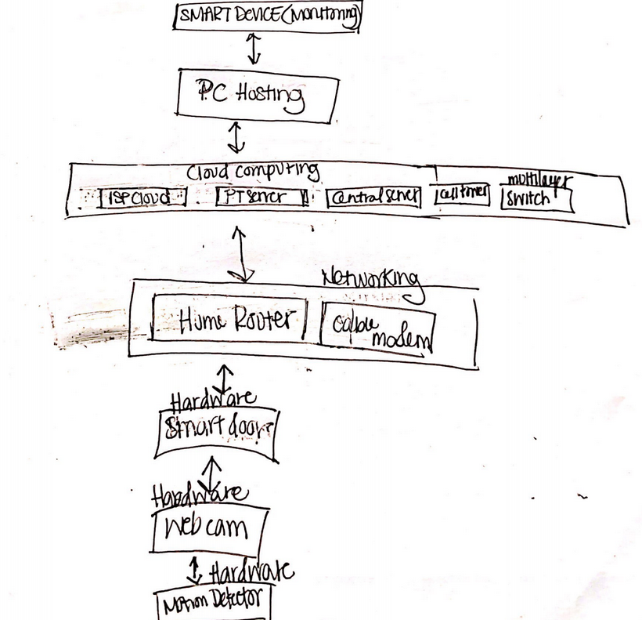
Software Specifications
FeedSmart allows owners to view webcam and sensors if the door is open
Notes:
What locally running software will you require? How would you describe the local software stack? Will you be using any locally running VMs? How will relevant software be distributed among the edge, the fog, and the cloud? How might a REST API call from a locally running Python program help your system get more value out of a cloud service?

Slide 13
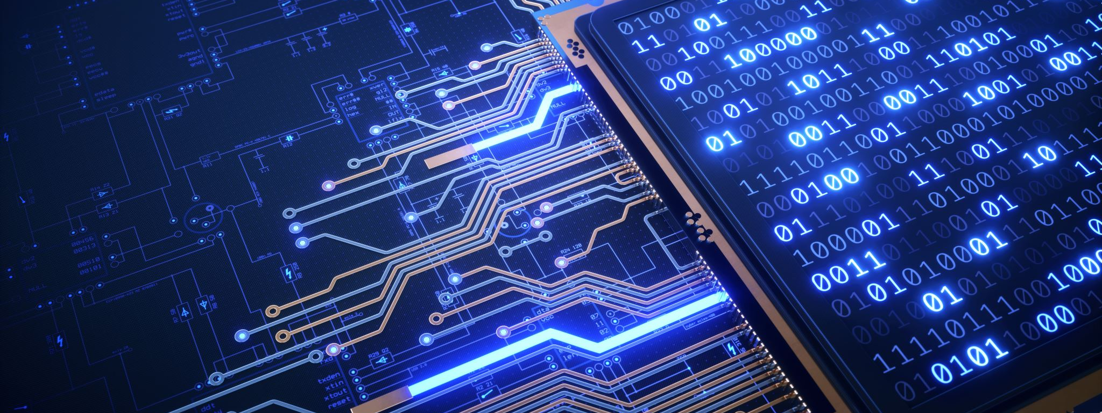
Networking and Networking Devices
Notes:
What are the edge, fog, and cloud computing aspects of your solution? Describe the LAN up to the gateway in detail. How will you connect to an ISP? Any special requirements needed from that ISP to carry your traffic to and from the cloud service? How would you describe the aspects of the networking stack you are proposing (especially which protocols)? Would describe your system as IoT?

Slide 14
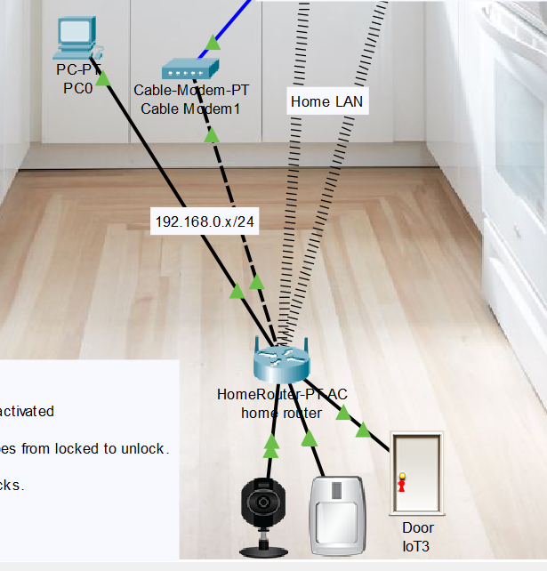
Network Specifications
Fog: The PC connected to the home router handles local interactions between devices (e.g: the motion sensor triggering the webcam to turn on, etc)
Cloud: Private cloud (using only personal computational devices and the Internet)

Slide 15

Cloud
Notes:
What role do cloud services, such as SaaS, PaaS, and/or IaaS, play in your solution? Which specific features of which specific cloud services would you propose to use? Does the cloud service support REST API calls from end devices in the mist, edge, or fog? What roles do big data, AI, and IoT play?

Slide 16
Cloud Services Specifications
SaaS: Software will handle requests to alert owner on their devices; software will also turn on and off the various locally connected devices such as the webcam.
Cloud Service Features: Easy to maintain, automatic, and is a self service.
Support of REST APIs: Makes it easier to access parts of the network
AI/IoT Roles: Home PC will control the

Slide 17

Cybersecurity
Notes:
How would you describe the attack surface? What are some of your system's possible vulnerabilities? How do you propose to mitigate them? Are there any privacy issues associated with your solution.

Slide 18
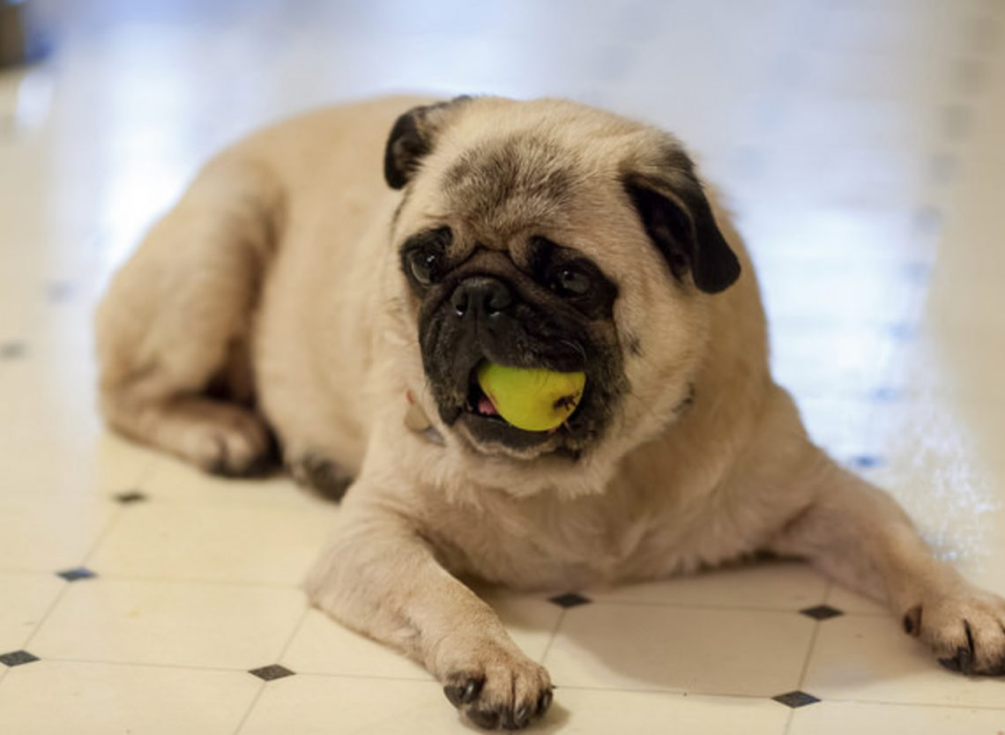
Security Specifications
The attack surface of the SmartFeeder would be neutral overall. Since it is only activated for the animal it was initially designed for, it is impossible for an unrecognizable pet to use it.
One vulnerability and privacy issue would be that information that is sent to the cloud from the device (motion sensor, webcam, and overall monitoring) may be shared or leaked if a hacker gets a hold of this information. One way to mitigate this risk is for pet owners to encrypt their data locally or using a cloud storage service.

