Slide 1

Gift Game
The Concept: We are a 2D mobile game based on a wacky gift exchange.
The Pitch: Shake, swap, and steal your way to the best haul in this exciting new mobile game about opening the best presents. Rattle the package to hear what’s inside, inspect the outside, and make your best judgement as to what’s inside, but beware, it’s not always what you think.
Core Experience: Excitement of participating in a wacky present swap where anything is possible.

Slide 2

Team N/A
Gabe Landwehr – Team Lead
Tre Stoterau – Project Manager
Evan Winters – QA Lead
Austin Krieger – Admin
Phyzon Milton – Marketing Lead
Jordan Kudray – Narrative Utility
Drew Concha – Sound Design
Jayme Skaggs – Art

Slide 3
Some Problems Encountered
Networking is hard
Pixel art is somewhat limiting
Refining our sense of humor

Slide 4

Solutions
One phone will be passed around
New art style
Remove personal bias

Slide 5


Slide 6
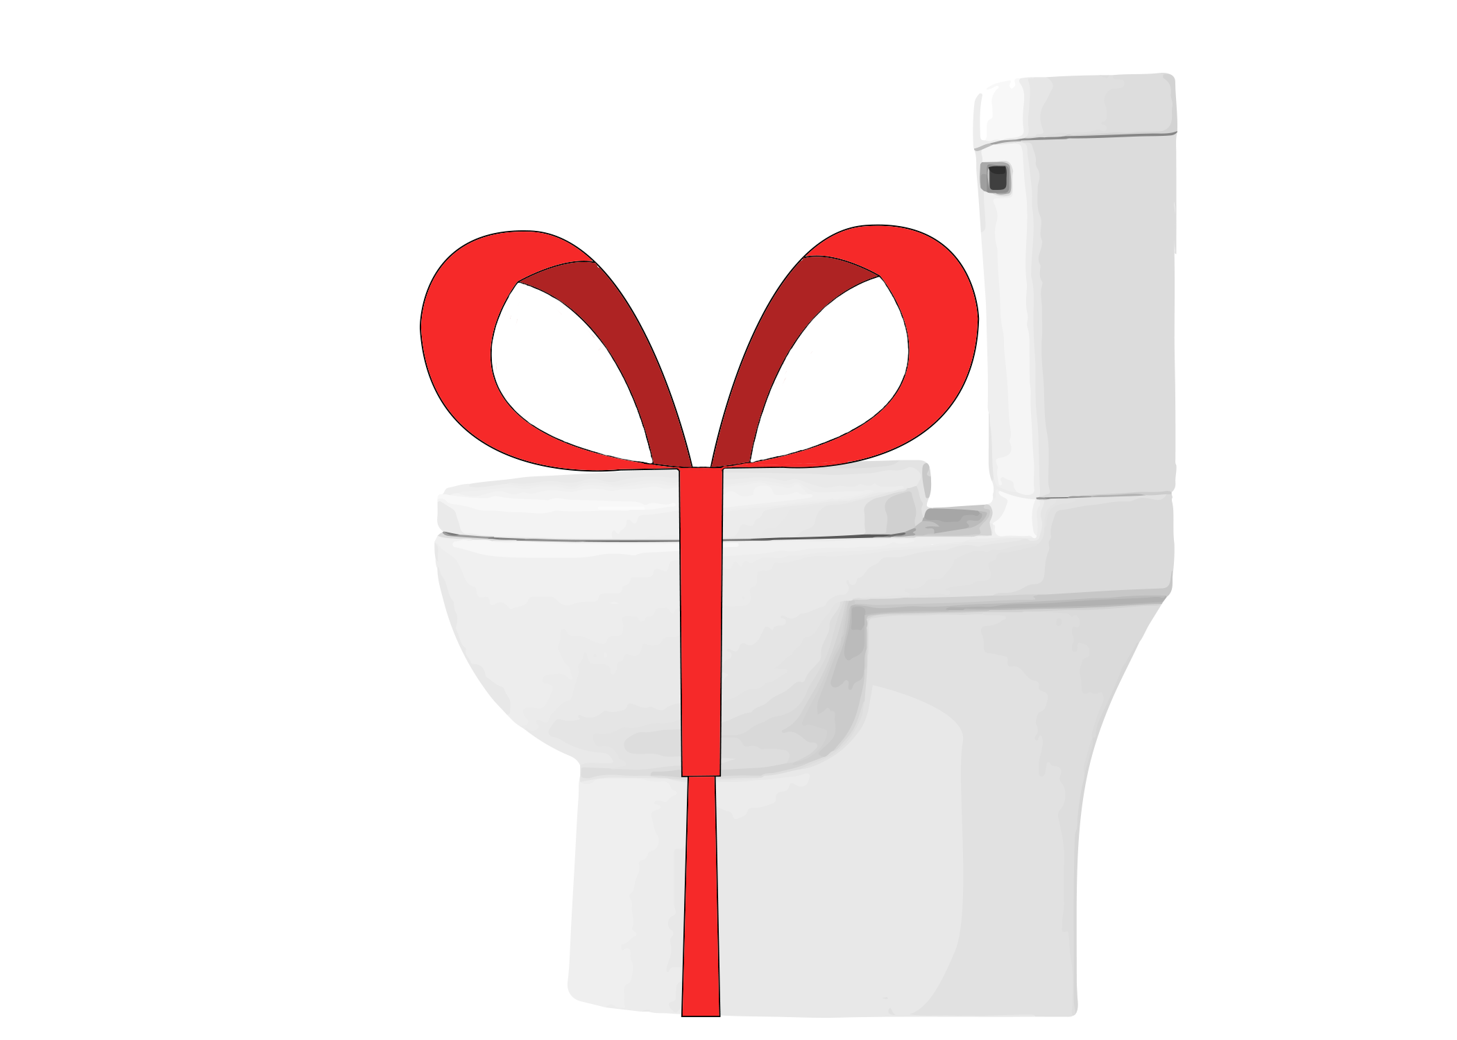
Questions?

