Slide 1
Gift Game
Team N/A

Slide 2

Our Team
Gabe Landwehr – Team Lead
Tre Stoterau – Project Manager
Evan Winters – QA Lead
Austin Krieger – Admin
Phyzon Milton – Marketing Lead
Jordan Kudray – Narrative Utility
Drew Concha – Sound Design
Jayme Skaggs – Art

Slide 3

The Concept
We are a (mostly) 2D mobile game.
Based around a wacky gift exchange.

Slide 4

The Pitch
Shake, swap, and steal your way to the best haul in this exciting new mobile game about opening the best presents. Rattle the package to hear what’s inside, inspect the outside, and make your best judgement as to what’s inside, but beware, it’s not always what you think.

Slide 5
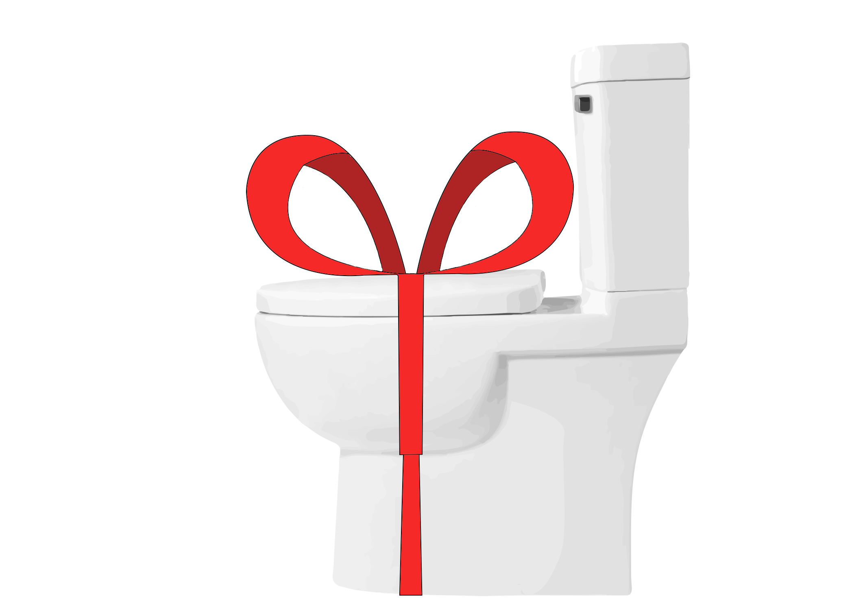
Core Experience
Excitement of participating in a wacky present swap where anything is possible.

Slide 6

Basic Mechanics
Receive
Visuals
Vibration
Shake
Sound
Pass gift
Keep gift

Slide 7
What’s New
Networking.
New Art Style
Sounds
Menus

Slide 8


Slide 9
Questions?

