Slide 1
Gift Game
GAME 333/444 Project

Slide 2

The Concept
Shake, swap, and steal your way to the best haul in this exciting new mobile game about opening the best presents. Rattle the package to hear what’s inside, inspect the outside, and make your best judgement as to what’s inside, but beware, it’s not always what you think.

Slide 3
The Pitch
Shake, swap, and steal your way to the best haul in this exciting new mobile game about opening the best presents. Rattle the package to hear what’s inside, inspect the outside, and make your best judgement as to what’s inside, but beware, it’s not always what you think.

Slide 4
Core Experience
Excitement of participating in a wacky present swap where anything is possible.

Slide 5
Basic Mechanics
Receive
Visuals
Vibration
Shake
Sound
Pass gift
Keep gift

Slide 6
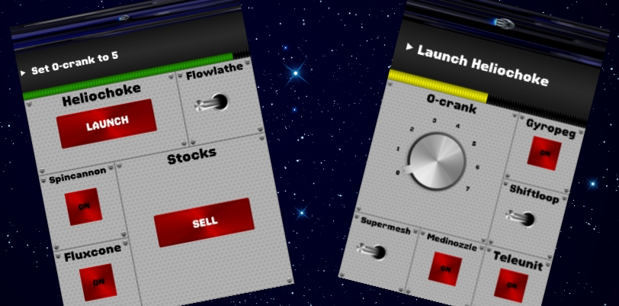
Reference Games
Space Team, Exploding Kittens, Jackbox Games

Slide 7

Questions?

