Slide 1
Gift Game Sprint Report
Team N/A

Slide 2
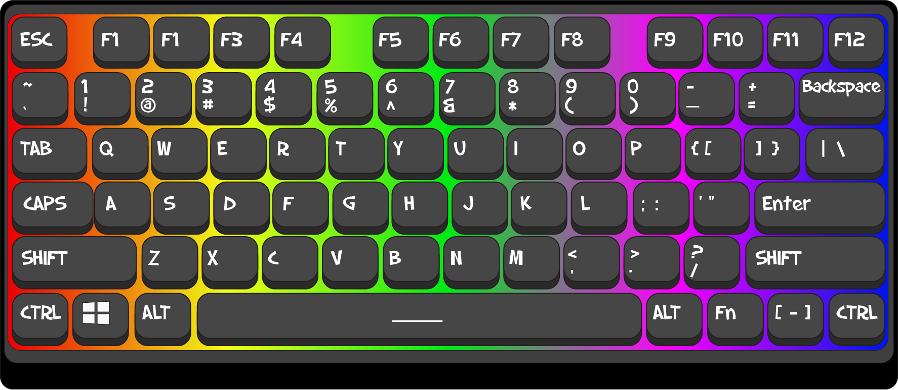
Some Tasks Completed
Created a “PlayerData” class
Configuration menu upgraded
More art assets
Giftbox model

Slide 3
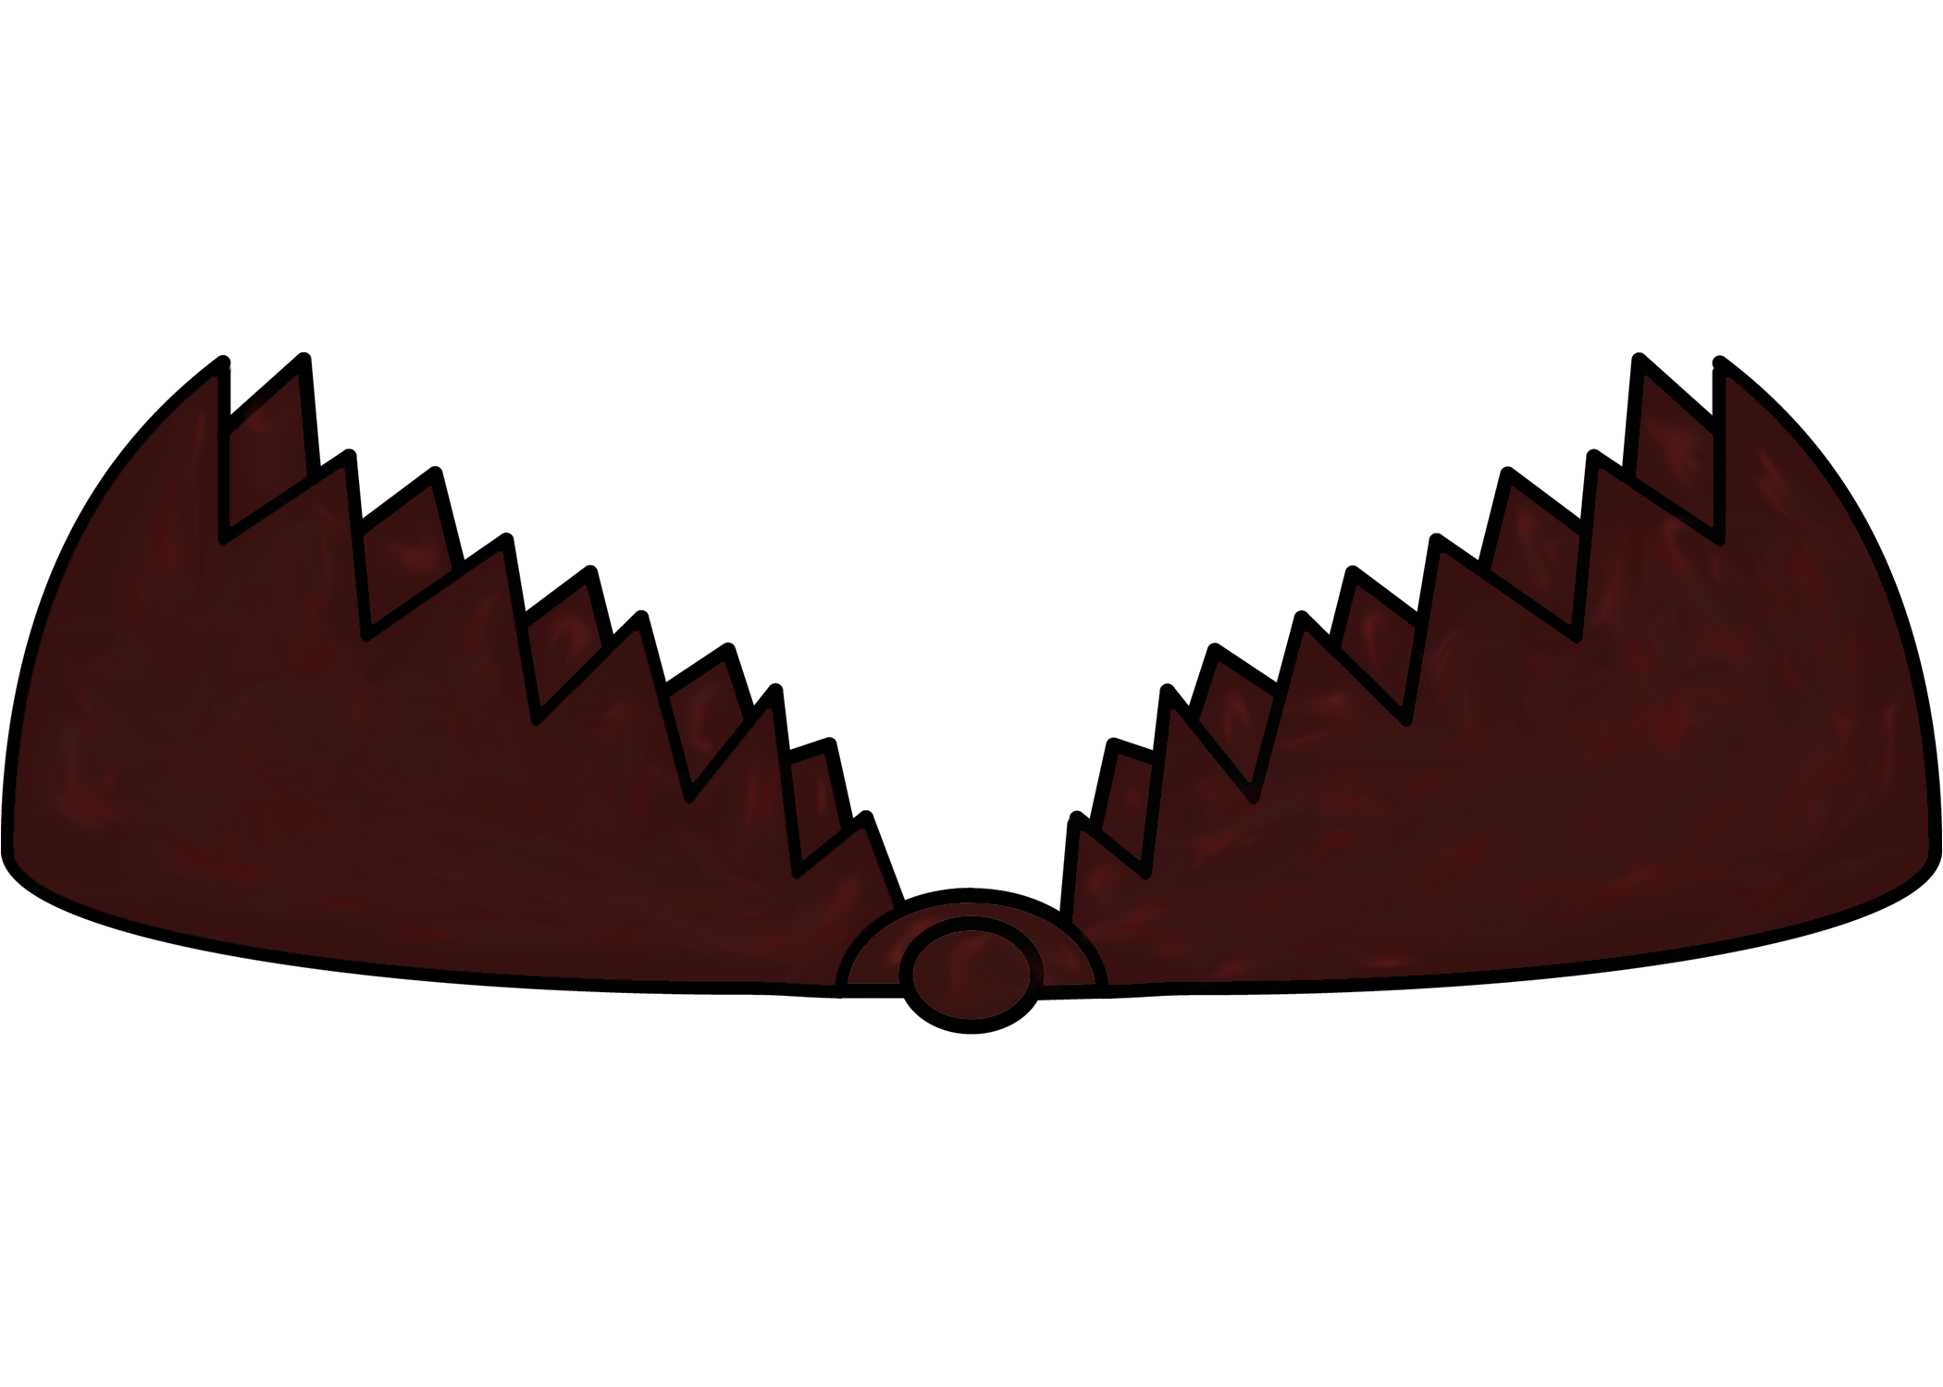
Issues
Workflow stagnation
Lack of communication

Slide 4
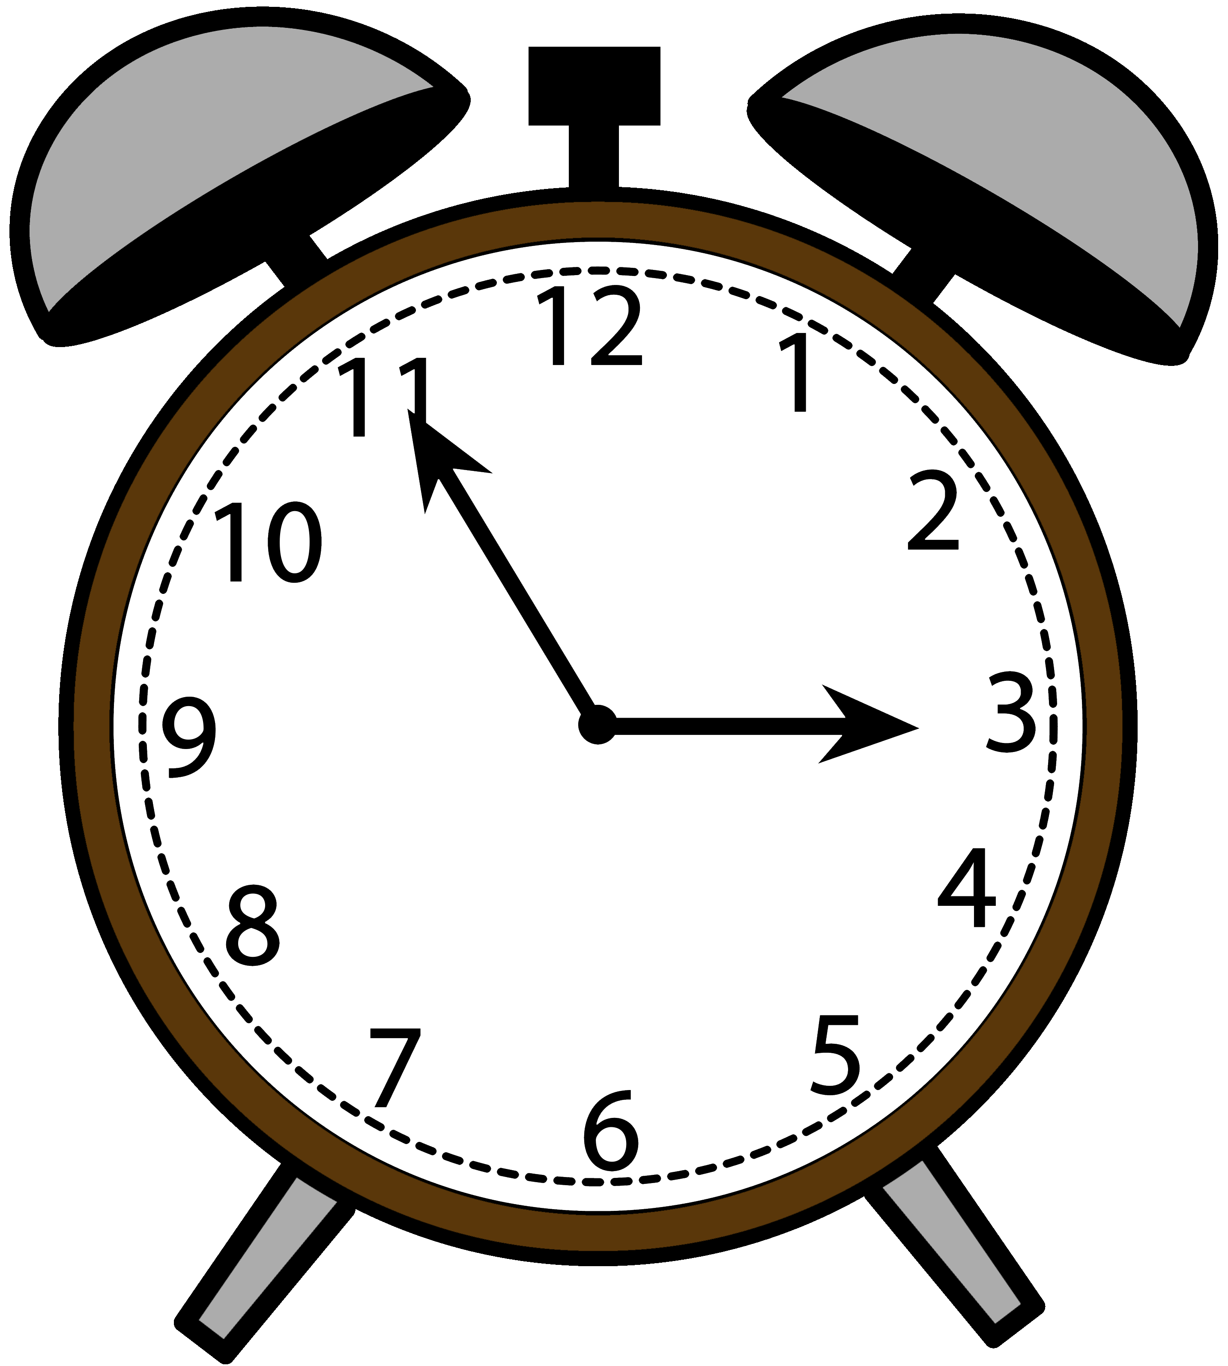
Future Plans
Implement scoring system
Create & implement more items
Refine sounds

Slide 5
Questions for Gabe’s Favorite Foods?

