Slide 1
Empowering India
Project Tittle :
Analysing the Evolution of Union Budget Allocations for Sustainable Growth.
(SmartInterz APSCHE Internship)
Student Name:
Sunitha Gadula

Slide 2
Introduction
The Union Budget outlines Government financial priorities.
Focus on infrastructure, defence, health, and agriculture.
This project analyzes allocation trends (2021-2024).
Objective: Understand sustainable growth strategy.

Slide 3
OBJECTIVES
• Study evolution of budget allocations.
• Analyze Top Departments and Schemes.
• Compare category-wise distribution.
• Build dashboard using Tableau.

Slide 4
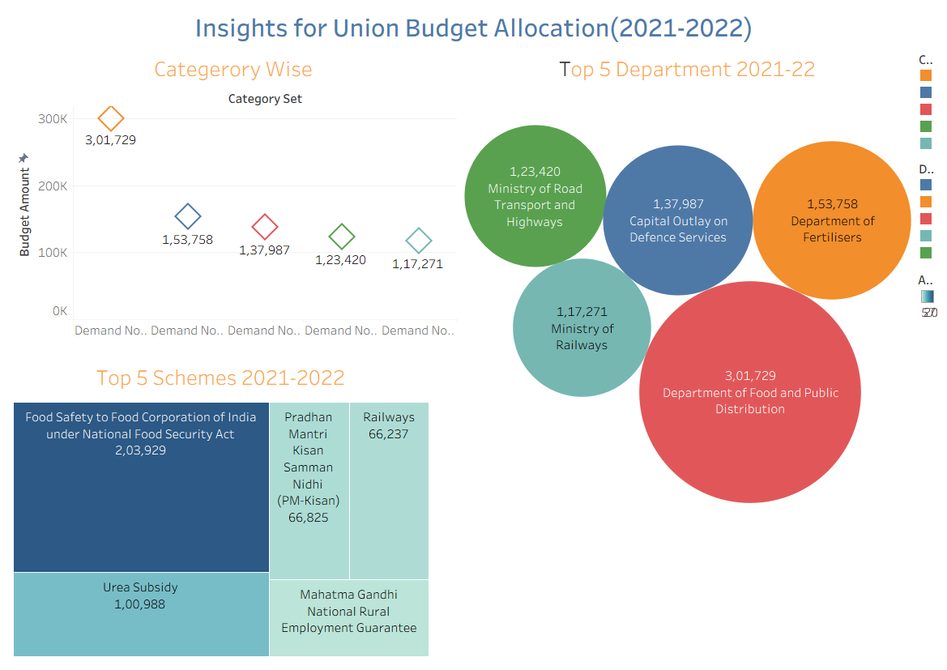
Dashboard 1 – Budget Allocation (2021-2022)

Slide 5
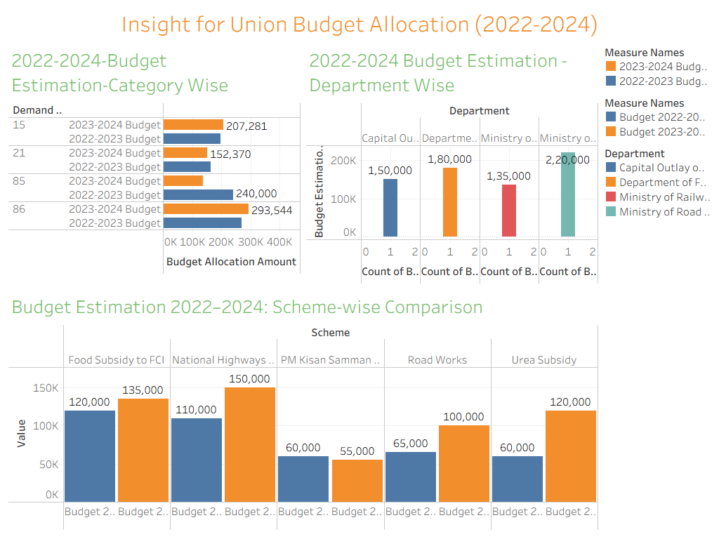
Dashboard 2 – Budget Estimation (2022-2024)

Slide 6
KEY INSIGHTS
• Defence sector received highest allocation.
• Strong capital investment in national security.
• Agriculture and food processing received major funding.
• Budget supports long-term sustainable growth.

Slide 7
CONCLUSION
• Budget trends indicate focus on infrastructure and security.
• Government emphasizes inclusive and sustainable development.
• Union Budget plays key role in empowering India.

