Slide 1
Final Project
PLSC31101
Gaegoung Kim
12/09/2019

Slide 2
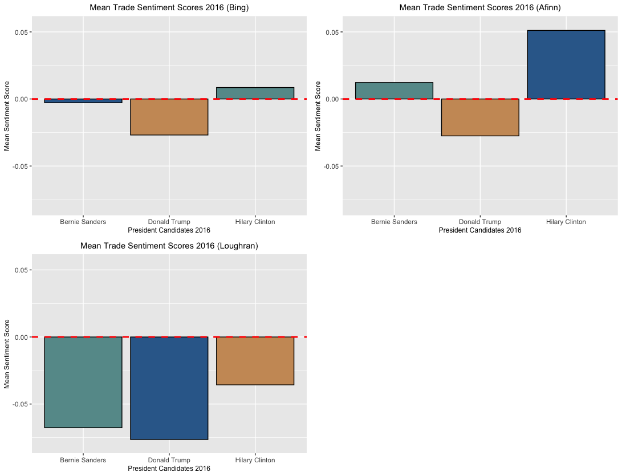

Slide 3
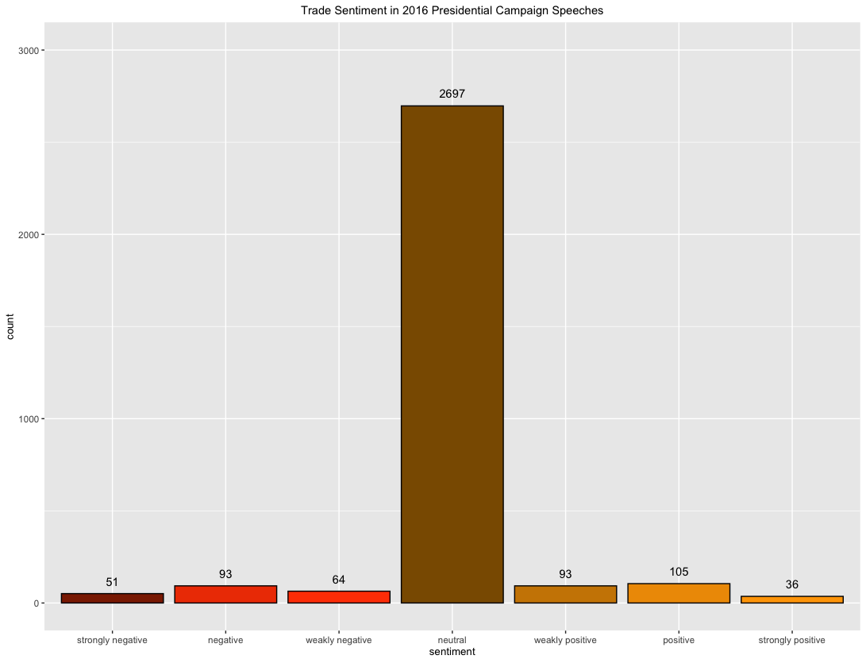

Slide 4
Thank You ☺

