Slide 1
JS Sankey Diagram
On a LAMP server for Tableau Integration

Slide 2
Process
Original CSV
1. Transform into JSON (Python)
2. Adjust Sankey (HTML)
4. Upload on LAMP Server
3. Integrate in Tableau

Slide 3
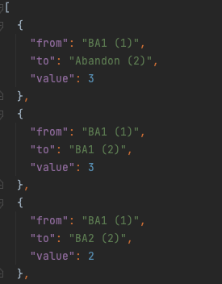
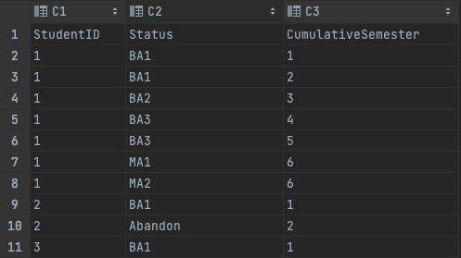
Transform into JSON
Tabular Format
Count Sequence

Slide 4
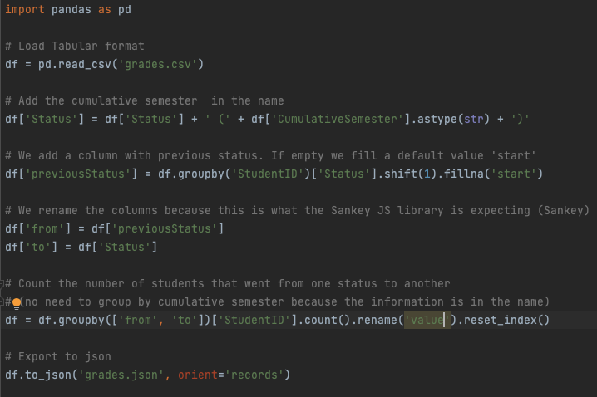
Transform into JSON (with Pandas)

Slide 5
Adjust Sankey
Path of JSON file
Colors
… (https://docs.anychart.com/Basic_Charts/Sankey_Diagram)

Slide 6
Upload on LAMP Server
Install Cyberduck
https://cyberduck.io/
Connect
Serveur: https://dav-acad.epfl.ch
User&PSW: GASPAR
Si pas d’accès => natalie.meystre@epfl.ch
Créer un répertoire dans htdocs et mettre le json et html

Slide 7
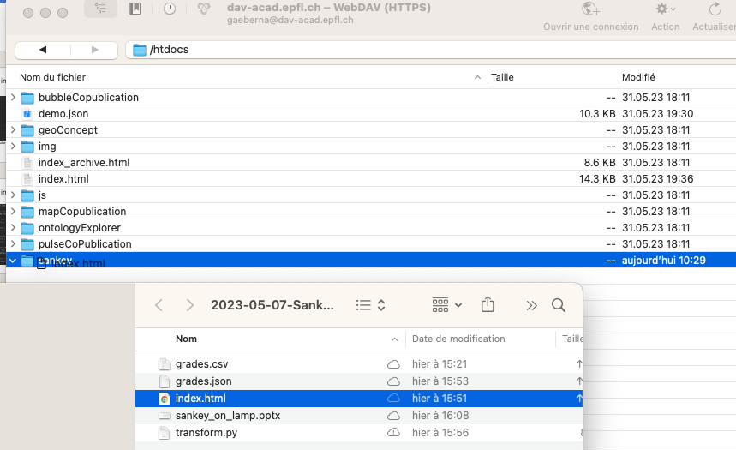
1. Créer un répertoire « sankey » dans htdocs
2. Drag&Drop json et HTML

Slide 8
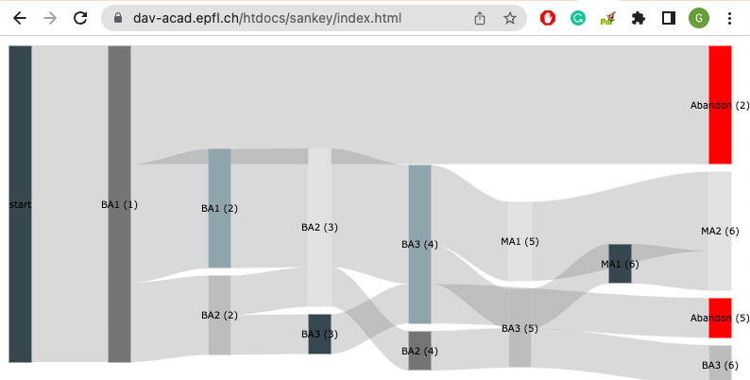
Voila

Slide 9
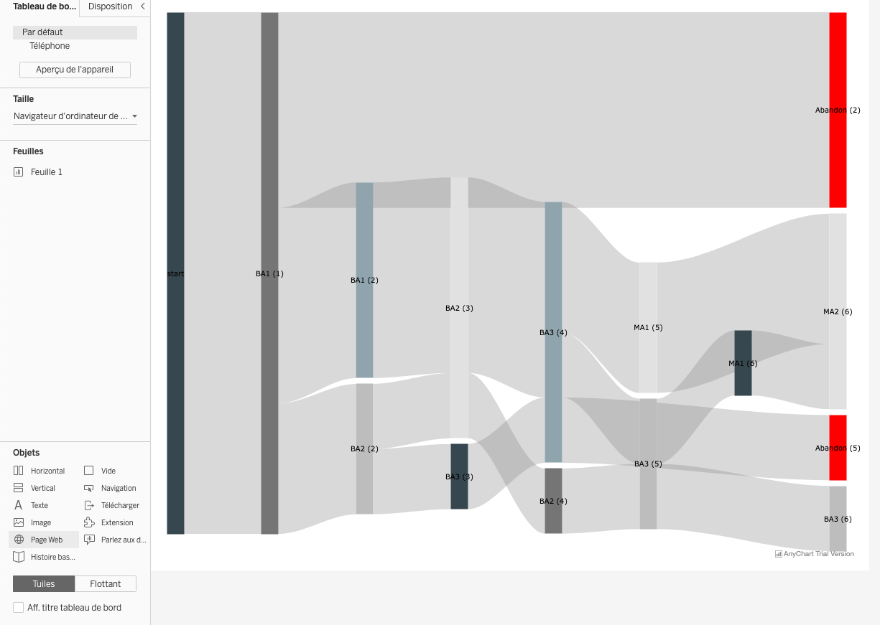
Integrate in Tableau
Démo:
https://tblprd/#/views/test/Feuille1?:iid=1
1. Drag&Drop Page web in Tableau

Slide 10
Lamp Server
Advantages
Drawbacks
Flexibility:
JS, PHP and a DB:
The sky is the limit
Security:
Anyone with a GASPAR account can access the JSON or the sankey

