Slide 1

PowerShell User Group
London 23/11/2016

Slide 2
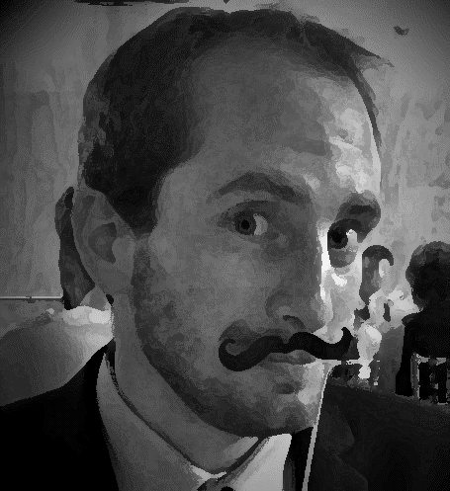
Brought to you by…
Ebru, Corey, Ryan, Iain, Gael
Sponsored by SAPIEN, rackspace
@gaelcolas
Gael Colas Cloud Automation CONSULTANT

Slide 3







Sponsors and Friends!

Slide 4
Code of conduct
If you have a lot to say, please submit a talk ☺
Do submit lighting talks (5 min, 10min, 15, 30…)
Try to keep your questions for the end, unless it’s very specific to what the speaker just said
Give us feedback on what you do, like and want to hear
Participate and interact with the community, it’s rewarding!
Please thank our Sponsors, it’s free, you are the product!

Slide 5
News!
PSConf.EU will be on the 3-5 May 2017
Session submission still open!
Registration starts 1st of Nov
WinOps Conf London will be in September 2017

Slide 6
Follow ON TWITTER
@lonpsug – our PowerShell user group handle for news and events!
@gaelcolas @ebrucucen @cburke007 @iainbrighton @ryanyates1990
@jsnover – PowerShell inventor
@yochayk – Azure PM, Special guest tonight!
@PSConfEU – PowerShell Conference Europe
@WinOpsLDN – WinOps meetup and conference news
@markg_msft – PowerShell PM, working on DSC
@techdiction – Marcus from the MSFT UK Tech Evangelist team
@PowerShell_Team

Slide 7


Join the PSUG Slack TEAM
We’re here:
https://get-psuguk.herokuapp.com
Or
http://bit.ly/2eQyxOD

Slide 8
Next MEETUP – January 2017!
What would you like to see?
PowerShell Advanced functions
PowerShell Classes

