Slide 1

PowerShell User Group
London 25/05/2017

Slide 2

Brought to you by…
Hosted and refreshed by Fujitsu!
THANK YOU!

Slide 3





Sponsors and Friends!

Slide 4
THE BEST (old) NEWS!
PowerShell half Day
Saturday 17th of June
Track 1: Easy
Track 2: Intermediate

Slide 5
PSConfEu 2017
PowerShell fun for 3 Days + 1 PreConf
Great turn up
DSC content
Plenty other, but I was speaking
Videos online: http://powershell.video
Next year: April 18-20, 2018

Slide 6
DevOps
Kenneth Hansen: “DevOps and the harmonious whole”
https://www.youtube.com/watch?v=eAp9m4N5pNA
PowerShell and DevOps
A Tool of choice

Slide 7
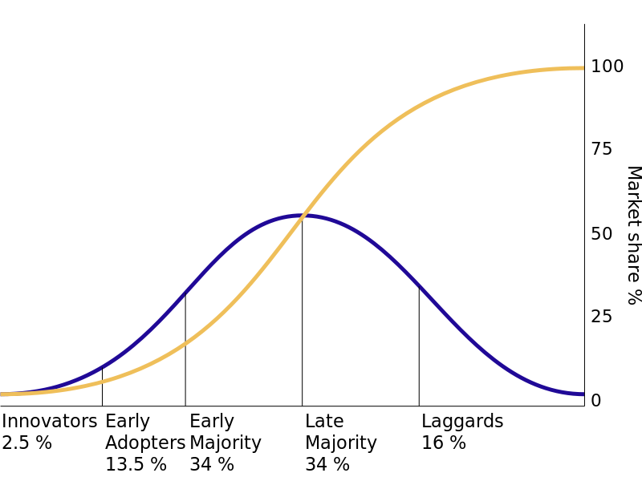
DevOps

Slide 8
DevOps Market Segments

Slide 9


DevOps or SRE, by Google
Hire Devs, with System knowledge to do Ops

Slide 10
Dev is the new Ops
You code, you’re a Dev!
Behave like one! Learn like one!
Survival is not mandatory!

Slide 11
MSFT Clues…
Cross Platform – Not about the OS anymore
Cloud – Less about the HW/Infra anymore
Services increased – Managing those = more ops
Number of APIs – Different Management Model
What does the P in API stands for?
PS6.x to be more Dev Friendly
Container / Microservices / Functions or Lambdas…

