Slide 1
Reducing ER Diagrams to Schemata
Entity sets and relationship sets can be expressed as unique relation schemata.
Each schema has columns corresponding to attributes

Slide 2
Reducing ER Diagrams to Schemata
Convert strong entity sets directly to schemata with the same attributes.
instructor(ID, name, salary)
student(ID, name, tot_cred)

Slide 3
Reducing ER Diagrams to Schemata
Convert weak entity sets to schemata with the same attributes plus the primary key attribute(s) of the entity sets that own them. Primary key is union of owning set's primary key and discriminating attributes of the weak set.
section(course_id, sec_id, semester, year)

Slide 4
Reducing ER Diagrams to Schemata
Flatten composite attributes by creating a separate attribute for each member of the composition.
instructor(ID, first_name, middle_initial, last_name, street_number, street_name, apt_number, city, state, zip_code, date_of_birth)

Slide 5
Reducing ER Diagrams to Schemata
Multivalued attributes are represented as separate schemata containing a foreign key of the containing entity set plus the multivalued attribute. All attributes form the primary key.
instructor_phone(ID, phone_number)

Slide 6
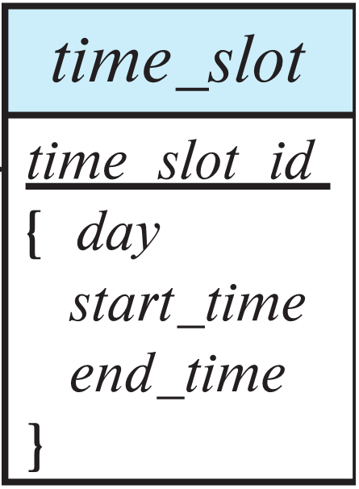
Reducing ER Diagrams to Schemata
If the containing entity set contains just a single primary key and a single multivalued attribute, a separate schema isn't needed. Here, the primary is minimized.
time_slot(time_slot_id, day, start_time, end_time)

Slide 7
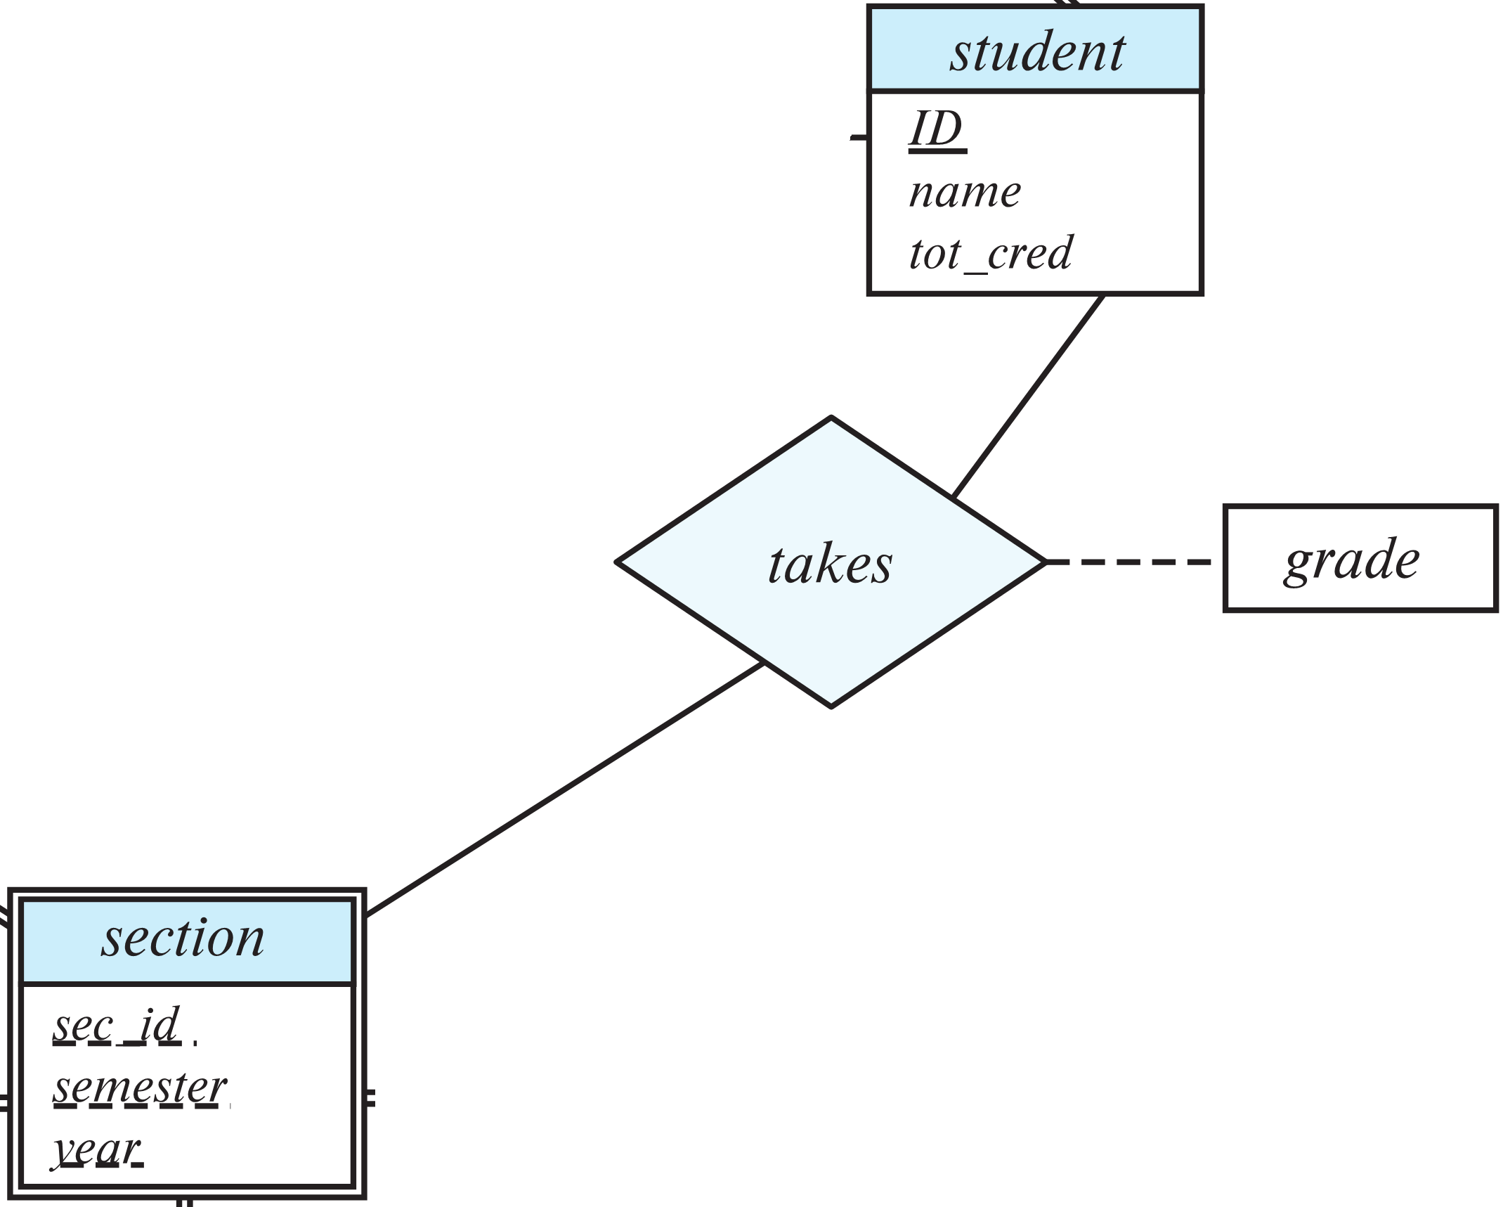
Reducing ER Diagrams to Schemata
Many-to-many relationships can be represented as schemata with attributes for primary keys of the entity sets plus relationship-specific attributes. Primary key is union of primary keys of related entity sets.
takes(ID, course_id, sec_id, semester, year, grade)

Slide 8
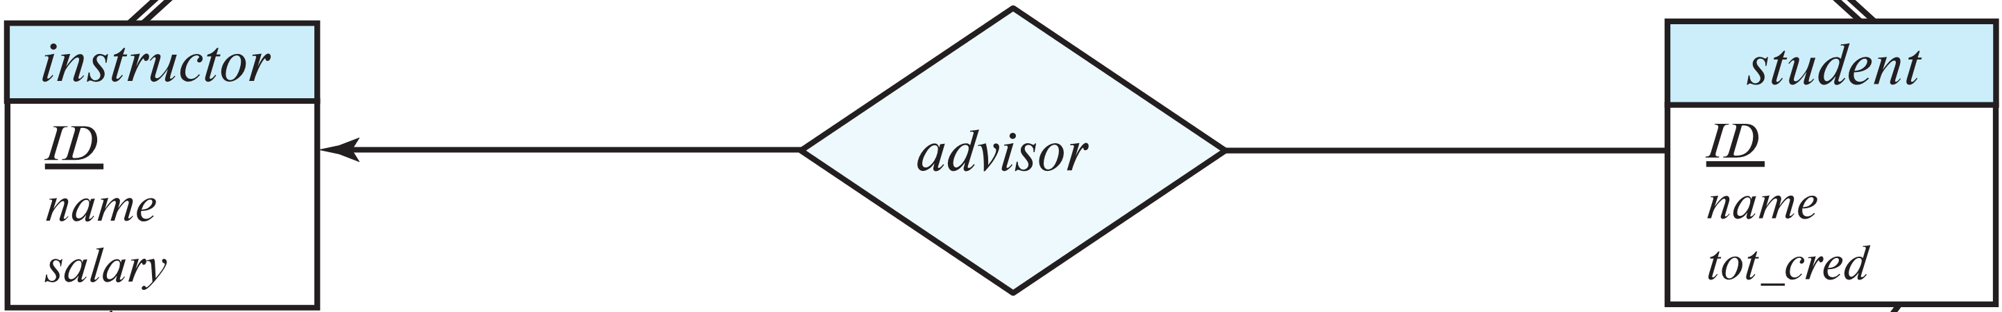
Reducing ER Diagrams to Schemata
Many-to-one and one-to-many relationships can be represented as schemata with attributes for primary keys of the entity sets plus relationship-specific attributes. Primary key is taken from then many side.
advisor(s_id, i_id)

Slide 9
classroom(building, room_number, capacity)
department(dept_name, building, budget)
course(course_id, title, credits)
instructor(ID, name, salary)
student(ID, name, tot_cred)
time_slot(time_slot_id, day, start_time, end_time)
section(course_id, sec_id, semester, year)
teaches(ID, course_id, sec_id, semester, year)
takes(ID, course_id, sec_id, semester, year, grade)
advisor(s_ID, i_ID)
prereq(course_id, prereq_id)
sec_course(course_id, sec_id, semester, year)
sec_time_slot(course_id, sec_id, semester, year, time_slot_id)
sec_class(course_id, sec_id, semester, year, building, room_number)
inst_dept(ID, dept_name)
stud_dept(ID, dept_name)
course_dept(course_id, dept_name)

Slide 10
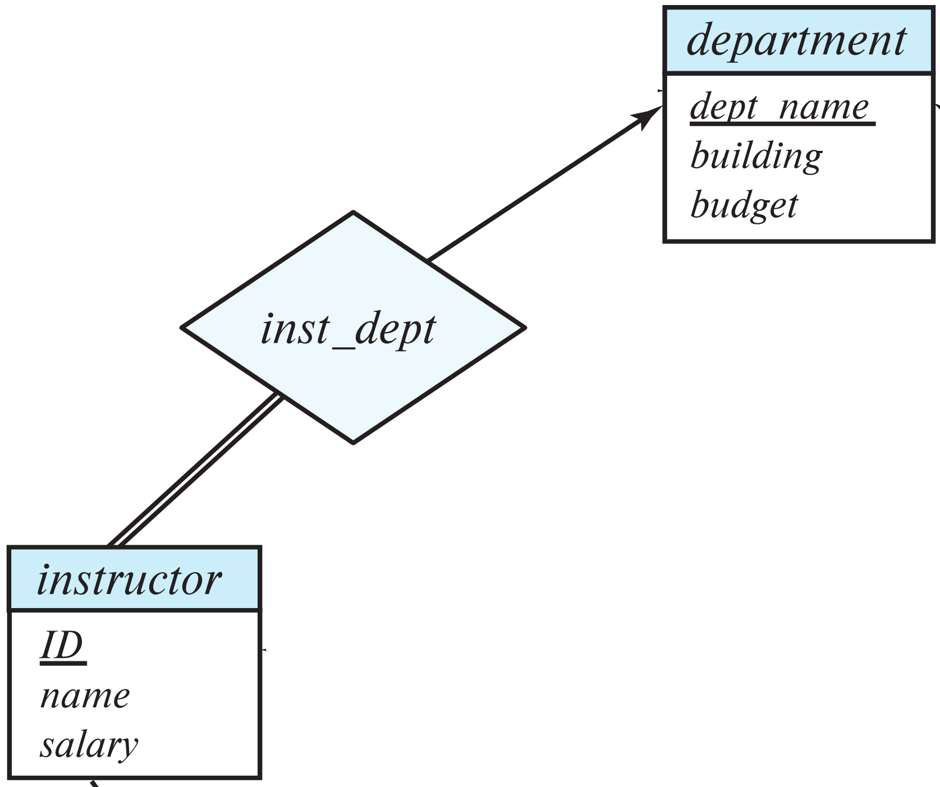
Reducing ER Diagrams to Schemata
Many-to-one and one-to-many relationships that are total on the many side can be eliminated by adding a foreign key attribute to the many side referencing the one side.
department(dept_name, building, budget)
instructor(ID, name, dept_name, salary)
department(dept_name, building, budget)
instructor(ID, name, salary)
inst_dept(ID, dept_name)

Slide 11
classroom(building, room_number, capacity)
department(dept_name, building, budget)
course(course_id, title, dept_name, credits)
instructor(ID, name, dept_name, salary)
student(ID, name, dept_name, tot_cred)
classroom(building, room_number, capacity)
department(dept_name, building, budget)
course(course_id, title, credits)
instructor(ID, name, salary)
student(ID, name, tot_cred)
time_slot(time_slot_id, day, start_time, end_time)
section(course_id, sec_id, semester, year, building, room_number,
time_slot_id)
section(course_id, sec_id, semester, year, building, room_number)
section(course_id, sec_id, semester, year)
teaches(ID, course_id, sec_id, semester, year)
takes(ID, course_id, sec_id, semester, year, grade)
advisor(s_ID, i_ID)
prereq(course_id, prereq_id)
sec_course(course_id, sec_id, semester, year)
sec_time_slot(course_id, sec_id, semester, year, time_slot_id)
sec_class(course_id, sec_id, semester, year, building, room_number)
inst_dept(ID, dept_name)
stud_dept(ID, dept_name)
course_dept(course_id, dept_name)

