Slide 1


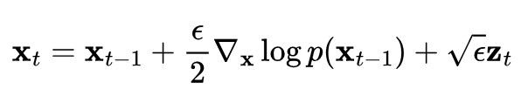

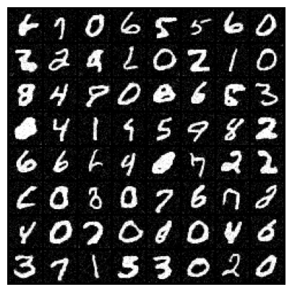
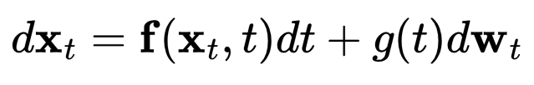


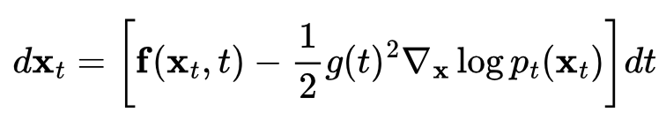


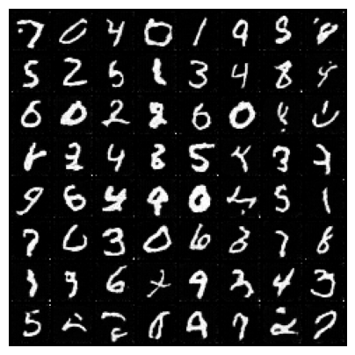
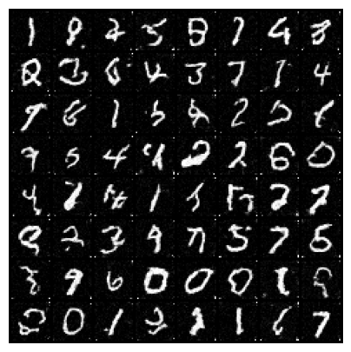
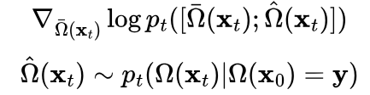
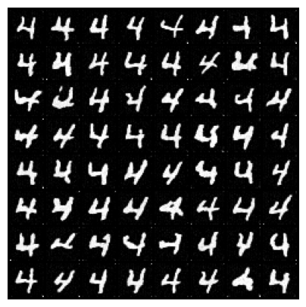
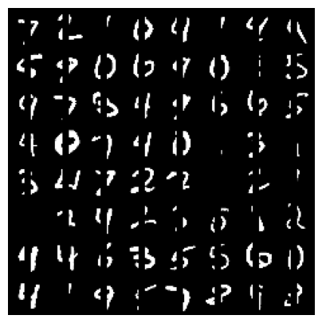
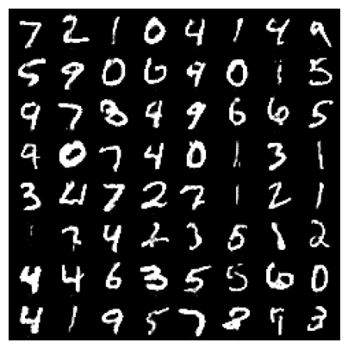
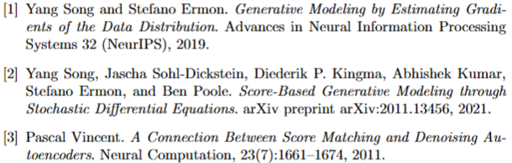
Score-Based Generative Modeling Through Stochastic Differential Equations
Objective: given i.i.d. samples, learn to sample from their distribution
Discrete Langevin Dynamics [1]
Score Denoising Technique [3]
Explicit Score Matching
Intractable because we don’t know the log-density
Denoising Score Matching
SGD compatible
Continuous diffusion via SDEs [2]
Controllable Generation [2]
Score-based framework is very flexible.
We just need to compute
We give two examples.
Reverse SDE
Probability flow ODE
Class-conditional generation
Imputation
Reverse diffusion on the masked part

