Slide 1


Smart Roller Shutter Project
Internet of Things
A.Y. 2019-2020
Gaetano Valenti

Slide 2
Introduction
The project aims to build a system composed by sensors and actuators, installed on the roller shutters of an house in order to monitor the outside brightness
These device are able to interface with a cloud application trough a command line interface. It permits to periodically observe values returned from physical sensors and dynamically change their status.
Gaetano Valenti

Slide 3
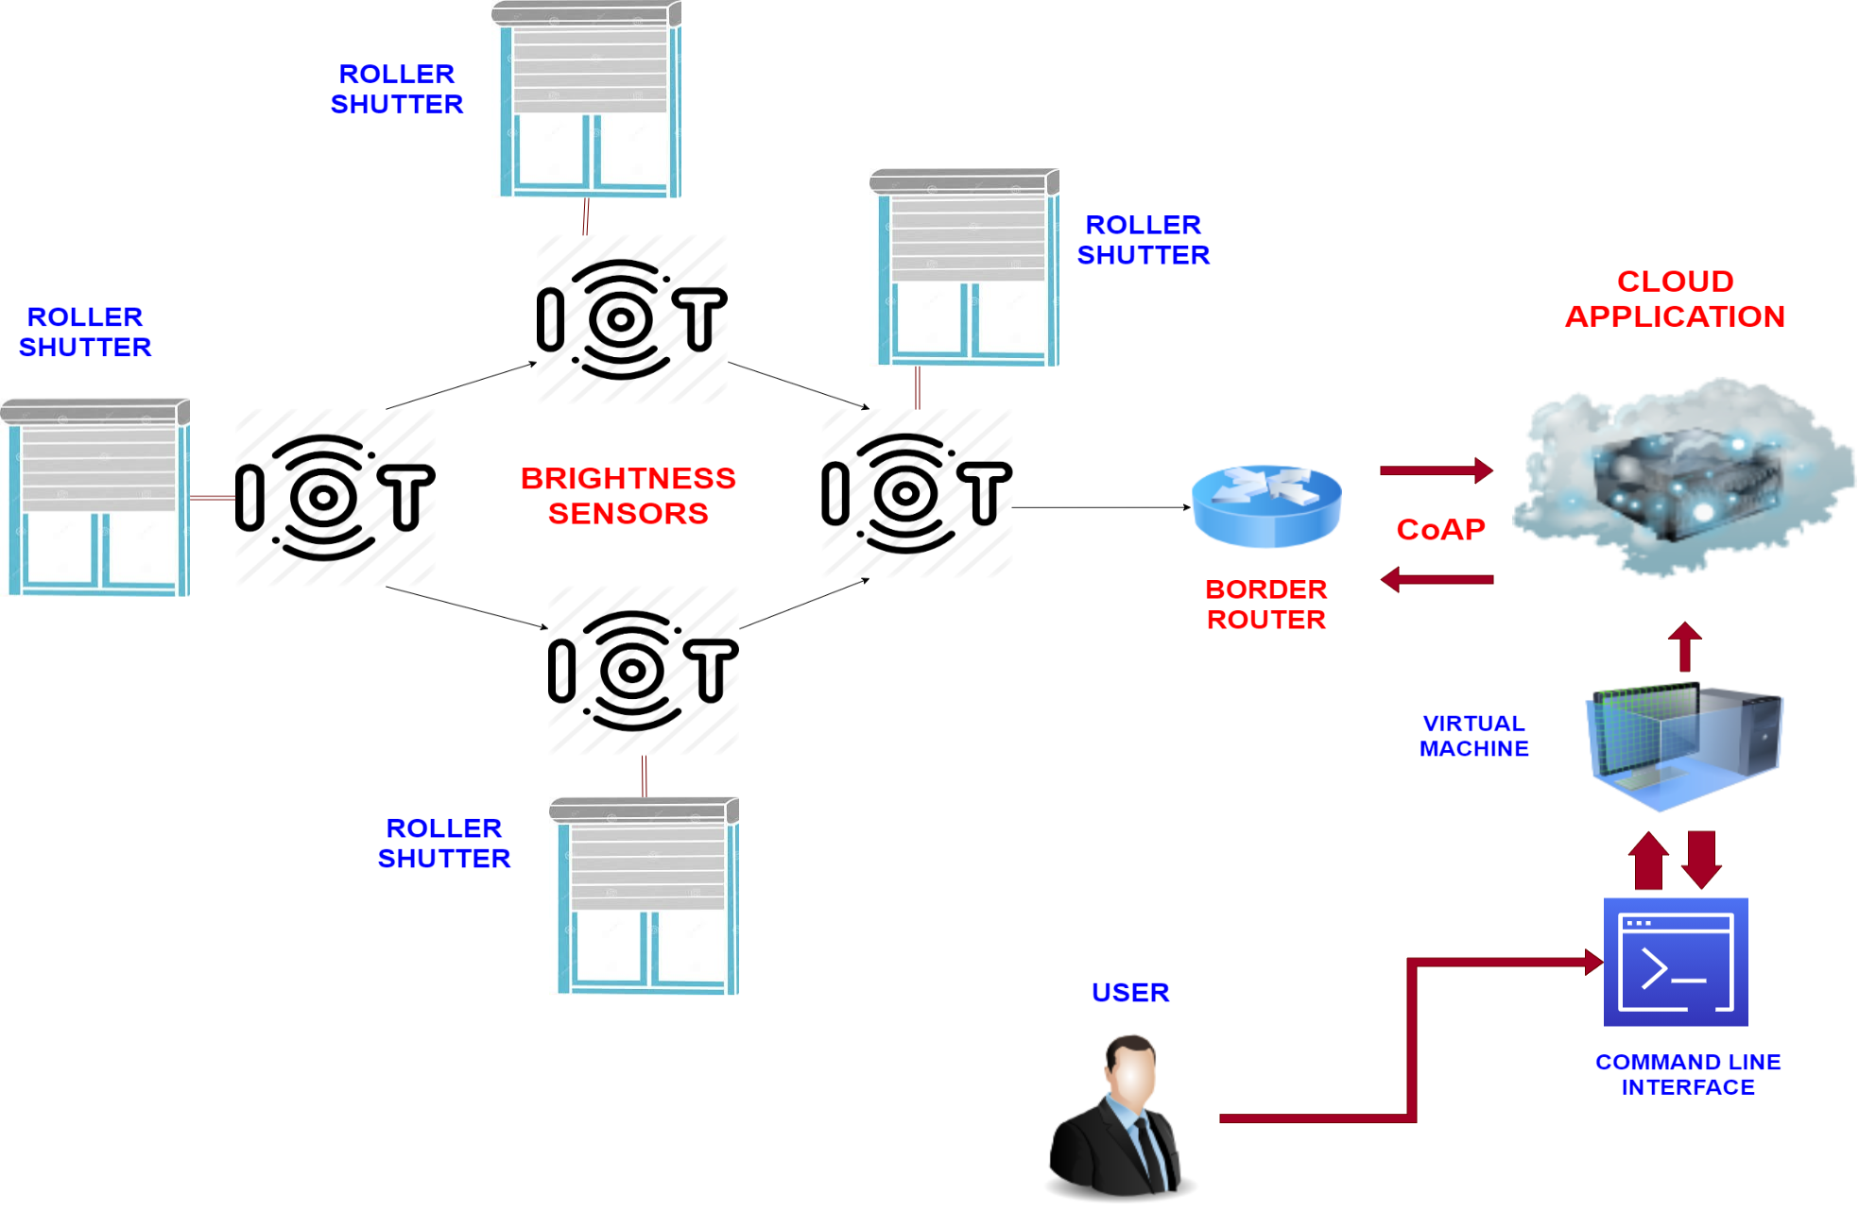
System scheme and structure
Gaetano Valenti

Slide 4
LLN
Each roller shutter is equipped with:
A brightness sensor that collects data about the outside brightness.
Its values correspond to the level of the luminosity (value is between 0 and 1023)
A roller shutter actuator that controls the roller shutter in order to open/close it.
These two devices are installed on a single node in the network.
All the nodes are managed by a border router.
Gaetano Valenti

Slide 5
Functioning and Possible Extension
The status of the roller shutter depends on two thresholds:
If the value is higher than the maximum threshold the roller is opened, in order to exploit the external light.
Otherwise, if it is lower than a minimum threshold the roller is closed.
In addition, the user can change status via an interface command.
This project could be improved with the goal of avoid loss of energy. It can be upgraded adding a smart light bulb that automatically switch off when the roller is opened and vice versa.
Gaetano Valenti

Slide 6
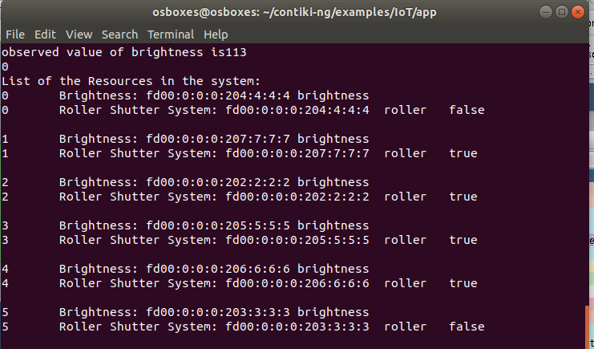
Cloud Application
The cloud application has:
A CoAP server that at bootstrap registers the smart nodes and starts monitoring them through the CoAP observing.
A command line interface that allows to the user to send request to the network and obtain data about the status of the nodes.
Gaetano Valenti

Slide 7
Cooja Simulation
The Cooja simulation shows:
The Cooja Mote Output describe what happens in the network. So if the roller are opens, the request and data received, etc.
On the top left corner, the topology of the network, with one border router and six sensor nodes.
On the right, the status of the actuators. GREEN if the roller is open and RED if it is closed.
Gaetano Valenti

Slide 8
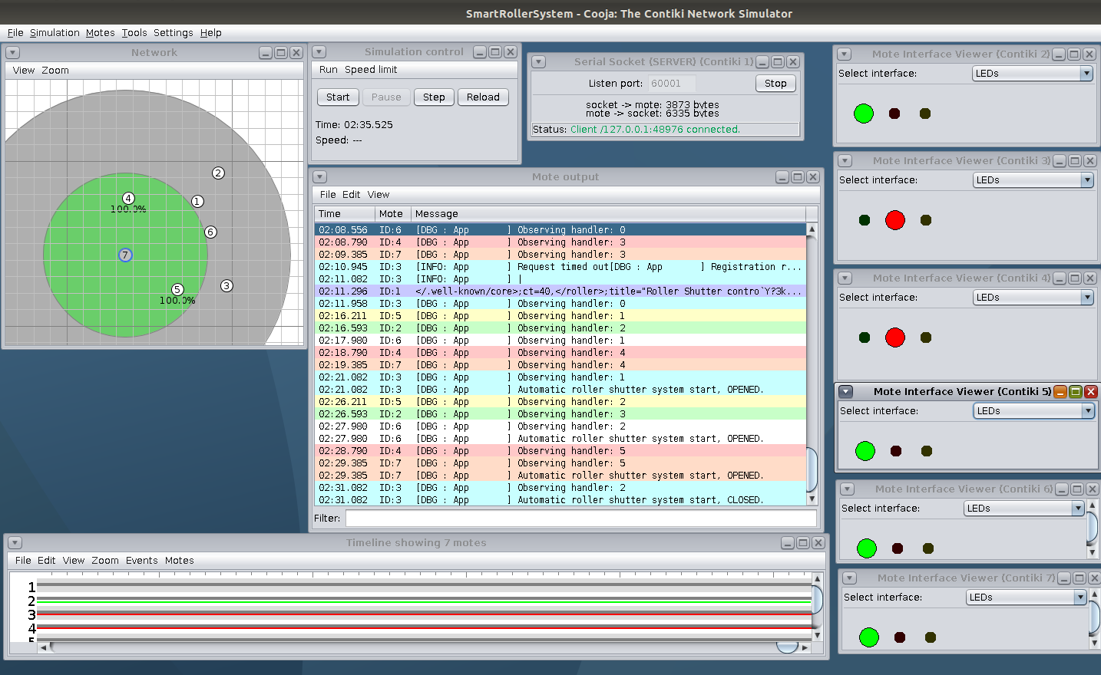
Cooja Simulation
Gaetano Valenti

Slide 9
Thanks for the attention!
Gaetano Valenti

