Slide 1
Finite State Machine (FSM)
When the sequence of actions in your design depend on the state of sequential elements, a finite state machine (FSM) can be implemented
FSMs are widely used in applications that require prescribed sequential activity
  Example:
    Sequence Detector
    Fancy counters
    Traffic Light Controller
    Data-path Controller
    Device Interface Controller
    etc.

Slide 2
Finite State Machine (FSM) (cont.)
All state machines have the general feedback structure consisting of:
  Combinational logic implements the next state logic
    Next state (ns) of the machine is formed from the current state (cs) and the current inputs
  State register holds the value of current state
Next State
Inputs
Next-State
Logic
Memory
Current
State

Slide 3
Types of State Machines
Moore State Machine
Next-State
Logic
ns
State
Register
cs
Output
Logic
Inputs
Outputs
Next state depends on the current state and the inputs but the output depends only on the present state
  next_state(t) = h(current_state(t), input(t))
  output = g(current_state(t))

Slide 4
Types of State Machines (cont.)
Mealy State Machine
Output
Logic
Outputs
Next-State
Logic
ns
State
Register
cs
Inputs
Next state and the outputs depend on the current state and the inputs
  next_state(t) = h(current_state(t), input(t))
  output(t) = g(current_state(t), input(t))

Slide 5
Typical Structure of a FSM
module mod_name ( … );
  input … ;
  output … ;
  parameter size = … ;
  reg [size-1: 0] current_state;
  wire [size-1: 0] next_state;
  // State definitions
  `define state_0 2'b00
  `define state_1 2b01
  always @ (current_state or the_inputs) begin
    // Decode for next_state with case or if statement
    // Use blocked assignments for all register transfers to ensure
    // no race conditions with synchronous assignments
  end
  always @ (negedge reset or posedge clk) begin
    if (reset == 1'b0) current_state <= state_0;
    else current_state <= next_state;
  end
//Output assignments
endmodule
Next State
Logic
State
Register

Slide 6
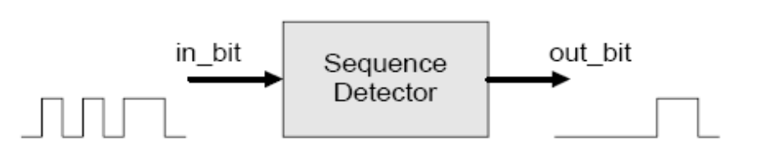
Sequence Detector FSM
Functionality: Detect two successive 0s or 1s in the serial input bit stream
reset
reset_state
out_bit = 0
0
1
FSM
Flow-Chart
1
out_bit = 0
read_1_zero
read_1_one
out_bit = 0
0
0
0
1
1
read_2_zero
read_2_one
0
1
out_bit = 1
out_bit = 1

Slide 7
Sequence Detector FSM (cont.)
module seq_detect (clock, reset, in_bit, out_bit);
input clock, reset, in_bit;
output out_bit;
reg [2:0] state_reg, next_state;
// State declaration
parameter reset_state = 3'b000;
parameter read_1_zero = 3'b001;
parameter read_1_one = 3'b010;
parameter read_2_zero = 3'b011;
parameter read_2_one = 3'b100;
// state register
always @ (posedge clock or posedge reset)
if (reset == 1)
state_reg <= reset_state;
else
state_reg <= next_state;
// next-state logic
always @ (state_reg or in_bit)
case (state_reg)
reset_state:
if (in_bit == 0)
next_state = read_1_zero;
else if (in_bit == 1)
next_state = read_1_one;
else next_state = reset_state;
read_1_zero:
if (in_bit == 0)
next_state = read_2_zero;
else if (in_bit == 1)
next_state = read_1_one;
else next_state = reset_state;
read_2_zero:
if (in_bit == 0)
next_state = read_2_zero;
else if (in_bit == 1)
next_state = read_1_one;
else next_state = reset_state;

Slide 8
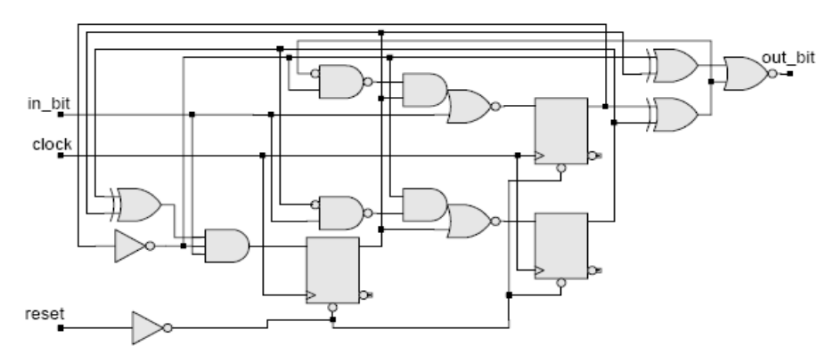
Sequence Detector FSM (cont.)
read_1_one:
if (in_bit == 0)
next_state = read_1_zero;
else if (in_bit == 1)
next_state = read_2_one;
else next_state = reset_state;
read_2_one:
if (in_bit == 0)
next_state = read_1_zero;
else if (in_bit == 1)
next_state = read_2_one;
else next_state = reset_state;
default: next_state = reset_state;
endcase
assign out_bit = ((state_reg == read_2_zero) || (state_reg == read_2_one)) ? 1 : 0;
endmodule

Slide 9
Clock Domain Synchronization
Larger designs generally consists of several parts that operate at independent clocks – clock domains
Clock domain synchronization is required when ever a signal traverses from one clock domain to another clock domain
Problem can be treated as the case where flip-flop data input is asynchronous
  Can cause metastabilty in the receiving flip-flop
  Rupture the sequential behavior
This can be avoided by using synchronization circuits
Notes:
Problems with Clock Domain Crossing:
Structural issues (sCDC): If the data input to a storage element changes too close to a clock edge, the element may go into a metastable state and the output cannot be reliably used. Asynchronous clock domain crossings are particularly prone to metastability failures. To address this issue, the circuit must be designed to “buy time” so the metastable signal can settle to a stable value, typically using synchronizers.
After completing the synchronization, the structures beyond the synchronizers still matter. For example, the design must ensure that the synchronized signals do not converge. Reconvergence can create
functional errors
Functional errors (fCDC): Designers must ensure that the stability and functionality on either side of the CDC circuit are handed over properly. Otherwise, there could be loss of signal values for signals passing between clock domains, with data instability in the receiving clock domain.
CLOCK DOMAINS
A clock domain is defined as that part of the design driven by either a single clock or clocks that have constant phase relationships. A clock and its inverted clock or its derived divide-by-two clocks are
considered a clock domain (synchronous). Conversely, domains that have clocks with variable phase and time relationships are considered different clock domains.
The sections of logic elements driven by different clocks are called clock domains, and the signals that interface between these asynchronous clock domains are called the clock domain crossing (CDC) paths.
Metastability
The proper operation of a clocked flip-flop depends on the input being stable for a certain period of time before and after the clock edge. If the setup and hold-time requirements are met, the correct output will
appear at a valid output level (either VoL or VoH) at the flip-flop output after a maximum delay of tCO (the clock-to-output delay). However, if these setup and hold-time requirements are not met, the output
of the flip-flop may take much longer than tCO to reach a valid logic level. This is called unstable behavior, or metastability.
Metastability cannot be avoided, but a solution for handling the metastable signal enables proper functioning of the design.

Slide 10
Clock Domain Synchronization (cont.)
Note:
  Metastability can not be avoided
  Metastability causes the flip-flop to take longer time than t_{clock-output} to recover
Solution: Let the signal become stable before using it (i.e. increase the MTBF)
DA
D
DB
Flip-flop1
Flip-flop2
clkA
clkB

Slide 11
Types of Synchronization Techniques
Case-1: When the width of asynchronous input pulse is greater than the clock period i.e.
T_{async_in} > T_{clock}
q1
async_in
sync_out
Flip-flop1
Flip-flop2
clock
reset

Slide 12
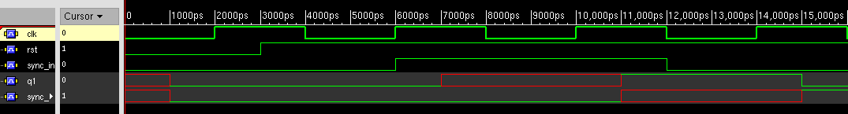
Simulation Results
Presence of Metastable State
clock
reset
async_in
q1
metastable
sync_out
not metastable
The flip flips
get reset
The reset is de-asserted
Flip-flop1 enters metastability
Flip-flop1 comes back to a stable state, latching async_in
async_in becomes high simultaneously with the posedge of the clock, thus violating the setup time
Flip-flop1 gets a stable input at this (2nd) edge
Flip_flop2 latches the stable value of flip_flop1 (q1), thus delaying async_in by 3 clock cycles*
* As sync_out will be available to latch only at the next clock edge
Notes:
The metastability (unstable output), (in ff1) should end before the next clock edge comes. But when the output signal stablizes, it can attain the intended input value (1) or 0. If it reaches the intended value (i.e. it could sample the input correctly in spite of setup/hold time violation) there is delay of only two clock cycles but if it reaches the opposite value (i.e. it could not sample the input correctly due to setup/hold time violation) then it will latch the ff1 will latch the correct value at the next edge and thus causing a delay of 3 clock cycles.

Slide 13
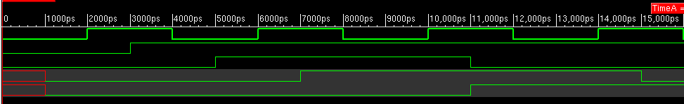
Simulation Results (cont.)
Absence of Metastable State
clock
reset
async_in
q1
sync_out
The flip flips
get reset
The reset is de-asserted
Flip-flop1 enters stable state latching async_in
async_in becomes high before the posedge of the clock, thus meeting the setup time
Flip_flop2 latches the stable value of flip_flop1 (q1), thus delaying async_in by 2 clock cycles
Notes:
When the metastable state ends up (before the next clock edge) into the desired state or when you don’t have metastability at all, in both these cases you suffer only 2 clock cycle delay.

Slide 14
Types of Synchronization Techniques (cont.)
Case-2: When the width of asynchronous input pulse is less than the clock period i.e.
T_{async_in} < T_{clock}
q1
q2
V_{DD}
sync_out
Flip-flop1
Flip-flop2
Flip-flop3
async_in
clock
reset
Notes:
Since the async_in is a narrow pulse it can arrive anywhere between the clock period and thus we can’t guarantee that it will be sensed at the posedge of ff2, that’s why we need to treat it as a clock. The first ff, i.e. ff1, just ensures that the presence of async_in pulse is sensed. The first ff, also converts this narrow pulse pulse into a much wider pulse (by latching a 1 i.e. vdd indefinitely (until it is cleared by sync_out)). So, ff1 basically converts this situation into CASE1.
Since ff1 has to latch a 1 (vdd) whenever async_in come, this can cause ff2 to go into metastability if q1 does not meet the setup/hold time of ff2. So, ff2 actually acts as a survivor (just like CASE1) to save ff3 and the circuit ahead from going to metastability.
Now, after ff3 has latched the inteded value i.e. 1, after two/three clock cycles, we need to clear ff1 to allow ff1 to sense other incoming pulses on async_in.

Slide 15
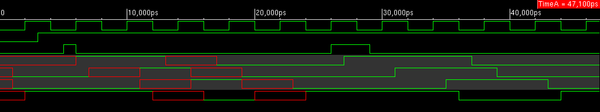
Simulation Results
clock
reset
async_in
q1
q2
sync_out
first_reset
Reset Sequence for the synchronization circuit
Flip-flop1 gets a stable posedge of async_in
Sync_out becomes high after 2 clocks and causes
flip-flop1 to reset
Flip-flop1 latches 1

Slide 16
First-in First-out Memory (FIFO)
When the source clock is higher than the destination clock, loss of data can occur due to inability of the destination to sample at the source speed
How to avoid this?
  Use handshake signals (i.e. supply data only when the destination is ready to receive e.g. master-slave protocol)
    Transfer rates are lower
  High performance parallel interfaces between independent clock domains are implemented with first-in first-out memory called FIFO.
Notes:
Clock domain synchronization just makes sure that you can reliably latch a signal/data in one clock domain in another clock domain (i.e. avoid the destination from going into metastability), . It does not guarantee that if the two clocks are very different, you will not lose any data. Obviously, if the source clock is 200MHz and the destination clock is 150MHz, the destination will not be able to sample all the bits that are transmitted by the source.

Slide 17
FIFO Features
A FIFO consists of block of memory and a controller that manages the traffic of data to and from the FIFO
A FIFO provides access to only one register cell at a time (not the entire array of registers)
A FIFO has two address pointers, one for writing to the next available cell, and another one for reading the next unread cell
The pointers for reading and writing are relocated dynamically as commands to read or write are received
A pointer is moved after each operation
A FIFO can receive data until it is full and can be read until it is empty

Slide 18
FIFO Features (cont.)
A FIFO has:
  Separate address pointers and datapaths for reading and writing data
  Status lines indicating the condition of the stack (full, almost full, empty etc.)
The input (write) and output (read) domains can be synchronized by two separate clocks, allowing the FIFO to act as a buffer between two clock domains
A FIFO can allow simultaneous reading and writing of data (however synchronization is necessary if read/write parts are different clock domains)
The write signal is synchronized to the read clock using clock synchronizers
FIFOs are usually implemented with dual-port RAMs with independent read- and write-address pointers and registered data ports (see www.idt.com)

Slide 19
FIFO Structure
stack_height -1
stack_full
data_in
stack_half
write_to_stack
stack_empty
FIFO Buffer
clk_write
data_out
read_from_stack
rst
clk_read
Internal Signals
0
stack_width -1
0
write_ptr
Input-output Ports
read_ptr

Slide 20
FIFO Model
Note: Prohibit write if the FIFO is full and Prohibit read if the FIFO is empty
module FIFO_Buffer (clk, rst, write_to_stack, data_in, read_from_stack, data_out, stack_full, stack_half_full, stack_empty);
parameter stack_width = 32;
parameter stack_height = 8;
parameter stack_ptr_width = 3;
parameter HF_level = 4;
input clk, rst, write_to_stack, read_from_stack;
input [stack_width-1:0] data_in;
output stack_full, stack_half_full, stack_empty;
output [stack_width-1:0] data_out;
reg [stack_ptr_width-1:0] read_ptr, write_ptr;
reg [stack_ptr_width:0] ptr_gap; // Gap between the pointers
reg [stack_width-1:0] data_out;
reg [stack_width:0] stack [stack_height-1:0];
// stack status signals
assign stack_full = (ptr_gap == stack_height);
assign stack_half_full = (ptr_gap == HF_level);
assign stack_empty = (ptr_gap == 0);

Slide 21
FIFO Model (cont.)
always @ (posedge clock or posedge reset)
if (rst == 1) begin
data_out <= 0;
read_ptr <= 0;
write_ptr <= 0;
ptr_gap <= 0;
begin
else if (write_to_stack && (!read_from_stack) && (!stack_full)) begin
stack [write_ptr] <= data_in;
write_ptr <= write_ptr + 1;
ptr_gap <= ptr_gap + 1;
end
else if ((!write_to_stack) && read_from_stack && (!stack_empty)) begin
data_out <= stack[read_ptr];
read_ptr <= read_ptr + 1;
ptr_gap <= ptr_gap - 1;
end
else if (write_to_stack && read_from_stack && stack_empty) begin
stack [write_ptr] <= data_in;
write_ptr <= write_ptr + 1;
ptr_gap <= ptr_gap + 1;
end

Slide 22
FIFO Model (cont.)
else if (write_to_stack && read_from_stack && stack_full) begin
data_out <= stack[read_ptr];
read_ptr <= read_ptr + 1;
ptr_gap <= ptr_gap - 1;
end
else if (write_to_stack && read_from_stack && (!stack_empty) && (!stack_full)) begin
stack [write_ptr] <= data_in;
data_out <= stack[read_ptr];
write_ptr <= write_ptr + 1;
read_ptr <= read_ptr + 1;
end
endmodule

