Slide 1
XML - eXtensible Markup Language
Foothill College
COIN 78

Slide 2
What is XML?
eXtensible Markup Language
The bigger part of SGML
Tags that you can create
Uses elements and style sheets
  DTD: Document Type Definition
  XSL: eXtensible Style Language

Slide 3
Why XML?
Presentation of data
Connecting databases
Build your own <XML> tags
Use DTDs to define elements
In B2B creates a “poor man’s EDI”

Slide 4
XML terminology
Unlearning bad habits
An overview of an XML document
A simple XML document
A simple Document Type Definition (DTD)
A simple XSL stylesheet

Slide 5
Unlearning bad habits
HTML is forgiving, XML is not
Well formed HTML “is XML”
XML tags are case sensitive
Attribute values must be in quotation marks
Non-empty elements must have an opening and closing tag: <paragraph></paragraph>
Tags must be nested correctly:
  <italic><bold>this is incorrect</italic></bold>
  <italic><bold>this is incorrect </bold></italic>

Slide 6
An overview of an XML document
The XML document - contains the document data, typically tagged with meaningful XML elements, some of which may contain attributes
A stylesheet - dictates how document elements should be formatted when they are displayed
Document Type Definition - file specifies rules for how XML document elements, attributes, and other data are defined and logically related in an XML-compliant document

Slide 7
A simple XML document
<?xml version=”1.0” standalone=“no”?>
<!DOCTYPE OReilly:Books SYSTEM “simple.dtd”>
<!-- Here begins the XML data -->
<OReilly:Books xmlns:OReilly=‘http://www.oreilly.com/’>
<OReilly:Product>XML Pocket Reference</OReilly:Price>
</OReilly:Books>

Slide 8
A simple Document Type Definition (DTD)
Simple.dtd
<!-- DTD for sample documents -->
<!ELEMENT OReilly:Books (OReilly:Product, OReilly:Price)>
<!ELEMENT OReilly:Product (#PCDATA)>
<!ELEMENT OReilly:Price (#PCDATA)>

Slide 9
A simple XSL stylesheet
<?xml version=“1.0”?>
<xsl:stylesheet
xmlns:xsl=“http://www.w3.org/TR/WD-xsl”
xmlns:fo=“http: ://www.w3.org/TR/WD-xsl/FO”>
<xsl:template match=“/”>
<fo:block font-size=“18pt”>
<xsl:apply-templates/>
<fo:block font-size=“18pt”>
</xsl:template>
</xsl:stylesheet>

Slide 10
XML Reference
Well-formed XML
XML instructions
Element and attribute rules
XML reserved attributes
Entity references

Slide 11
Well-formed XML
The document must use a DTD or contain an XML declaration with the standalone attribute set to “no”
All element attribute vales must be in quotation marks
An element must have both an opening and a closing tag (unless empty element)
If a tag is stand alone empty it must have a (/)
All opening and closing element tags must nest correctly

Slide 12
XML instructions
Version
Encoding
Standalone
SYSTEM
PUBLIC
CDATA
Comments

Slide 13
Version and encoding
Version - the version attribute specifies the correct version of XML required to process the document, such as “1.0”
Encoding - specifies the character encoding used in the document
Standalone - the optional standalone specifies whether a DTD is required to parse the document. The value must be yes or no.

Slide 14
Version and encoding in XML
<?xml…?>
<?xml version=“number”
[encoding=“encoding”]
[standalone=“yes|no”] ?>
<?xml version=“1.0”?>
<?xml version=“1.0”
encoding=“US-ASCII” standalone=“no”>

Slide 15
Element and attribute rules
An element is either bound by its starting and ending tags, or is an empty element. Elements can contain text, other elements, or a combination of both.
An element must start with a letter or an underscore. It then can have any number of letters, numbers, hyphens, periods, or underscores in its name. Elements are case sensitive: <Para> is not <para> is not <PARA>

Slide 16
XML reserved attributes
xml:lang
  indicates the language of an attribute
xml:space
  indicates whether white space is significant
xml:link=“link_type”
  signal an XLink processor that an element is a link element
xml:attributes - allows you to remap attributes

Slide 17
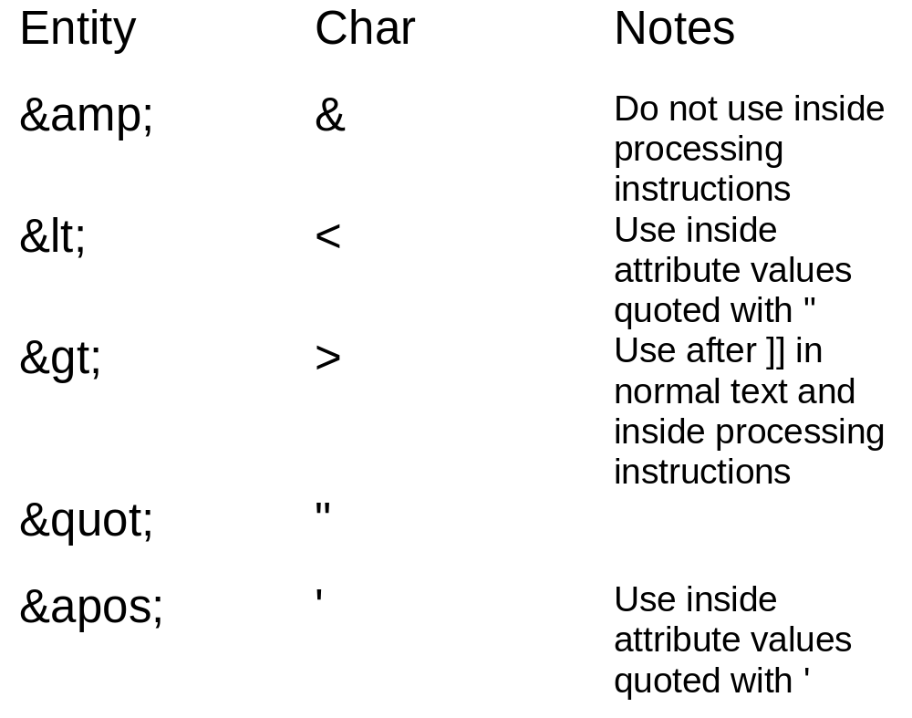
Entity references

Slide 18
Document Type Definitions
Element declarations
Entities
Attribute declarations in the DTD
Included and ignored marked sections
Internal subsets

Slide 19
Document type definitions
A DTD specifies how elements inside an XML document should relate to each other
It also provides grammar rules for the document and each of the elements
A document that adheres to the XML specifications and rules outlined by its DTD is considered to be “valid”
(Not to be confused with a well-formed document, which adheres to XML syntax rules

Slide 20
Element declarations
You must declare each of the elements that appear inside your XML document within your DTD
This is done with the <!ELEMENT> declaration, which uses the format:
<!ELEMENT elementname rule>
This declares an XML element and an associated rule, which relates logically in the XML document
The element name should not include < >

Slide 21
Element declarations
ANY and PCDATA
  <!ELEMENT library ANY>
  <!ELEMENT title (#PCDATA)
Multiple elements
  <!ELEMENT books (title, authors)>
  <!ELEMENT title (#PCDATA)>
  <!ELEMENT authors (#PCDATA)>

Slide 22
Grouping and recurrence, and empty elements
You can nest parenthesis inside your declarations to give finer granularity to the syntax you’re specifying
<!ELEMENT books ((title, author) | description)>
<!ELEMENT title (#PCDATA)>
<!ELEMENT author (#PCDATA)>
<!ELEMENT description (#PCDATA)>
Empty elements <!ELEMENT elementname EMPTY>

Slide 23
Entities
General entities
Parameter entities
External entities
Unparsed entities
Notations

Slide 24
External entities
XML allows you to declare an external entity with the following syntax:
<!ENTITY quotes SYSTEM “http://www.oreilly.com/stocks/quotes.xml>
<document>
<heading>Current Stock Quotes</heading>
&quotes
</document>
And inserts it into the current XML document

Slide 25
Attribute declarations in the DTD
Attributes for various XML elements must be specified in the DTD
You can specify each of the attributes with the <!ATTLIST> declaration, which uses the form:
<!ATTLIST target_element attr_name attr_type default>
The <!ATTLIST> declaration consists of the target element name, the name of the attribute, its datatype, and any default value you want to give it

Slide 26
Included and ignored marked sections
Within a DTD, you can bundle together a group of declarations that should be ignored (or included) using the ignore / include directive
<![IGNORE [
DTD content to be ignored
]]>
<![IGNORE [
DTD content to be ignored
]]>

Slide 27
Internal subsets
As mentioned earlier, you can place parts of your DTD declarations inside the DOCTYPE declaration of the XML document:
<!DOCTYPE boilerplate SYSTEM “generic-inc.dtd” [<!ENTITY corpname “Acme, Inc.”>
]>
The region between brackets is called the DTD’s internal subset, which is read first, followed by the external subset, referenced by the DTD

Slide 28
The xExtensible Stylesheet Language (XSL)
Formatting objects
General formatting
Pattern matching
XSL elements

Slide 29
Formatting objects
One area of the XSL specification that is gaining steam is the idea of formatting objects.
Formatting objects do not use the XSL namespace, but instead employ the fo namespace, as shown here:
<fo:block font-size=10pt”>
Formatted text using 10 point font
</fo:block>

Slide 30
General formatting (1)
The general order for elements in an XSL stylesheet is as follows:
<?xml version=“1.0”?>
<xsl:stylesheet
xmlns:xsl=“http://www.w3.org/TR/WD-xsl”>
<xsl:import/>
<xsl:include/>
<xsl:id/>
<xsl:strip-space>

Slide 31
General formatting (2)
<xsl:preserve-space>
<xsl:macro/>
<xsl:attribute-set/>
<xsl:constant/>
<xsl:template match=“pattern”>
template action
<xsl:template/>
</xsl>

Slide 32
Pattern matching
XSL requires you to match elements in an XML document based on various characteristics.
The most common of these XSL elements is the <xsl:template> element, which uses the match attribute to determine which elements to format.
With <xsl:template> and other elements, you can apply several pattern-matching strategies.
These patterns match an element that has a relationship to the current node.

Slide 33
XSL elements (1)
<xsl:apply-imports>
<xsl:apply-templates>
<xsl:arg>
<xsl:attribute>
<xsl:attribute-set>
<xsl:choose>
<xsl:comment>
<xsl:constant>
<xsl:contents>

Slide 34
XSL elements (2)
<xsl:copy>
<xsl:counter>
<xsl:counters>
<xsl:counter-increment>
<xsl:counter-reset>
<xsl:counter-scope>
<xsl:element>
<xsl:for-each>

Slide 35
XSL elements (3)
<xsl:id>
<xsl:if>
<xsl:import>
<xsl:include>
<xsl:macro>
<xsl:macro-arg>
<xsl:number>
<xsl:otherwise>

Slide 36
XSL elements (4)
<xsl:pi>
<xsl:preserve-space>
<xsl:strip-space>
<xsl:value-of>
<xsl:template>
<xsl:text>
<xsl:use>
<xsl:when>

Slide 37
XLink and XPointer
Unique identifiers
ID references
XPointers
XLink
Building extended links

Slide 38
XLink and XPointer
The final piece of XML is XLink and XPointer. These two creations fall under the eXtensible Linking Language (XLL), a separate portion of the XML standard to working with XML links.
It’s important to remember that an XML link is only an assertion of a relationship between pieces of documents; how the link is actually presented to a user depends on the application processing the XML document.

Slide 39
Unique identifiers
In order to create a link, we must first have a labeling scheme for XML elements. This is done by assigning an identifier to specific elements that are referenced using an ID attribute:
<paragraph id=“attack”>Suddenly the skies were filled with aircraft.</paragraph>
http://www.oreilly.com/documents/story.xml#attack
The combination of a document’s URI and an elements ID identify that element throughout.

Slide 40
ID references (1)
The easiest way to refer to an ID attribute is with an ID reference, or IDREF:
<?xml version=“1.0” standalone=“yes”?>
<DOCTYPE document [
<!ELEMENT document (employee*)>
<!ELEMENT employee (#PCDATA)>
<!ATTLIST person empnumber ID #REQUIRED
<!ATTLIST person boss IDREF #IMPLIED
]>

Slide 41
ID references (2)
<employee empnumber=“emp123”>Jay</employee>
empnumber=“emp124”>Kay</employee>
employee empnumber=“emp125”
boss=“emp123”>Frank</employee>
employee empnumber=“emp126”
boss=“empnumber”emp126”
As with ID attributes, an IDREF can be declared in the DTD, but you might call ID references “idref”

Slide 42
XPointers
ID references provide a convenient and efficient way to refer to elements within the same document.
XPointer uses the URI-augmented addressing scheme that looks like:
http://www.oreilly.com/documents/xmlpocket/XLink#XPtr
There are two parts, separated by a hash mark (#)
The first portion locates a resource (usually a document) the other forms the XPointer that “locates” something within the resource

Slide 43
XLink (1)
<?xml version=“1.0”?>
<simpledoc>
<title>An XLink Demonstration</title>
<section id=“target-section”>
<para>more information can be found at
reference xml:link=“simple”
href=“http://www.w3.org/”> the W3C
</reference>
</para>

Slide 44
XLink (2)
Similar to XPointers, Links show where portions of an XML document link to another:
<para>
This is a paragraph in the second section.
</para>
You should go read
<reference xml:link=“simple” href=“#target-section”> the first section
</reference> first
<para>

Slide 45
Building extended links
XLink has much more to offer, including links similar to simple ones but that can travel to multiple destinations, and links that aren’t even in the same document as any of the information that they link to:
Inline multiended links
Attributes of: inline, role, content-role, and content tittle. Link locators can have attributes of href, role, title, show, actuate, and behavior.

Slide 46
Summary
Why XML?
  Markup data
What is XML?
  Markup language for data
Basic XML tags
DTDs and style sheets
Using XML in e-Business
  documents for database driven process

Slide 47
Book References
XML Pocket Reference
Learn XML in 24 hours
XML for Dummies
XML Reference
XML Programmers Guide
XML - Your Visual Blueprint for Building Expert Web Pages

Slide 48
Web References
http://www.xml.com/
http://www.wdvl.com/Authoring/Languages/XML/http://www.xml.org/
http://www.w3.org/XML/
http://xml.coverpages.org/
http://www.alphaworks.ibm.com/
http://www.builder.com.com/

