Slide 1

Notes:
Welcome to our 3rd and final year of Let’s Play Music—woot woot!

Slide 2

The function of beauty in the education of children is to lead them imperceptibly to love, through sensory experience, what they will afterwards learn to know in its own form as an intelligible principle.
-Plato
Notes:
This quote is in the front of the manual 1st Year Student Manual. The underlying philosophy of Let’s Play Music. “Do you see the magic moms? Do you see how sneaky we are? This year you are REALLY gonna see how this comes into fruition and we finally start giving names to all of these concepts we have been internalizing and experiencing.”

Slide 3
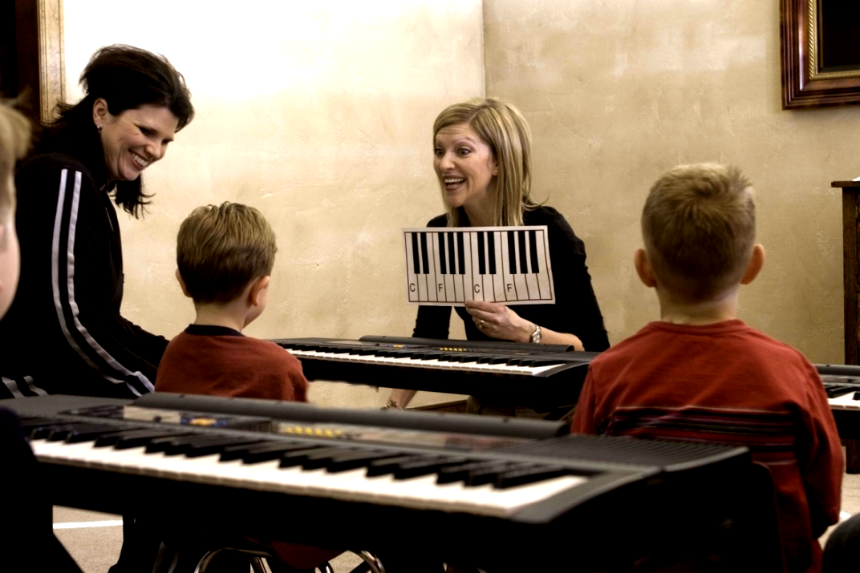
In Class Dos:
Enjoy your child
Learn what and how to practice with your child at home
Help your child at the keyboard
Sing along
Notes:
QUICK REVIEW OF THE ESSENTIALS:
You can have moms take turns reading a paragraph at a time. Make it all the way thru pg. 47 and then go back and break it down into Do’s and (then click to the next slide for Don’ts) or simply work through the slides
Essentially the same as your parents saw last year. But they are so stinking important that they should get reviewed.

Slide 4
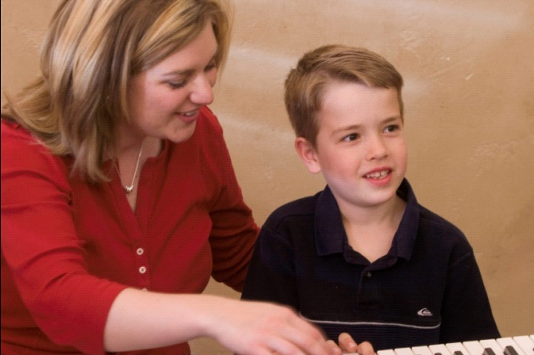
In Class Don’ts:
Touch hands or push down fingers
Force participation
Visit with other moms ☺
Notes:
Still pg. 47

Slide 5

At Home:
Have a good attitude
Consistent time
Touch on each activity
Active vs. passive practice
Sing along ☺
Notes:
Pg. 48

Slide 6
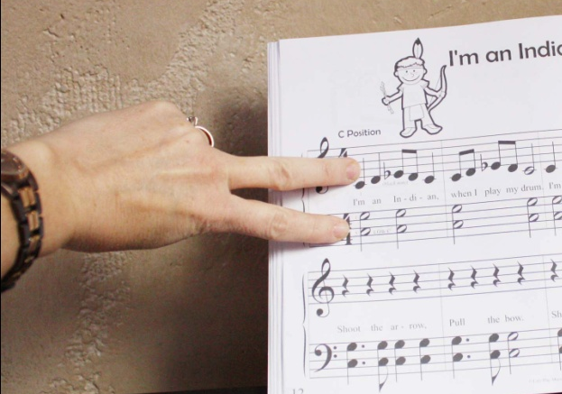
Practice Techniques
One hand at a time
Chunking
V-fingers
Parent duet
Notes:
Work through pg. 49 but be sure to demonstrate each of these techniques. Have parents do them for each other. Pretend one is the child and one is the parent.

Slide 7
Child Doesn’t Want to Practice?
Consider the time
Consider practice style
Consider attitude
Notes:
p.50

Slide 8
Don’t Play Yourself?
Now is the time to learn!
Must be able to play what your child is playing
Blind can’t lead the blind!
Notes:
Bottom of pg. 50

Slide 9
Learning a Song
Play through anything new first
Play most difficult part of song first
Supervise from a distance
Always end on a high note
Notes:
Pg. 51 Work through entire page together—VERY IMPORTANT SLIDE

Slide 10
Practice Conversation...
Be Positive
Empathetic answers will alleviate and vent frustration and encourage your child to
keep trying.
Notes:
Remind the parents of this page and how they will want to use it!
Like last year…..It would actually be a GREAT idea to role play through some of p. 52. “The most important thing is to be prepared with SOMETHING, cuz there is a good chance that there WILL be days that your Dear Sweet Angel MIGHT not want to practice."

Slide 11

The Complete Musician
Notes:
In the next few slides you will quickly review what we learned from 1st and 2nd Year and then in slide 13 go into detail on 3rd Year Skills. “Finally with this 3rd Year, we are making the complete musician.”

Slide 12


1st and 2nd Year Skills
Master internal music skills
  sing in tune
  keep a steady beat
  recognize sound of patterns and chords
  sing in harmony
Beginning keyboard skills
  self –accompany
  add chord to melody
  play with both hands
Notes:
Quickly show where we began in 1st Year and what we added 2nd year

Slide 13


3rd Year Skills
Play intermediate level pieces and self accompany
Sight-read and improvise on a melody - Echo Edison
Transpose beginning level pieces
Take melodic and rhythmic dictation
Play chords in 5 keys - Magic Keys!
Musical Expression and Form
Identify note names on staff
Learn real rhythm names and counting
Chord Theory and Inversions
Compose - bringing it all together
Notes:
And finally it all comes together!
Starting with bullet #1: Continue working through each bullet---you might need to give definitions, explanations, etc. of the different terms on each bullet. Explain exactly what and how we will be doing that skill---and how difficult or amazing that skill is. Give more or less details depending on what your parent need to be hearing…
On Bullet 2 you can bring up how Edna turns into Edison, and he likes musical questions and answers, and this encourages improvising.
On Bullet 5 you can bring up Magic Keys and reference pg 41 in manual if desired
On bullet 6 stay on page 41 and talk through legato and staccatto, and explain how cool the puppet shows in 3rd year are---overlapping themes, aba form
QUICKLY read through 7-10 Finally to #10: “And at the end of it all, your complete little musician will compose their own piece.” These last 4are a big deal, so let’s explain a little more about this. The next four slides are DEVOTED to each bullet.

Slide 14
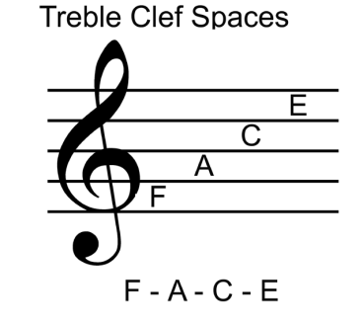
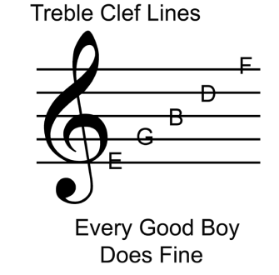
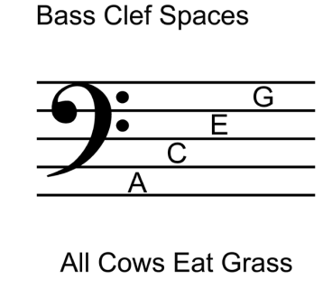
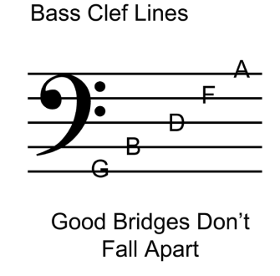

Identify Note Names on Staff
3-step process:
  Eyes translate note to letter name
  Brain translates letter into a white key
  Brain tells which finger to press the correct key
First step of process is the most difficult. Note naming must be drilled and mastered, like math facts.
The Purple Magic Flashcards!
Notes:
Note naming and music reading. Explain 3 step process of reading music…. First eyes translate note on page to a letter, then the brain translates the letter into a white key and then the brain has to tell which finger to move. Note naming is the FIRST and hardest step of this music reading process. Note names have to be like clockwork… like math facts. We will drill them a lot in a lot of different ways, but they won’t be learned if it’s once a week. MUST work flashcards every day.
Explain how the flashcards work, and SHOW in class---read the white card with them and explain how a section is added at a time.

Slide 15
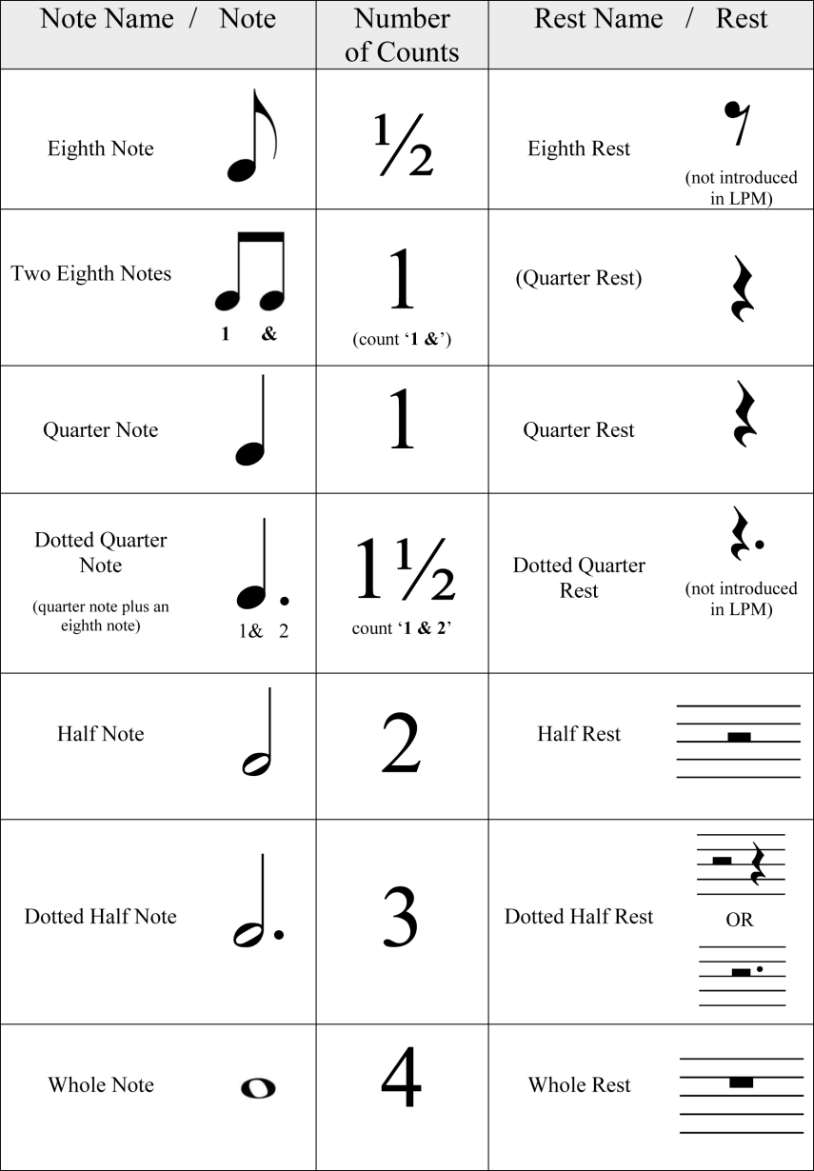
Real Rhythm Names and Counting
Notes:
“We FINALLY learn the actual names of all our rhythms as well as how to count them through a measure.”
could show the pregression from bugs, to purple pyramid to orange counting cards if so desired
could also explain ¾ and 4/4 and talk about lollipop and watermelon feel
Feel out what your parents need to hear

Slide 16


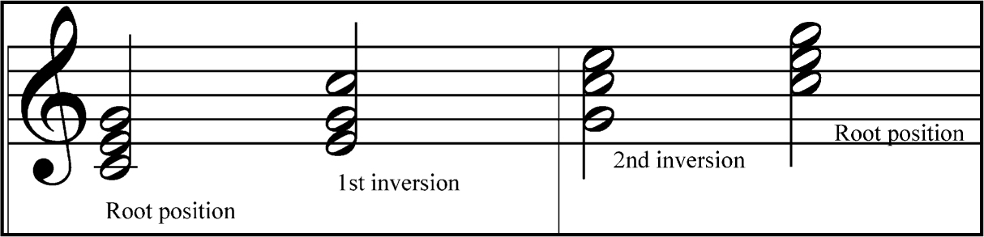
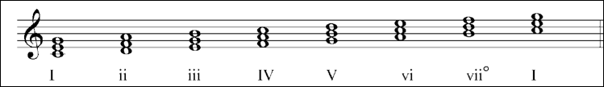
Chord Theory and Inversions
  Learn root position triads
    And not all of our primary chords are in Root Position
  Inversions--Understand and Play
    A red chord in C major is C-E-G no matter the order it is arranged on the staff. A blue chord in C Major…
  Red, Yellow and Blue become I, IV, and V
Notes:
“Okay moms!!! Here is your college level Theory 101! “
Work this in the segments as it comes.
1st bullet with picture---“When it is stacked up so, no gaps will let us know…”
2nd bullet with picture--- Obviously our primary chords as we know them so far, are NOT in Root Position
HOW are these POSSIBLY both the same primary chords??? Well….
Bullet #3 INVERSIONS! IN a NUTSHELL….
Bullet #4 with picture…
In this same realm of chord theory we will learn that our primary chords are also known as the I, IV, and V—briefly explain and show WHY they are called that—becuause their root is that number scale degree.

Slide 17
Compositions
Culmination of it ALL!
Encourage tinkering—freedom of expression
Private Lesson
    Orange Roots Lesson 6 and Lesson 11
Recital
Notes:
“This is the culmination of EVERYTHING that we will have learned over the entire course of Let’s Play Music. From classical form, to harmonic and melodic rhythm, to major and minor tonalities, and even our ability to play in various keys. This will ALL go into your child creating their very own composition.
Explain how we will use our improvising skills learned from Edison to help. We want to encourage ‘tinkering’ at the keyboard. And our student manuals in the orange semester WILL help with this.
Explain how you will work privately with their child during Private Lesson in the Orange Roots Semester.
And that this IS the recital. “No End of the Year Program, your little Mozart’s will actually be performing their very own compositions.”

Slide 18



Connections
Find Piano Teachers NOW
Endorsed Piano Teachers
What if my teacher isn’t Connected?
Connection Materials
Notes:
Connecting the gap between graduating from Let’s Play Music and transitioning into a private piano setting.
Private piano teachers are getting harder and harder to find. SO if you don’t already have someone, then be searching for one and get on their waiting list NOW!
BUT, if you specifically are looking for a teacher that KNOWS the LPM lingo, and will provide a smoother transition for your child then you CAN search for endorsed teachers through our website.
Through the same tab, send your teacher that you DO already know, to GET connected with LPM.
EVEN if your teacher isn’t ***gasp*** We now have a student book to send with your graduating LPM student to make for the best possible transition regardless of the teacher the go to.
Private teachers can also purchase various materials through the webstore… CD, manipulatives, magnet board, etc.

Slide 19
Studio Policies
Class will always start on time
No younger siblings in class, please.
Please shut off or silence cell phones
Tuition is by the semester and may be paid in 4 installments on Lessons 1, 5, 9 and 13
Late fees will be assessed at $5 per week
Notes:
Just like last year, this is your chance to lay down the law! Be sure you parents know your correct tuition amount if it is increased.

Slide 20
Classroom Details
Reward system/treasure box
Class is now 55 minutes long
Arrive on time – dictation at beginning of class
Practice duration
Moms come on Lessons 1, 5, 9, 13 and 15.
Class Calendar STILL has all info you need!
Notes:
Revise this slide to meet the specific needs of your classroom, but items such as the Compositions, Private Lessons, How to work Flashcards, class length, and mom attendance are pretty crucial if you did not cover them already.
GOOK LUCK!

