Slide 1
Tooting Trumpets Pinelands Music School
- Tim Jebsen - Nicholas Gaffney - Yu Gen Yeap - Jayden Dao

Slide 2
Requirements
List Requirements and functionality
Website:
Students:
Enrollment
Instrument hire
Profile
Class timetable
Teachers:
Edit profile
Manage students enrollment
Admin:
Create Teachers accounts
Reports for various business activities and statistics
Manage database data
Confirm these with client

Slide 3
Design & Usability
Design and aesthetic choice/reason
Explain usability and how good practices were used
Ask what their thoughts are on the design colours/layout… etc.

Slide 4
Technology
What technology/languages/services used.
Costs Involved.

Slide 5
Functionality
List functionality currently implemented
List functionality in development for Sp2
List functionality to be developed.
Error handling/exception handling/user restrictions
Explain what is currently in development, how much has been completed, estimates for completion.

Slide 6
Testing

Slide 7
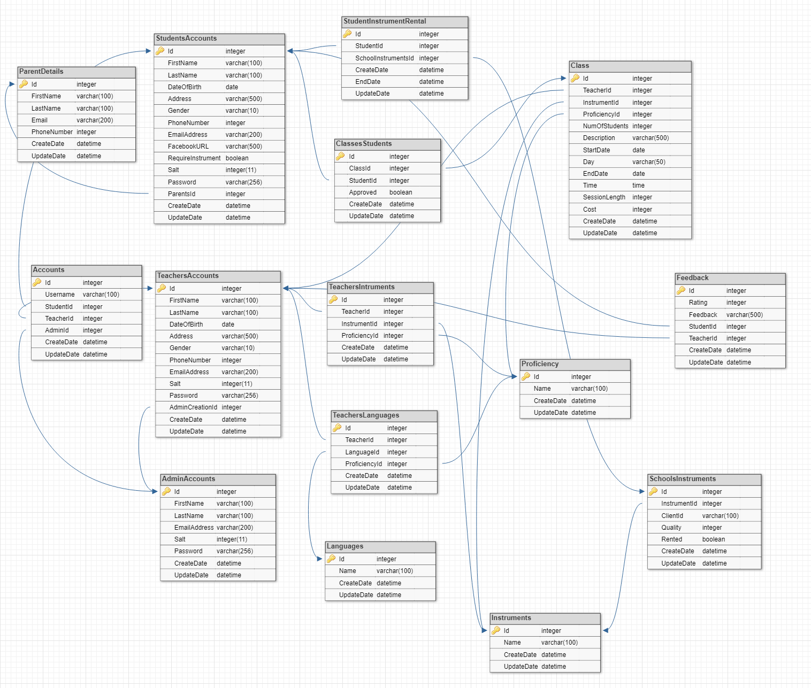
Database

Slide 8
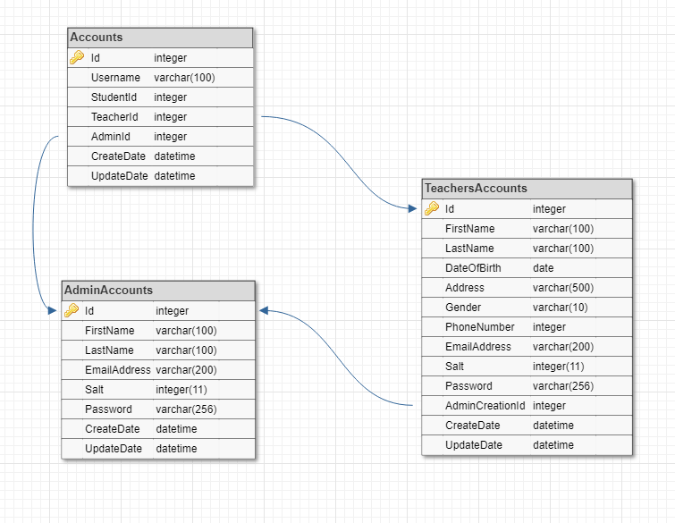
Admin Database

Slide 9
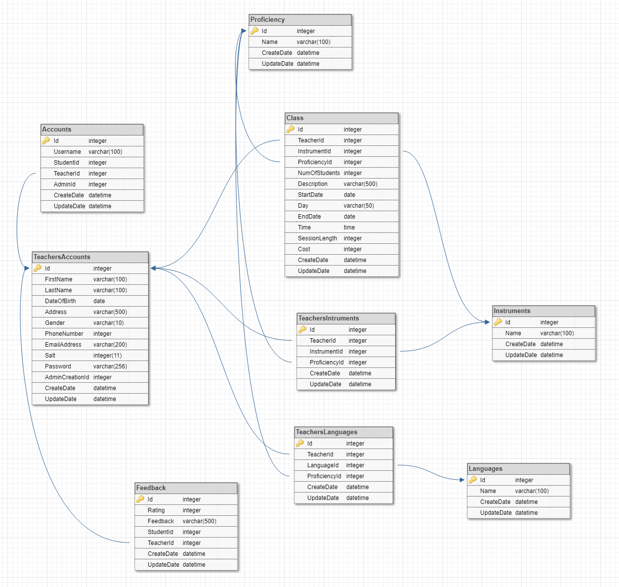
Teachers Database

Slide 10
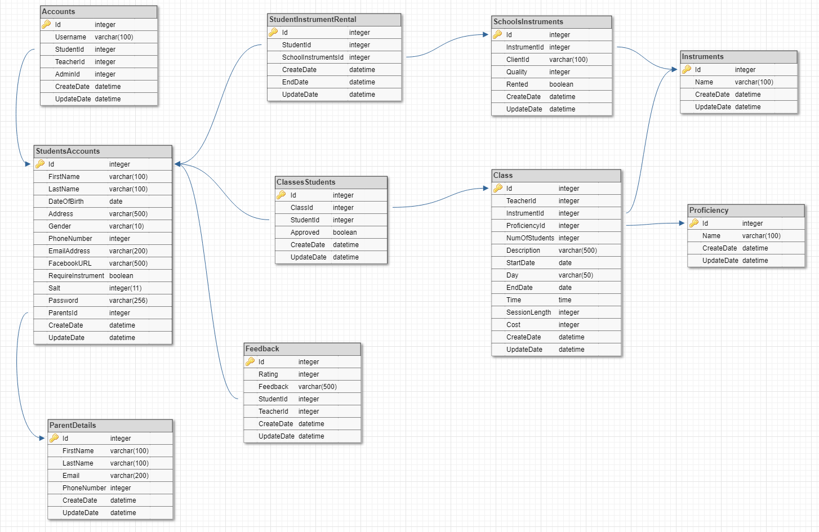
Students Database

Slide 11
Live Demo
tootingtrumpets.me

