Slide 1
Trec Evaluator
Team ;DROP TABLE teams

Slide 2
Briefing
The purpose of this application is to provide a tool that will allow researchers to evaluate how good their search system is, and how it compares to other submitted systems

Slide 3
Spec part A
Researchers must be able to create and maintain a profile
Researchers must be able to view tracks, and select a task from the list shown
Researchers can upload their .res files for a task
Researchers can see how well their runs have performed against all other runs

Slide 4
Spec Part B
Unregistered Visitors can view the leaderboard for each task
The leaderboard will show results in a tabled format
It will be sortable by P10, P20 and MAP
Researchers can describe the run they performed for each task
The admin can create tracks and tasks, with each task having a relevancy judgement file associated with it

Slide 5

Personas - Researcher

Slide 6

Personas - Visitor

Slide 7
System Architecture

Slide 8
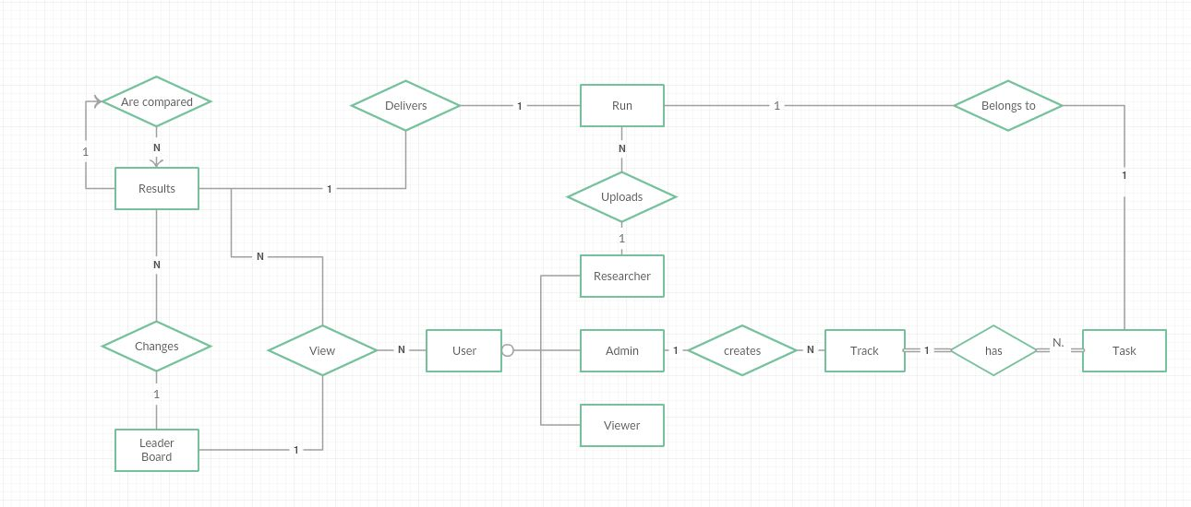
ER Diagram

Slide 9
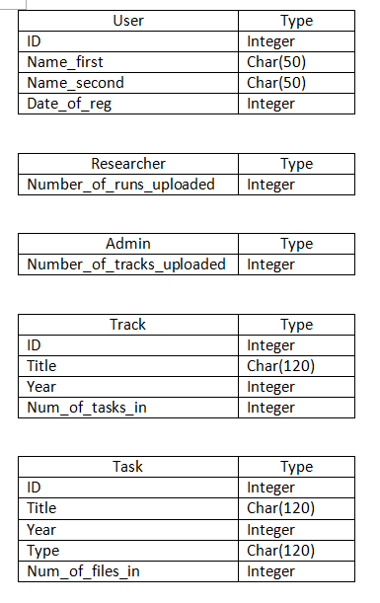
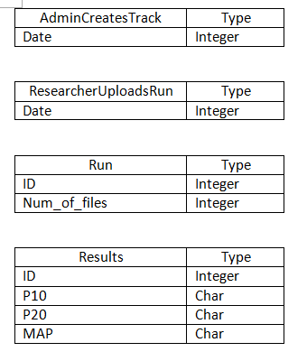
Attributes

Slide 10
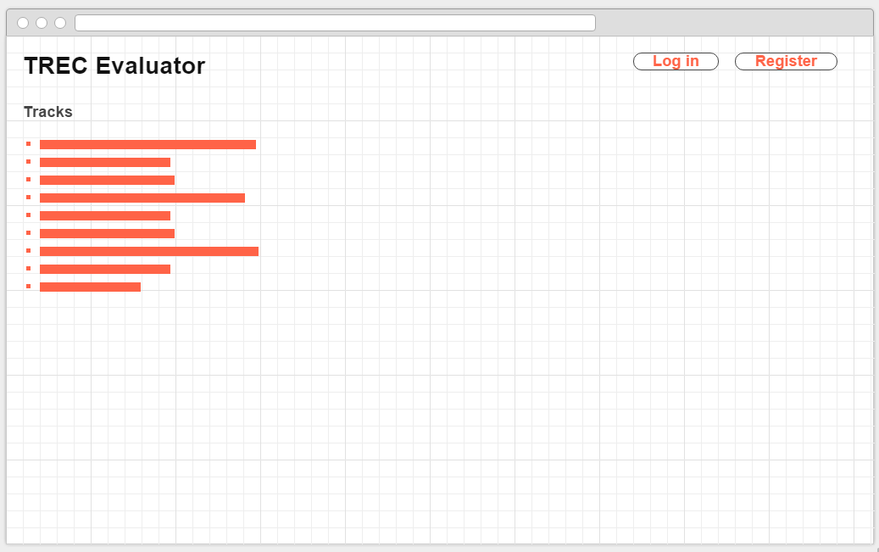
Wireframes - Homepage

Slide 11
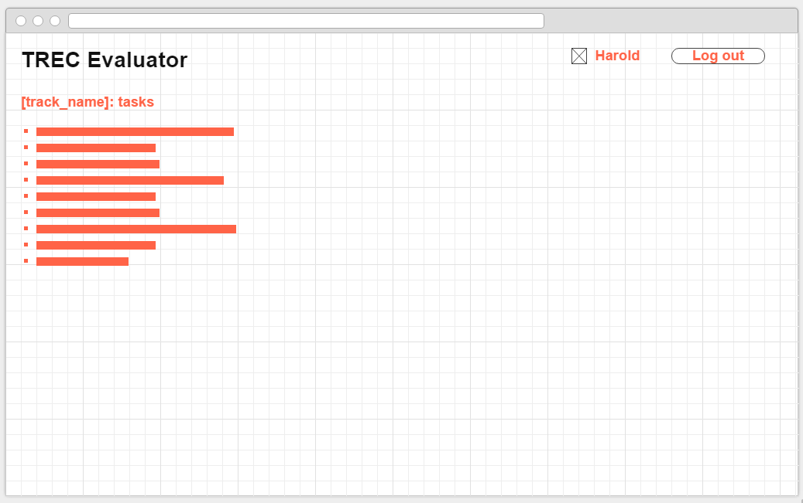
Wireframes – Logged In

Slide 12
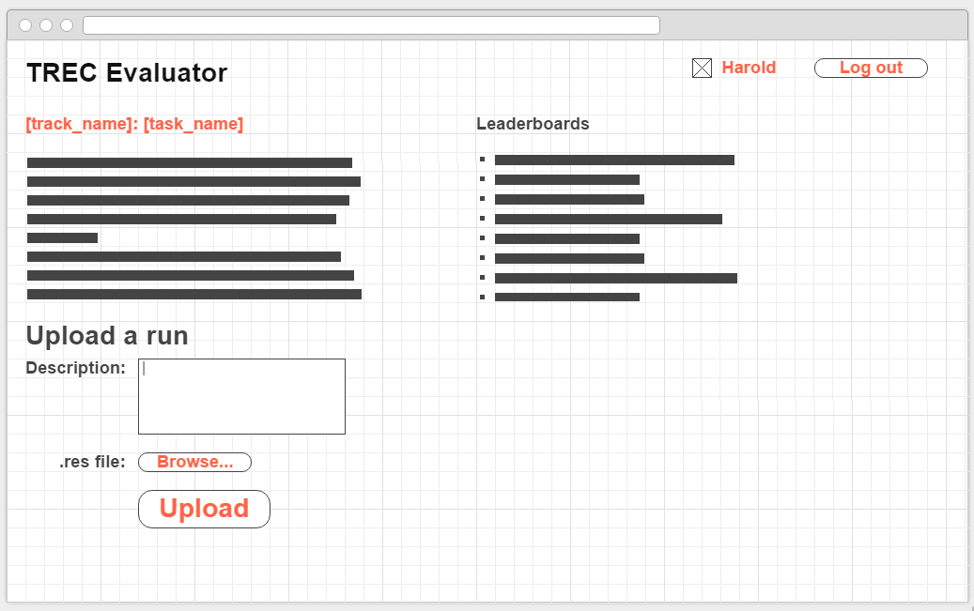
Wireframes – Upload a run

Slide 13
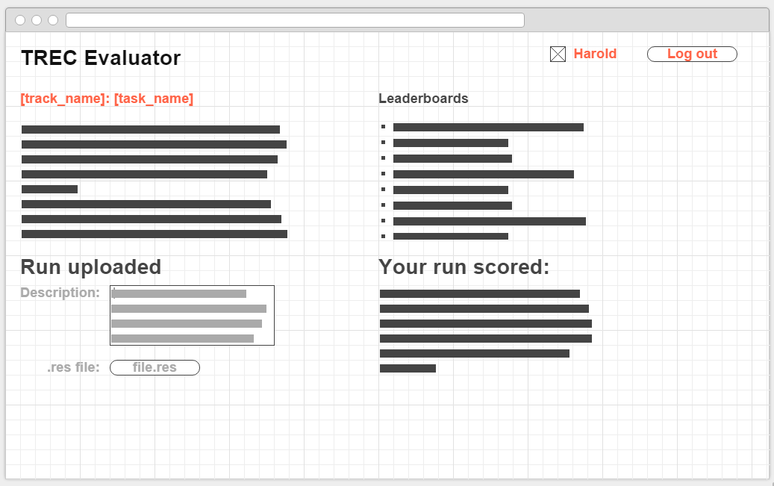
Wireframes – Run Uploaded

Slide 14
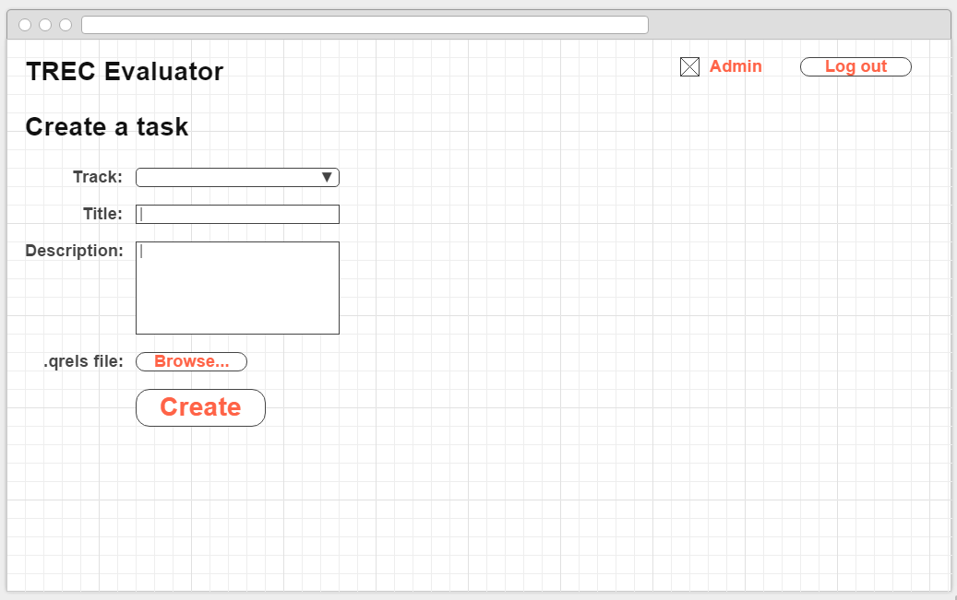
Wireframes – Create Task

Slide 15
Feature Walkthrough – Use Cases

Slide 16
Feature Walkthrough – Select Task
A list of are displayed, and a user can select one
A list of tasks in the selected track are displayed
Selecting a task will bring the user to the tasks page
This will contain various info about the task, along with a place to upload a run

Slide 17
Feature Walkthrough – Upload Run
The user will upload their .res file
The user will give a description of the run
Trec_eval will give scores for how well this run performed
The run will be added to the leaderboard

Slide 18
Feature Walkthrough – Create Task
The admin can create a task in a new track, or add it to an existing track
Each task will have
A title
Url
Year
Description
Task Type
Judgement relevancy file
List of official measures
Notes

