Slide 1
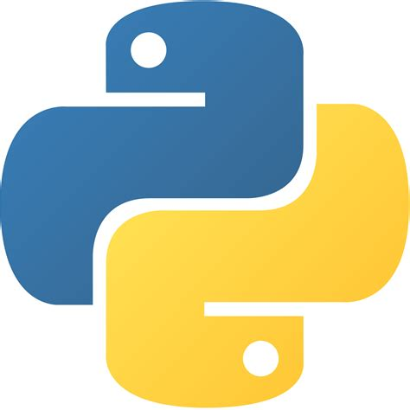
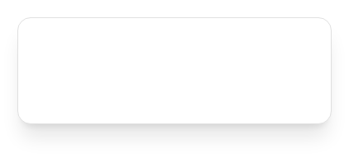

How Python Runs Programs
Course Instructor
Samandar Gofurjonov

Slide 2
Learning Objectives
What the Python Interpreter is and what it does
Describe execution flow: Source Code → Bytecode → PVM
Define and differentiate key terms: source code, bytecode, .pyc file, pycache, PVM, machine code.
Explain why Python uses bytecode and its impact on development speed vs performance
Compare the standard CPython with other Python implementations (PyPy, Cython, Jython, etc.)
Understand what standalone executables (frozen binaries) are and when to use them

Slide 3
What is Python Interpreter ?
Definition:
Python Interpreter is a program that reads and executes Python code line by line and carries out (executes) the instructions.
It acts as a bridge between your code and the computer hardware
Installing Python = installing the interpreter + standard library
The most common version is called Cpython
"Never forget: your Python code never runs directly on the CPU.
The interpreter is always in the middle."

Slide 4
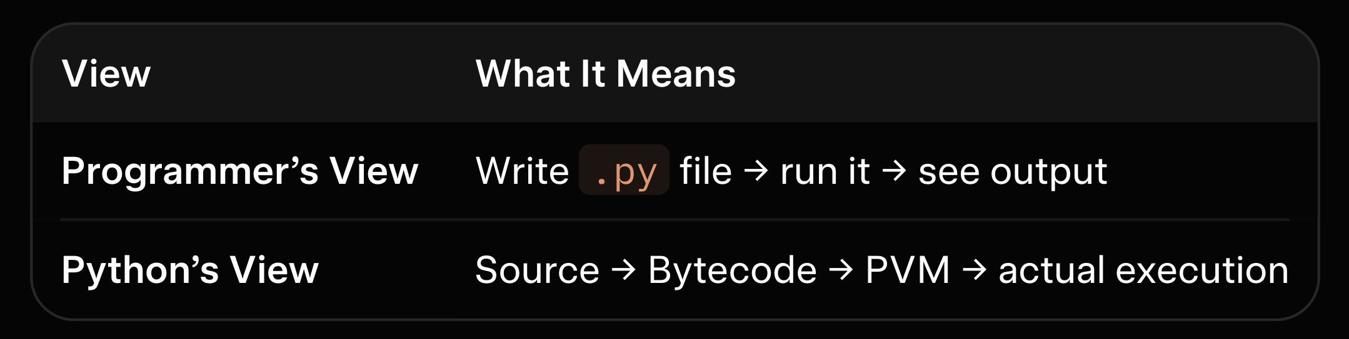
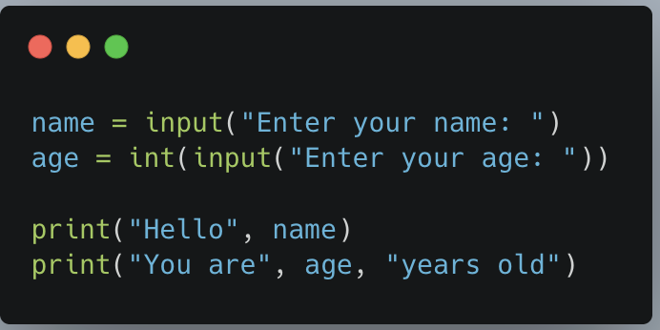
Two Views of Running a Program
“Most of you will only see the Programmer’s view.
Today we will explore the hidden Python view.”
Example: example.py

Slide 5
Python’s Internal Execution Model
You write source code (.py file)
Python compiles it automatically to bytecode
Bytecode is sent to the Python Virtual Machine (PVM)
PVM executes the bytecode → produces your output

Slide 6
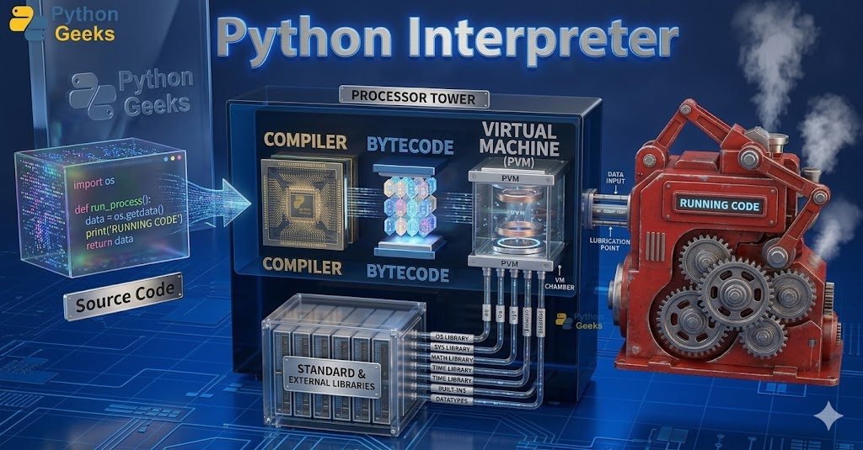
Clear Diagram Of Execution Model

Slide 7
Bytecode in Detail
Bytecode makes programs run faster than raw source code
Python saves it automatically in the __pycache__ folder
Next time you run the program, Python reuses the .pyc file (startup is faster)

Slide 8
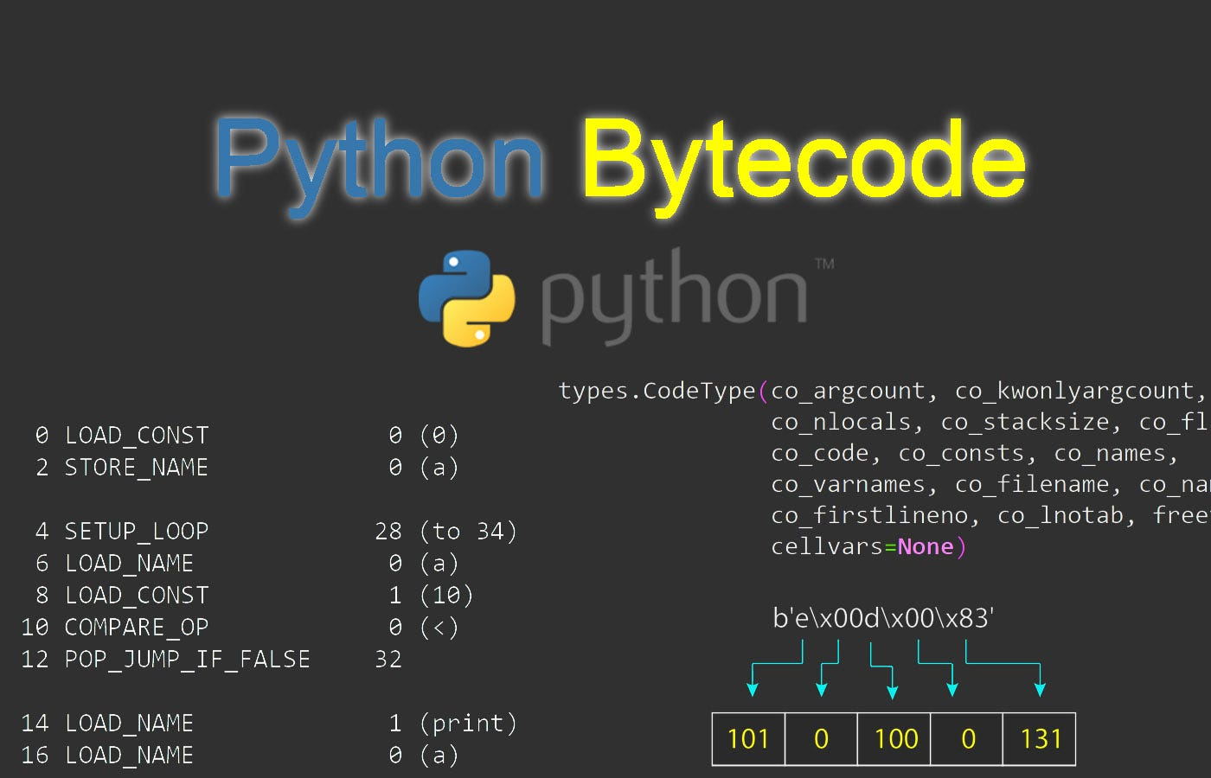
Example of real bytecode:
"You will never write bytecode yourself — Python does it for you."

Slide 9
Why Does Python Use Bytecode?
Advantage → Extremely fast development (no compile/link step)
Disadvantage → Slightly slower than C/C++
Python’s decision → Prioritizes Development speed + Flexibility
"This is why Python is so popular:
You get rapid development without sacrificing too much performance."

Slide 10
Development& Performance Advantages
Development Advantages
Edit & run instantly
Very dynamic (code can create and run other code at runtime)
Easy to customize programs on-site
Performance Note
Pure Python runs between traditional compiled and interpreted languages.
"This combination of speed-of-development + reasonable performance is Python’s biggest strength."

Slide 11
Python Implementation Alternatives
Implementation | Purpose | Key Advantage
Jython | Java integration | Works seamlessly with Java
IronPython | .NET integration | Works seamlessly with .NET
PyPy | Speed | JIT compiler (often much faster)
Numba | Numeric & scientific code | Excellent for math loops
Cython | Python + C hybrid | Compiles to very fast C code
MicroPython | Microcontrollers & browsers | Runs on tiny devices
CPython = The standard version (what we use in this course)

Slide 12
Standalone Executables (Frozen Binaries)
What are they?
Self-contained programs that run without installing Python on the user’s computer.
Tools: PyInstaller, cx_Freeze, py2exe, Buildozer
One single file (.exe, .app, .apk)
“Very useful when you want to share your program with friends or customers who don’t know Python.”

Slide 13
Chapter Summary
Key Takeaways
Python = Interpreter + automatic bytecode + PVM
Everything happens automatically behind the scenes
CPython is the standard implementation
Bytecode gives fast development + good performance
Other versions exist for speed or special integration

Slide 14
Quiz – Test Your Knowledge
What is the Python Interpreter?
What is Bytecode and why does Python use it?
What does PVM stand for and do?
What is CPython?
Name any two alternative implementations and their purpose.
What is Machine Code?

Slide 15
How You Run Programs
Course Instructor
Samandar Gofurjonov

Slide 16
Learning Objectives
Start and use the Python interactive REPL correctly
Create and run .py script files using command lines
Set up proper code folders and follow all conventions
Run code with multiple methods: command line, file clicks, IDLE, imports, exec, etc.
Know when to use REPL vs script files vs IDEs vs apps
Understand what standalone executables (frozen binaries) are and when to use them

Slide 17
Installing Python (Quick Reminder)
You need Python installed to follow along.
Windows / macOS → download installer from Download Python
Linux → usually pre-installed or use package manager
Android / iOS → install a Python app
Check first: type python3 (or py on Windows) in terminal

Slide 18
Two Main Ways to Run Code
Way | Description | Best For
Interactive REPL | Type code live at >>> prompt | Learning, testing, experiments
Script Files (.py) | Save code permanently and run the whole file | Real programs, reuse, sharing
"REPL = Read-Eval-Print-Loop. Script files are what professionals use most."

Slide 19
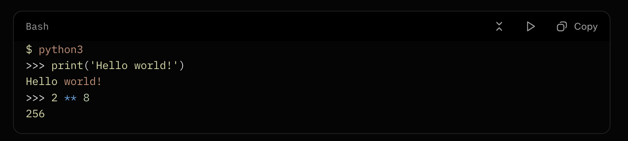
Starting The Interactive REPL
Platform commands:
Windows → py (or python)
macOS / Linux / Android → python3
Example:
"Anywhere you see “>>>” you are in the REPL. Type code and press Enter to run immediately."

Slide 20
Important Conventions
Best Practice – Code Folder Structure
One main code folder (e.g., Myproject or MyPython)
Inside it → per-chapter subfolders (Chapter03, Chapter04, …)
Why?
Keeps work organized
Makes import statements work without extra settings
Avoids filename clashes

Slide 21
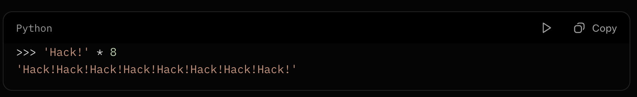
Running Code Interactively (Why Use REPL?)
Two big reasons:
Learning → instant feedback (type → see result immediately)
Testing → quickly test functions from your files

Slide 22
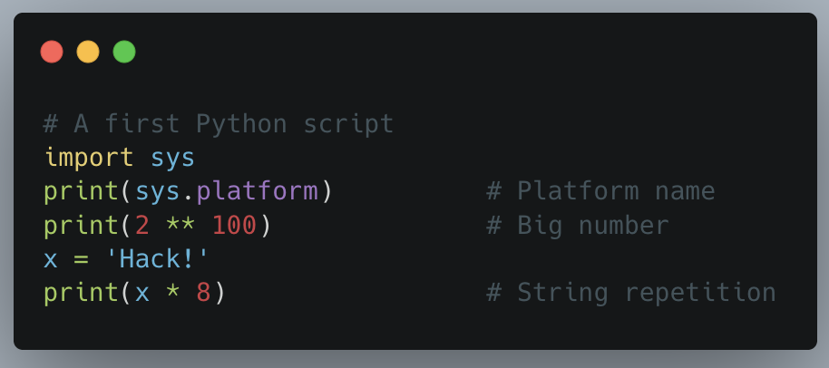
First Real Script
script.py
"This is our first full script. We will try to run it many different ways."

Slide 23
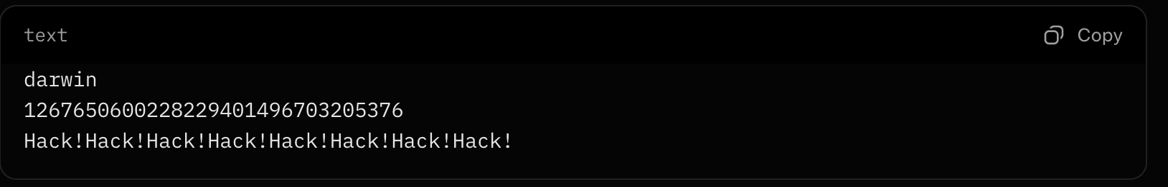
Running Scripts with Command Lines
(Most Important) !!
Steps:
Open terminal / command prompt
cd to your project folder
Type: python3 script1.py (use py on Windows)
Output:

Slide 24
Command-Line Variations
Redirect output: python3 script1.py > saveit.txt
Windows shortcut: just type script1.py
Run file in another folder: give full path
"These tricks are useful for testing and saving results."

Slide 25
Other Ways to Run Files
Method | How | Notes
File icon click | Double-click .py file | Window may close too fast
IDLE GUI | Run → Run Module | Free, visual, comes with Python
Smartphone apps | Tap file in app | Android/iOS Python apps
Jupyter Notebooks | Web browser cells | Great for science/data
WebAssembly (Pyodide) | Run in browser | Emerging technology

Slide 26
Other IDEs for Python
IDLE is great for beginners, but…
More powerful alternatives:
PyCharm
VSCode
PyDev
Wing
Spyder
PyScripter

Slide 27
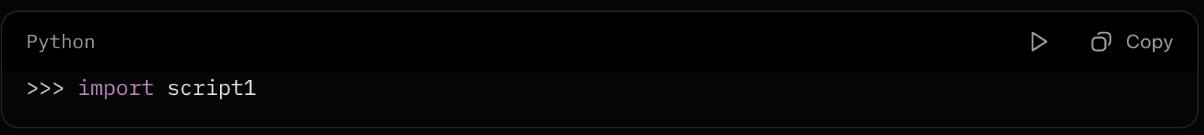
Running Code in Code (Imports & More)
1. Importing modules
Every .py file = a module
import loads and runs the file
Example:
"Imports are the foundation of larger Python programs."

Slide 28
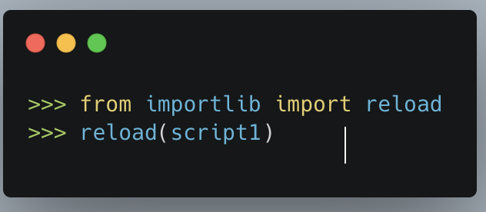
Reloading Modules
Problem:
import runs a file only once per session.
Solution:
"Reload lets you test changes without restarting Python."

Slide 29
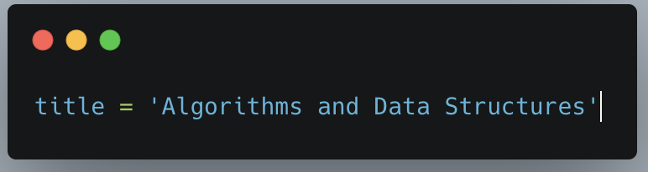
Module Attributes – First Look
Key concepts:
Module = namespace (package of names)
Top-level variables = attributes
Access with . (dot) or from
Simple example (myfile.py):
Usage:
import myfile → myfile.title
from myfile import title → title
"Modules prevent name collisions and organize code."

Slide 30
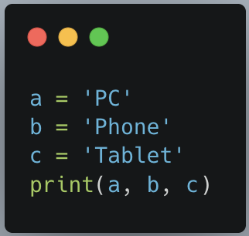
Module Attributes – Bigger Example
After import:
import threenames → threenames.b
from threenames import b, c → use b, c directly

Slide 31
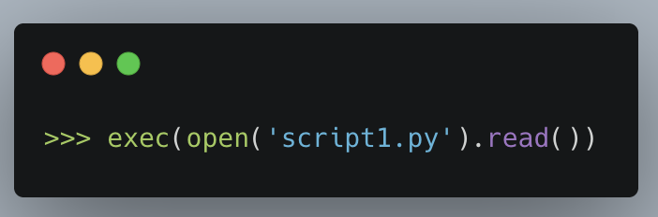
The exec Built-in
Alternative to import:
exec()
Pros: Runs current version every time (no reload needed)
Cons: Can overwrite variables in current namespace
"Useful for dynamic code, but import/reload is usually safer."

