Slide 1
METAFONT向量字體 基於METAFONT字型設計軟體開發

Slide 2

METAFONT原理展示
模式1(筆尖固定)
模式2 (筆尖可改變)
pickup pencircle
penpos1(1pt,90)
penpos1(3pt,90)

Slide 3
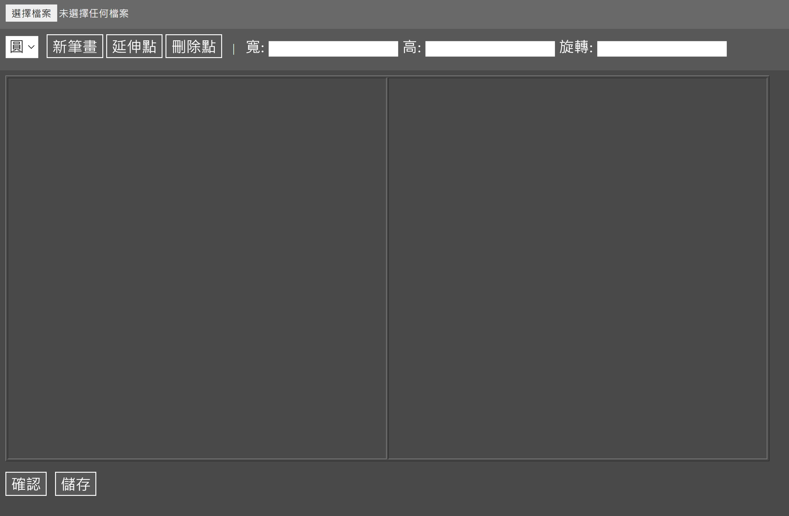
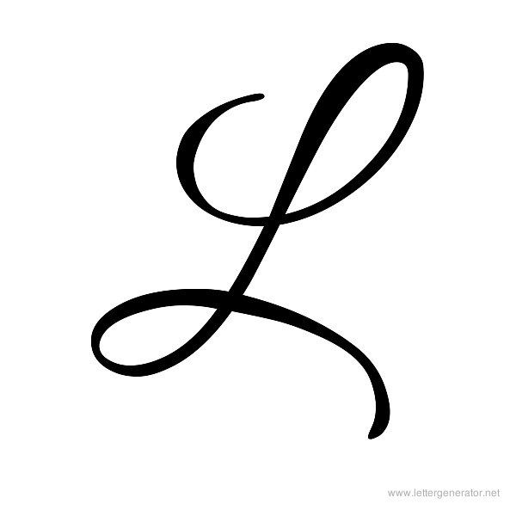
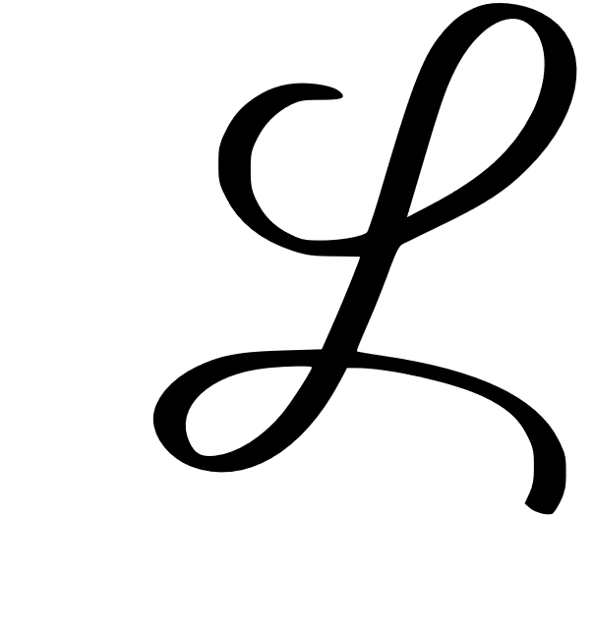
1
16
20
20
7
0
2
3
15
mode_setup;
beginchar (B, 10pt#, 10pt#, 0);
% define points
x10=0.49w;y10=0.81h;
x11=0.35w;y11=0.70h;
x12=0.45w;y12=0.58h;
x13=0.68w;y13=0.64h;
x14=0.78w;y14=0.93h;
x15=0.64w;y15=0.81h;
x16=0.57w;y16=0.58h;
x17=0.5w;y17=0.41h;
x18=0.36w;y18=0.26h;
x19=0.26w;y19=0.29h;
x110=0.39w;y110=0.41h;
x111=0.69w;y111=0.38h;
x112=0.82w;y112=0.28h;
x113=0.81w;y113=0.19h;
% define pen
pickup pencircle xscaled 16 yscaled 7 rotated 345;
draw z10..z11..z12..z13..z14..z15..z16..z17..z18..z19..z110..z111..z112..z113;
endchar;
end
4
參考圖
結果

