Slide 1
Direct Memory Access
The Kernel DMA API

Slide 2
DMA Motivation
Remove the participation of the CPU in the data transfer between main memory and I/O.
It results in general performance boost.

Slide 3
DMA Use Case
Software requisition

Slide 4
DMA Use Case
Software requisition
1) A process P calls read
2) The driver allocates DMA buffer
3) The driver instructs the device to transfer its data
4) P is put to sleep

Slide 5
DMA Use Case
Software requisition
1) A process P calls read
2) The driver allocates DMA buffer
3) The driver instructs the device to transfer its data
4) P is put to sleep
5) The device writes to DMA buffer
6) The device raises an interrupt when it’s done
7) The interrupt handler gets the input data and awakens P
8) P is ready to access the data

Slide 6
DMA Use Case
Software requisition
Example:
Network card DMA ring descriptors.

Slide 7
DMA Use Case
Hardware accumulation - Streaming
1) The driver maintains a buffer to be accumulated with data
2) The device raises an interrupt to announce new data
3) The interrupt handler allocates a buffer
4) The interrupt handler tells the device to transfer its data

Slide 8
DMA Use Case
Hardware accumulation - Streaming
1) The driver maintains a buffer to be accumulated with data
2) The device raises an interrupt to announce new data
3) The interrupt handler allocates a buffer
4) The interrupt handler tells the device to transfer its data
5) The device writes data to the buffer
6) The device raises another interrupt when it’s done
7) The handler dispatches the new data
8) The handler wakes any relevant process
9) The handler takes care of housekeeping

Slide 9
DMA Use Case
Hardware accumulation - Streaming
Examples:
- Networking buffers transmitted/received by a device.
- Filesystem buffers written/read by a SCSI device.

Slide 10
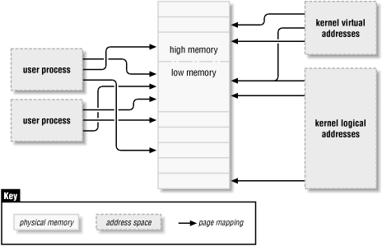
Kernel Memory Model

Slide 11
Kernel Memory Management
vmalloc()
kmap()
kmalloc()
Devices will deal with contiguous memory.

Slide 12

Cache coherence

Slide 13
Cache coherence
It can be even worse in write-back cache systems.

Slide 14
Allocation functions
kmap
vmalloc
DONT USE
OK
kmalloc
Block I/O buffer
Network buffer
dma_map_*
dma_alloc_*

Slide 15
Addressing Limitations
Kernel assumes that any device can address full 32-bits.
If that is not true, consult the kernel...

Slide 16
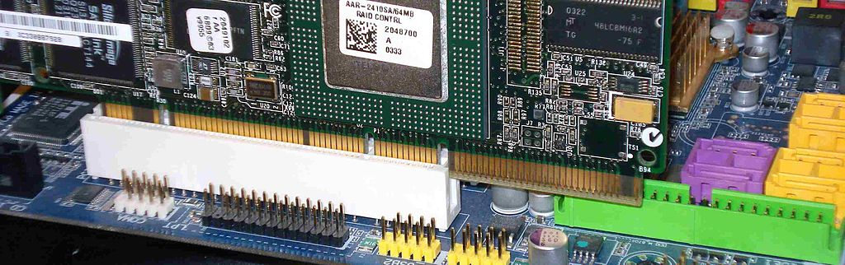
Addressing Limitations
Kernel assumes that any device can address full 32-bits.
If that is not true, consult the kernel...
64-bit PCI-X card partially inserted in 32-bit PCI slot, showing compatibility.

Slide 17
Addressing Limitations
Interrogate the kernel!
int dma_set_mask_and_coherent(struct device *dev, u64 mask);
Dev: pointer to your device struct
Mask: a bitmask describing which bits of an address device your device supports
Return 0 if your card can perform DMA properly on the current machine
If the return != 0, an attempt to use DMA will result in an undefined behavior

Slide 18
Addressing Limitations
Useful macro:
#define DMA_BIT_MASK(n) (((n) == 64) ? ~0ULL : ((1ULL<<(n))-1))

Slide 19
Addressing Limitations
Failure cases
1) Use another DMA mask, if possible.
2) Use some non-DMA mode for data transfer, if possible.
3) Ignore this device and do not initialize it.

Slide 20
Addressing Limitations
Notable example: Old Sound Card Drivers
The hardware is composed by an ISA card with PCI front-end
The PCI side is responsible for playback and can handle 32-bit addresses
The ISA side is responsible for recording and can handle 24-bit addresses

Slide 21
Addressing Limitations
Notable example: Old Sound Card Drivers
#define PLAYBACK_ADDRESS_BITS DMA_BIT_MASK(32)
#define RECORD_ADDRESS_BITS DMA_BIT_MASK(24)
struct my_sound_card *card;
struct device *dev;
if (!dma_set_mask(dev, PLAYBACK_ADDRESS_BITS)) {
card->playback_enabled = 1;
} else {
card->playback_enabled = 0;
dev_warn(dev, "%s: Playback disabled due to DMA limitations\n",
card->name);
}
if (!dma_set_mask(dev, RECORD_ADDRESS_BITS)) {
card->record_enabled = 1;
} else {
card->record_enabled = 0;
dev_warn(dev, "%s: Record disabled due to DMA limitations\n",
card->name);
}

Slide 22
Addressing Limitations
Notable example: e1000 Network Driver
/* there is a workaround being applied below that limits
* 64-bit DMA addresses to 64-bit hardware. There are some
* 32-bit adapters that Tx hang when given 64-bit DMA addresses
*/
pci_using_dac = 0;
if ((hw->bus_type == e1000_bus_type_pcix) &&
!dma_set_mask_and_coherent(&pdev->dev, DMA_BIT_MASK(64))) {
pci_using_dac = 1;
} else {
err = dma_set_mask_and_coherent(&pdev->dev, DMA_BIT_MASK(32));
if (err) {
pr_err("No usable DMA config, aborting\n");
goto err_dma;
}
}
Double-address cycle

Slide 23
Allocating Large Spaces
A PAGE_SIZE allocation is considered big.

Slide 24
Allocating Large Spaces
A PAGE_SIZE allocation is considered big.
dma_addr_t dma_handle;
cpu_addr = dma_alloc_coherent(dev, size, &dma_handle, gfp);

Slide 25
Allocating Large Spaces
A PAGE_SIZE allocation is considered big.
dma_addr_t dma_handle;
cpu_addr = dma_alloc_coherent(dev, size, &dma_handle, gfp);
In bytes
Use GFP_ATOMIC in interrupt handlers
virtual address
struct device*
The physical address. Pass it to device

Slide 26
Allocating Large Spaces
A PAGE_SIZE allocation is considered big.
dma_addr_t dma_handle;
cpu_addr = dma_alloc_coherent(dev, size, &dma_handle, gfp);
dma_free_coherent(dev, size, cpu_addr, dma_handle);

Slide 27
Allocating Large Spaces
A PAGE_SIZE allocation is considered big.
dma_addr_t dma_handle;
cpu_addr = dma_alloc_coherent(dev, size, &dma_handle, gfp);
dma_free_coherent(dev, size, cpu_addr, dma_handle);
Remember the dma_set_coherent_mask()!

Slide 28
Allocating Small Spaces
If you need to allocate lots of smaller memory regions, the kernel can subdivide pages for you with the dma_pool API.

Slide 29
Allocating Small Spaces
If you need to allocate lots of smaller memory regions, the kernel can subdivide pages for you with the dma_pool API.
struct dma_pool *pool;
pool = dma_pool_create(name, dev, size, align, boundary);
string ID for diagnostics
Limit the dma_pool address to boundary in bytes.
Currently only 2 values were found: 0 and PAGE_SIZE
A power of 2.
The hardware alignment in bytes.

Slide 30
Allocating Small Spaces
If you need to allocate lots of smaller memory regions, the kernel can subdivide pages for you with the dma_pool API.
struct dma_pool *pool;
pool = dma_pool_create(name, dev, size, align, boundary);
cpu_addr = dma_pool_alloc(pool, flags, &dma_handle);
GFP_KERNEL: normally
GFP_ATOMIC: in interrupt stage or when holding Symmetric Multiprocessing (SMP) locks

Slide 31
Allocating Small Spaces
If you need to allocate lots of smaller memory regions, the kernel can subdivide pages for you with the dma_pool API.
struct dma_pool *pool;
pool = dma_pool_create(name, dev, size, align, boundary);
cpu_addr = dma_pool_alloc(pool, flags, &dma_handle);
dma_pool_free(pool, cpu_addr, dma_handle);
dma_pool_destroy(pool);

Slide 32
DMA Direction
Before we introduce another way of DMA’ing, we need to understand how to optimize the future kernel functionalities.

Slide 33
DMA Direction
DMA_BIDIRECTIONAL
DMA_TO_DEVICE
DMA_FROM_DEVICE
DMA_NONE

Slide 34
DMA Direction
DMA_BIDIRECTIONAL “I don’t know the direction”
DMA_TO_DEVICE from main memory to the device
DMA_FROM_DEVICE from the device to main memory
DMA_NONE for debugging. Acts like a data listener, which will
discover the precise direction of the data.

Slide 35
DMA Direction
Example: Networking drivers
To transmit packets: map/unmap with DMA_TO_DEVICE direction
To receive packets: map/unamp with DMA_FROM_DEVICE direction

Slide 36
Streaming DMA Mappings
Can be called from interrupt context.
Mapping a
page region:
struct device *dev = &my_dev->dev;
dma_addr_t dma_handle;
struct page *page = buffer->page;
unsigned long offset = buffer->offset;
size_t size = buffer->len;
dma_handle = dma_map_page(dev, page, offset, size, direction);
if (dma_mapping_error(dev, dma_handle)) {
/*
* reduce current DMA mapping usage,
* delay and try again later or
* reset driver.
*/
goto map_error_handling;
}

Slide 37
Streaming DMA Mappings
Can be called from interrupt context.
Unmapping:
  dma_unmap_page(dev, dma_handle, size, direction);
  dma_unmap_single(dev, dma_handle, size, direction);

Slide 38
Streaming DMA Mappings
Can be called from interrupt context.
Unmapping:
  dma_unmap_page(dev, dma_handle, size, direction);
  dma_unmap_single(dev, dma_handle, size, direction);

Slide 39
Streaming DMA Mappings
Syncing
Use cases:
  Reuse streaming DMA region multiple times
  Touch the data in between DMA transfers

Slide 40
Streaming DMA Mappings
Syncing
After calling dma_map_single()...
To remap after each DMA transfer call:
dma_sync_single_for_cpu(dev, dma_handle, size, direction);
To let the device get the DMA area again, finishing accessing data with the CPU, call the following function before giving the buffer to hardware:
dma_sync_single_for_device(dev, dma_handle, size, direction);

Slide 41
Streaming DMA Mappings
Syncing example:
my_card_setup_receive_buffer(struct my_card *cp, char *buffer, int len)
{
dma_addr_t mapping;
mapping = dma_map_single(cp->dev, buffer, len, DMA_FROM_DEVICE);
if (dma_mapping_error(cp->dev, mapping)) {
/*
* reduce current DMA mapping usage,
* delay and try again later or
* reset driver.
*/
goto map_error_handling;
}
cp->rx_buf = buffer;
cp->rx_len = len;
cp->rx_dma = mapping;
give_rx_buf_to_card(cp);
}

Slide 42
Streaming DMA Mappings
Syncing example:
if (header_is_ok(hp)) {
dma_unmap_single(&cp->dev, cp->rx_dma, cp->rx_len,
DMA_FROM_DEVICE);
pass_to_upper_layers(cp->rx_buf);
make_and_setup_new_rx_buf(cp);
} else {
/* CPU should not write to
* DMA_FROM_DEVICE-mapped area,
* so dma_sync_single_for_device() is
* not needed here. It would be required
* for DMA_BIDIRECTIONAL mapping if
* the memory was modified.
*/
give_rx_buf_to_card(cp);
}
}
}
my_card_interrupt_handler(int irq, void *devid, struct pt_regs *regs)
{
struct my_card *cp = devid;
...
if (read_card_status(cp) == RX_BUF_TRANSFERRED) {
struct my_card_header *hp;
/* Examine the header to see if we wish
* to accept the data. But synchronize
* the DMA transfer with the CPU first
* so that we see updated contents.
*/
dma_sync_single_for_cpu(&cp->dev,
cp->rx_dma,
cp->rx_len,
DMA_FROM_DEVICE);
/* Now it is safe to examine the buffer. */
hp = (struct my_card_header *) cp->rx_buf;

Slide 43
Scatterlists
When your device is smart and have an IOMMU
You can allocate lots of memory, even if they aren’t contiguous.
The IOMMU deals with virtual memory addressing using a basic linked list: the scatterlist.

Slide 44
Scatterlists
struct scatterlist {
struct page *page;
unsigned int offset;
dma_addr_t dma_address;
unsigned int length;
};

