Slide 1

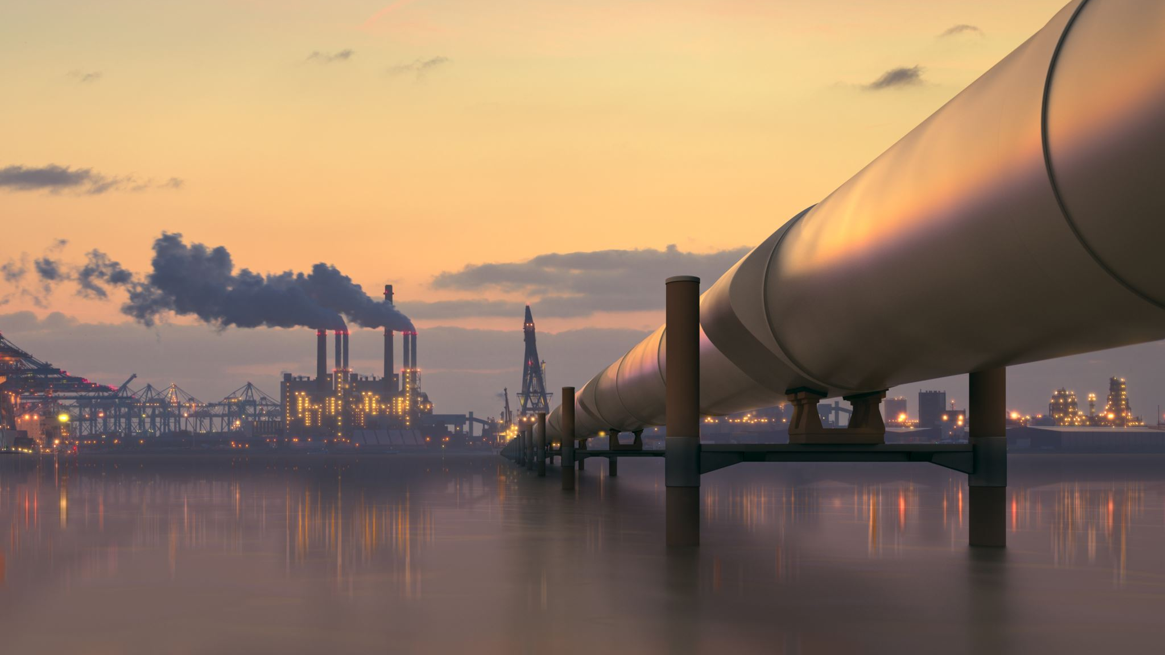
Machine Learning for Environmental Sustainability: Waste Classification and Climate Prediction
Data Mining and Machine learning
​
F21DL-Group 13​
Analysing the Impact of Waste Management on Climate
Presented by:​
​
Adarsh Kumar​
Gagan Lokesh Shetty
Kiran Narayana​​
Neha Giliyar Nagaraj​
Sanjana Koujalgi​​

Slide 2
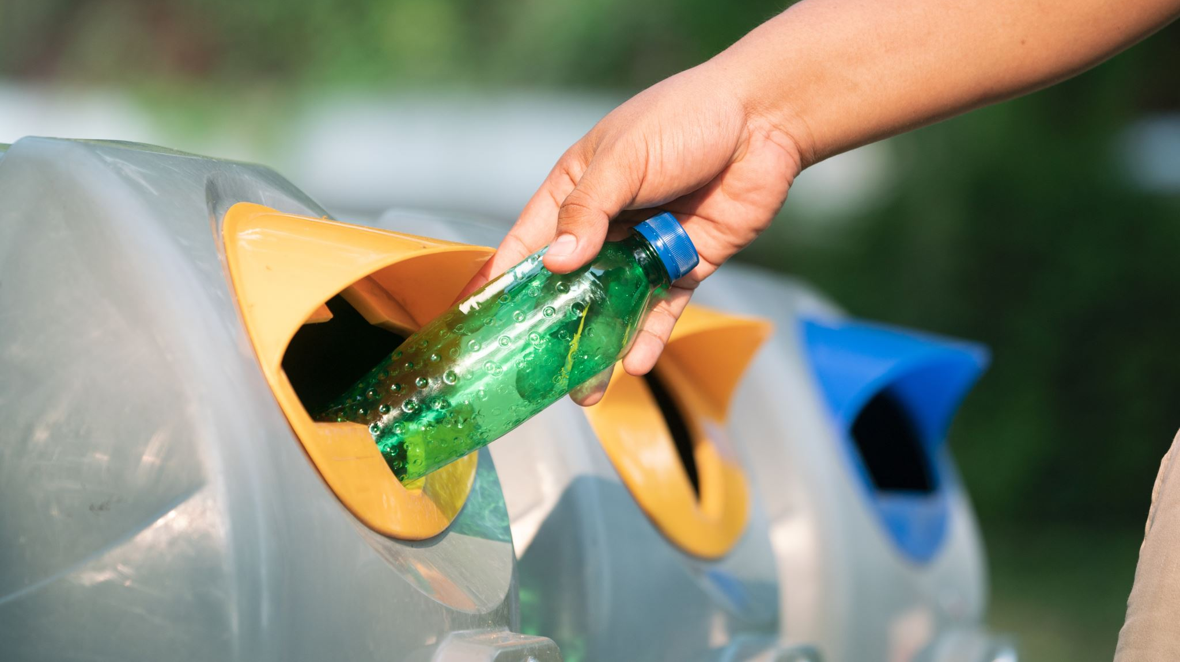
Introduction to the Project
Overview:
Understanding the connection between waste classification, climate trends, and pollution statistics.
Utilizing machine learning techniques to analyse datasets.
Highlighting the environmental impact and actionable insights.
Objective:
To classify waste types, analyse climate trends, and correlate pollution data for actionable results.

Slide 3

Datasets Overview
Datasets Used:Garbage Dataset:
Source: Image-based dataset of garbage types.
Key Info: Includes 12 categories of waste (e.g., battery, plastic, paper).
Climate Dataset:
Source: Historical temperature data across countries.
Key Info: Average temperature trends with monthly granularity.
Pollution Dataset:
Source: Country-level waste statistics.
Key Info: Metrics like plastic, metal, and paper waste percentages.
Dataset Integration:Combined datasets for comprehensive analysis.

Slide 4

Dataset Preprocessing
Garbage Dataset:
Image resizing and normalization.
Augmentation for enhanced diversity.
Climate Dataset:
Handling missing values.
Feature engineering: Yearly averages and normalized temperatures.
Pollution Dataset:
Standardized waste metrics.
Extracted key features like total waste generated and waste composition.

Slide 5

Machine Learning Techniques
Garbage Dataset: Model Used: Convolutional Neural Networks (CNNs).
Purpose: Classify waste into 12 categories.
Climate Dataset: Model Used: Linear Regression.
Purpose: Predict temperature trends and correlate with organic waste decomposition.
Pollution Dataset: Model Used: Decision Trees and Linear Models.
Purpose: Predict organic waste percentage based on waste metrics.
Combined Dataset: Model Used: K-Nearest Neighbors (KNN) and Linear Regression.
Purpose: Derive insights from the correlation between climate and pollution data.

Slide 6
Garbage Dataset: CNN achieved 90% accuracy in classifying waste.
Climate Dataset: Linear regression identified trends in temperature rise correlating with waste decomposition rates.
Pollution Dataset: Decision trees showed the influence of plastic and paper waste on overall pollution.
Combined Dataset: Correlation between rising temperatures and organic waste decomposition observed.
Results and Analysis

Slide 7
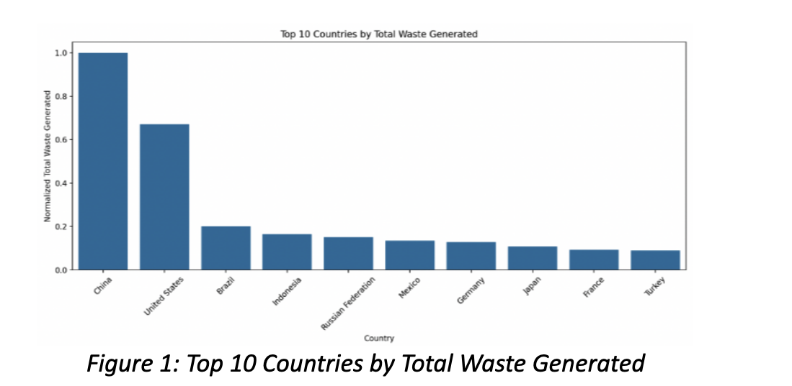
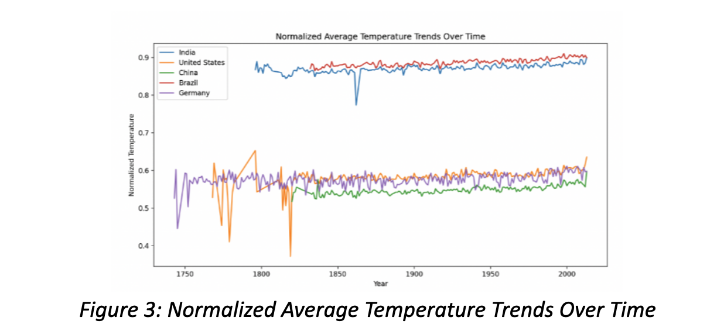
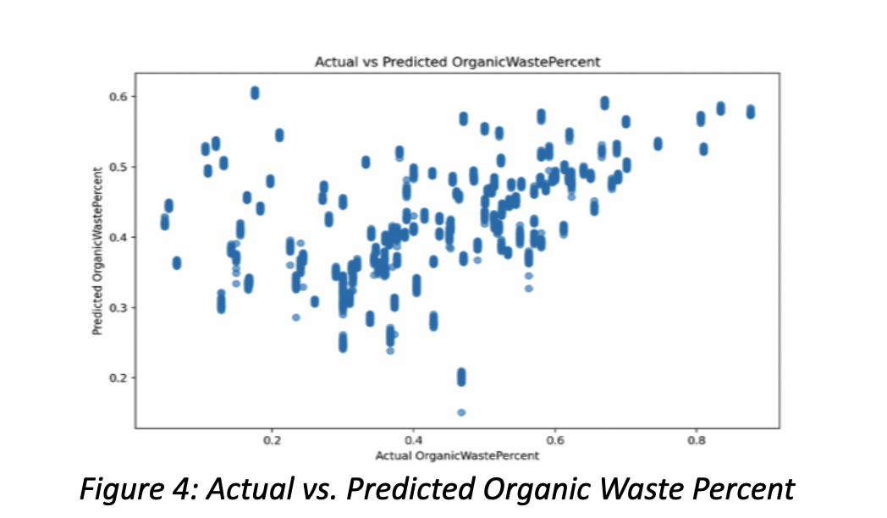
Visualization Examples

Slide 8

Alignment with Coursework Requirements
Data Exploration:Preprocessing and feature selection performed for all datasets.
Clustering:Identified waste types with similar decomposition characteristics.
Model Training:Applied CNNs, Decision Trees, and Linear Regression.
Neural Networks:CNNs effectively classified garbage images.

Slide 9
Addressing Coursework Requirements (R1–R2)
R1: Data Collection and Integration
Datasets Used:
Garbage Images (12 Categories).
Climate Data (Average Temperature by Country).
Pollution Data (Waste Composition by Country).
Process: Preprocessing, cleaning, and integration for analysis.
R2: Data Analysis and Exploration
Techniques: EDA, correlation analysis, and feature selection.
Key Features:
Climate Dataset: Normalized Temperature.
Pollution Dataset: Plastic, Paper, Glass, and Organic Waste Percentages.
Outcome: Insights into relationships between temperature and waste decomposition.

Slide 10
Addressing Coursework Requirements (R1–R2)
R3: Clustering
Approach: Grouped similar data points.
Garbage: Waste type classification probabilities.
Pollution: Countries with similar waste composition.
Climate: Countries with similar temperature patterns.
R4: Baseline Training and Evaluation
Algorithms Used:
CNN for Garbage Classification.
Decision Trees for Pollution Data.
Linear Regression for Climate Data.
Evaluation Metrics: Accuracy, MAE, RMSE, Precision, Recall.

Slide 11
End Goal and Impact
End Goal:
Through the integration of garbage, climate, and pollution datasets, the project identifies patterns and actionable data points to improve waste management processes.
For example, analyzing the composition of waste (plastic, organic, glass, etc.) and its correlation with climatic conditions enables targeted waste recycling and management strategies
Impact:
Supports waste management strategies.
Raises awareness about climate-pollution connections.

Slide 12

Future Work
Incorporate Regional Policies and Regulations
Add features that consider regional waste management policies to tailor predictions and recommendations accordingly.
Implement Geospatial Analysis
Integrate geospatial data to identify regions with the highest waste generation and analyze climatic effects on waste decomposition geographically.
Use Ensemble Machine Learning Models
Combine multiple machine learning models (e.g., Random Forests, Gradient Boosting) to improve prediction reliability and handle diverse data patterns effectively.

Slide 13

Conclusion
Key Takeaways: Waste classification and its decomposition are influenced by climate.
Effective waste classification is essential for sustainable waste management and environmental conservation. Machine learning facilitated actionable insights, bridging the gap between waste generation, climate impact, and pollution patterns.
Closing Statement:
Our analysis serves as a foundational step toward a data-driven approach to waste management. By leveraging machine learning and interdisciplinary collaboration, we aim to support policy-making

Slide 14

QA?

Slide 15

Thank You

