Slide 1


SMART INDIA HACKATHON 2026
Problem Statement ID – 26153
Problem Statement Title - AI based Network Attack Forecasting from Network Traffic Data
Theme - Blockchain & Cybersecurity
PS Category - Software
Team ID -
Team Name - Foresight

Slide 2

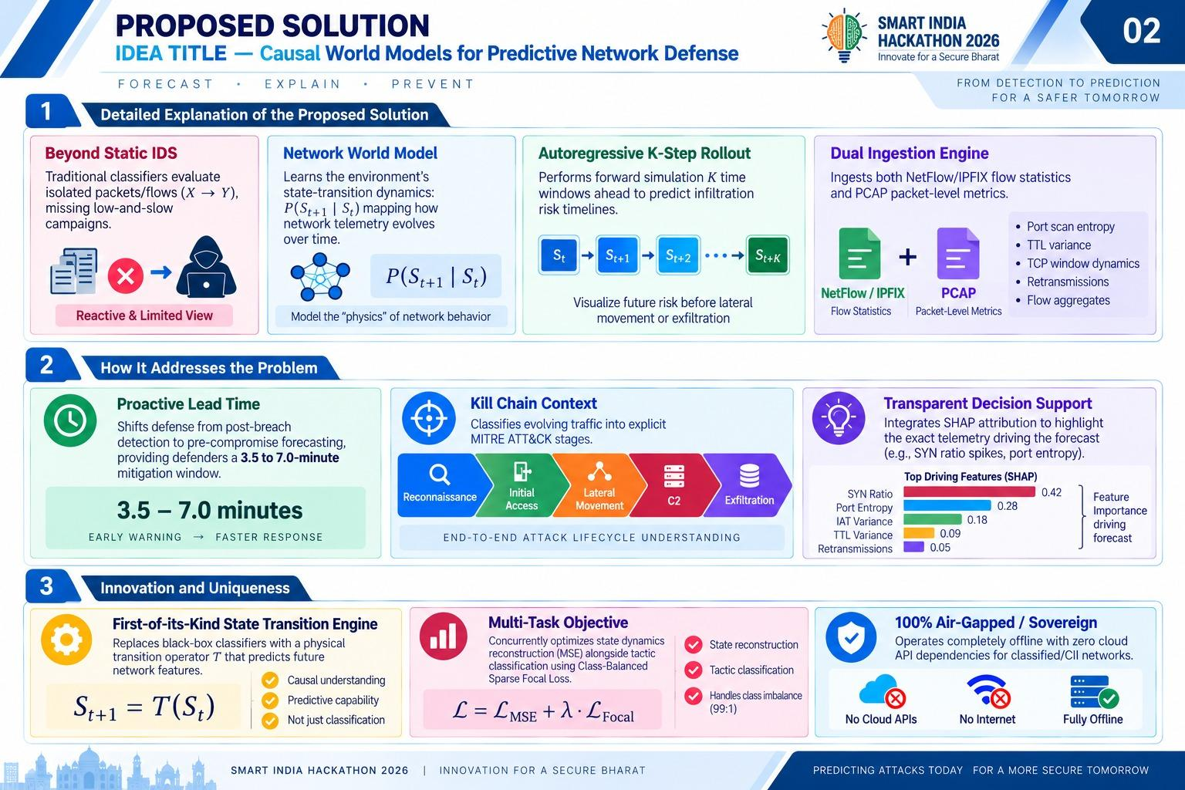
THREAT-HORIZON
Detailed Explanation of the Proposed Solution
Beyond Static IDS
Traditional classifiers evaluate isolated packets/flows (X →Y),
missing low-and-slow campaigns

Slide 3
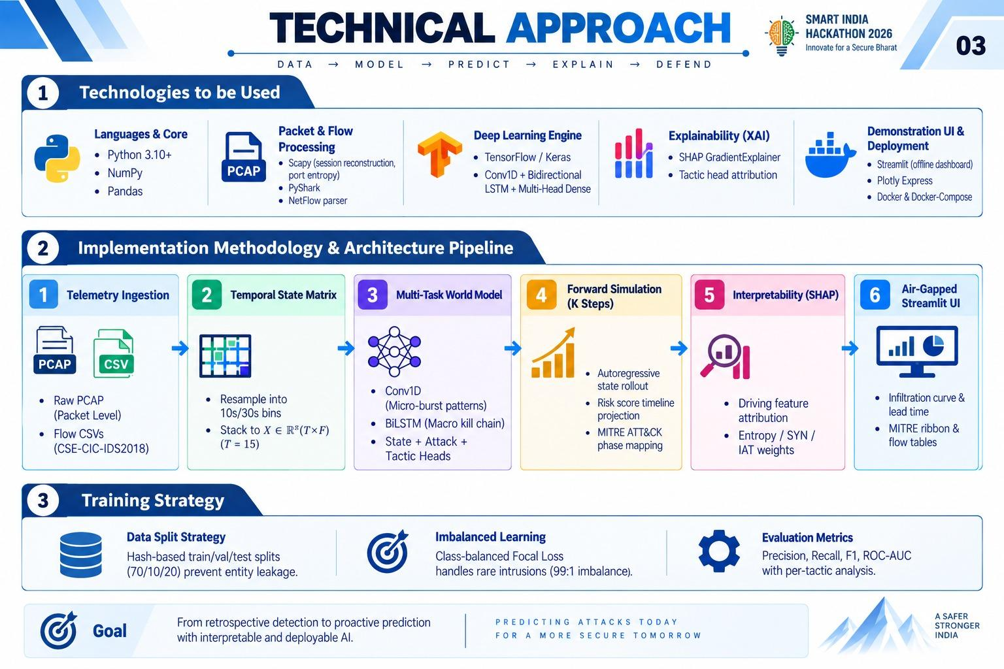
TECHNICAL APPROACH

Slide 4
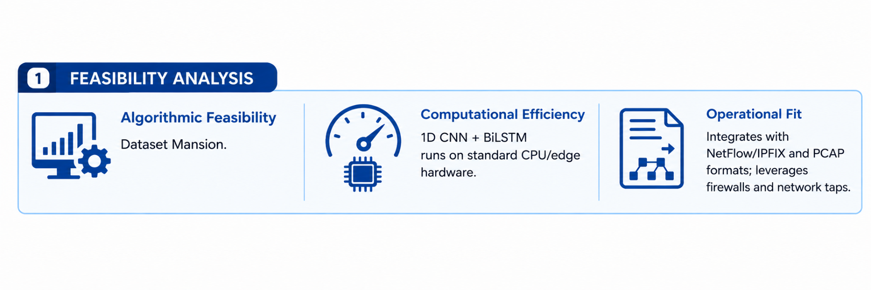
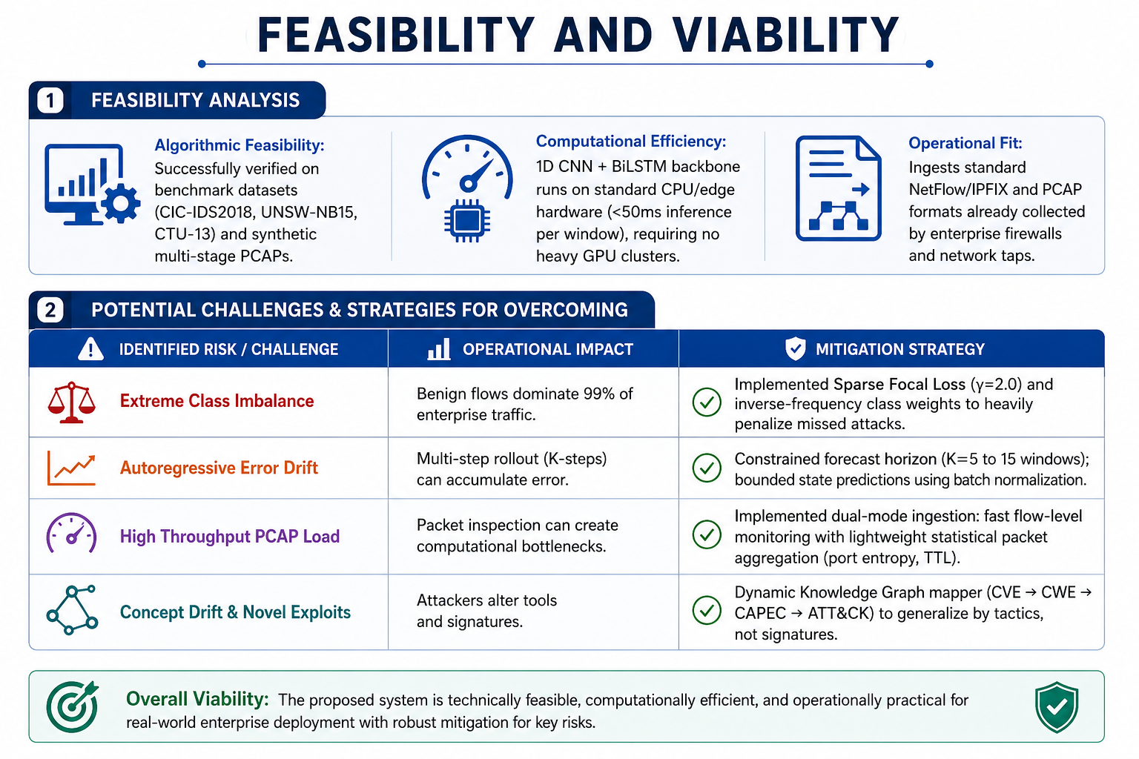
FEASIBILITY AND VIABILITY
benchmark datasets
(CIC-IDS 2018, UNSW-NB15)

Slide 5

IMPACT AND BENEFITS

Slide 6
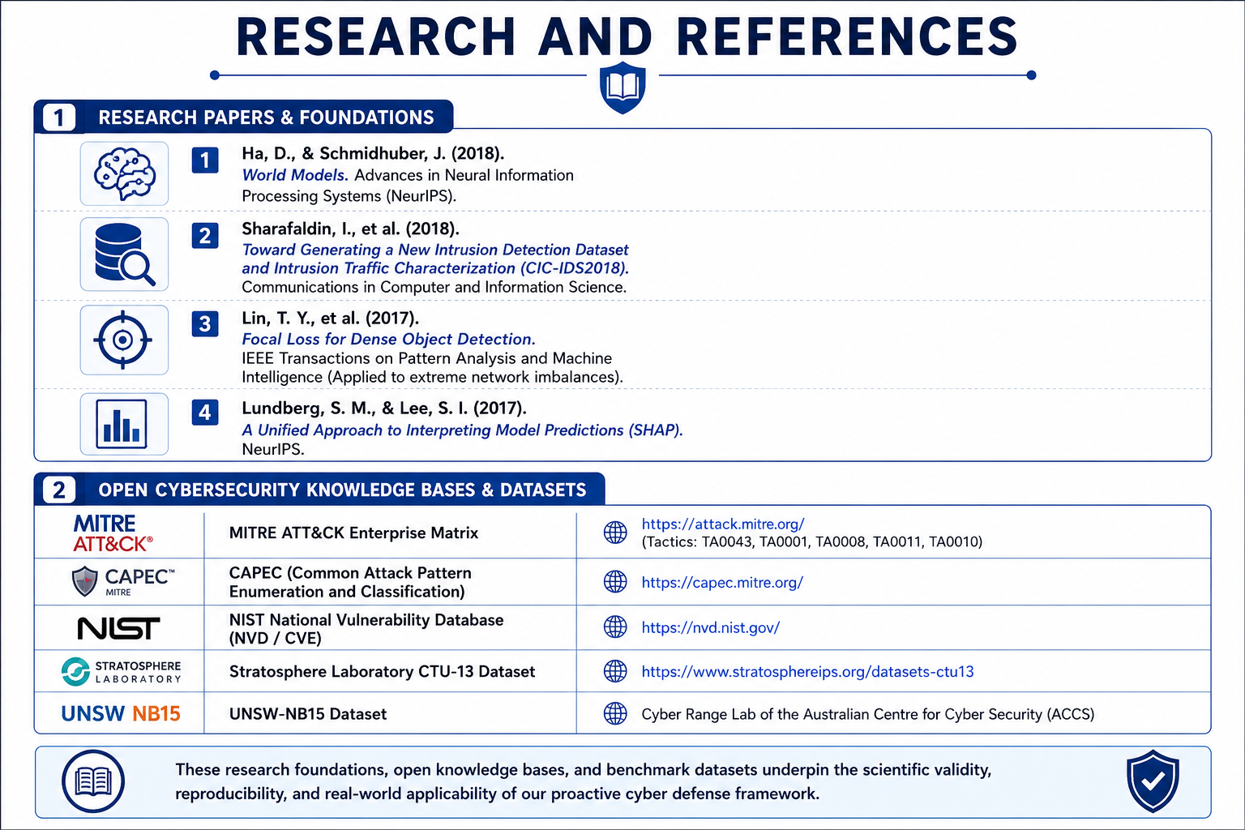
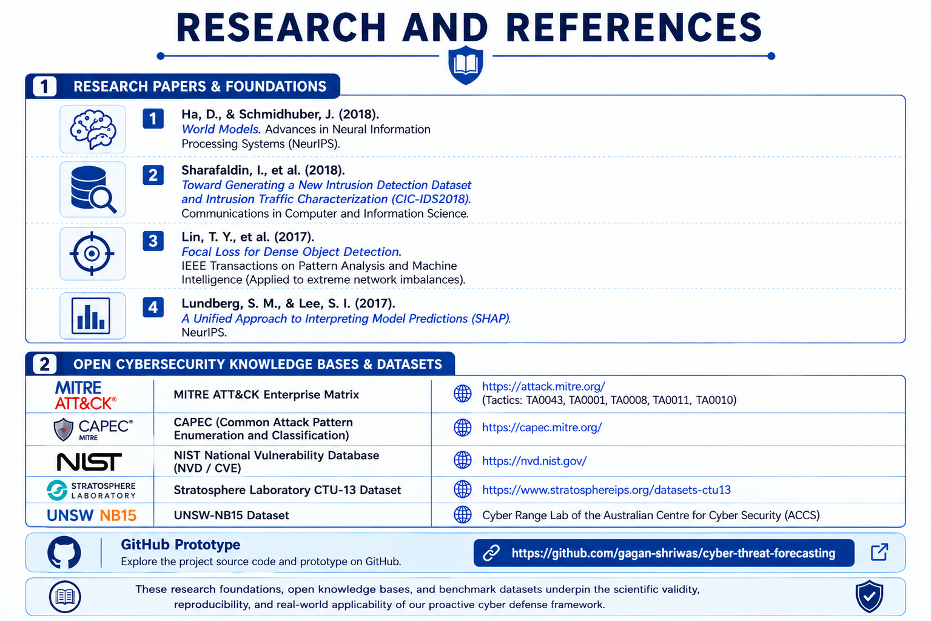
RESEARCH AND REFERENCES
https://attack.mitre.org/
https://capec.mitre.org/
https://nvd.nist.gov/
https://stratosphereips.org/datasets-ctu13
https://github.com/gagan-long/SIH2026-AI-Network-Attack-Forecaster-

