Slide 1

Predicting Loan Defaulters Using Machine Learning for Enhanced Risk Management
Submitted By: Akshay Goel
Ishika Bansal
Harshita Kaur Chugh
Yuvraj Rawat

Slide 2
Introduction
Loan defaulters are borrowers who fail to meet the repayment obligations of their loans as per the agreed schedule. Defaulting on a loan can occur when a borrower misses several payments or stops making payments entirely, often due to financial difficulties, loss of income, or mismanagement of funds. Loan defaults negatively impact the borrower's credit score and can lead to legal action, asset seizures, or other penalties. For financial institutions, loan defaults represent a risk of financial loss, which is why they carefully assess borrowers' creditworthiness before approving loans. We build models to analyze historical data, including features like income, credit score, debt-to-income ratio, and employment history, to predict whether a borrower will fail to repay a loan. Accurate predictions help financial institutions minimize risk and make informed lending decisions.

Slide 3
Problem Statement
The objective of this project is to develop a machine learning model capable of predicting loan defaults based on borrower characteristics, transaction history, and other relevant factors. This model aims to provide a more precise and interpretable evaluation of loan applicants, improving risk management and minimizing default rates. By utilizing algorithms such as Logistic Regression, Random Forest, and Gradient Boosting, the project will explore and compare the performance and interpretability of these models. The goal is to identify the most effective and accurate approach for predicting loan defaulters, ultimately enhancing the bank's decision-making process and mitigating financial risks.

Slide 4

Hardware & Software Used
Hardware Used
Windows Computer
Software/Code Editor Used
Google Colab
Libraries Used
Pandas
NumPy
Seaborn
Matplotlib
Sklearn

Slide 5
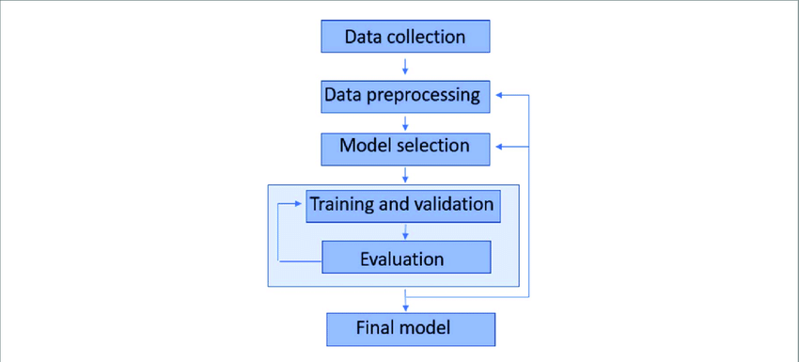
Proposed Work
Data Collection – A CSV files: train, test are used for this project.
Analyzing Data – Analyzing what kind of data we are dealing with.
Data Cleaning – Cleaning the data of any null values, if present.
Model Building – After analyzing and cleaning the data, we can build ML models.
Evaluating Performance Metrics of Models – Evaluating which ML model works best & tuning it.

Slide 6
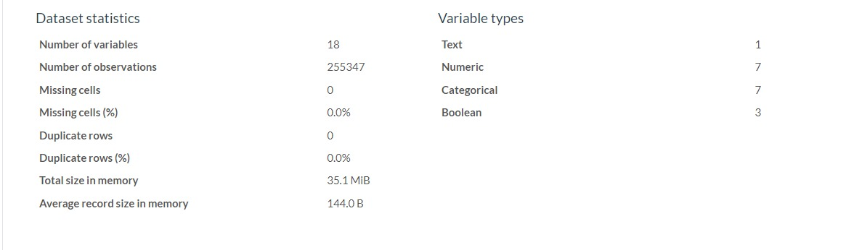
Data Cleaning
Data cleaning is a crucial step in data preprocessing. It involves identifying and handling inaccurate or inconsistent data. Key steps include:
Handling Missing Data: Replace missing values using the mean, median, or mode based on data type and distribution.
Outlier Detection: Use a box plot to visualize data spread and identify outliers, which appear as points outside the "whiskers."
Outlier Treatment: Address outliers by removing or transforming them to avoid skewing analysis results.
Standardization: Ensures data consistency for accurate modeling.
Efficient cleaning leads to better insights and model performance.

Slide 7
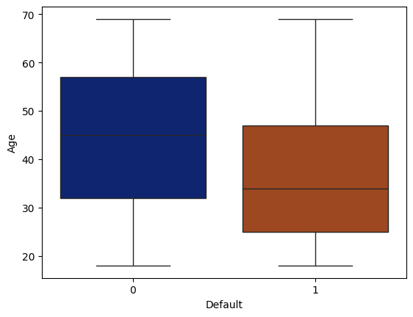
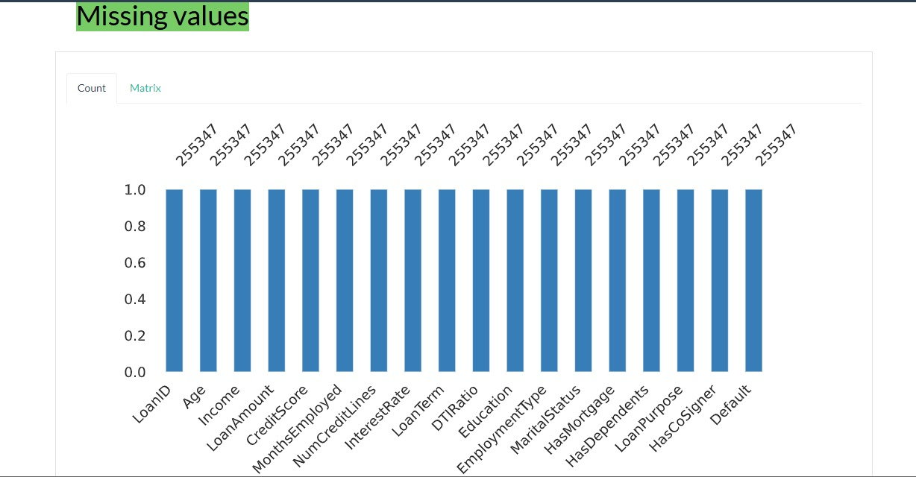
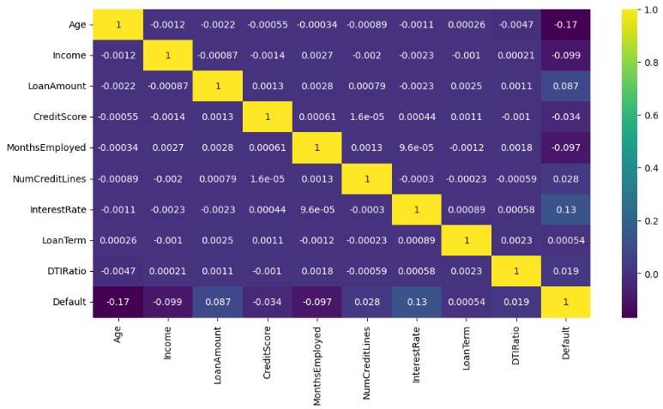
Data Insights

Slide 8
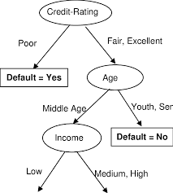

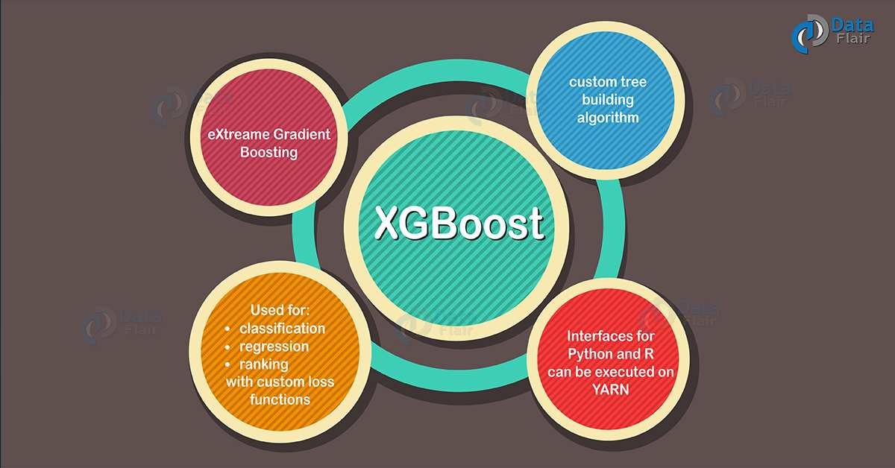
Models Build
Decision Tree
Random Forest
Gradient Boosting
AdaBoost
XgBoost

Slide 9
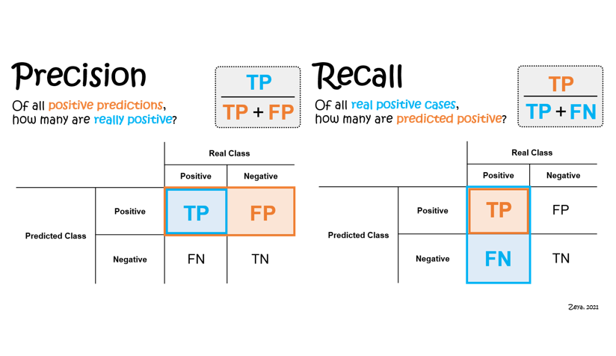
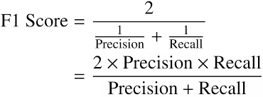
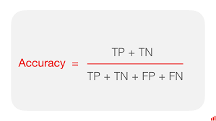
Metrics Used For Evaluation
F1 Score
Precision
Recall
Accuracy

Slide 10
Real-World Applications:
Loan Approval Decisions: Financial institutions can use the model to assess the creditworthiness of applicants, deciding whether to approve or reject loan applications based on the predicted risk of default.
Risk-based Pricing: Lenders can use the predictions to set personalized interest rates. Higher-risk borrowers (those more likely to default) may be charged higher interest rates, while lower-risk borrowers get better terms.
Personalized Offers: Lenders can use the predictions to tailor loan products to different customer segments, offering better terms to lower-risk individuals.

Slide 11
Thank You

