Slide 1
TDD Discussion

Slide 2
What is TDD ?
Test-driven development (TDD), also called test-driven design, is a method of software development in which unit testing is repeatedly done on source code.
The concept is to "get something working now and perfect it later.“
After each test, refactoring is done and then the same or a similar test is performed again.
The process is iterated as many times as necessary until each unit is functioning according to the desired specifications.
Test-driven development is part of a larger software design paradigm.

Slide 3
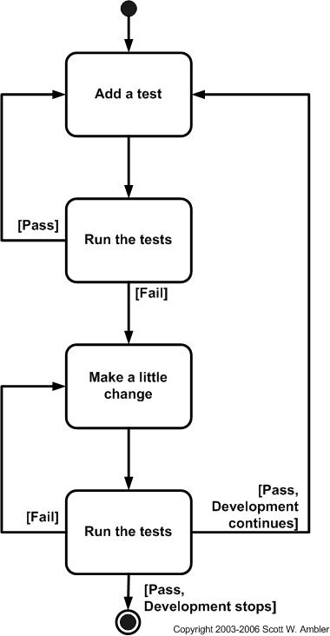
Introduction

Slide 4
Pros of Test-Driven Development
It can lead to simple, elegant, modular code.
It can help developers find defects and bugs earlier than they otherwise would. It’s a common belief that a bug is cheaper to fix the earlier you find it.
The tests can serve as a kind of live documentation and make the code much easier to understand.
It’s easier to maintain and refactor code, your own and other programmer’s code.
It can speed up development in the long-term.
It can encourage developers to think from an end user point-of-view.

Slide 5
Cons of Test-Driven Development
It require a lot of time and effort up front, which can make development feel slow to begin with.
It’s difficult to write good tests that cover the essentials and avoid the superfluous.
It takes time and effort to maintain the test suite – it must be reconfigured for maximum value.
If the design is changing rapidly, you’ll need to keep changing your tests. You could end up wasting a lot of time writing tests for features that are quickly dropped.

