Slide 1

INT-312 Big Data Fundamentals
Unit 5-Introduction To Hbase

Slide 2
CONTENTS
Introduction to Hbase Features of Hbase HBase Architecture Data Model in Hbase Read/Write Mechanism HBase Use Cases

Slide 3
Introduction To HBase
Open-source distributed NoSQL database
Built on Hadoop and HDFS
Modeled after Google Bigtable
Column-oriented storage system
Supports random real-time access
Scales to billions of rows

Slide 4
HBase vs RDBMS
HBase is schema-less NoSQL DB
RDBMS uses predefined table schemas
HBase handles large sparse datasets
RDBMS supports complex joins natively
HBase scales horizontally by regions
RDBMS scales vertically with hardware

Slide 5
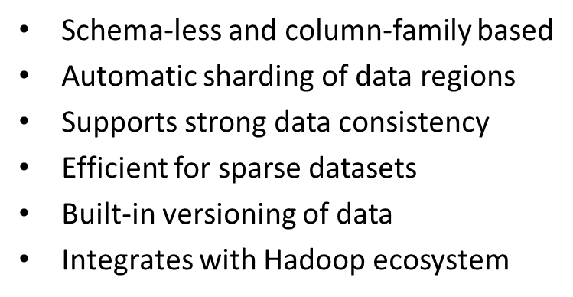
Features of HBase

Slide 6
HBase Architecture
HMaster controls region assignment
RegionServers manage data regions
ZooKeeper handles coordination tasks
Data stored in HDFS blocks
MemStore holds in-memory writes
HFiles store persistent data

Slide 7
Data Model in HBase
Data organized in tables
Rows identified by row keys
Columns grouped in families
Each cell has timestamp version
Columns can vary per row
Supports millions of columns

Slide 8
Read/Write Mechanism
Write-Ahead Log ensures durability
MemStore buffers recent writes
Data flushed to HFiles periodically
Reads check MemStore and HFiles
BlockCache stores frequently read data
Efficient scan and lookup operations

Slide 9
HBase Use Cases
Real-time analytics on big data
Sensor and IoT data storage
Time-series data processing
Social media data analysis
Clickstream behavior tracking
Log data management system

Slide 10
Real-World Use Cases
Facebook uses HBase for messages
Pinterest stores user feeds data
Adobe uses HBase for analytics
Flipkart uses it for transactions
Yahoo! logs clickstream in Hbase
HBase supports IoT time series

Slide 11
HBase Shell Commands
Use create to define tables
Insert data using put command
get retrieves data by row key
scan fetches table range data
delete removes data from HBase
Supports namespaces and descriptions

Slide 12
Advantages and Limitations
Highly scalable and distributed system
Supports massive data volumes
Strong consistency guarantees
Requires expert tuning efforts
Limited query and join support
Dependent on Hadoop infrastructure

Slide 13
THANK YOU

