Slide 1
Percentage
Lecture: 5

Slide 2
Contains:
Calculation of percentage
Percentage Comparison
Percentage to Fraction conversion
Problem based on marks

Slide 3
Percentage: Per means divided and cent means 100.
To convert any value on the base of hundred.
Conversion of percentage to fraction: To convert percentage to fraction, divide that percent value by 100.
E.G. 50% = 50/100 = ½
25% = 25/100 = ¼
Conversion of fraction to percentage: To convert fraction to percentage multiply the fraction by 100.
For e.g. 3/8 = (3/8)*100 = 37.5 %

Slide 4
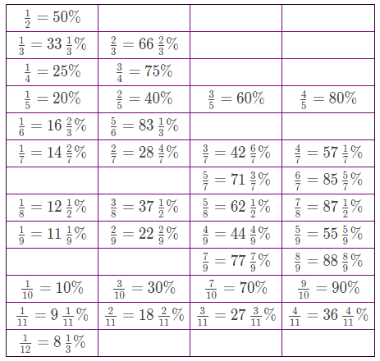

Slide 5
Let’s Practice.
Question : Find 55.55 % of 45.
Question : Find 45.45 % of 44

Slide 6
Conversion Percentage to Fraction
1. Convert 62.5% to a fraction.
2. Convert 28.56 % to a fraction.

Slide 7
3.Convert 130% to a fraction.
4. Convert 460% to a fraction.
5. Convert 133.33% to a fraction.

Slide 8
Q. If 16% of 40% of a number is 8, then find the number.
120
125
130
135

Slide 9
Q. What percentage of 2/7 is 1/35 ?
10%
20%
25%
none

Slide 10
Q. 16.66% of 300.
50
75
30
18.88

Slide 11
X % of Y = Y% of X
Question : Find 45% of 133.33
Answer : 45% of 133.33 = 133.33 % of 45
= (100+33.33)% of 45
= (1+1/3) * 45
= 4/3 * 45
= 60

Slide 12
Percentage Comparison
40 is what percentage of 60?
60 is how much percentage greater than 40?
40 is how much percentage lesser than 60?

Slide 13
Question : If A’s salary is 20 % more than B, then by how much Percentage B’s salary is less than A.
20%
25%
16.66%
30%

Slide 14
Question : If A’s marks in an exam is 40 % less than B then by how much % B’s marks are more than A.
40 %
60 %
66.66 %
20 %

Slide 15
Question : If 16(2/3) % of a number is added to itself the number becomes 700. Find original number.
400
600
800
700

Slide 16
Question: A student multiplied a number by 3/5 instead of 5/3 What is the percentage error in the calculation? (a) 44% (b) 64% (c) 40% (d) 60%

Slide 17
Question: The number was being multiplied by 5/6. By mistake it is divided by 5/6. Find percentage error in result. (a) 44% (b) 64% (c) 40% (d) 60%

Slide 18
Problem based on Marks

Slide 19
Question : A student scored 140 Marks and still failed by 35 marks. If the passing criteria of that exam is 35%. Then find the maximum marks of that exam.
500
600
1000
700

Slide 20
Question : A student scored 25 % in an examination and still failed by 30 marks while another candidate scored 50% marks and get 20 marks more than the passing marks. Then find the passing percentage.
30 %
40 %
45 %
50 %

Slide 21
Question: In an Exam, 52% candidates failed in English, 42% in mathematics and 17% in both. What was the number of percentage of passed students in both subjects?
(a) 23
(b) 77
(c) 6
(d) 94

Slide 22


