Slide 1

Lecture: 9
Simple Interest and Compound Interest

Slide 2
Contains:
Concept of interest calculation.
comparison of simple and compound interests
compounding based problem on depreciation and growth.

Slide 3
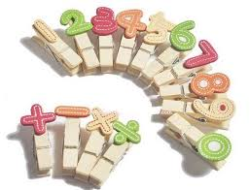
Simple Interest:
Let Principal = P, Rate = R% per annum (p.a.)
and Time = T years. Then
Simple Interest =(P x R x T)/100
Rate: (interest x 100)/(PXT)%
Time: (Interest X 100)/PXR years

Slide 4
Principal
The money borrowed or lent out for a certain period is called the principal or the sum.
Interest
Extra money paid for using other's money is called interest.
Simple Interest
If the interest on a sum borrowed for certain period is reckoned uniformly, then it is called simple interest.

Slide 5
Question: If P= Rs.1000, R=10% p.a. T=3 years. Find Simple Interest for 3 years.

Slide 6
Compound Interest:
Compound interest is the interest earned not only on the original principal, but also on all interests earned previously
Let Principal = P, Rate = R% per annum, Time = n years.
When interest is compounded Annually:
Amount= P(1+R/100)^n
2. When interest is compounded Half-yearly:
Amount=P[1+(R/2)/100]^2n
3. When interest is compounded Quarterly:
Amount=P[1+(R/4)/100]^4n

Slide 7
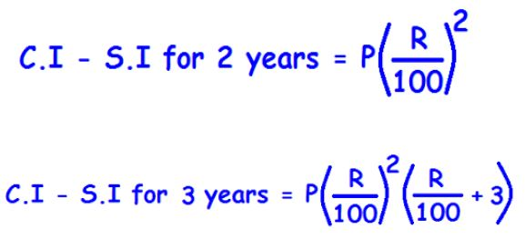

Slide 8
Question: Reena took a loan of Rs. 1200 with simple interest for as many years as the rate of interest. If she paid Rs. 432 as interest at the end of the loan period, what was the rate of interest?
[A] 3.6
[B] 6
[C] 18
[D] Can not be determined

Slide 9
Question: The interest for the 3rd year on a certain sum at a certain rate of simple interest is Rs.3000. find the sum of the interests accrued on it in the 6th, 7th and 8th years.
[A] Rs.6000
[B] Rs.9000
[C] Rs.4500
[D] Rs.12000

Slide 10
Question: A sum was invest for 2 years. It will give Rs. 300 more, if invested at 3% higher rate. Find the sum.
[A] Rs.4000
[B] Rs.5000
[C] Rs.6000
[D] Rs.10000

Slide 11
Question: A sum amounts to Rs.1008 in 2 years and amounts to Rs.1112 in 3 years at SI. Find the sum and rate of interest per annum.
[A] Rs.800, 13% pa
[B] Rs.600, 12 % pa
[C] Rs.800, 12% pa
[D] Rs.600, 13% pa

Slide 12
Question: A shopkeeper borrow Rs. 20,000 from two money lenders. For one loan, he paid 12% pa and for other 14% pa. After one year he paid Rs. 2560 as total interest. How much did he borrow each?
[A] Rs.8000, Rs.12000
[B] Rs.12000, Rs.8000
[C] Rs.6000, Rs.14000
[D] Rs.14000, Rs.6000

Slide 13
Question: Rs. 950 is lend in two ways. The rate of S.I given on one part is 6% and on other part is 4%. If the S.I of 5 years is Rs. 200 then how much is given on 6%?
[A] Rs.500
[B] Rs.400
[C] Rs.200
[D] Rs.100

Slide 14
Question: If a sum of money at simple interest doubles in 6 years, it will become 4 times in:
[A] 12 years
[B] 14 years
[C] 16 years
[D] 18 years

Slide 15
Question: If P= Rs.1000, R=10% p.a. T=3 years. Find Compound Interest for 3 years.

Slide 16
Question: Find the interest earned in the first year on Rs.400 at 20%p.a. compound interest, the interest being compounded half yearly.
[A] Rs.42
[B] Rs.72
[C] Rs.84
[D] Rs.144

Slide 17
Question: Find CI. If P= Rs. 10000, r = 10 % p.a. and T= 1 year and 73 days.
[A]Rs.2220 [B] Rs.3200
[C] Rs.2120
[D] Rs.1220

Slide 18
Question: Find C.I. on Rs. 8000, 20% P.A. For 9 month compounded quarterly.
[A] Rs.262
[B] Rs.1261
[C] Rs.9261
[D] Rs.831

Slide 19
Question: If Rs.2000 amounts to Rs.2880 in 2 years at compound interest, what is the rate of interest per annum if the interest is being compounded annually?
[A] 10%
[B] 20%
[C] 15%
[D] 25%

Slide 20
Question: What will be the difference between the S.I and C.I. On Rs. 600 for one year at 10% P.A, if compounded half yearly.
[A] Rs.1.5
[B] Rs.15
[C] Rs.3.5
[D] Rs.35

Slide 21
Question: If the difference between S.I and C.I at 4% P.A for 2 years is 20 Rs. What will be the value of principle amount?
[A] Rs.50000
[B] Rs.12000
[C] Rs.12500
[D] Rs.25000

Slide 22
Question: The difference between C.I and S.I at the some rate for Rs. 5000 for 2 years is Rs. 72. what is the rate of interest per annum?
[A] 6% pa
[B] 10% pa
[C] 12% pa
[D] 15% pa

Slide 23
Question: A sum doubles in 8 years at compound interest. In how many years will the sum become 4 times the original sum if the interest is compounded annually?
[A] 16 years
[B] 24 years
[C] 64 years
[D] 32 years

Slide 24
Question: A sum of money under compound interest doubles itself in 4 years. In how many years will it become 16 times itself?
[A] 12 years
[B] 16 years
[C] 8 years
[D] None of these

Slide 25


