Slide 1






Slide 2
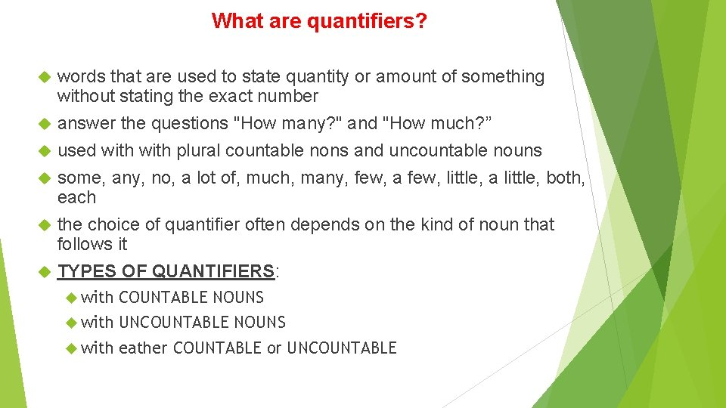

Slide 3
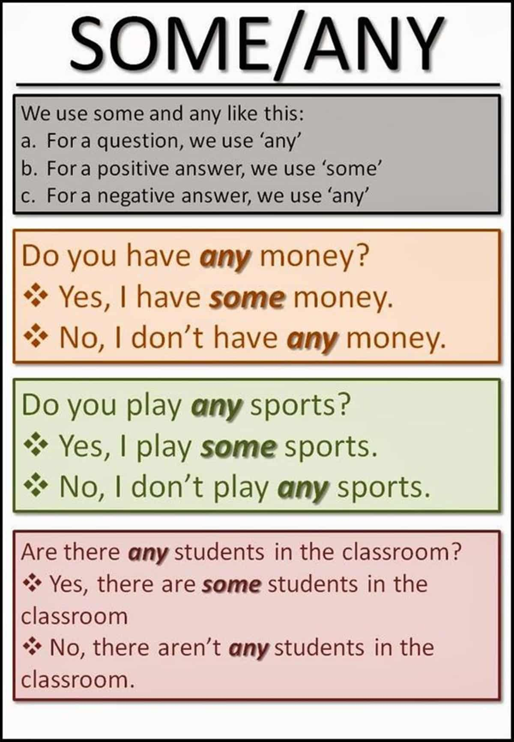

Slide 4
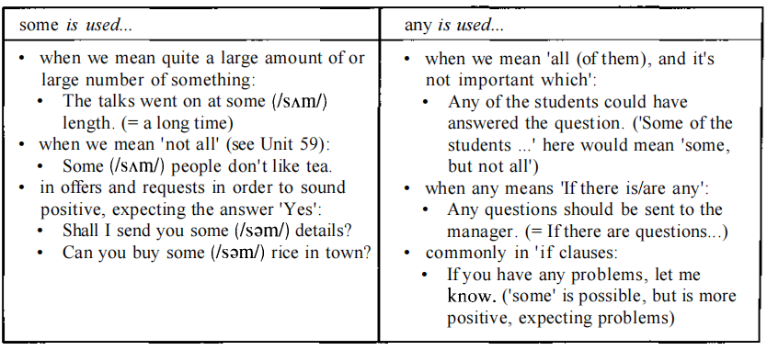

Slide 5
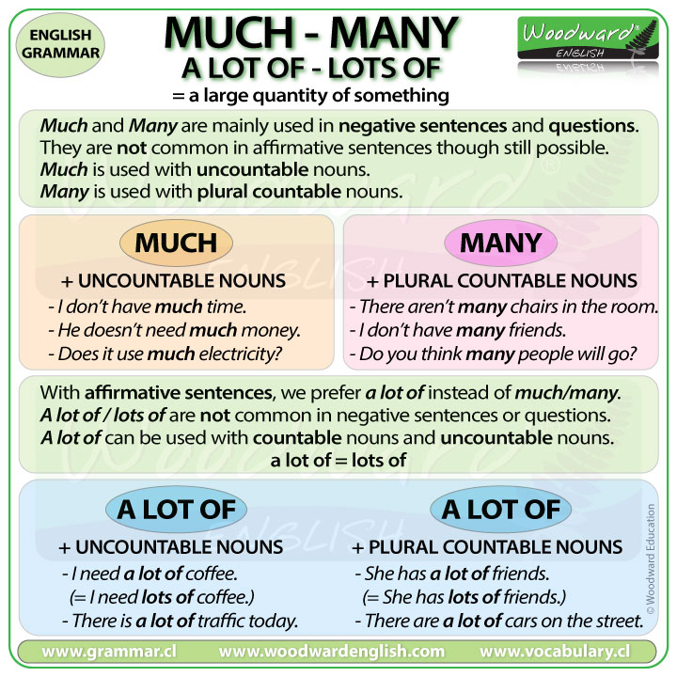

Slide 6
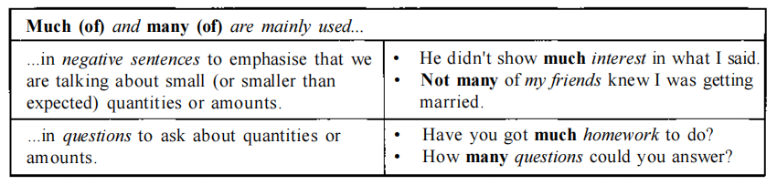
y)
USE OF MUCH(of) AND MANY(of)

Slide 7
a lot of, lots of, or plenty of
a lot of, a lots of, or plenty of are used to talk about large
amounts and quantities, particularly in conversation and informal writing.
e.g.
We had plenty of hotels to choose from, ('many hotels' is more formal)
I've given the problem a lot of thought, ('much thought' is very formal)
John offered me a lot of money for the car. {not much money)
.

Slide 8
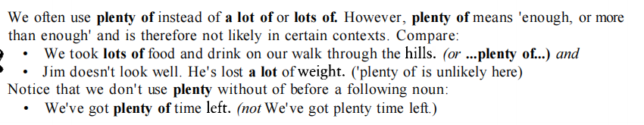
plentyVs a lot of
Plenty of Vs A lot of/lots of

Slide 9
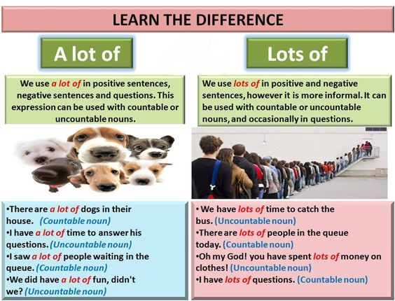

Slide 10
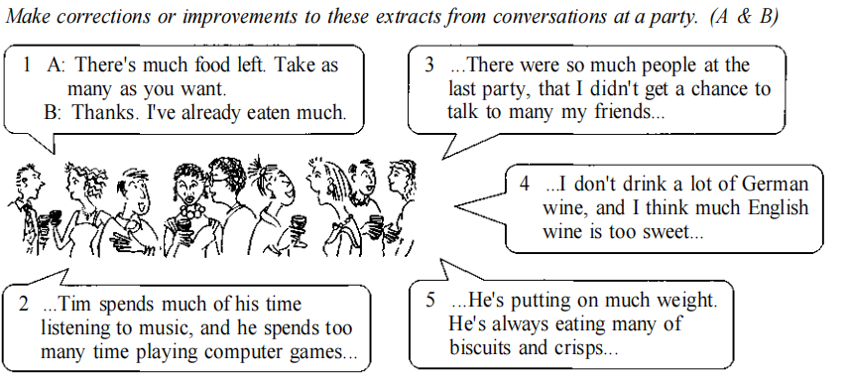
ACTIVITY

Slide 11
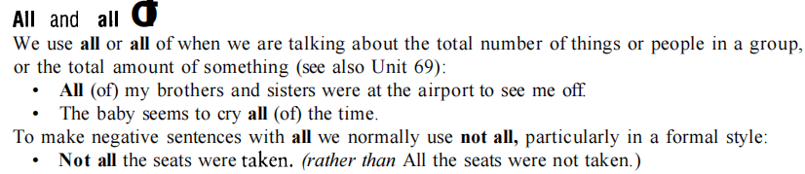
All (of), the whole (of), both (of )

Slide 12
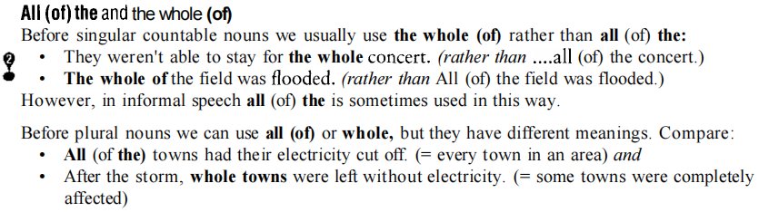


All (of) the and the whole (of)

Slide 13
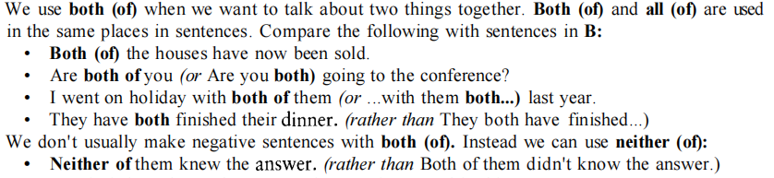
Both (of) and all (of)

Slide 14
Correct the sentences, if necessary
1. All the children didn't come.
2 Many, if none of the students, could speak English fluently.
3 Almost all his spare time is spent working in the garden.
4 Both of us didn't speak again until we had reached home.
5 Everything depends on the last match of the football season.
6 Mrs Lee and Mr Pointer, them both teachers, are standing as candidates in the next election.
7 Many people suffer side-effects from taking the drug. However, these not all are bad.
8 I'm afraid neither answer is correct. Try again.
9 All at the meeting voted for Terry.

Slide 15
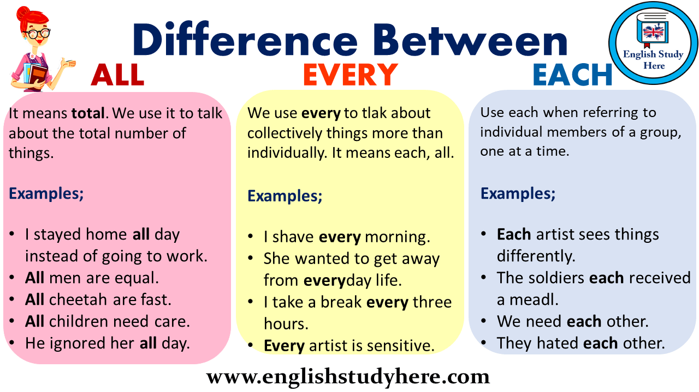

Slide 16
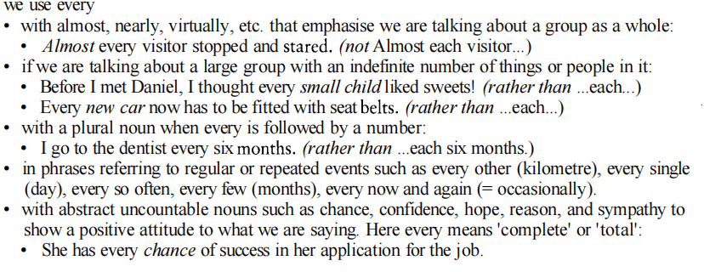
USE OF ‘EVERY’

Slide 17
USE OF EACH
We use EACH
if we are thinking about the individual members of the group
when we are talking about both people or things in a pair:

Slide 18
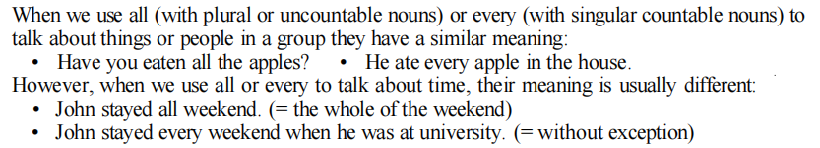
USE OF ‘ALL or EVERY’

Slide 19
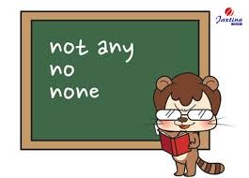

Slide 20
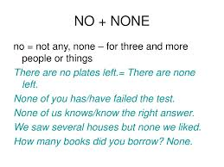

Slide 21
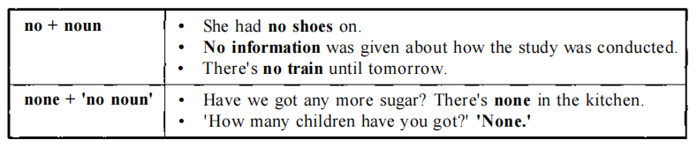

Slide 22
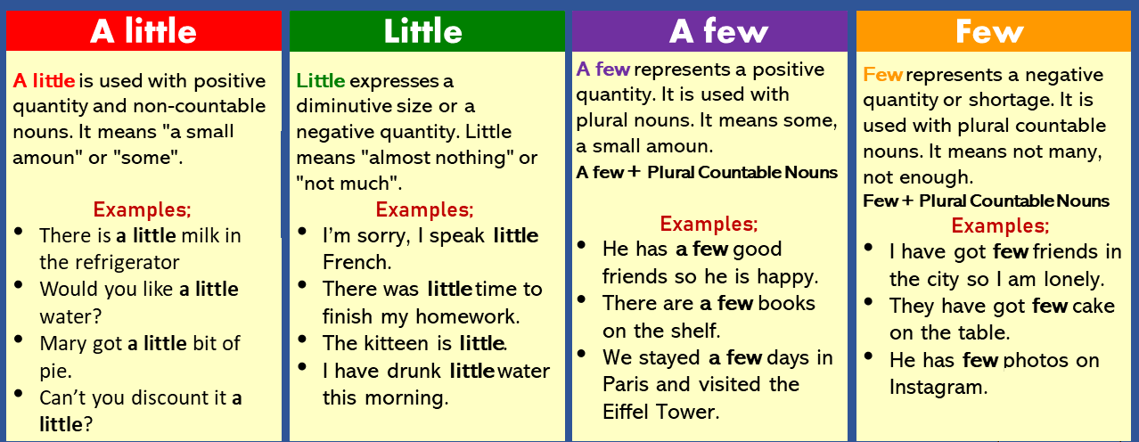
Uses of Few, a few (of), little, a little (of)

Slide 23
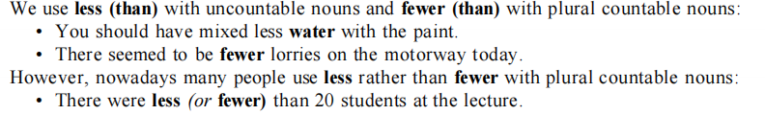
Less (than), and fewer(than)

Slide 24
With or without “of”
Quantifier | without of | with of
some | I made some fresh coffee and handed a cup to Adam | Some of my jewellery is missing
any | Don't pay any attention to what she says. | Have you seen any of these new light bulbs in the shops yet?
much | She did the job, but without much enthusiasm. | Snow is now covering much of the country.
many | Many talented young scientists are moving to Australia. | She gave many of her best paintings to her friends.
both | Both Alice and Tim enjoy cycling. | Both of my parents are teachers.

Slide 25
Quantifier | without of | with of
all | All people over 18 are required to vote. | All of Bob's closest friends were women
each | He wrote down the cost of each item in his shopping basket. | Each of you should sign the register before you leave.
none | She searched the shelves for books on yoga, but could find none. | I tried on lots of coats but none of them fitted perfectly.
few | There was silence for a few seconds, and then she began to speak. | They had a few of their friends round.
little | It'll take a little time, but I should be able to mend it. | Little of his money came from his parents.

Slide 26


