Slide 1
Tense
Week 2_PEL125

Slide 2
Use of Will and going to
Will /going to + infinitive are commonly used to talk about the future.
e.g. • John'll / John's going to meet us in the restaurant at 8 o'clock.
Will you / Are you going to come back this evening? However, going to is preferred in spoken English (where it is often pronounced /дэпэ/) and will is preferred in formal written
English.

Slide 3
We use Going to when we PREDICT that something will happen in the future because we have some evidence for it now.
e.g. Did you know that Bob and Kath are going to get married?
We use Will if prediction is based on our opinion or our past experience we use will:
e.g. Why not come over at the weekend? The children will enjoy seeing you again.

Slide 4
When we talk about INTENTIONS or DECISIONS about the future that were made some time before we report them, we prefer going to or the present continuous .
e.g. 'Who's arranging the party?' 'Jo's going to do it.'
When we state a decision made at the moment of speaking, we prefer will:
e.g. 'Is that the phone?"Don't worry. I'll get it.'

Slide 5
We can use will or going to in the main clause of an if-sentence when we say that something (often something negative) is conditional on something else - it will happen if something else happens first:
e.g. If we go on like this, we'll / we're going to lose all our money.
We use will (or another auxiliary), not going to, when we describe a future event that follows another.
e.g. If you move to your left, you'll (or may) be able to see the church.

Slide 6
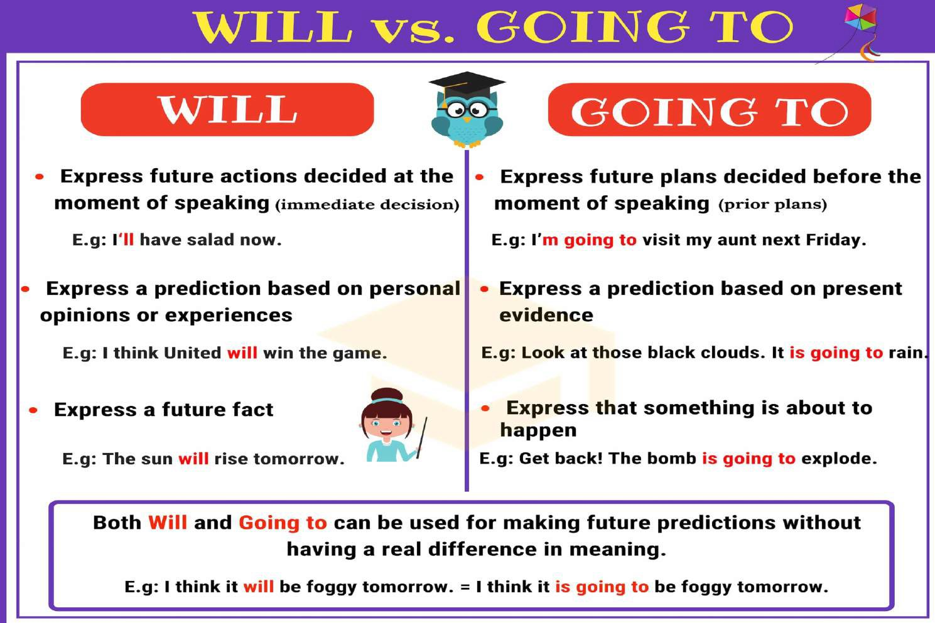

Slide 7
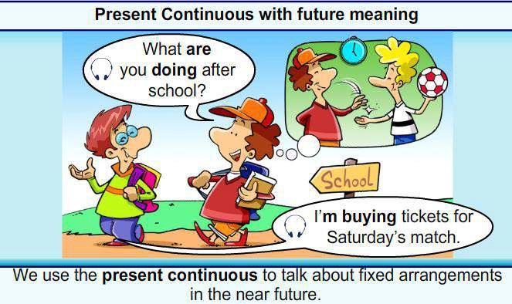

Slide 8
When we talk about an INTENTION to do something in the future, where no definite arrangement has been made, we prefer going to.
e.g I'm still not feeling very well, so I think I'm going to see the doctor some time this week. (Indefinite arrangement)
When we talk about a DEFINITE ARRANGEMENT, we prefer the present continuous.
e.g. We're having a party on Sunday, 12th November. Can you come? (Definite arrangement)

Slide 9
We don't use the present continuous for the future:
when we make or report predictions about activities or events over which we have no control
e.g. I think it's going to rain / '11 rain soon, (not I think it's raining soon.)
when we talk about permanent future situations
e.g. People are going to live / will live longer in the future, (not
...are living...)
with the verb be
e.g. I'm going to be in Tokyo in May. (not I'm being in Tokyo...)

Slide 10
Going to+go OR Be +going
We tend to avoid going to + go and use the present continuous form of go instead:
e.g.
I'm going to town on Saturday, (rather than I'm going to go to town...)
Alice is going to university next year, (rather than ...is going to go to university...)

Slide 11
Uses of Present Simple for Future
We use the present simple when we talk about future events that are part of some definite arrangement such as a timetable or programme or activity.
e.g.
Their plane arrives at 2 o'clock in the morning.
I'm away on holiday next week. Can we meet the week after?
The sun rises at 5.16 tomorrow

Slide 12
We use the present simple to refer to the future in adverbial clauses introduced by time conjunctions such as after, before, when, and until
and in conditional clauses with if, unless, in case, and provided.
e.g.
Wait here until I call you
Provided the right software is available, I should be able to solve the problem.
I'll bring a compass in case we get lost.

Slide 13
We use the present simple in that- and wh/-clauses when both the main clause and the that- /wh-clause refer to the future.
e.g.
I'll let you know when she gets here, (not ...when she will get here.)

Slide 14
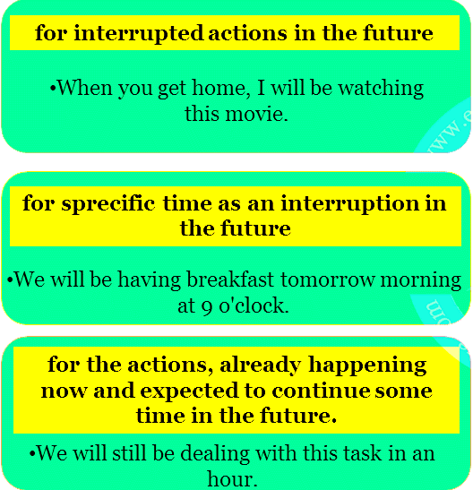

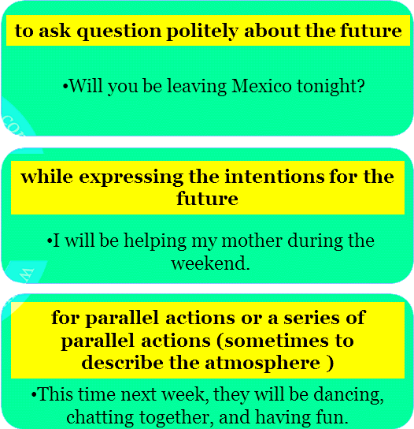

Slide 15
Future continuous and present continuous for the future
We can often use either the future continuous or the present continuous when we talk about planned activities or events in the future
e.g.
We will be leaving / are leaving for Istanbul at 7.00 in the evening.
But we prefer the present continuous to talk about surprising or unexpected activities or events:
e.g Have you heard the news? Dr Radford is leaving! (rather than ...will be leaving.)

Slide 16
Be to +infinitive
Be to + infinitive is used to talk about formal or official arrangements, formal instructions, and to give orders. It is particularly common in news reports to talk about future events.
e.g.
We don't know where the meteorite is going to land, (not ...the meteorite is to land.)
I suppose we will all die eventually, (not ...we are all to die...)

Slide 17
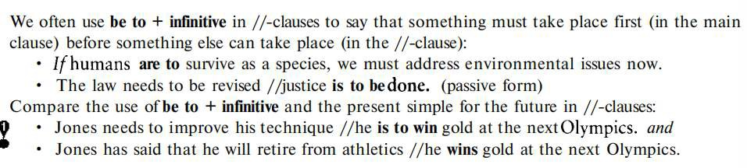

Slide 18
Future perfect
We use the future perfect to say that something will be ended, completed, or achieved by a particular point in the future
e.g.
Let's hope the volcanic eruption will have finished before we arrive on the island.
Although people are now angry about what he did, I'm sure that his behaviour will soon have been forgotten. (= passive form)
By the time you get home I will have cleaned the house from top to bottom.

Slide 19
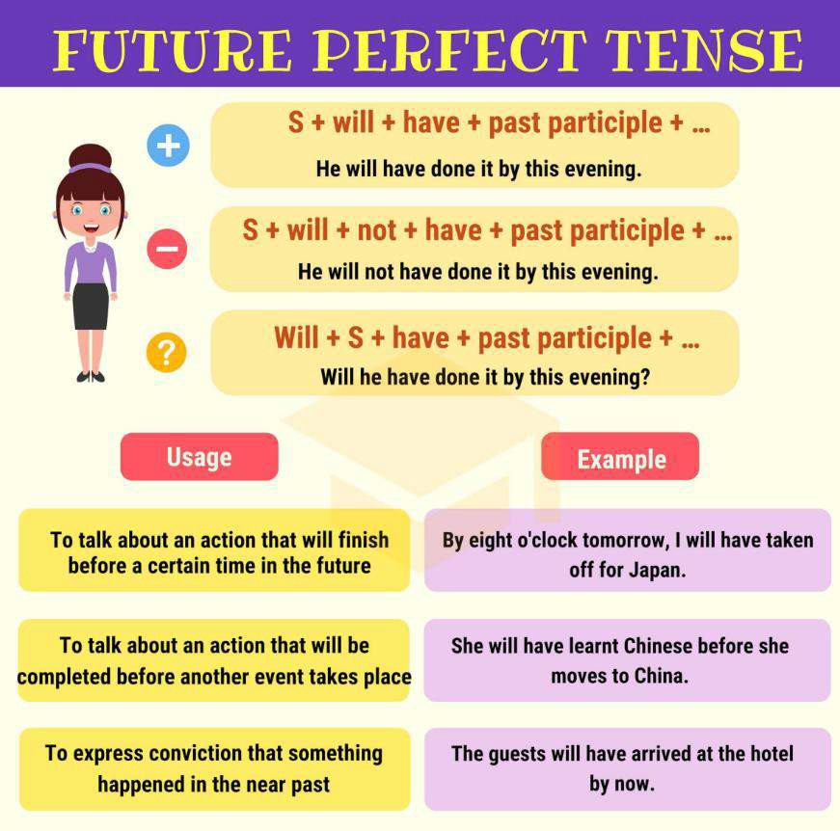

Slide 20
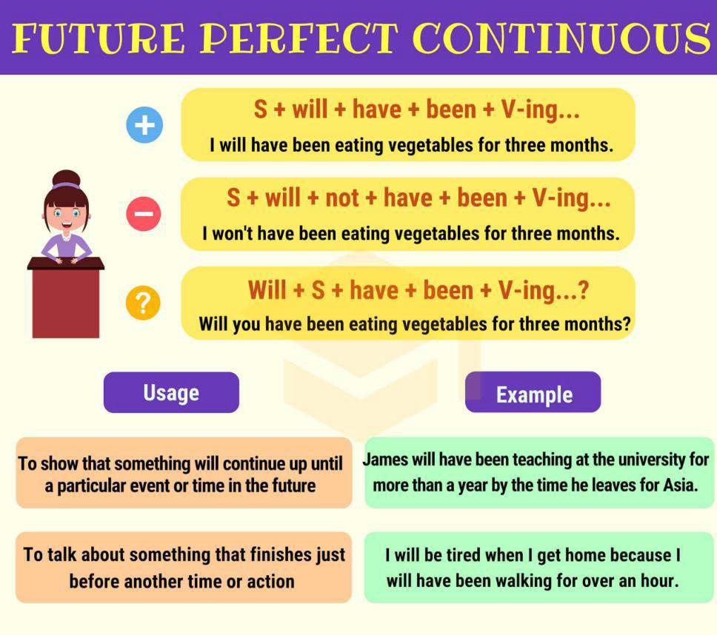

Slide 21
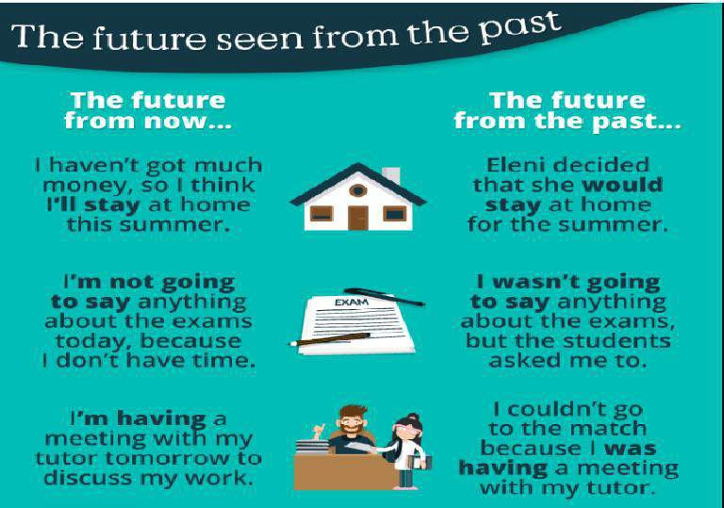

Slide 22
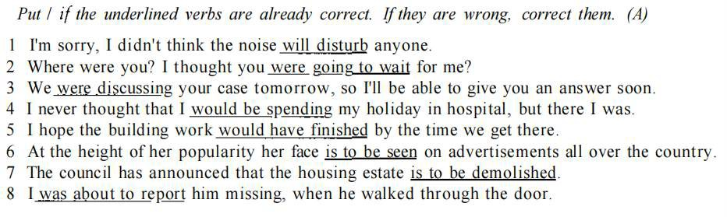

Slide 23


