Slide 1
Forming Passive sentences
Week 4

Slide 2

Verbs and Voice
Voice is the form a verb takes to indicate whether the subject of the verb performs or receives the action.
There are two types of voice: active voice and passive voice.

Slide 3
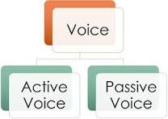

Slide 4
Active Voice
Active Voice – indicates that the subject of the verb is acting
Because the subject does or "acts upon" the verb in such sentences, the sentences are said to be in the active voice.

Slide 5
Active Voice
These examples show that the subject is doing the verb's action.
The leopard is chasing the antelope.
The leopard (subject) is doing the chasing (verb).
Kristy will give a book report to the class.
Kristy (subject) is doing the giving (verb).
The computer ate my paper.
The computer (subject) is doing the eating (verb).

Slide 6
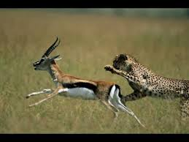
The leopard is chasing antelope

Slide 7
Passive Voice
In a passive voice sentence, the subject and object flip-flop. The subject becomes the passive recipient of the action.
Because the subject is being "acted upon" (or is passive), such sentences are said to be in the passive voice.

Slide 8
Passive Voice
These examples show the subject being acted upon by the verb.
The boy was jumped on by the dog.
Boy (subject) was being jumped on (verb)
A book report will be given by Kristy to the class.
Report (subject) will be given (verb).
My paper was eaten by the computer.
Paper (subject) was being eaten (verb).

Slide 9
Reasons to Use the Active Voice
We prefer to use active voice because it is more direct.
Compare
Active: The waiter dropped the tray of food.
Passive: The tray of food was dropped by the waiter.

Slide 10
Reasons to Use the Active Voice
The active voice is less awkward and clearly states relationship between subject and action.
Compare
Passive: Your request for funding has been denied by the review committee.
Active: The review committee denied your request for funding.
The active voice sentence pattern propels the reader forward through your writing thus avoiding weak prose.

Slide 11
When to Use Passive Voice
Emphasizing the action or receiver
When the doer is unknown or less important
Example: "The experiment was conducted by scientists."

Slide 12
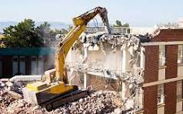
Transitive verbs can have a passive form
• They destroyed the building. «—• The building was destroyed

Slide 13
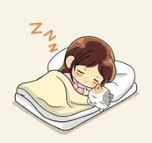
Intransitive verb can’t have passive forms.
For e.g.
I slept for nearly ten hours last night.

Slide 14
Double object
Verbs that can be followed by either
object + object or
object + prepositional object in active clauses
It can have two corresponding passive forms.

Slide 15
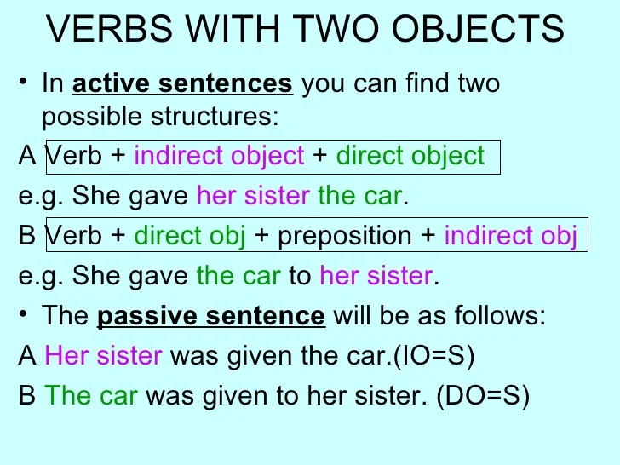

Slide 16
Form of Passive Voice Verbs
Writers should be familiar with the forms of "to be" , often called linking verbs, so that they can easily identify the passive voice in their work.
the forms of "to be":
am, is, are, was, were, be, being, been

Slide 17
Form of Passive Voice Verbs
Note the forms of "to be" in the examples of the verb "to kick" in various forms of the passive voice:
is kicked----------------had been kicked was kicked-------------is going to be kicked is being kicked---------will be kicked has been kicked-------can be kicked was being kicked------should be kicked

Slide 18
Form of Passive Voice Verbs
Often passive voice sentences will contain a "by" phrase indicting who or what performed the action.
Passive sentences can be easily transformed into active sentences when the object of the preposition "by" is moved to the subject position in the sentence.

Slide 19
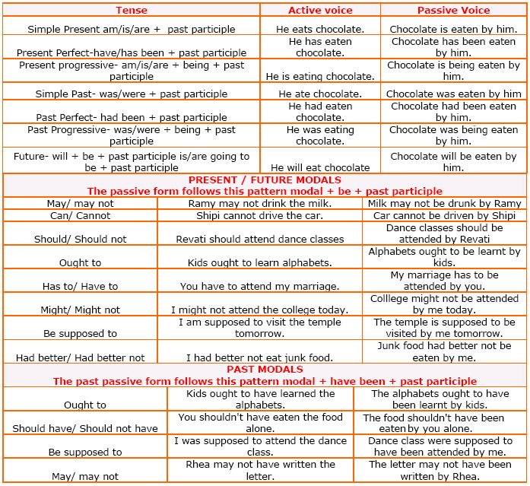

Slide 20
Let’s Practice
Directions: Change the sentences below to the active voice.
The statue is being visited by hundreds of tourists every year.
My books were stolen by someone yesterday.
These books had been left in the classroom by a careless student.
Coffee is raised in many parts of Hawaii by plantation workers.
The house had been broken into by someone while the owners were on vacation.

Slide 21
Let’s Practice
Directions: Change the sentences below to the passive voice.
Children cannot open these bottles easily.
The government built a road right outside her front door.
Mr. Ross broke the antique vase as he walked through the store.
When she arrived, the changes amazed her.
The construction workers are making street repairs all month long.

Slide 22


