Slide 1

NLP PROJECT: Resume Parsing System
NAME: T GAGAN KUMAR REDDY
REG NO:192110071
DEP:CSE
SUBJECT:THEORY OF COMPUTATION
COURSE CODE:CSA1337

Slide 2
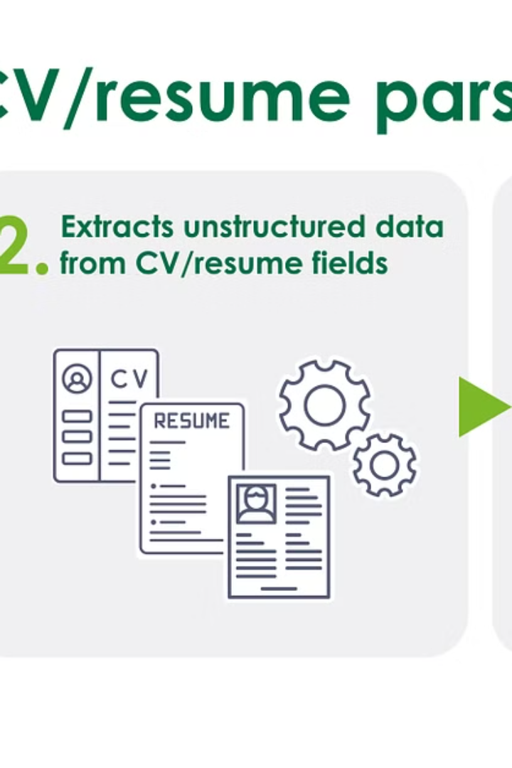
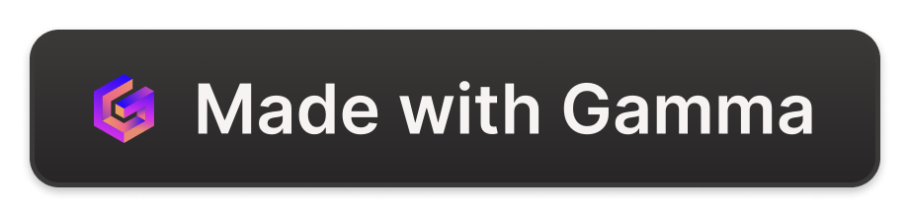
Introduction to Resume Parsing System
Unlock the power of AI-driven resume parsing to streamline your hiring process. Our cutting-edge system extracts key candidate data with unparalleled accuracy, empowering you to make informed decisions and build high-performing teams.

Slide 3
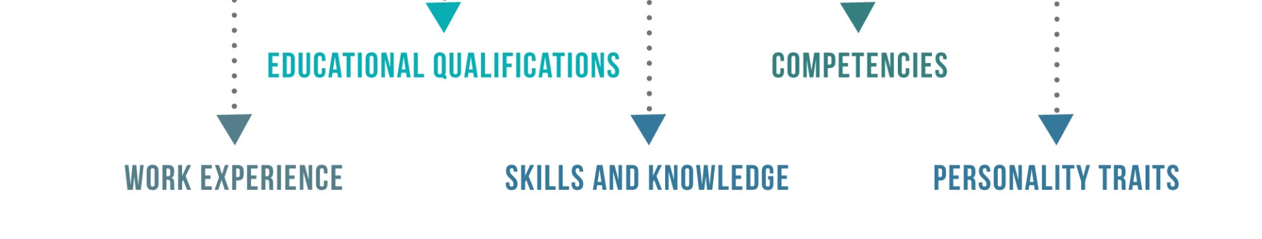
NLP Fundamentals
Understand the core concepts of natural language processing (NLP), including text analysis, semantic understanding, and language generation.
Explore key NLP techniques such as tokenization, part-of-speech tagging, named entity recognition, and sentiment analysis.
Gain knowledge of deep learning architectures, including recurrent neural networks and transformer models, and their application in NLP tasks.

Slide 4
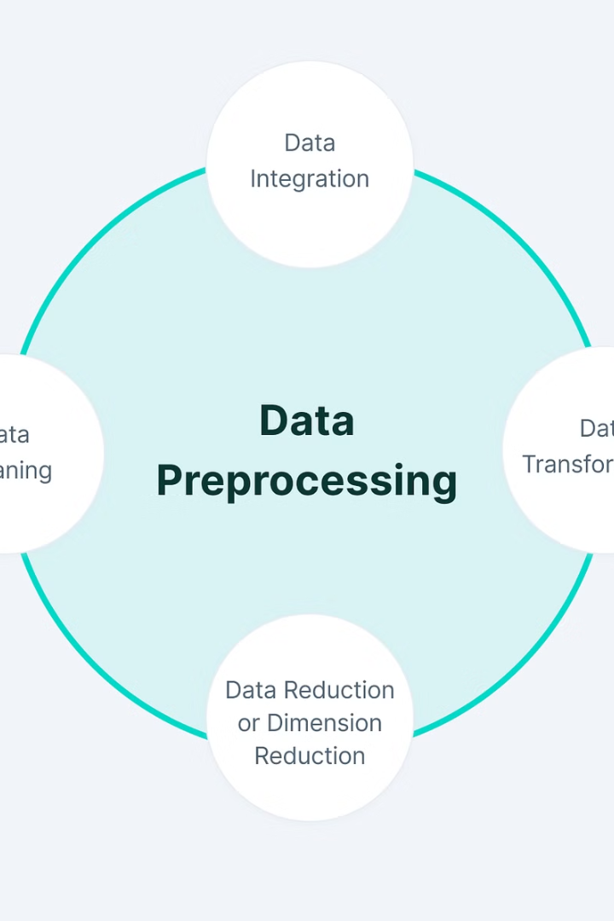
Data Preprocessing
Effective data preprocessing is crucial for accurate resume parsing. This stage involves cleaning, formatting, and structuring the raw resume data to prepare it for information extraction.
Key steps include removing irrelevant content, standardizing formats, handling missing/noisy data, and segmenting the resume into logical sections like contact info, work history, and skills.

Slide 5
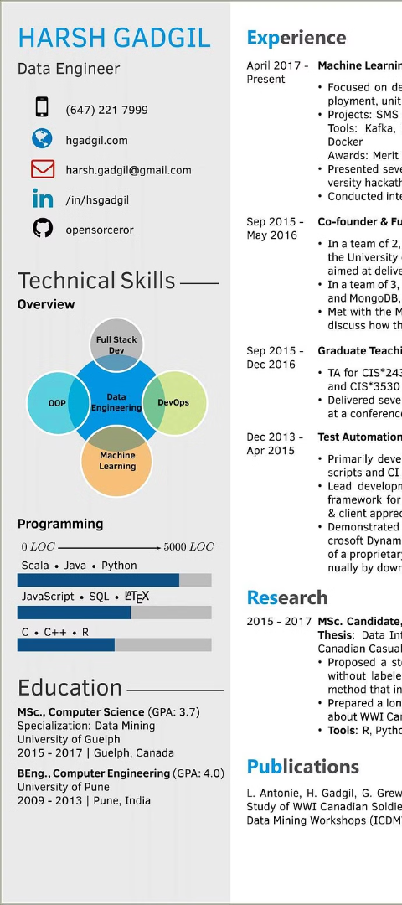
Information Extraction Machine Learning Integration
1
Information Extraction
Leveraging natural language processing techniques to extract relevant information from resumes, such as work history, skills, and education.
2
Machine Learning Models
Applying supervised and unsupervised learning algorithms to classify resume data and identify patterns for effective candidate matching.
3
Integrated Workflow
Seamlessly integrating the resume parsing and machine learning components to provide a streamlined and automated recruitment process.

Slide 6
Implementation Strategies
Pilot Testing
Iterative Improvements
Change Management
Scalability
Begin with a pilot implementation, testing the resume parsing system on a small subset of job applicants. This allows for fine-tuning and optimization before full-scale deployment.
Design the system to handle growing volumes of resumes and applications as the business expands. Leverage cloud-based infrastructure for scalable processing power and storage.
Continuously monitor the system's performance and gather feedback from users. Make incremental updates to enhance accuracy, efficiency, and user experience over time.
Develop a comprehensive change management plan to ensure seamless transition and adoption of the new resume parsing system across the organization.

Slide 7




Integration with Applicant Tracking Systems
Streamlined Integration
Automated Workflows
Data Synchronization
Flexible Integrations
Seamlessly integrate the resume parsing system with leading Applicant Tracking Systems (ATS) to automate data extraction and candidate evaluation.
Leverage the parsing system to power efficient candidate screening, scheduling, and communication workflows within the ATS.
Ensure real-time updates and consistent data across the resume parsing system and the ATS for a seamless end-to-end hiring process.
Build custom integrations to adapt the resume parsing system to the unique requirements and configurations of different Applicant Tracking Systems.

Slide 8
Future Enhancements and Roadmap
Enhance Accuracy
1
Leverage advanced NLP models and techniques
Expand Integrations
2
Connect with more Applicant Tracking Systems
Personalization
3
Tailor resume parsing to individual client needs
Automation
4
Streamline the end-to-end hiring process
As we look to the future, our resume parsing system roadmap is focused on continually enhancing the accuracy of our information extraction, expanding our integrations with leading Applicant Tracking Systems, offering personalized solutions to meet the unique needs of our clients, and automating more of the hiring workflow to drive efficiency and productivity.

Slide 9
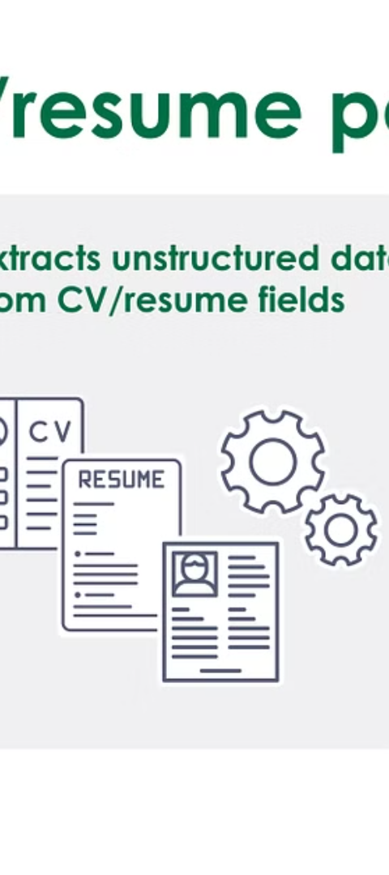
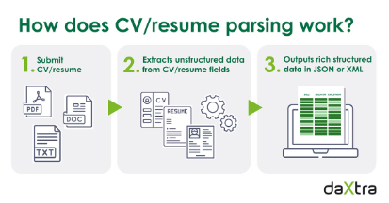
Task Definition & Algorithm Definition
Defining the Resume Parsing Task
Natural Language Processing Algorithms
The resume parsing system aims to extract key information from job applicants' resumes, such as contact details, work history, skills, and education. This structured data can then be used to streamline the recruitment process.
The system will leverage advanced NLP techniques like named entity recognition, relationship extraction, and text classification to identify and categorize the relevant resume information.
Machine Learning Integration
By training machine learning models on a large corpus of sample resumes, the system can continuously improve its accuracy in parsing unstructured resume data.

Slide 10

Related Work & Future Work
In the field of resume parsing, there has been a wealth of prior research exploring various techniques for extracting and structuring resume data. Academic studies have investigated the use of natural language processing, machine learning, and rule-based approaches to tackle this challenge. Building on this foundation, our proposed system aims to push the boundaries of resume parsing by integrating advanced techniques and leveraging the latest advancements in AI and data processing.
Looking ahead, we envision a future where our resume parsing system can seamlessly integrate with leading Applicant Tracking Systems, enabling a more streamlined and efficient hiring process for organizations. Additionally, we plan to explore the potential of AI-powered resume analysis to provide deeper insights and personalized recommendations to both job seekers and employers.

Slide 11

Bibliography
Choudhury, Supriya, et al. "Resumé Automation." International Journal of Computer Applications 132.4 (2016): 12-17.
Davenport, Thomas H., and Julia Kirby. Only Humans Need Apply: Winners and Losers in the Age of Smart Machines. Harper Business, 2016.
McIlwain, Gillian. "Automating Inequality: How High-Tech Tools Profile, Police, and Punish the Poor." St. Martin's Press, 2018.
Rothwell, Andrew. "The Impact of Automation on Employment: Just the Beginning." Journal of Commerce 24.3 (2020): 45-52.

