Slide 1
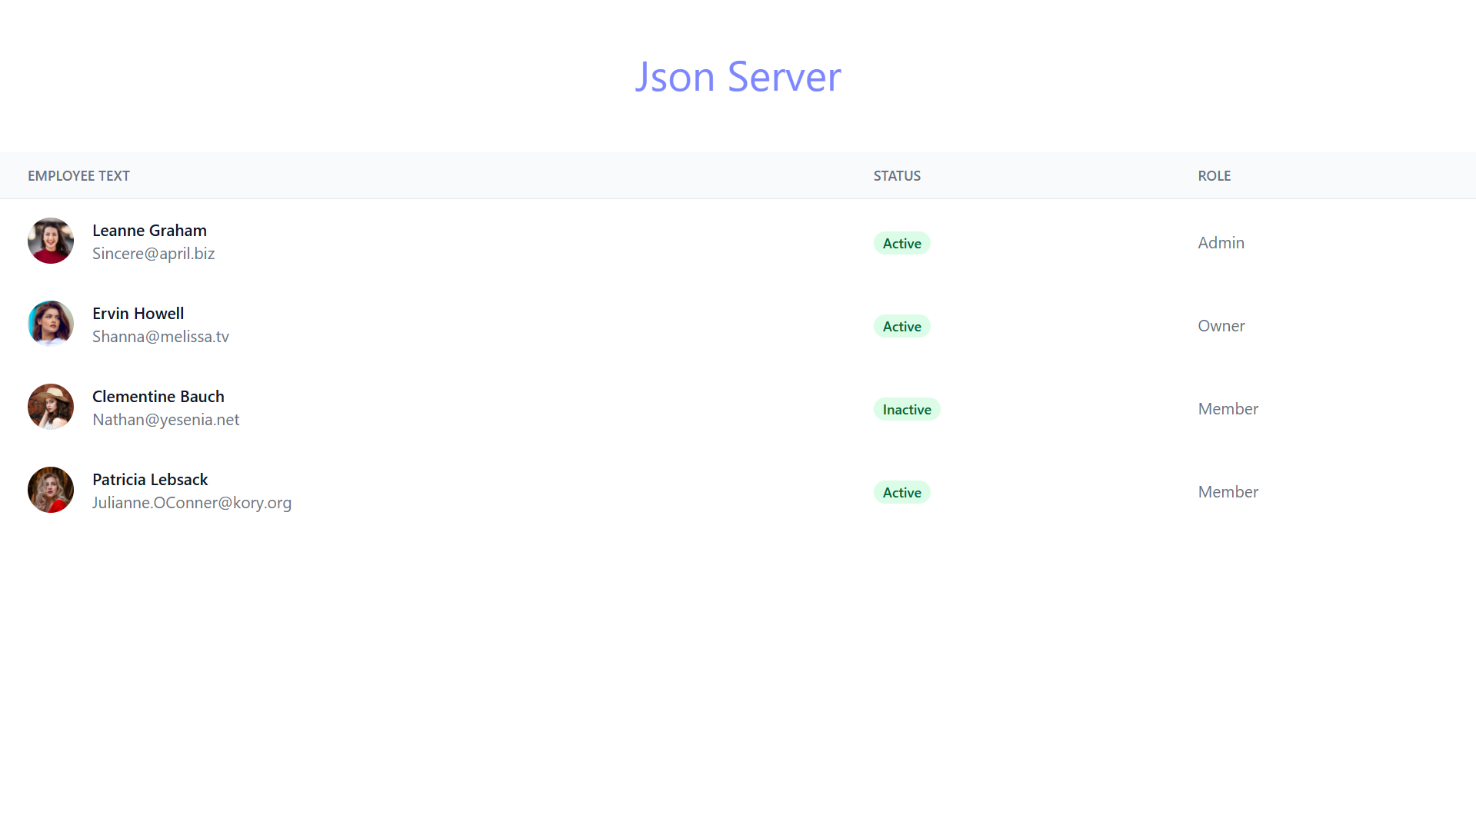
Built a Beautiful Employee UI with Mock API using JSON Server!

Slide 2
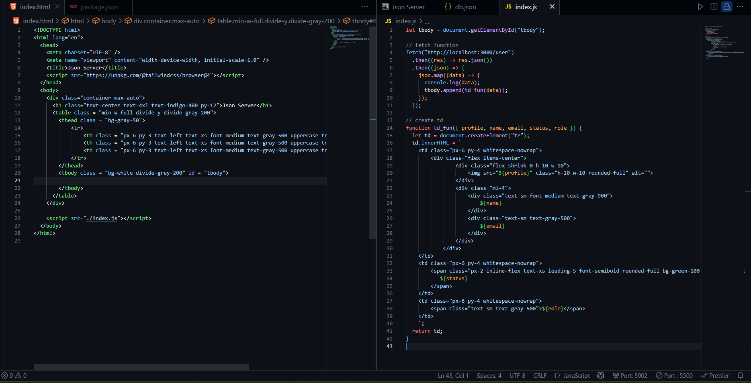
HTML
Javascript

Slide 3
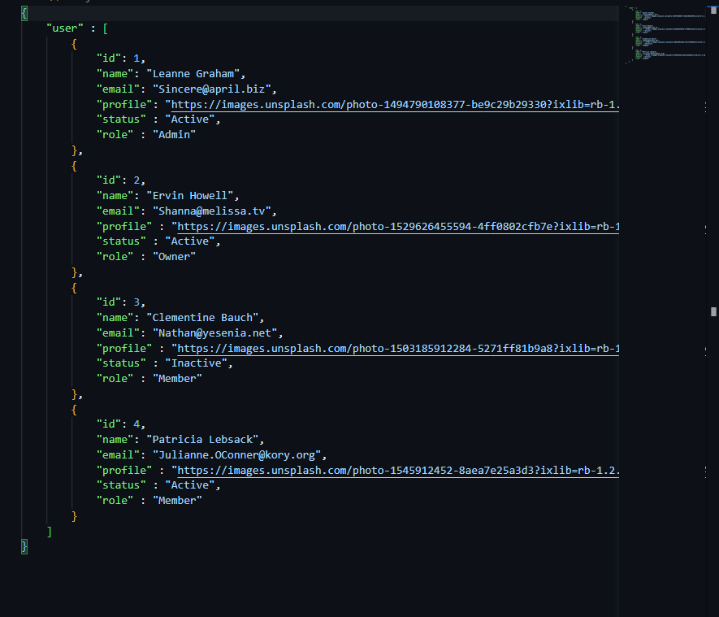
Db.json file

Slide 4
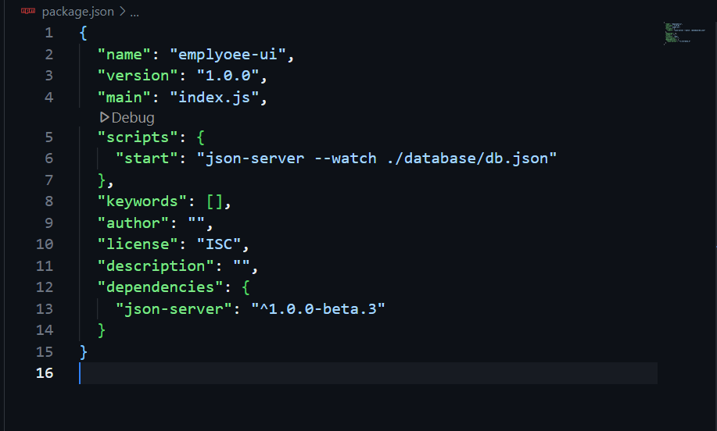
Package.json file

