Slide 1
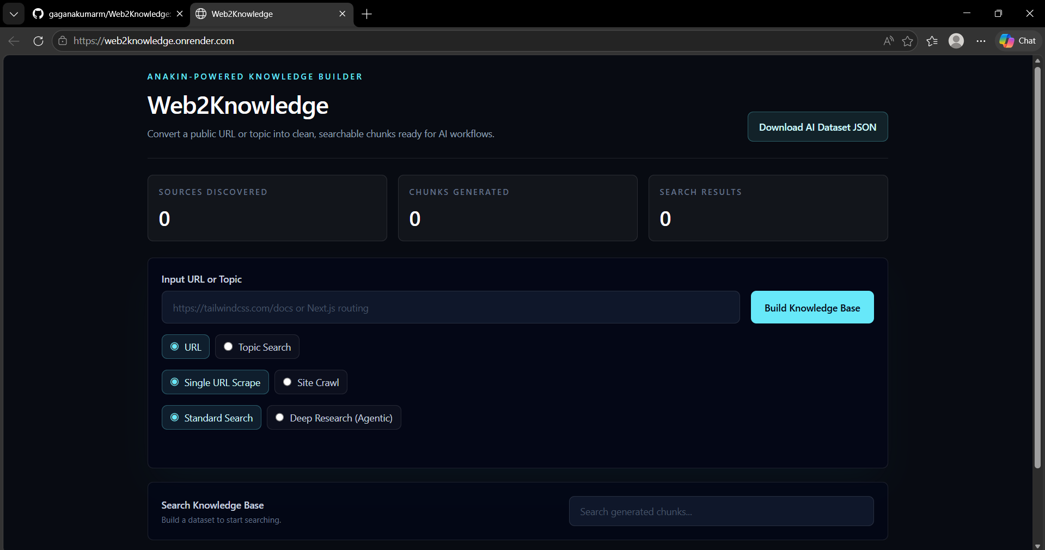
Homepage UI

Slide 2
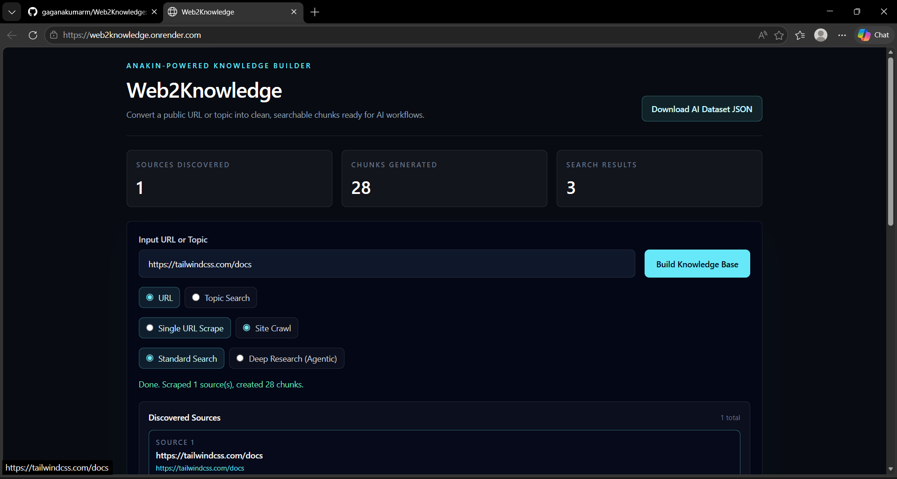
URL Mode

Slide 3
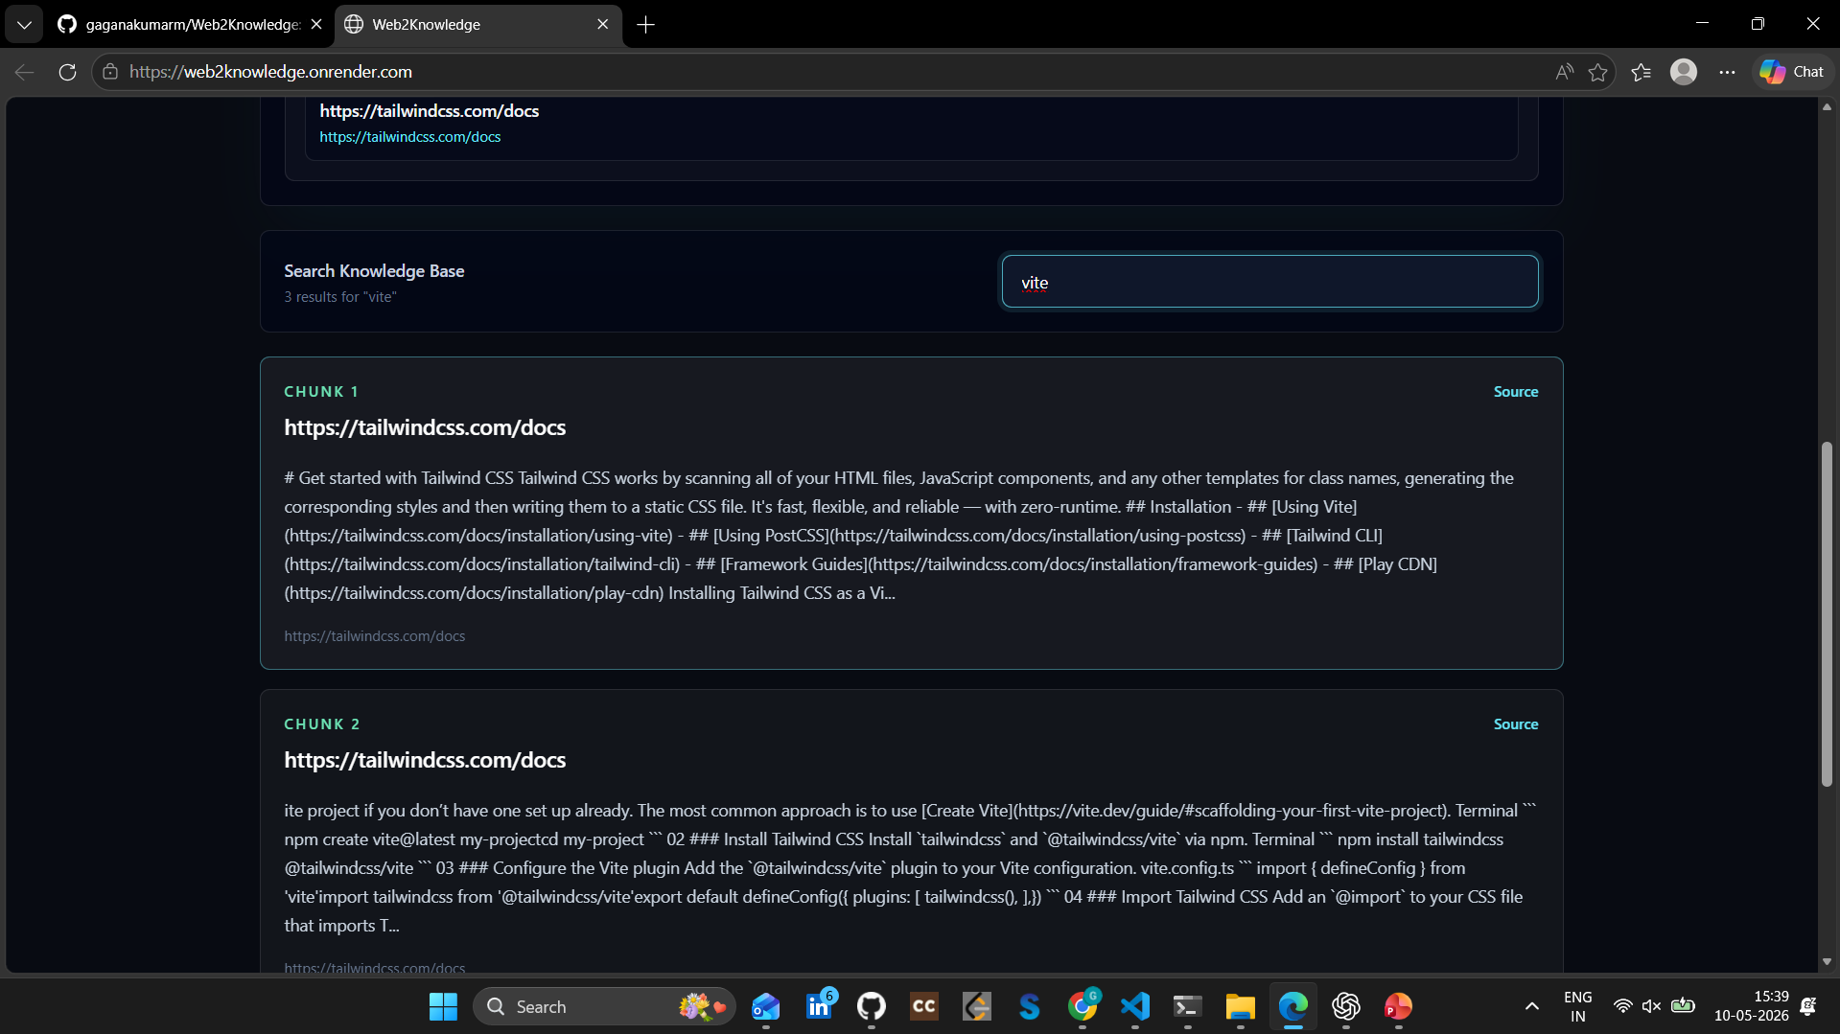
Search Results

Slide 4
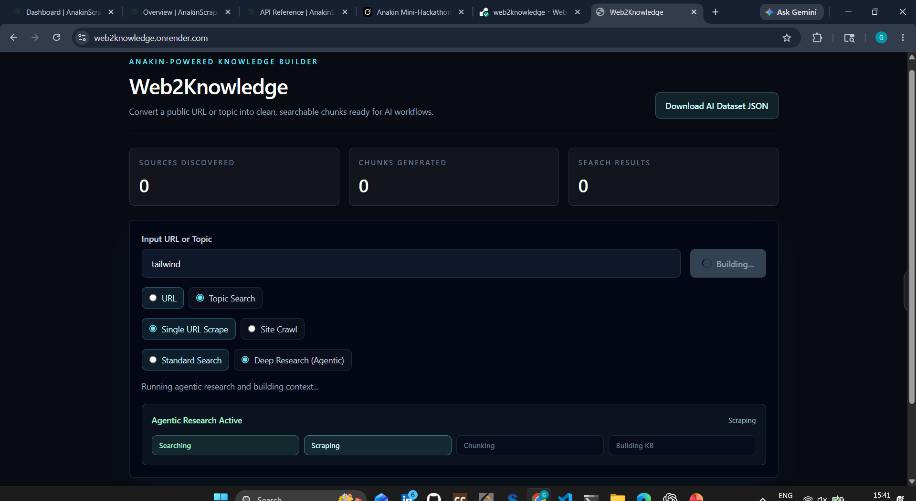
Topic Search

Slide 5
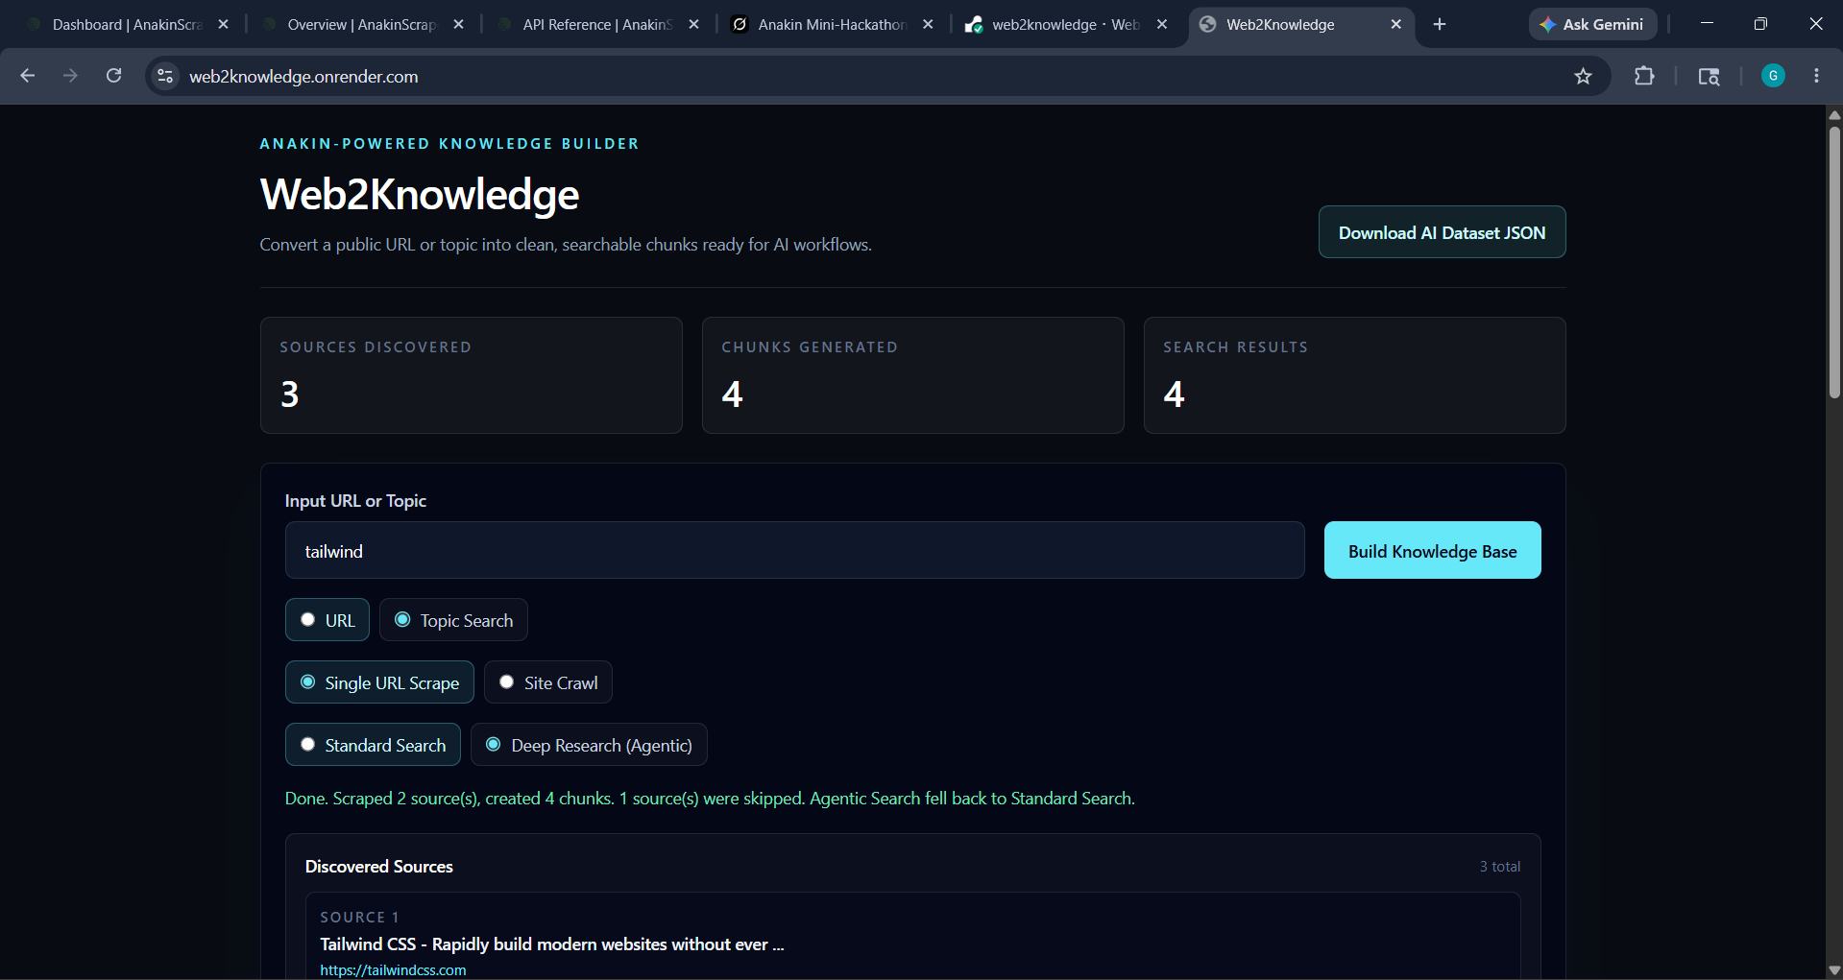
Agentic Research

Slide 6
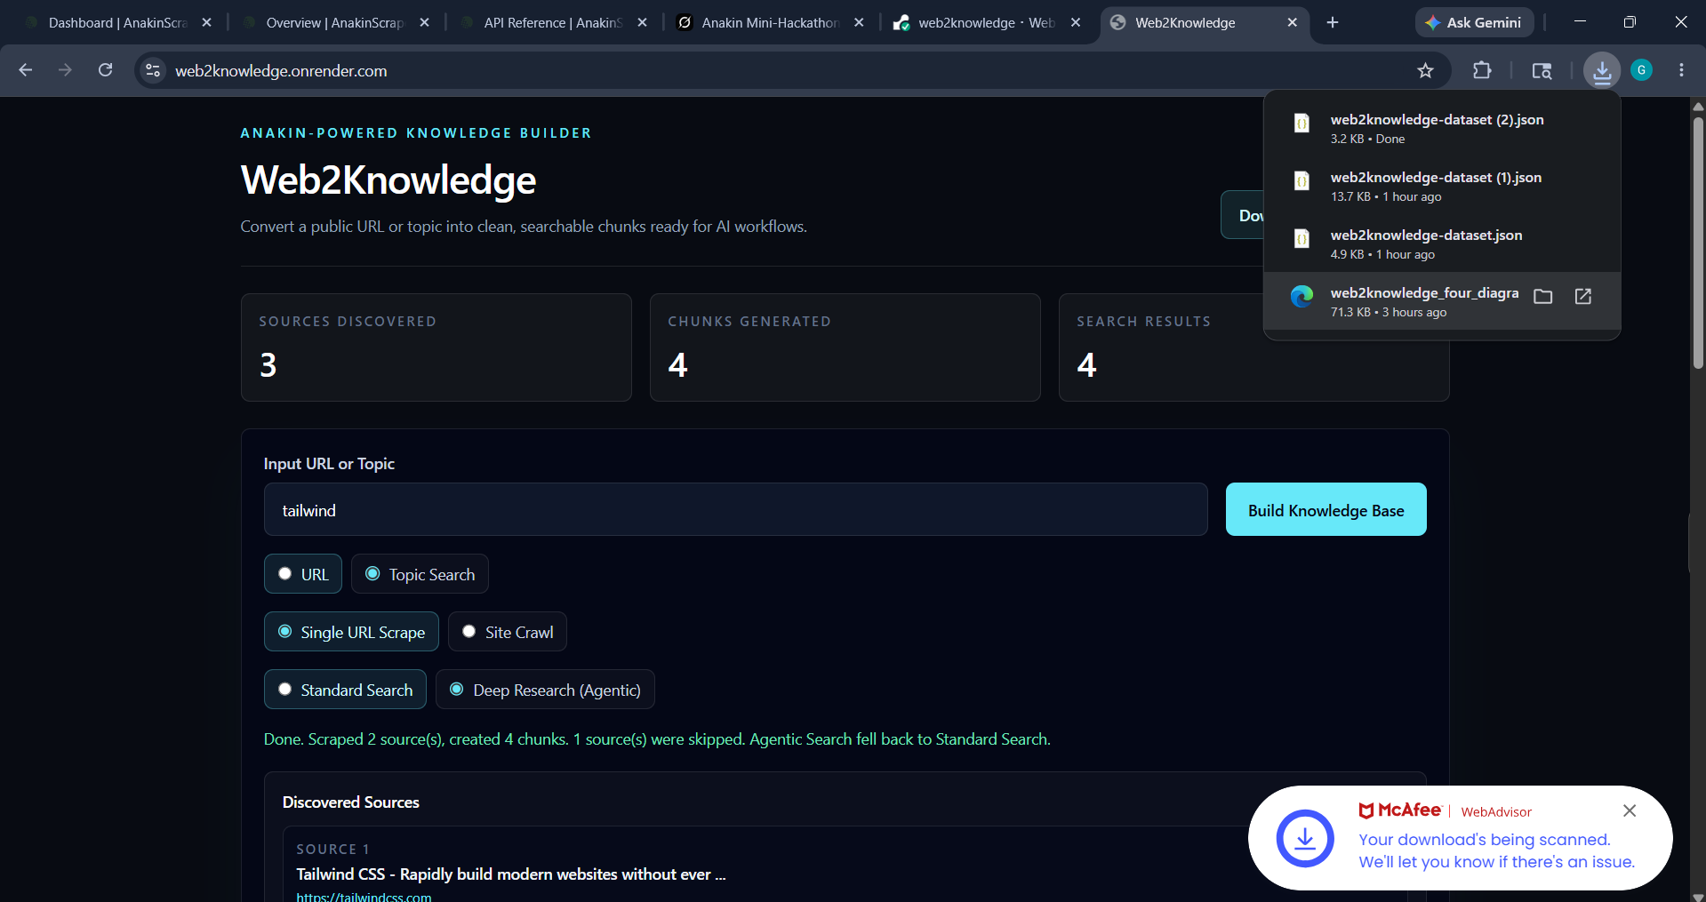
Dataset Export

Slide 7
GitHub + Deployment
https://github.com/gaganakumarm/Web2Knowledge
https://web2knowledge.onrender.com/

