Slide 1
DATA ANALYTICS ACADEMIC PROJECT
Axon Healthcare Analytics
Healthcare Data Analysis & Dashboard Project
Final Project Review
MySQL • MS Excel • Tableau • Power BI

Slide 2
1. Project Overview
Problem context and technical scope of the Axon Healthcare Analytics project.
Problem Context
Technical Scope
• Healthcare information contains multiple dimensions such as patients, doctors, visits, diagnoses, laboratory tests and revenue.
• Reviewing these measures separately makes it difficult to understand the complete performance picture.
• The project addresses this need through a consolidated analytics and dashboard-based view.
• The dashboard helps users identify trends, compare categories and monitor important healthcare KPIs.
• MySQL Engine — querying, filtering, aggregating and preparing healthcare data for analysis.
• MS Excel — data preparation, calculations, validation and dashboard development.
• Tableau — interactive visual analysis and dashboard presentation.
• Power BI — interactive reporting, KPI cards, visuals and dashboard presentation.
AXON HEALTHCARE ANALYTICS • FINAL PROJECT REVIEW 2

Slide 3
2. Strategic Objectives
What the project aims to achieve.
Centralize Healthcare Data
Monitor KPIs
Identify Clinical Patterns
Bring core healthcare measures into a structured
analytical view.
Track patient, visit, provider, laboratory and
financial indicators.
Understand diagnosis, follow-up and laboratory-
result patterns.
Analyse Financial Performance
Enable Interactive Analysis
Support Decisions
Monitor revenue and treatment-cost trends.
Filter and explore healthcare information by
relevant dimensions.
Turn data into a clear and decision-ready visual story.
AXON HEALTHCARE ANALYTICS • FINAL PROJECT REVIEW 3

Slide 4
3. Tools Used
Technology stack covered while preparing and visualizing the dashboard.
MySQL
MS Excel
Data Querying
Used to retrieve, filter, aggregate and analyse the healthcare data.
Data Preparation & Dashboard
Used for data cleaning, calculations, validation and dashboard creation.
Tableau
Power BI
Visualization
Used to build interactive analytical views and visualizations.
Dashboard & Reporting
Used for KPI cards, interactive visuals, filters and dashboard reporting.
MySQL → Excel → Tableau / Power BI → Interactive Dashboard
AXON HEALTHCARE ANALYTICS • FINAL PROJECT REVIEW 4

Slide 5
4. KPI Brief in the Dashboard
Short explanation of the main performance indicators.
Patients Count
Total Doctors
Total Visits
Average Age
Total number of patients
represented in the dataset.
Number of doctors available for
provider-level analysis.
Total recorded visits, indicating
overall healthcare activity.
Average age of patients, showing
the demographic profile.
Total Lab Tests
Total Revenue
Average Treatment Cost
Avg. Patients / Doctor
Total laboratory tests recorded,
reflecting diagnostic activity.
Revenue generated, providing a
high-level financial indicator.
Average cost associated with
treatment.
Average patient load per doctor.
Together, these KPIs provide a quick view of healthcare activity, clinical workload and financial performance.
AXON HEALTHCARE ANALYTICS • FINAL PROJECT REVIEW 5

Slide 6
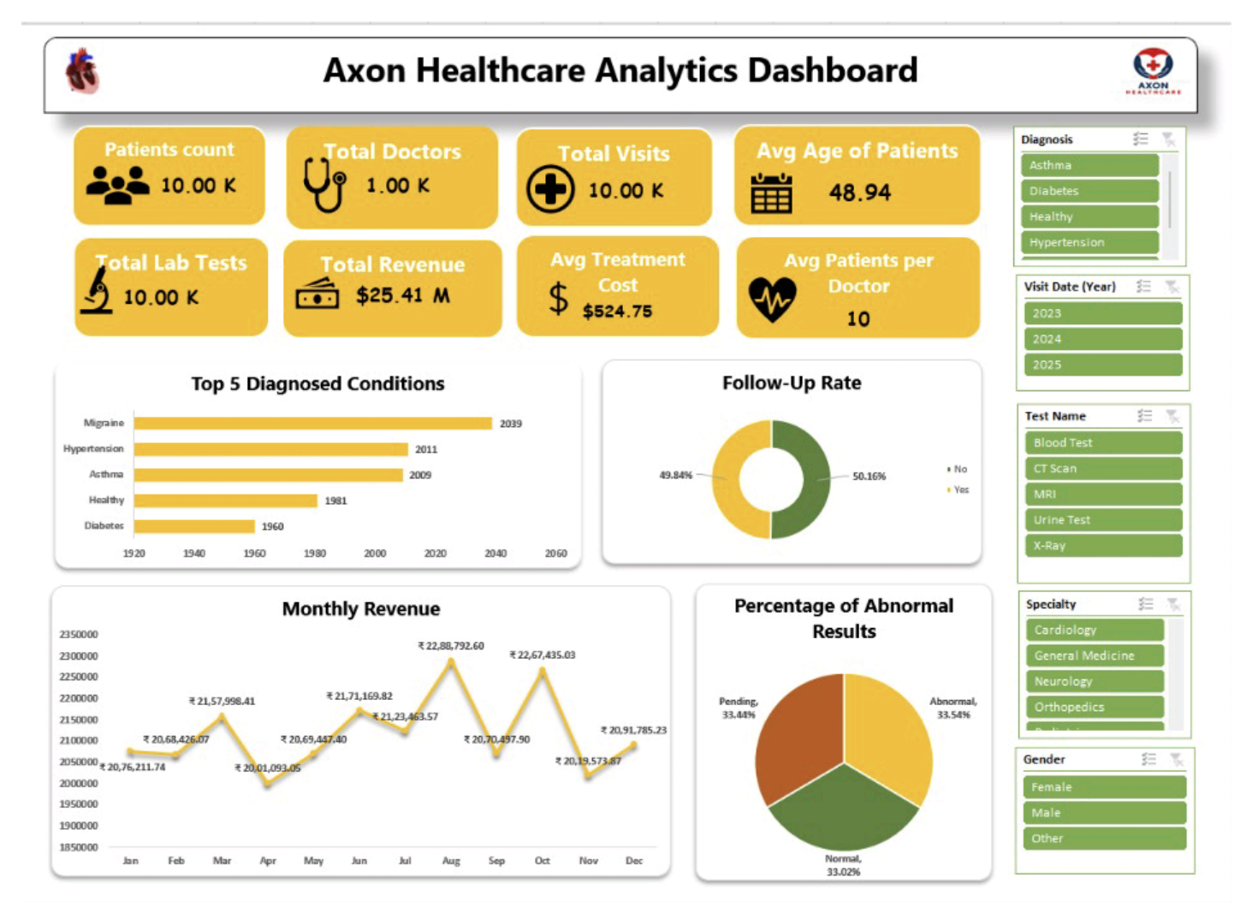
5. MS Excel Dashboard
Dashboard view developed in MS Excel.
AXON HEALTHCARE ANALYTICS • FINAL PROJECT REVIEW 6

Slide 7
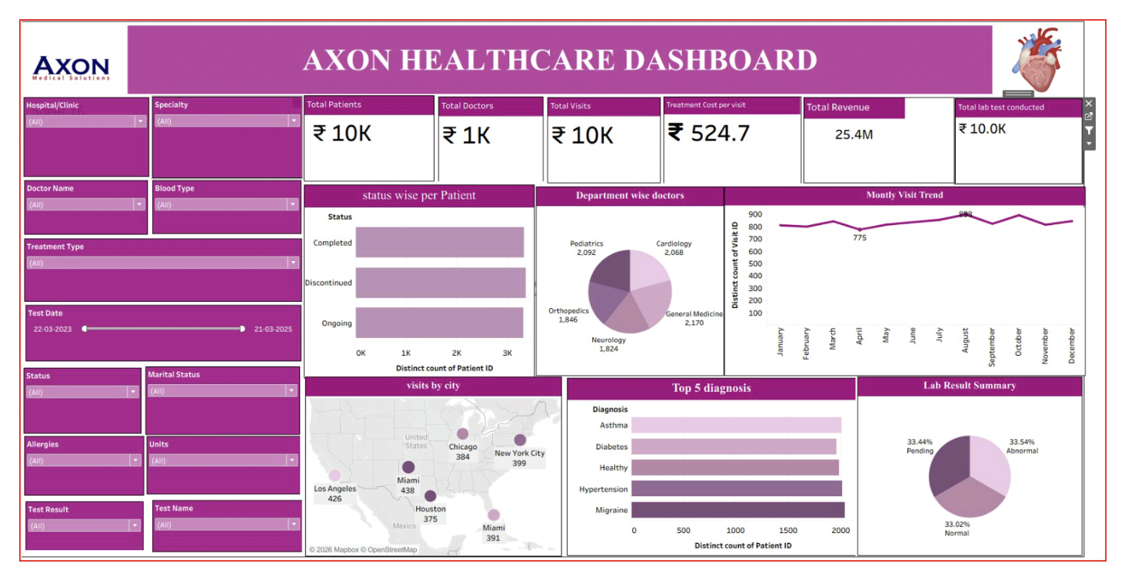
6. Tableau Dashboard
Interactive dashboard view developed in Power BI.
AXON HEALTHCARE ANALYTICS • FINAL PROJECT REVIEW 7

Slide 8
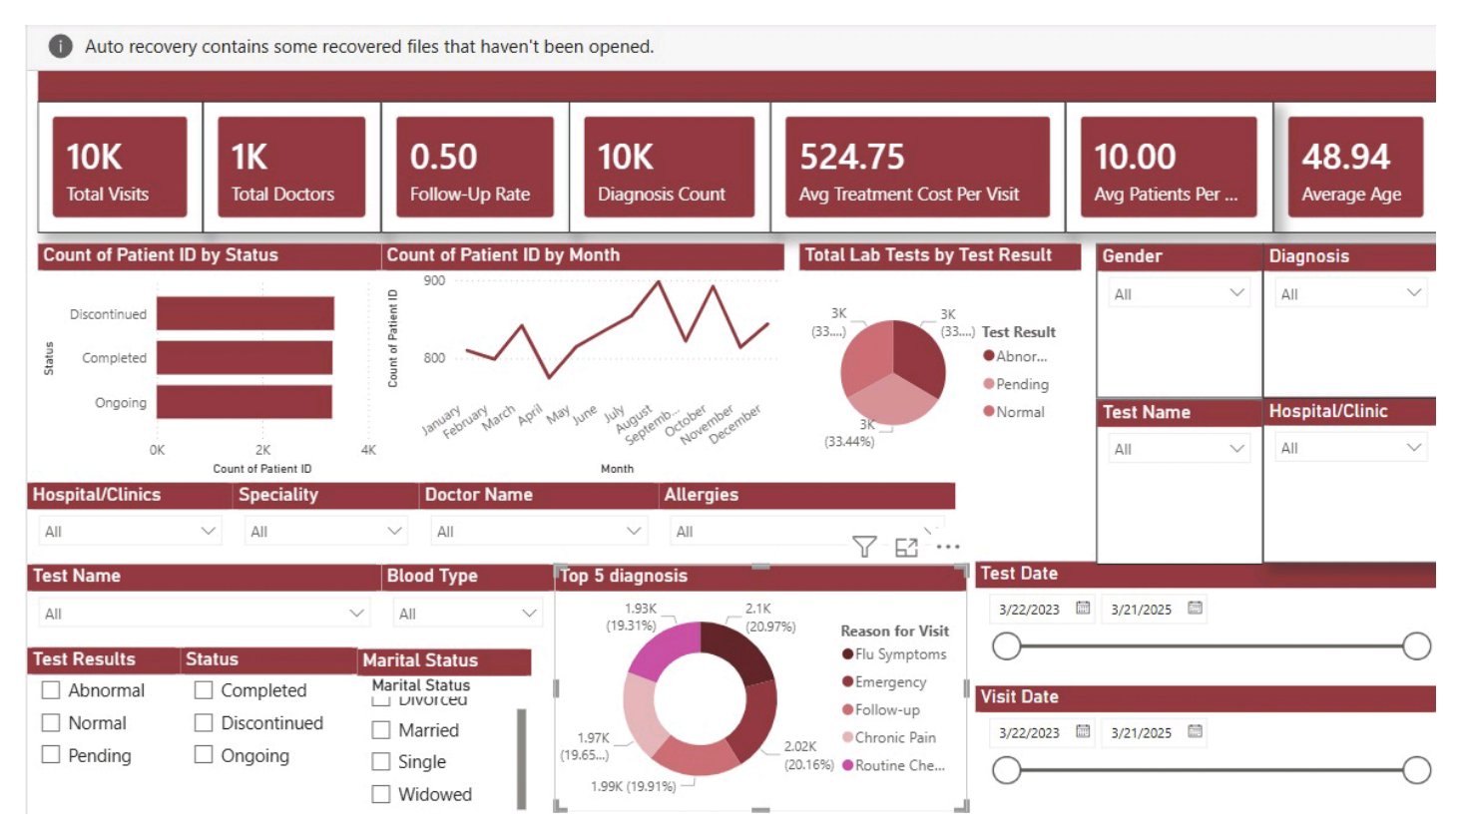
7. Power Bi Dashboard
Interactive visualization view developed in Tableau.
AXON HEALTHCARE ANALYTICS • FINAL PROJECT REVIEW 8

Slide 9
8. Project Conclusion & Improvements
Final outcome and possible enhancements for the next version.
Project Conclusion
Possible Improvements
• The project converts healthcare data into a structured visual analytics solution.
• The dashboards bring together patient, visit, clinical, laboratory and financial indicators.
• KPI cards and interactive visuals make key patterns easier to monitor and communicate.
• The project demonstrates an end-to-end analytics workflow using MySQL, Excel, Tableau and Power BI.
• Add automated or scheduled data refresh to reduce manual preparation.
• Introduce deeper trend analysis and forecasting for visits and revenue.
• Add more drill-down views for diagnosis, specialty and patient segments.
• Include additional data-quality checks and validation rules.
• Extend the dashboard with role-based views for management and operational users.
AXON HEALTHCARE ANALYTICS • FINAL PROJECT REVIEW 9

Slide 10
THANK YOU
Questions & Discussion

