Slide 1
UTILIZATION OF IMAGES FOR MONITORING OF PROGRESS OF CONSTRUCTION ACTIVITIES FOR BUILDING CONSTRUCTION PROJECTS
CSE7101- Capstone Project
Review-5
Batch Number:ISE_05
Roll Number | Student Name
Under the Supervision of,
Dr . Zafar Ali Khan
Professor
School of Computer Science and Engineering
Presidency University
20221ISE0025 | GAGANA S R
20221ISE0021 | TANUSHREE M S
20221ISE0042 | SNEHA KUMARI
Name of the Program: B. Tech Information Science Engineering(Robotics)
Name of the HoD: Dr. Zafar Ali Khan
Name of the Program Project Coordinator: Ms. Suma N G
Name of the School Project Coordinators: Dr. Sampath A K, Dr. Geetha A

Slide 2
Content
Abstract
Problem Statement
Objectives
Analysis of Problem Statement
Current Challenges
Git-hub Link
Timeline of the Project
References
Base Paper
Final Result
AI and similarity check of report
Declaration and Bonafide Certificate

Slide 3
Abstract
In the contemporary construction sector, proper project monitoring and control are a very crucial element towards ensuring that, projects are delivered on time, cost effectively, and quality results. Conventional ways of measuring progress like manual inspection and paper reports can be slow, subjective and prone to human error. As a way of solving these problems, monitoring of construction progress through the use of images has become a new and reliable approach. This method presupposes capturing visual information on the construction sites by using digital cameras, smartphones, drones, and surveillance cameras every certain period throughout the project. The photos taken are valuable documents of the work at the site. The stakeholders, project managers, and engineers can easily evaluate the progress of work visually. Comparison of images captured over time will be able to monitor the progress with reference to the scheduled times, identify delays or differences, and ensure the construction adheres to the design requirements. Monitoring through images provides an objective and data-based perspective of the situation at a site, eliminating the possibility of subjective human assessments. Furthermore, the integration of the image analysis with such technologies as Artificial Intelligence (AI), Computer Vision, and Building Information Modeling (BIM) has significantly enhanced the accuracy of the progress tracking and has increased its efficiency. The AI algorithms are capable of automatically identifying structural parts, quantifying quantities and estimating the percentage completion on the basis of images. The visual insights when linked to BIM models could be compared to the digital plans to identify deviations, safety issues, or places that will require corrections. High-resolution drones provide aerial survey of a big or complicated location, which would otherwise be unfeasible by ground inspections. The remote collaboration among the stakeholders of a project is also facilitated through the use of image-based monitoring systems. Cloud platforms can be used to share real-time visual updates and allow architects, engineers, and clients to check the site progress at any location. This improves the level of transparency, communication, and decision-making in the project. Also, maintaining history of documentation in picture form is an accountability measure and will assist in solving quality or time related disputes.On the whole, the ability to track the progress of the construction with the help of images is a great step towards more intelligent and effective project management. It does not only enhance precision and efficiency, but also enables sustainable business by minimizing field trips and maximizing on resource utilization. With the shift to the use of digital tools in the construction industry, the image-based monitoring can be considered as a low-cost, scalable, and potent solution to improve project results in a contemporary construction industry.

Slide 4
Problem Statement Number: 351
Organization: Ministry of Housing and Urban Affairs
Category (Hardware / Software / Both) :Software
Problem Description : Monitoring the progress of building construction projects is often challenging due to the reliance on manual inspections and subjective reporting, which can lead to delays and errors. By systematically collecting and analyzing images, project managers can create visual progress records, compare actual work with planned schedules, generate quantitative progress metrics, and detect delays or quality issues early. This approach improves transparency, reduces the need for frequent site visits, and enhances decision-making, ultimately leading to more efficient project management.
Expected output: Accurate visual records and measurable insights on construction progress, enabling early issue detection, reduced manual monitoring, and improved project management efficiency
Problem Description:

Slide 5
Objectives
To design and develop a software system that uses site images to monitor and evaluate the progress of construction activities.
To automate the comparison of planned versus actual progress with image data.
To provide visual dashboards and reports for project managers and stakeholders.
To reduce manual effort, errors, and delays in construction monitoring.
To improve decision-making and transparency in construction projects.

Slide 6
Analysis of Problem Statement
Manual and Slow Process
Quality and Site Challenges
Data Management Difficulties
Lack of Integration
Need for Automation

Slide 7
Current Challenges
Manual challenges:
Not Enough Skilled Workers
Projects Taking Longer Than Planned
Going Over Budget
Poor Communication
Slow Use of New Technology
Technical challenges:
Data Acquisition and Environmental Challenges
Data Processing and Integration Challenges
Data Management and Storage Challenges
Security and Ethical Challenges
Business and Operational Challenges

Slide 8
Github Link
https://github.com/Tanushreems/Utilization-of-images-for-monitoring-of-progress-of-construction-activities

Slide 9
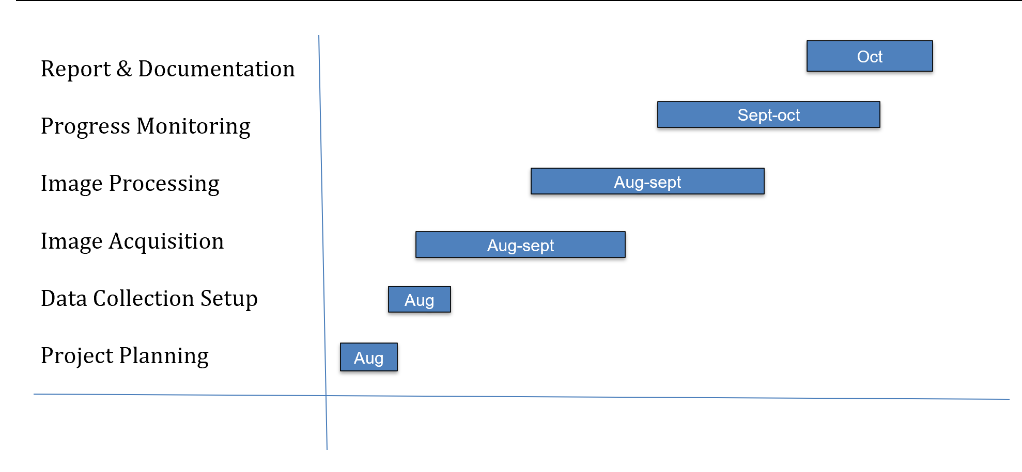
Timeline of the Project (Gantt Chart)

Slide 10
References (IEEE Paper format)
[1] M. Golparvar-Fard, F. Pena-Mora, and C. A. Arboleda, “Construction performance monitoring via still images, time-lapse photos, and video streams: Now, tomorrow, and the future,” Automation in Construction, 2012. [Online]. Available: https://www.sciencedirect.com/science/article/abs/pii/S1474034615000233
[2] R. Zheng, J. Liu, and Y. Xu, “Review of Image-Based 3D Reconstruction of Building for Automated Construction Progress Monitoring,” Applied Sciences, 2021. [Online]. Available: https://www.mdpi.com/2076-3417/11/17/7840
[3] B. Ekanayake and L. S. Marasinghe, “Automated Computer Vision-Based Construction Progress Monitoring: A Systematic Review,” Buildings, 2022. [Online]. Available: https://www.mdpi.com/2075-5309/12/7/1037
[4] B. Ekanayake and L. S. Marasinghe, “Construction Progress Monitoring and Reporting using Computer Vision Techniques – A Review,” ISARC, 2022. [Online]. Available: https://www.iaarc.org/publications/fulltext/062_ISARC%202022_Paper_48.pdf
[5] M. Golparvar-Fard, S. Bohn, and F. Pena-Mora, “Visualization of Construction Progress Monitoring with 4D Simulation Model Overlaid on Time-Lapsed Photographs,” Journal of Computing in Civil Engineering, 2009. [Online]. Available: https://www.researchgate.net/publication/228662339
[6] Z. Jiang, “Automated Construction Progress Monitoring using Image Segmentation and Building Information Models,” Pennsylvania State Univ. Dissertation, 2023. [Online]. Available: https://etda.libraries.psu.edu/catalog/19715zpj5026
[7] W. Wei, et al., “Integrated vision-based automated progress monitoring of indoor construction using mask region-based convolutional neural networks and BIM,” Automation in Construction, 2022. [Online]. Available: https://www.sciencedirect.com/science/article/abs/pii/S092658052200200X
[8] A. Braun, et al., “BIM-based progress monitoring,” Automation in Construction, 2017. [Online]. Available: https://www.academia.edu/44587691/BIM_based_progress_monitoring
[9] C. C. Hsieh, et al., “Integration of Construction Progress Monitoring Results using AI Image Recognition from Multiple Cameras onto a BIM,” ISARC, 2024. [Online]. Available: https://www.iaarc.org/publications/2024_proceedings...
[10] A. S. Greeshma and R. B. Edayadiyil, “Computer Vision for Construction Progress Monitoring: A Real-Time Object Detection Approach,” arXiv preprint, 2023. [Online]. Available: https://www.researchgate.net/publication/374014867
[11] A. S. Greeshma and R. B. Edayadiyil, “Automated progress monitoring of construction projects using Machine learning and image processing approach,” Materials Today: Proceedings, 2022. [Online]. Available: https://www.sciencedirect.com/science/article/abs/pii/S2214785322014602
[12] M. Bonyani and M. Soleymani, “Towards Improving Workers' Safety and Progress Monitoring of Construction Sites Through Construction Site Understanding,” arXiv preprint, 2022. [Online]. Available: https://arxiv.org/abs/2210.15760
[13] B. Ekanayake and L. S. Marasinghe, “Deep learning-based computer vision in project management: Automating indoor construction progress monitoring,” Project Leadership and Society, 2024. [Online]. Available: https://www.sciencedirect.com/science/article/pii/S2666721524000346
[14] A. Pal, J. J. Lin, S. H. Hsieh, and M. Golparvar-Fard, “Automated Vision-Based Construction Progress Monitoring in Built Environment through Digital Twin,” Developments in the Built Environment, vol. 16, Article 100247, 2023. [Online]. Available: https://www.sciencedirect.com/science/article/pii/S2666165923001291
[15] W. Jung and Y. Kang, “Automated progress measurement using a novel image recognition method for civil engineering applications,” Automation in Construction, 2014. [Online]. Available: https://www.academia.edu/17128808

Slide 11
Base Paper
“Deep-Learning-Based Automated Building Construction Progress Monitoring for Prefabricated Prefinished Volumetric Construction”
Open PDF: https://www.mdpi.com/1424-8220/24/21/7074
Author: Wei Png Chua, Chien Chern Cheah,
Published in: Sensors, 2024, 24(21), Article no. 7074
Summary:
The WAVBCPM System, an automated system for monitoring Prefabricated Prefinished Volumetric Construction (PPVC) construction progress via image processing and deep learning computer vision. The main goal of WAVBCPM is to determine the amount of progress made with respect to the original plans by verifying the alignment of the existing windows in relation to the architectural drawings.
WAVBCPM characteristics include:
Utilization of YOLOv5 technology for window identification on the exterior of buildings. Picture masking techniques enable reliable window identification and recreate previously obstructed windows along the façades through use of geometric characteristics associated with a façade.
Automatically computes construction status in relation to how many windows have been located already against how many are expected to be on a job site.
WAVBCPM has been demonstrated as a tremendous success when compared to object detection techniques used in the construction field, as occluded windows, light variations, and other obstacles will all affect object detection in realistic construction environments.
Limits of use
The use of image processing and AI to evaluate the construction progress works optimally with regularly arranged prefab window layouts
The system will only track progress externally. Internal construction and progress will not be tracked
To achieve an optimum degree of accuracy, clear images of the exterior façade of the project must be captured
The ability to evaluate the level of completion through image processing and AI supports the project objective to measure building progress, accurately and efficiently by the use of photographic images of the development of the structure.

Slide 12
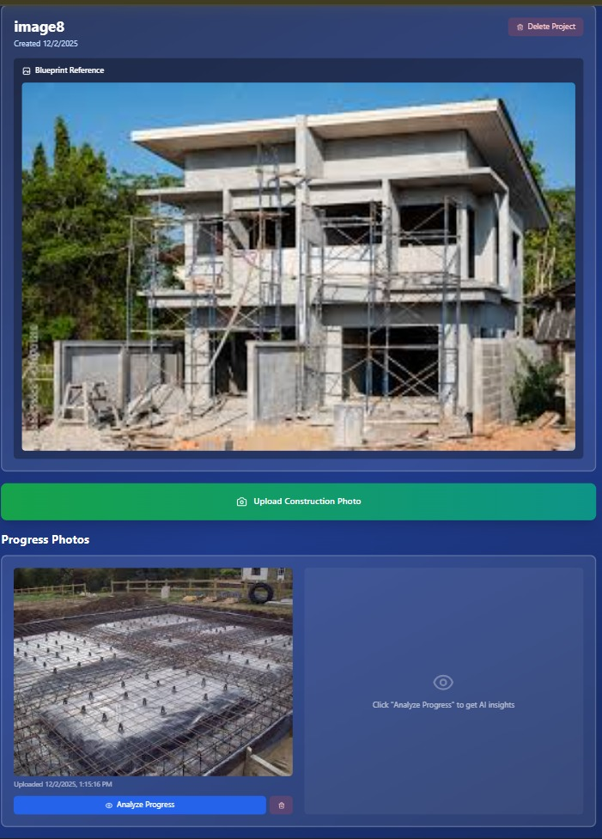
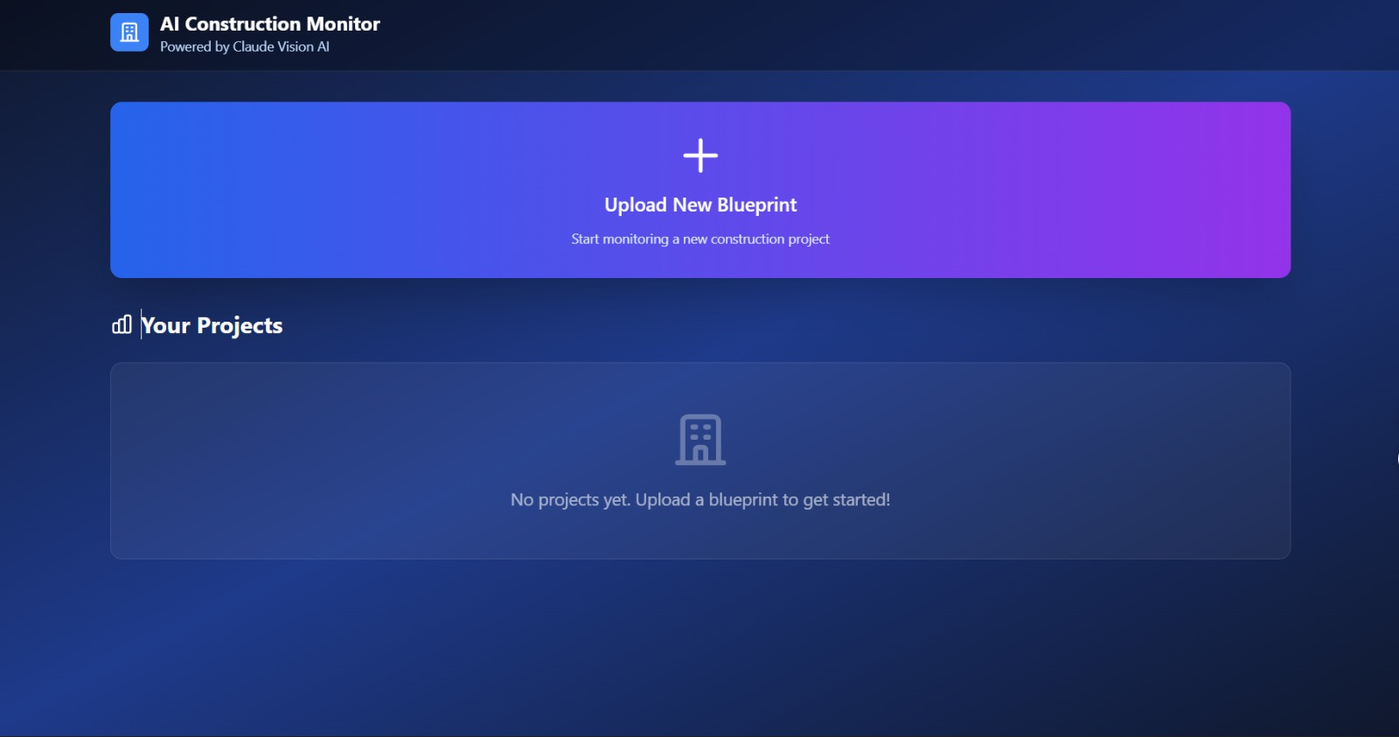
Final Result
Here we are uploading the images and it will
Shows the how much construction work
is completed

Slide 13
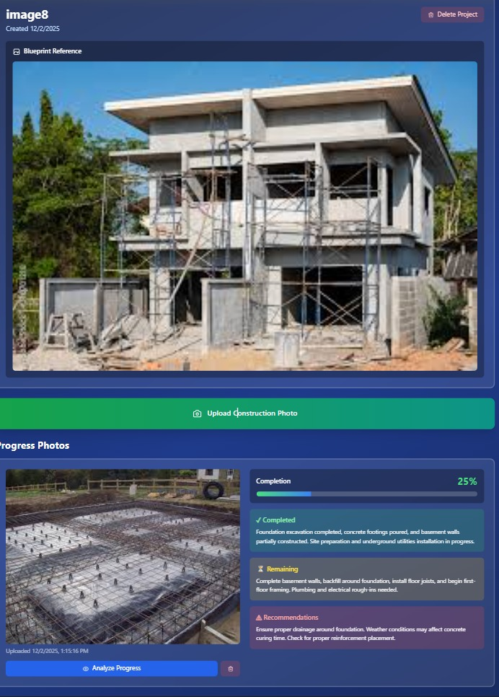
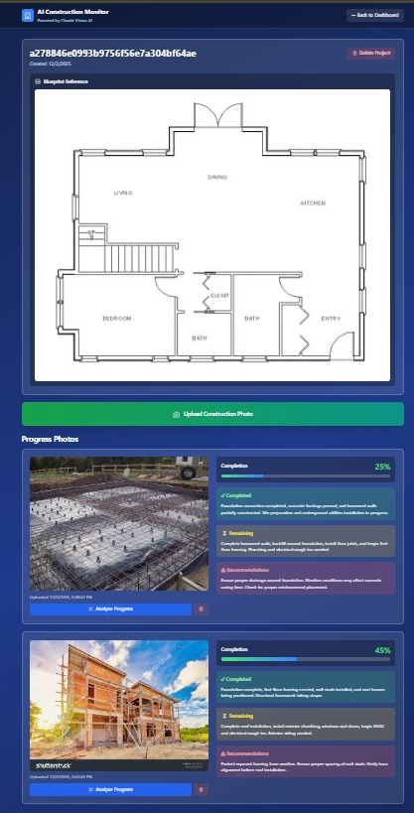
Final Result
After uploading the
Images model will predict
The completed
Construction work.

Slide 14
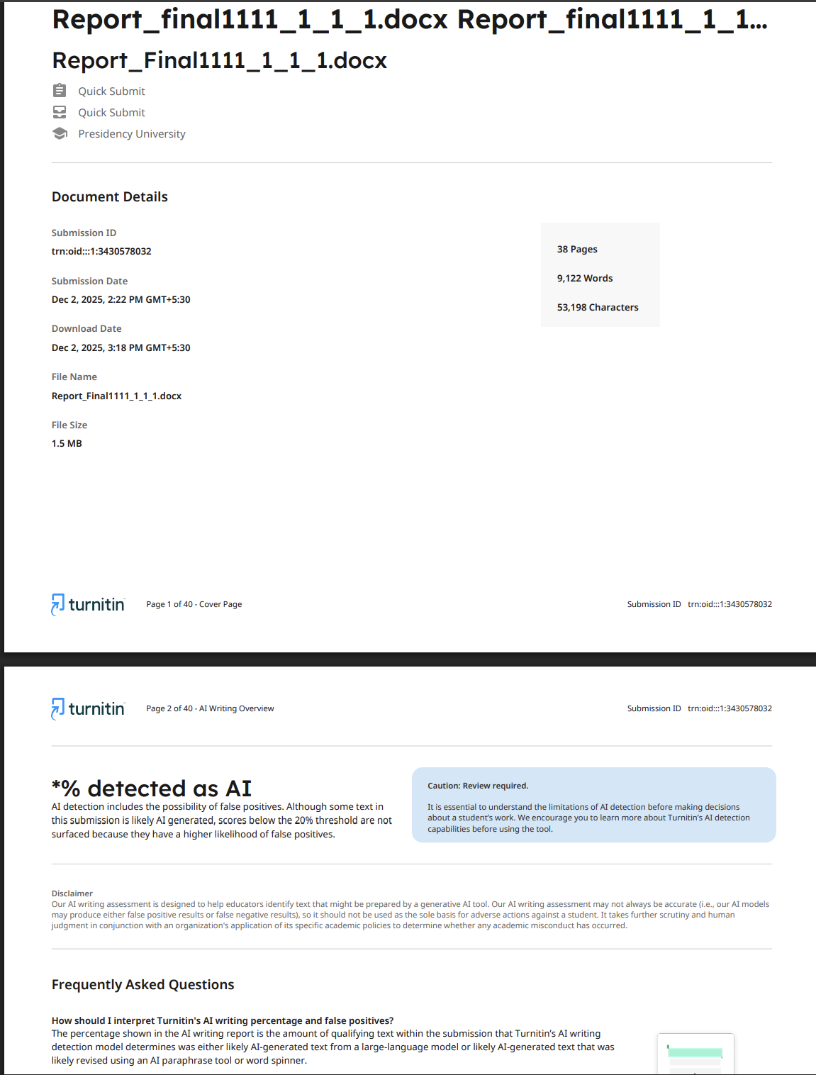
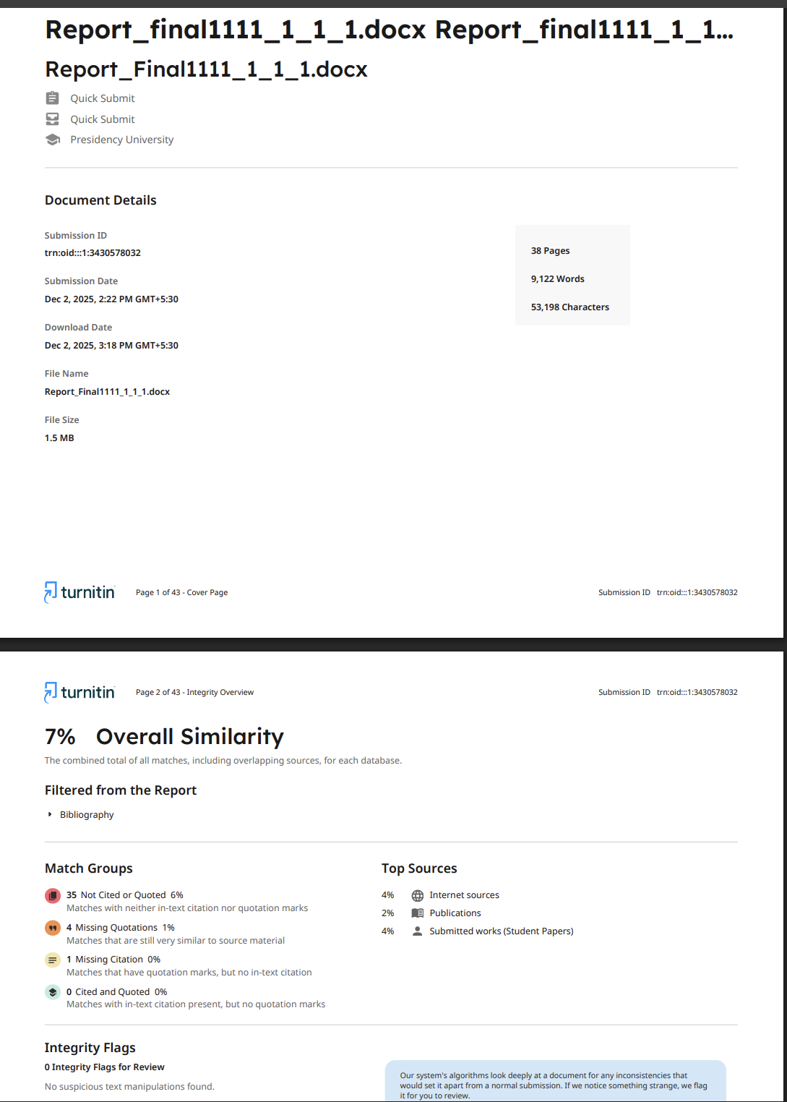
AI and similarity check of report

Slide 15
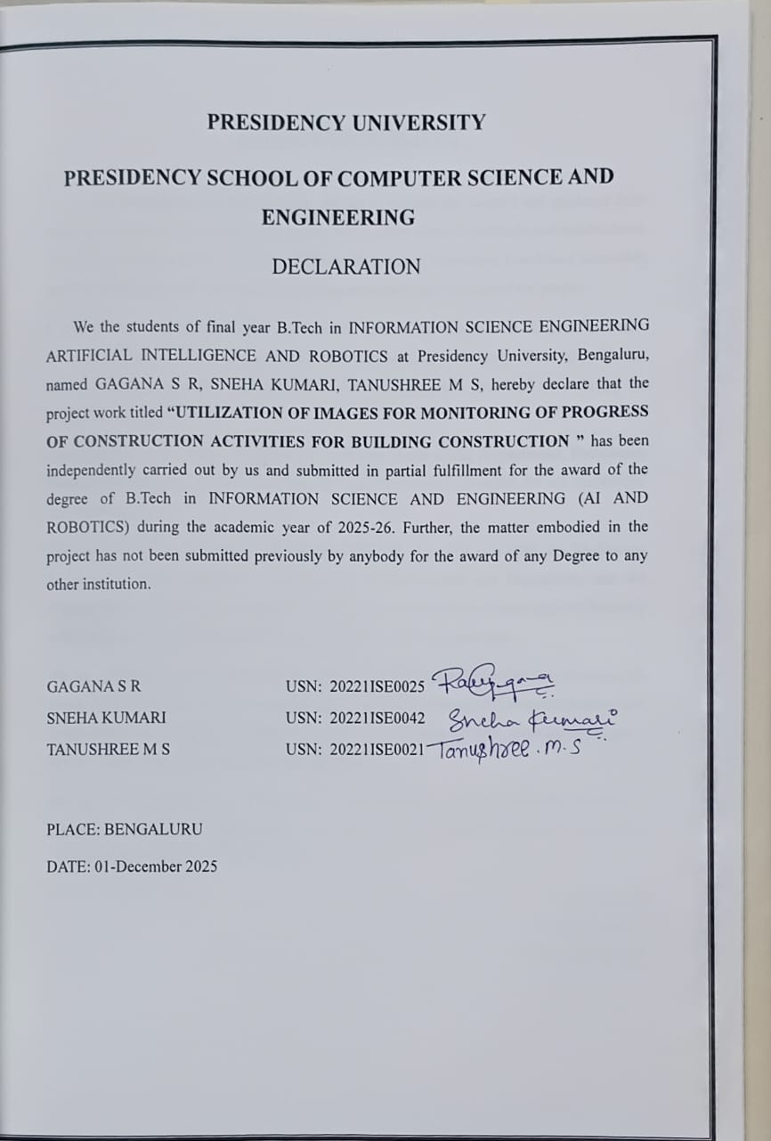
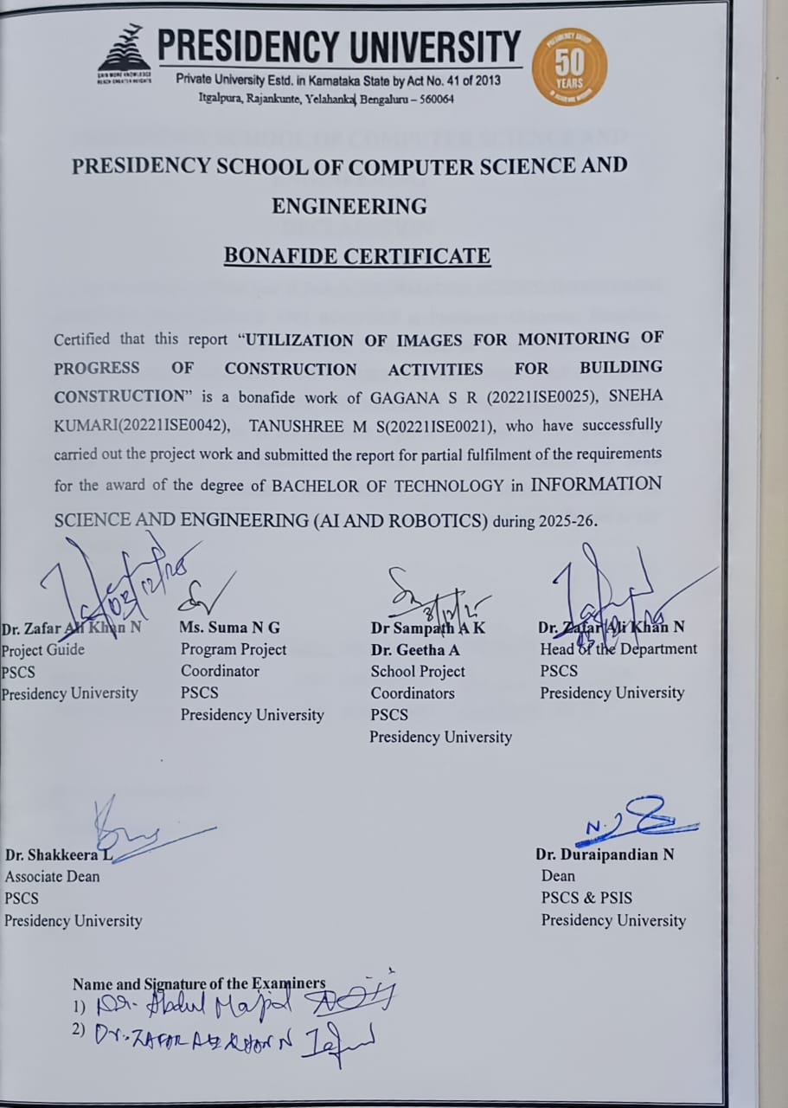
Declaration and Bonafide Certificate

Slide 16


