Slide 1


bower
A package manager for the web
Gagandeep Singh

Slide 2
Why Bower ?
Web sites are made of lots of things — frameworks, libraries, assets, and utilities. Bower manages all these things for you.
Keeping track of all these packages and making sure they are up to date (or set to the specific versions you need) is tricky. Bower to the rescue!
Bower can manage components that contain HTML, CSS, JavaScript, fonts or even image files. Bower doesn’t concatenate or minify code or do anything else - it just installs the right versions of the packages you need and their dependencies.

Slide 3
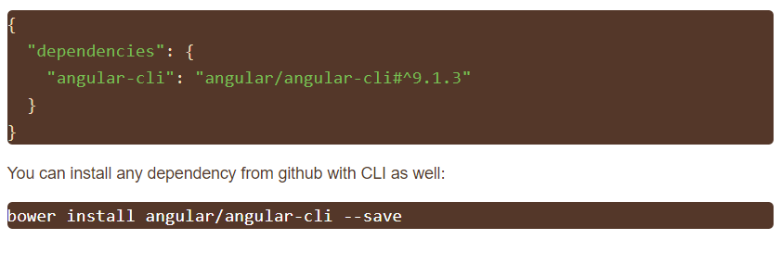
Creating Packages in Bower
As Bower is deprecated, registering new Bower packages is not supported anymore.
Nevertheless, you can install any GitHub repository as Bower package by putting full name in bower.json.

Slide 4
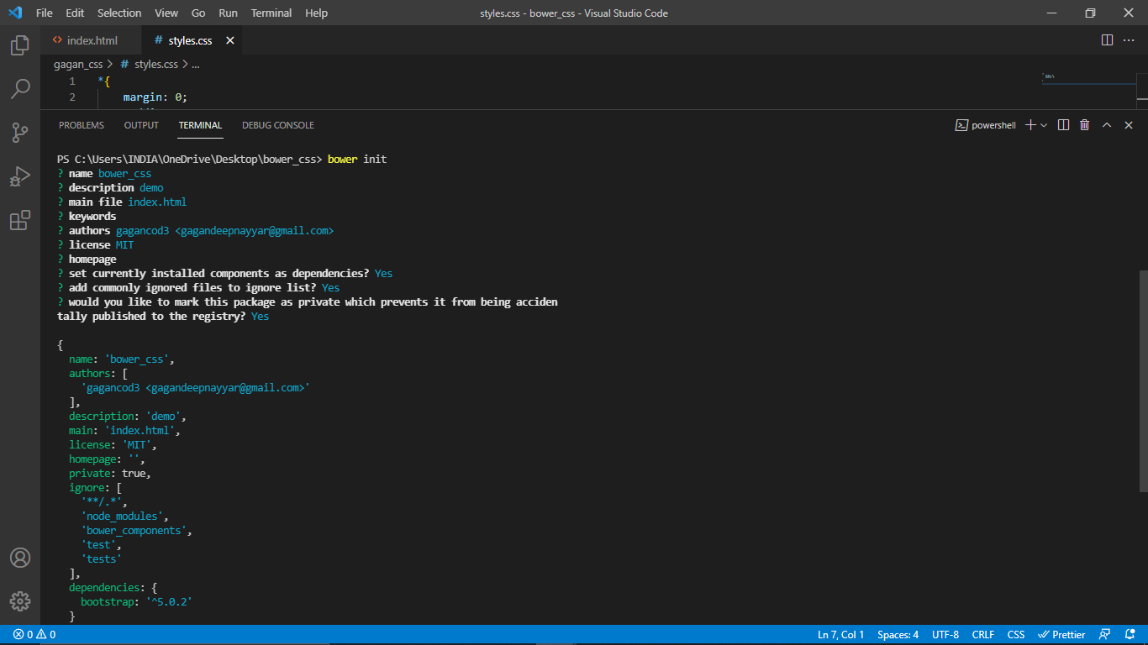
Creating bower.json file

Slide 5
gcss_lib
I created a styles.css file where I have built a basic CSS code which can be used just like bootstrap on a HTML file.
It’s my personalized library where I just have to mention class name in HTML tags to access those styles in my web page.
Here’s the link of my Github repo: “https://github.com/gagancod3/gcss_lib”

Slide 6
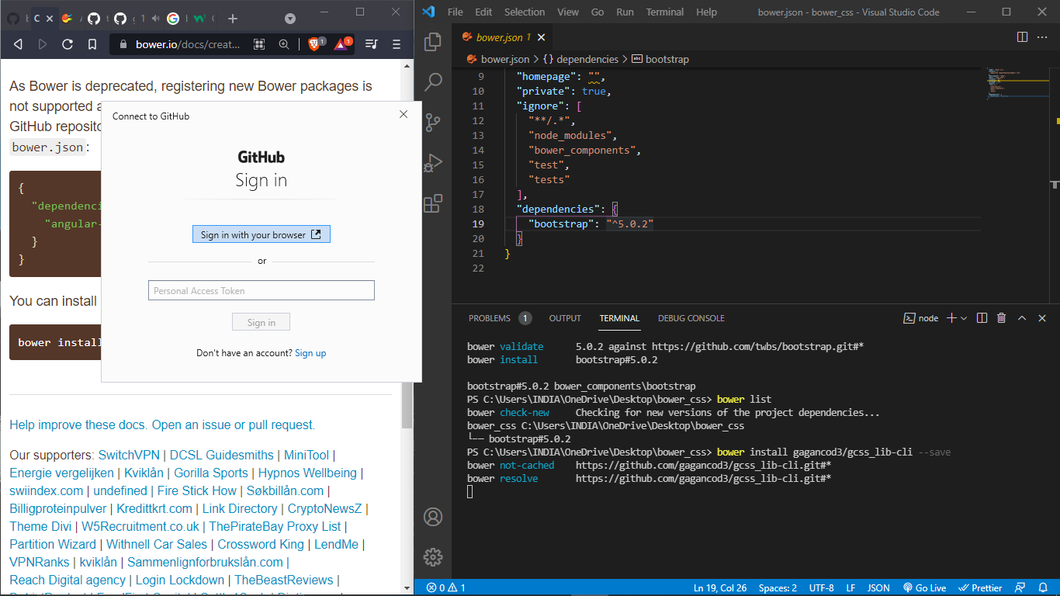
Access Github repo with bower

Slide 7
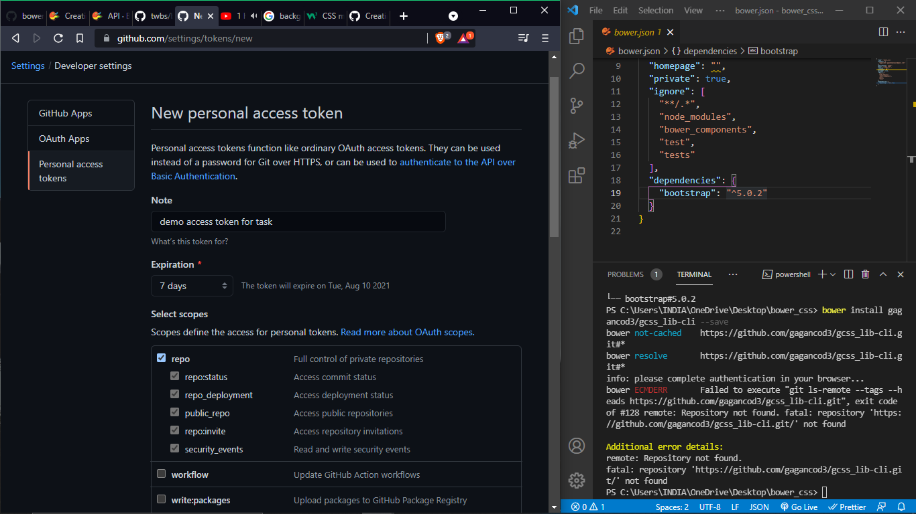
Creating Personal access token

Slide 8
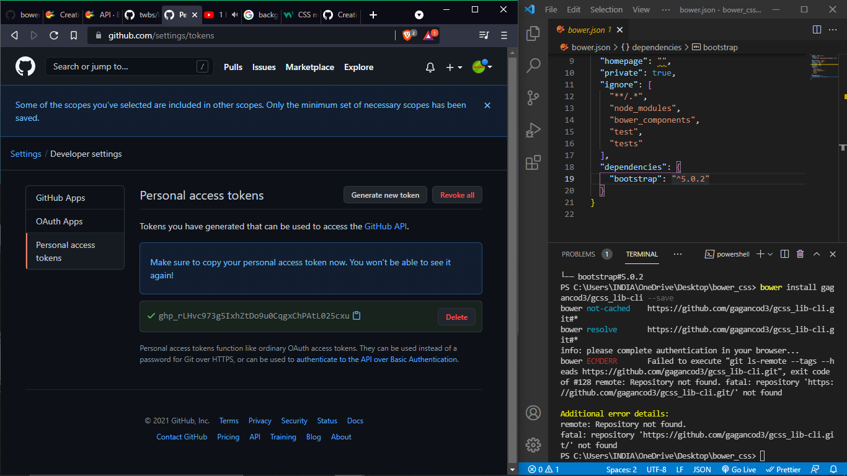

Slide 9
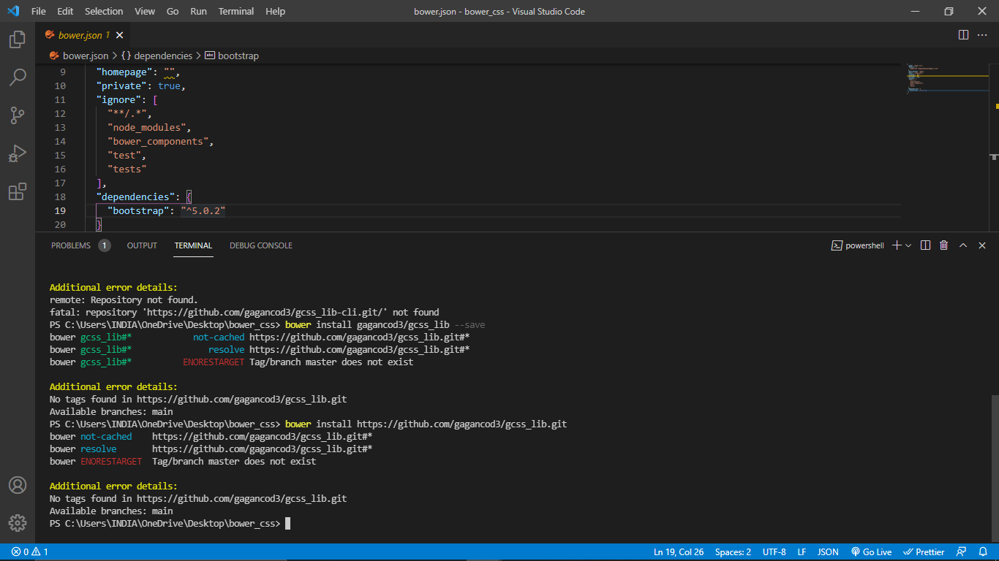
ERROR

Slide 10
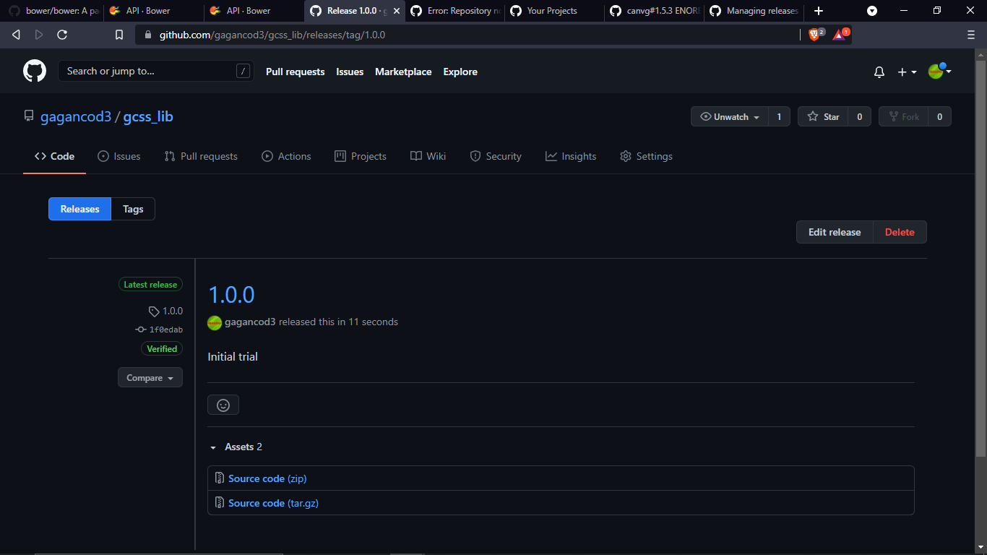
Created version in order to get “tag master”

Slide 11
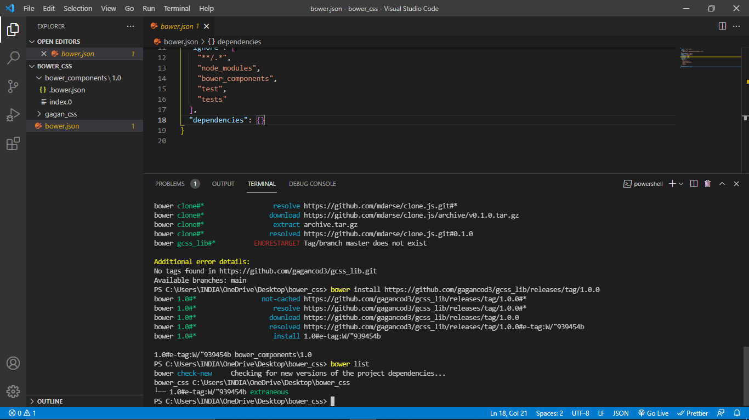
Successfully installed but file is missing!?

Slide 12
Thankyou

