Slide 1
How we can Use Material UI and BootStrap together?
Gagandeep Singh

Slide 2
BootStrap | Material UI
It is an HTML, CSS & JS framework to make responsive websites that are mobile-friendly and easy to create. | Material UI is a highly interactive & customizable framework based on React UI and Material Design.
Developed by Twitter, initially named Twitter Blueprint. | Developed by a small team of passionate developers by referring to Google’s material design.
High speed of development because of reusable code | Speed of development is lesser than compared to bootstrap but can be increased by extensive use of reusable components and templates.
12-column grid system for responsive design | 12-column grid system, same as bootstrap
Bootstrap’s information layout provides a clear and consistent UI for all platforms. | Also, it a mobile-first and supports all platforms, but excess use of customizations, transitions, and animations might affect accessibility on some platforms.
Unnecessary JS, jQuery scripts, and large class definitions might make that application heavy if appropriate optimizations & refactoring are not performed. | It works on React JS components which can be independent of each other. It doesn’t require any library to work & thus we can only use what we need.
Bootstrap is very consistent and provides a simple, clear interface that, is easy to learn. And comparatively less customizable than Material UI. | Material UI is highly customizable with which designers can create tons of designs. But it may produce inconsistency among components.

Slide 3
Option 1: Using BootStrap and Materialize CSS

Slide 4
What is Materialize CSS
Materialize CSS is a UI component library which is created with CSS, JavaScript and HTML. It is created and designed by Google.
Materialize CSS is also known as Material Design.
It is a design language which combines the classic principles of successful design along with innovation and technology.

Slide 5
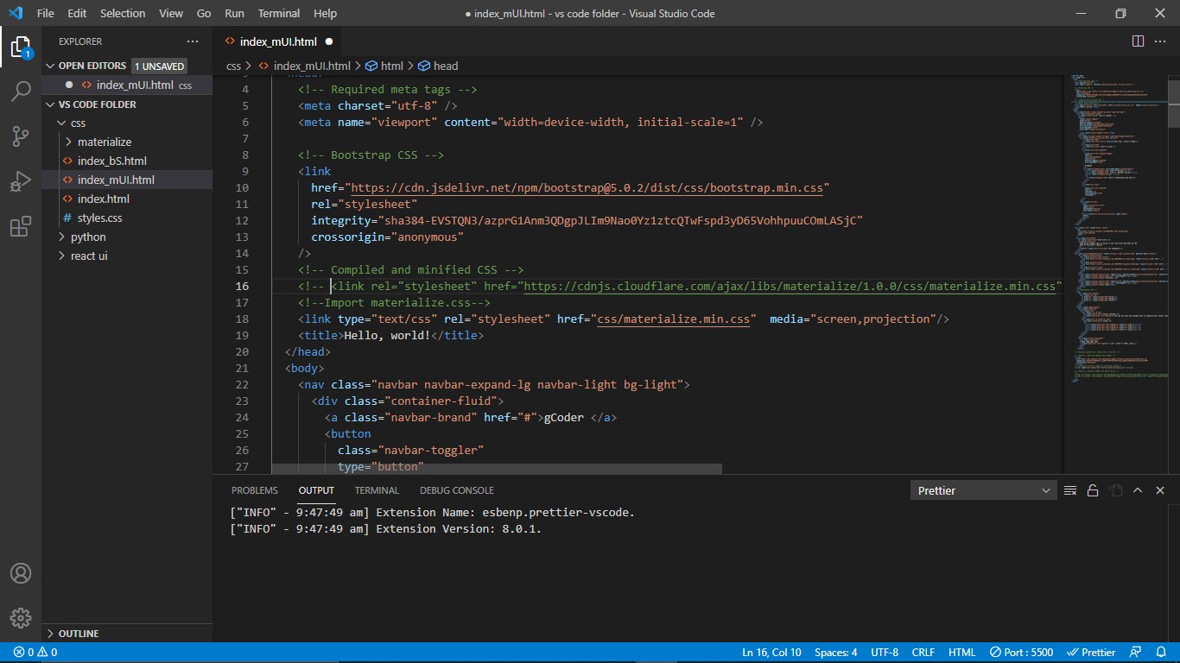
We can Combine BootStrap with Materialize CSS (I have commented the CDN link for MD CSS)

Slide 6
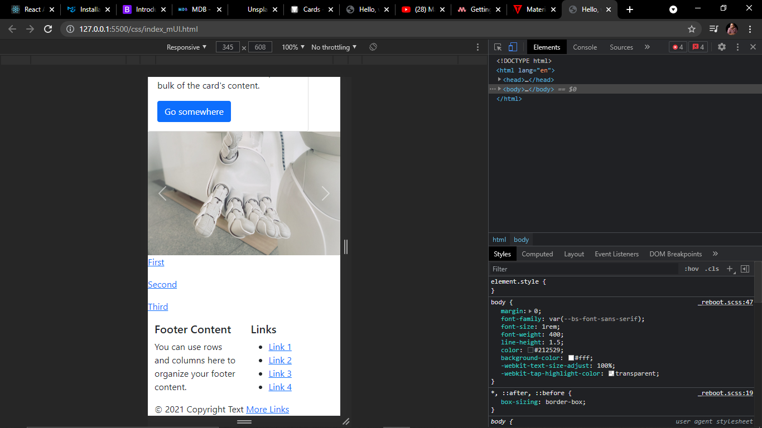
As CDN link is commented MD CSS is not applied

Slide 7
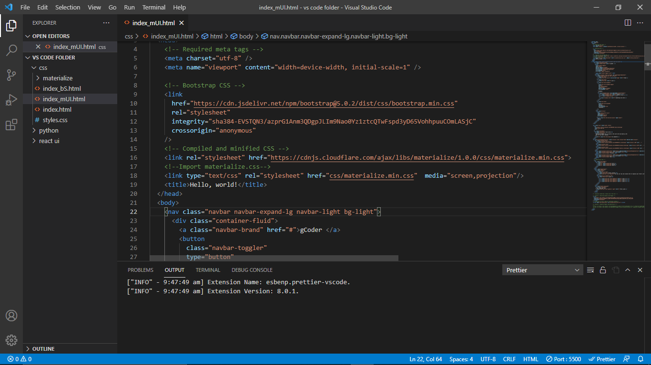
Enabling the CDN of Materialize CSS

Slide 8
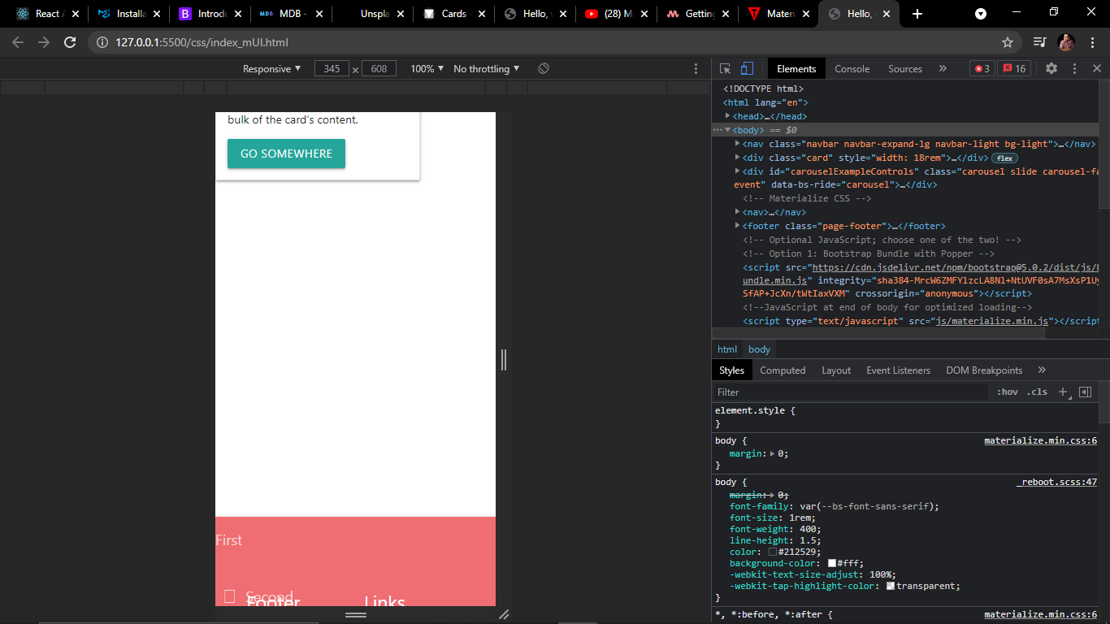
Somehow the BootStrap isn’t responding for carousel !

Slide 9
Option 2: Using Material UI and BootStrap

Slide 10
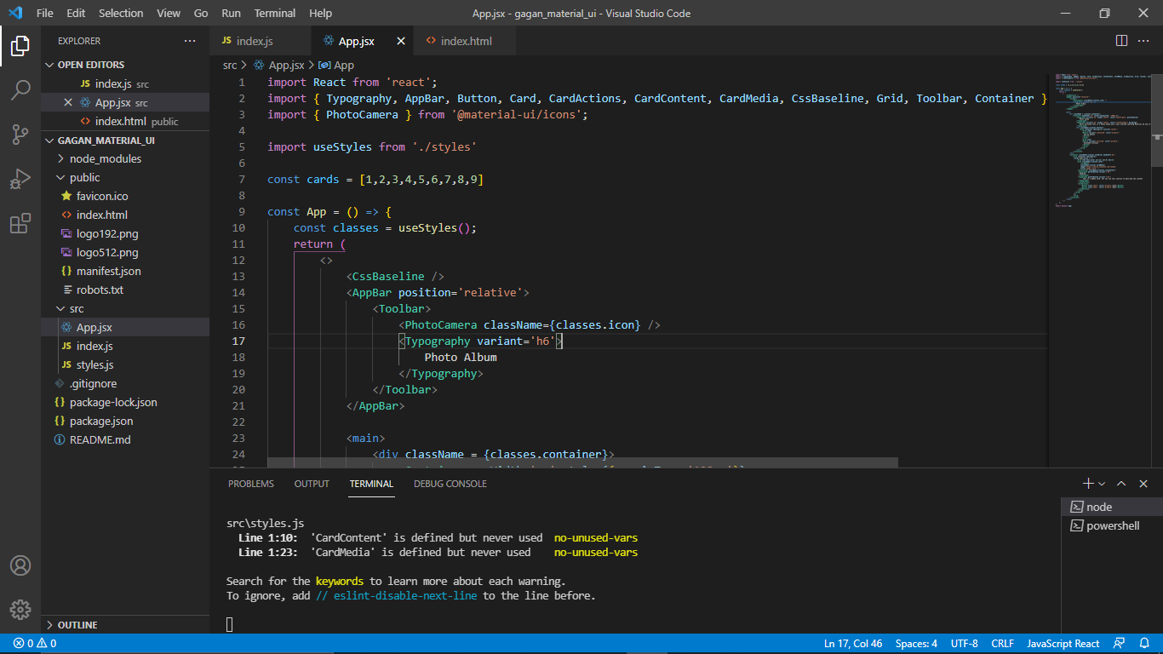
Using Material UI and Bootstrap

Slide 11
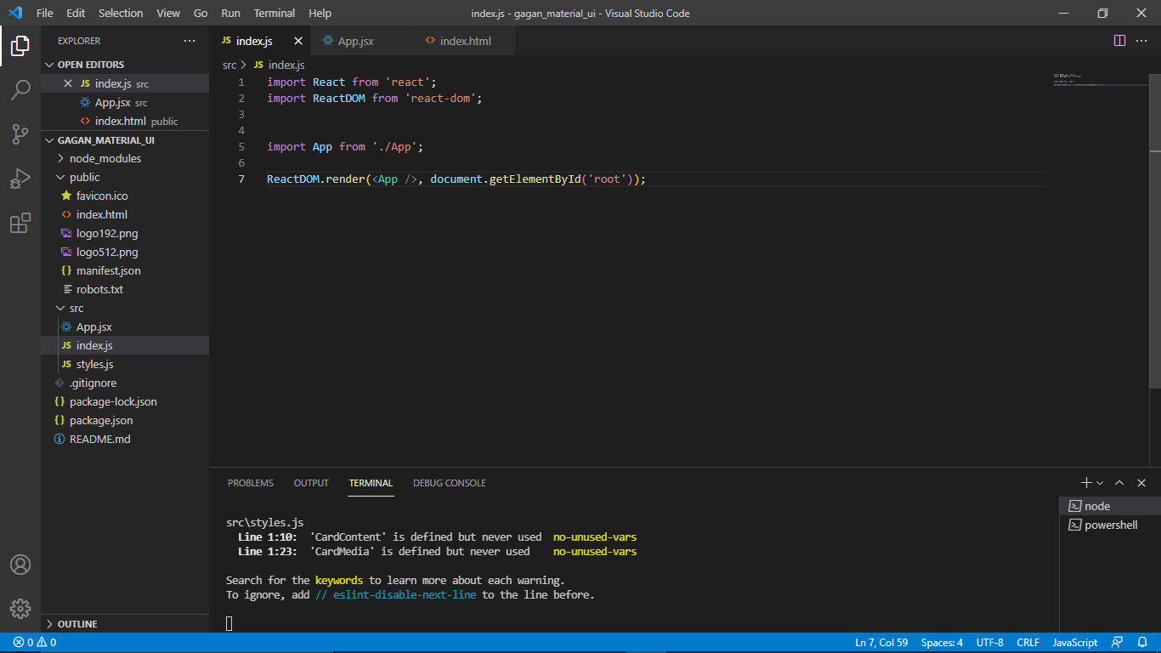

Slide 12
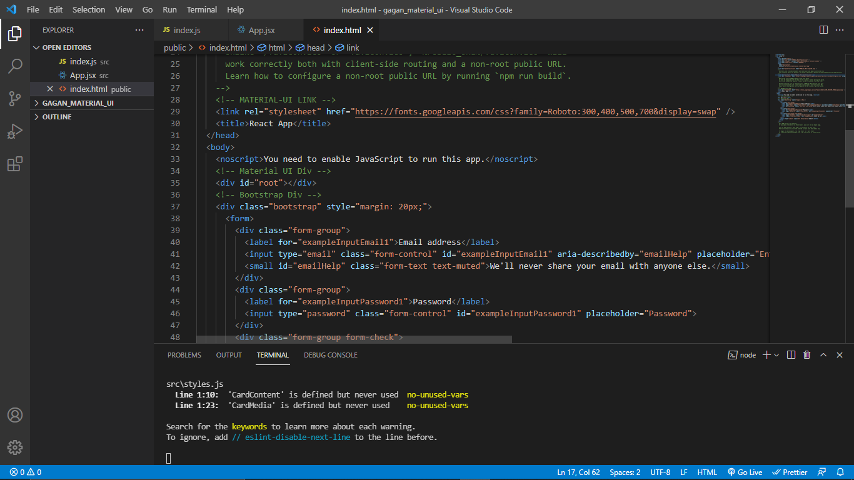

Slide 13
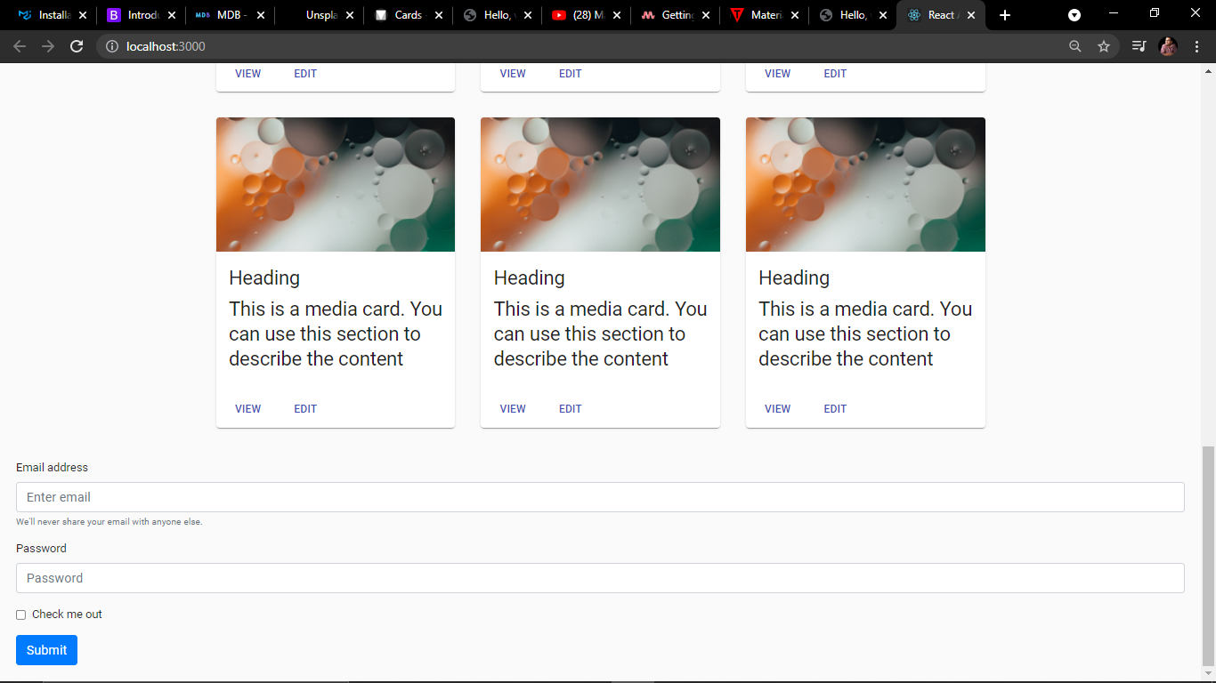

Slide 14
Option 3: Using MDB Framework

Slide 15
MDB - MaterialDesignBootStrap
Can we use both of them?
Is it possible to take advantage of both? To enjoy a stylish responsive design without spending too much time adapting the app for various platforms?
Yes, material design makes this possible with Bootstrap (also known as mdbootstrap). It is a set of libraries built on Bootstrap and follows other well-known frameworks and content design guidelines such as Vue, Angular, React. Allows those combo developers to use Bootstrap syntax that is familiar to everyone, so there will be fewer issues when developing.

Slide 16
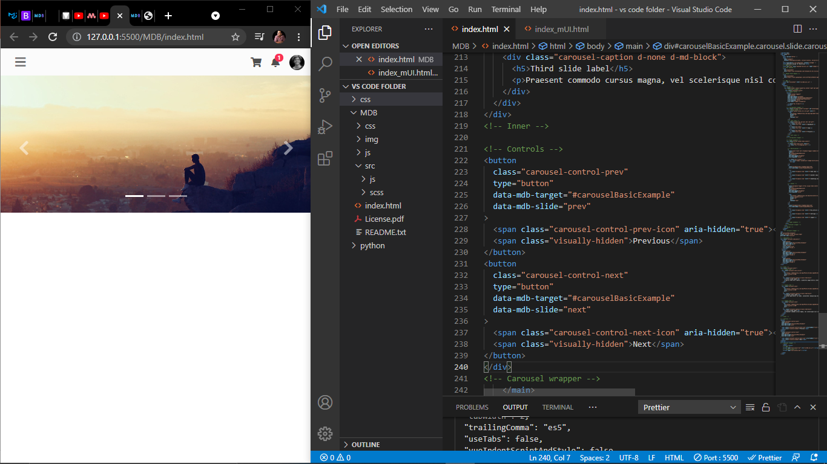
MDB Framework

Slide 17
Let’s Summarize what we have learnt
There are multiple ways we can use Multiple CSS Frameworks together but what I have done here is use particular framework on particular html tags and we have to make sure that we don’t get confuse between different syntax of frameworks and we can add classes to those tags to distinguish which framework we have used on which tag.

Slide 18
Thankyou

