Slide 1
Model Evaluation and Metrics
Jay Urbain, PhD

Slide 2
Topics
Regression
Assessing the accuracy of model coefficients
RMSE – Root Mean Squared Error
Classification
Confusion matrix
ROC Curve

Slide 3

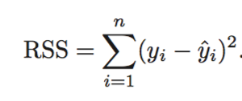

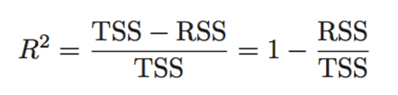
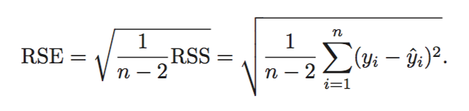
Review: Assessing the accuracy of model coefficients
Linear regression with residual term. Represents what we can’t explain with our model.
RSS measures the amount of variability that is left unexplained after performing the regression
TSS (Total sum of squares) measures the total variance when measuring the response y.
R² amount of variance explained by our model
The RSE is an estimate of the standard deviation of ε. It is basically the average amount that the response will deviate from the true regression line.

Slide 4
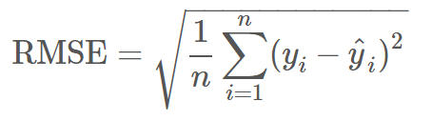
Root Mean Squared Error
Used for regression problems
Square root of the mean of the squared errors
Easily interpretable (in the “y” units)
“Punishes” larger errors
Other: absolute error

Slide 5
Root Mean Squared Error
Example:
y_true = [100, 50, 30]
y_preds = [90, 50, 50]
RMSE = np.sqrt((10**2 + 0**2 + 20**2) / 3) = 12.88

Slide 6
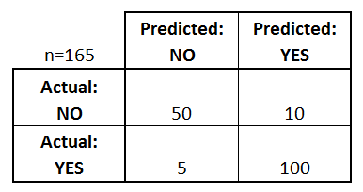
Confusion Matrix: table to describe the performance of a classifier
How many classes are there?
How many patients?
How many times is disease predicted?
How many patients actually have the disease?
Example: Test for presence of disease
NO = negative test = False = 0
YES = positive test = True = 1

Slide 7
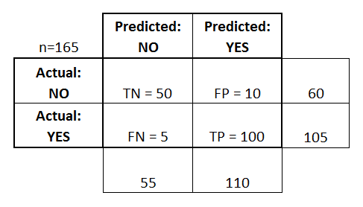
Confusion Matrix: table to describe the performance of a classifier
Basic Terminology:
True Positives (TP)
True Negatives (TN)
False Positives (FP) - Type I Error
False Negatives (FN) - Type II Error
Accuracy:
Overall, how often is it correct?
(TP + TN) / total = 150/165 = 0.91
Misclassification Rate (Error Rate):
Overall, how often is it wrong?
(FP + FN) / total = 15/165 = 0.09

Slide 8
Confusion Matrix: table to describe the performance of a classifier
True Positive Rate, Sensitivity, Recall:
When actual value is positive, how often is prediction correct?
TPR = TP / T = 100/105 = 0.95
“True Positive Rate” or “Recall”
False Positive Rate, Fall-out:
When actual value is negative, how often is prediction wrong?
FPR = (FP / F) = 10/60 = 0.17
Specificity, True Negative Rate:
When actual value is negative, how often is prediction correct?
TNR = (TN / F) = 50/60 = 0.83

Slide 9
Receiver operating characteristic (ROC) Curve
The ROC curve, is a graphical plot that illustrates the diagnostic ability of a binary classifier system as its discrimination threshold is varied.
The ROC curve is created by plotting the true positive rate (TPR) against the false positive rate (FPR) at various threshold settings.

Slide 10
Receiver operating characteristic (ROC) Curve
To draw a ROC curve, only the true positive rate (TPR) and false positive rate (FPR) are needed (as functions of some classifier parameter).
A ROC space is defined by FPR and TPR as x and y axes, respectively, which depicts relative trade-offs between true positive (benefits) and false positive (costs).
The best possible prediction method would yield a point in the upper left corner or coordinate (0,1) of the ROC space, representing 100% sensitivity (no false negatives) and 100% specificity (no false positives).
The (0,1) point is also called a perfect classification.

Slide 11
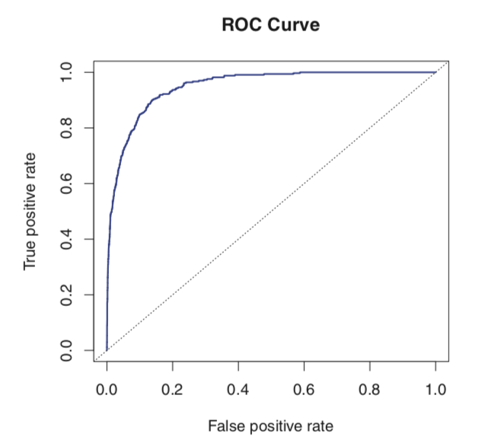
ROC Curves
The overall performance of a classifier summarized over all possible thresholds, is given by the area under the ROC curve (AUC).
An ideal ROC curve will hug the top left corner, so the larger the AUC the better the classifier.
A classifier performing not better than chance would have an AUC of 0.5

Slide 12
ROC Space

Slide 13
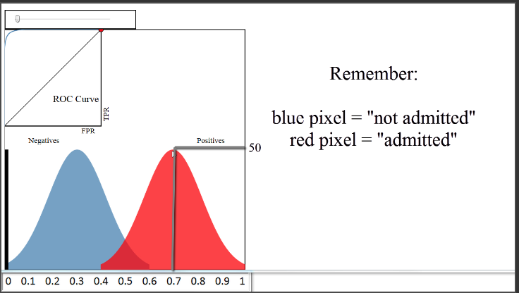
http://www.navan.name/roc/
http://www.navan.name/roc/

Slide 14
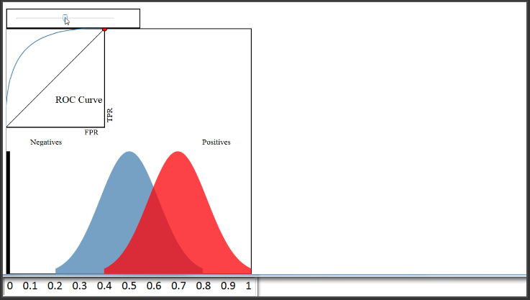

Slide 16
ROC Curve
Every email is assigned a “spam” score by our classification algorithm. To actually make our predictions, we choose a numeric cutoff for classifying as spam.
An ROC Curve will help us visualize how well our classifier is doing without having to choose a cutoff!
Email Number | Score | True Label
5 | 0.99 | Spam
8 | 0.82 | Spam
2 | 0.60 | Spam
1 | 0.60 | Ham
7 | 0.48 | Spam
3 | 0.22 | Ham
4 | 0.10 | Ham
6 | 0.02 | Ham

Slide 17
ROC Curve
ROC Curve
Email Number | Score | True Label
5 | 0.99 | Spam
8 | 0.82 | Spam
2 | 0.60 | Spam
1 | 0.60 | Ham
7 | 0.48 | Spam
3 | 0.22 | Ham
4 | 0.10 | Ham
6 | 0.02 | Ham
TPR
FPR

Slide 18
ROC Curve
ID | Classifier Score | True Label | TPR | FPR
5 | 0.99 | T
8 | 0.82 | T
2 | 0.72 | F
1 | 0.68 | T
7 | 0.51 | F
3 | 0.48 | T
4 | 0.30 | F
6 | 0.02 | F
ROC Curve
TPR
FPR

Slide 19
ROC Curve
https://www.dataschool.io/roc-curves-and-auc-explained/
TPR: When actual value is spam, how often is prediction correct?
FPR: When actual value is ham, how often is prediction wrong?
Email Number | Score | True Label
5 | 0.99 | Spam
8 | 0.82 | Spam
2 | 0.60 | Spam
1 | 0.60 | Ham
7 | 0.48 | Spam
3 | 0.22 | Ham
4 | 0.10 | Ham
6 | 0.02 | Ham
Cutoff | TPR (y) | FPR (x) | Cutoff | TPR (y) | FPR (x)
0 |  |  | 0.50
0.05 |  |  | 0.65
0.15 |  |  | 0.85
0.25 |  |  | 1

Slide 20
ROC Curve
TPR: When actual value is spam, how often is prediction correct?
FPR: When actual value is ham, how often is prediction wrong?
Email Number | Score | True Label
5 | 0.99 | Spam
8 | 0.82 | Spam
2 | 0.60 | Spam
1 | 0.60 | Ham
7 | 0.48 | Spam
3 | 0.22 | Ham
4 | 0.10 | Ham
6 | 0.02 | Ham
Cutoff | TPR (y) | FPR (x) | Cutoff | TPR (y) | FPR (x)
0 | 1 | 1 | 0.50 | 0.75 | 0.25
0.05 | 1 | 0.75 | 0.65 | 0.5 | 0
0.15 | 1 | 0.5 | 0.85 | 0.25 | 0
0.25 | 1 | 0.25 | 1 | 0 | 0

Slide 21
ROC Curve
Q: Would the ROC Curve (and AUC) change if the scores changed, but the ordering remained the same?
A: Not at all! The ROC Curve is only sensitive to rank ordering and does not require calibrated scores.
Email Number | Score | True Label
5 | 0.99 | Spam
8 | 0.98 | Spam
2 | 0.97 | Spam
1 | 0.97 | Ham
7 | 0.96 | Spam
3 | 0.95 | Ham
4 | 0.94 | Ham
6 | 0.93 | Ham

