Slide 1
Linear regression with gradient descent
Jay Urbain, PhD
Credits: Nando de Freitas, Oxford; Andrew Ng, Stanford; Hastie and Tibshirani, Stanford

Slide 2
Linear Regression with Gradient Descent
Linear Regression
Hypothesis formulation, hypothesis space
Optimizing Cost with Gradient Descent
Using multiple input features with Linear Regression
Notes on:
Feature Scaling
Nonlinear Regression
Optimizing Cost using derivatives

Slide 3
Housing Prices
(Milwaukee, WI)
Price
(in 1000’s of dollars)
Size (feet²)
Supervised Learning
Given the “right answer” for each example in the data.
Regression Problem
Predict real-valued output
Notes:
Fit line to data to predict house price – continuous value output, e.g., size(feet^2) = 1250, price = $220k
Draw line

Slide 4
Training set of
housing prices
(Milwaukee, WI)
Size in feet² (x) | Price ($) in 1000's (y)
2104 | 460
1416 | 232
1534 | 315
852 | 178
… | …
Notation:
m = Number of training examples
x’s = “input” variable / features
y’s = “output” variable / “target” variable
X⁽¹⁾ = 2104
X⁽²⁾ = 1416
…
Y⁽¹⁾ = 460
(x, y) – one training example
(x⁽¹⁾,y⁽¹⁾) – i^{th} training example

Slide 5

Training Set
How do we represent h ?
Learning Algorithm
Linear regression with one variable.
(Univariate linear regression)
Size of house
h
Estimated price
h – hypothesis to learn (parameterized model)
h maps from x to y

Slide 6
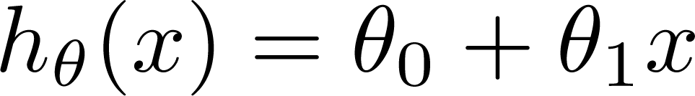

Training Set
Size in feet² (x) | Price ($) in 1000's (y)
2104 | 460
1416 | 232
1534 | 315
852 | 178
… | …
Hypothesis:
‘s: Parameters
How to choose ‘s ?

Slide 7
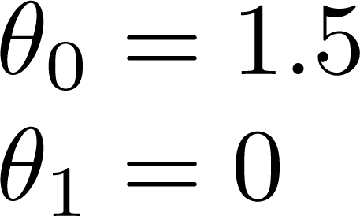
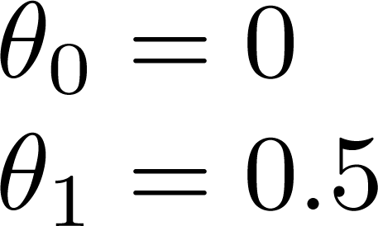
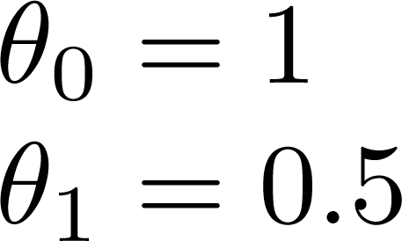
y
x
Draw h(x)

Slide 8
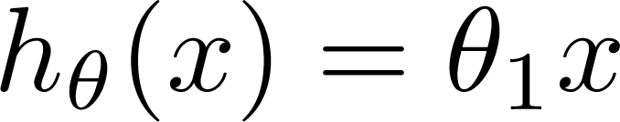
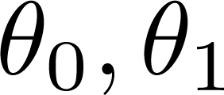

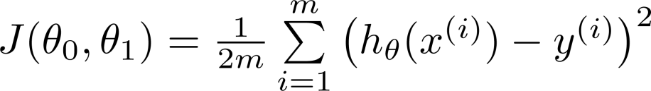
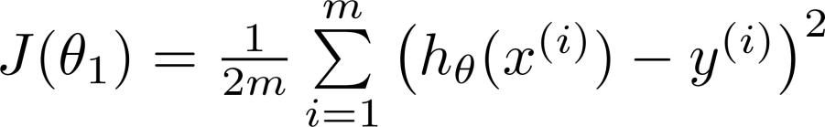
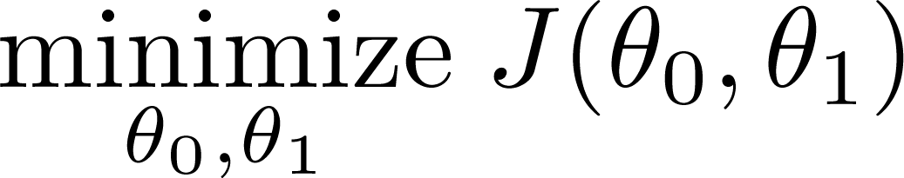
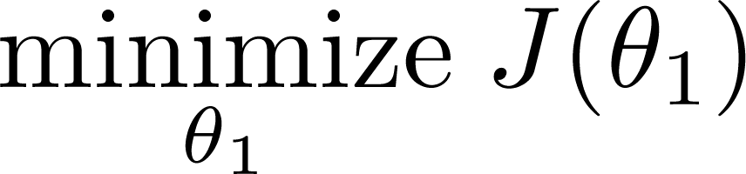
Simplified
Hypothesis:
Parameters:
Cost Function:
Goal:

Slide 9







(for fixed , this is a function of x)
(function of the parameter )
y
x
x
x
x
x
x
x
x
x
Note: h(x^{(i)})-y^{(i)}=0, J^{(i)}= 1/(2m)*(0²+0²+0²)=0
Notes:
H(x(i)) = y

Slide 10
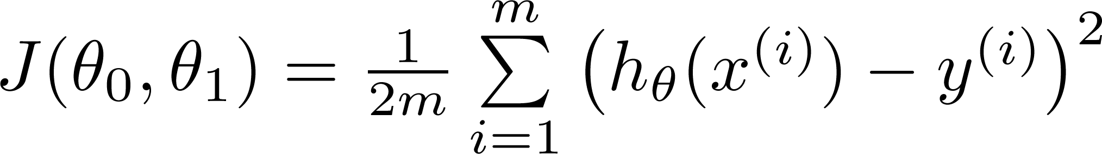
Hypothesis:
Parameters:
Cost Function:
Goal:

Slide 11
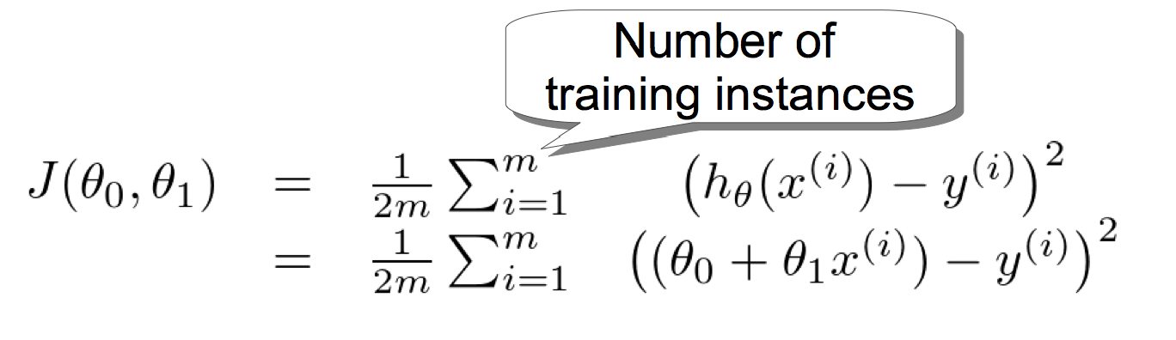
Fitting data well: least squares cost function
In regression, you almost always want to fit the data well
smallest average distance to points in training data
(h(x) close to y for (x, y) in training data)
Cost function J:
Squaring
Penalty for positive and negative deviations the same
Penalty for large deviations stronger

Slide 12
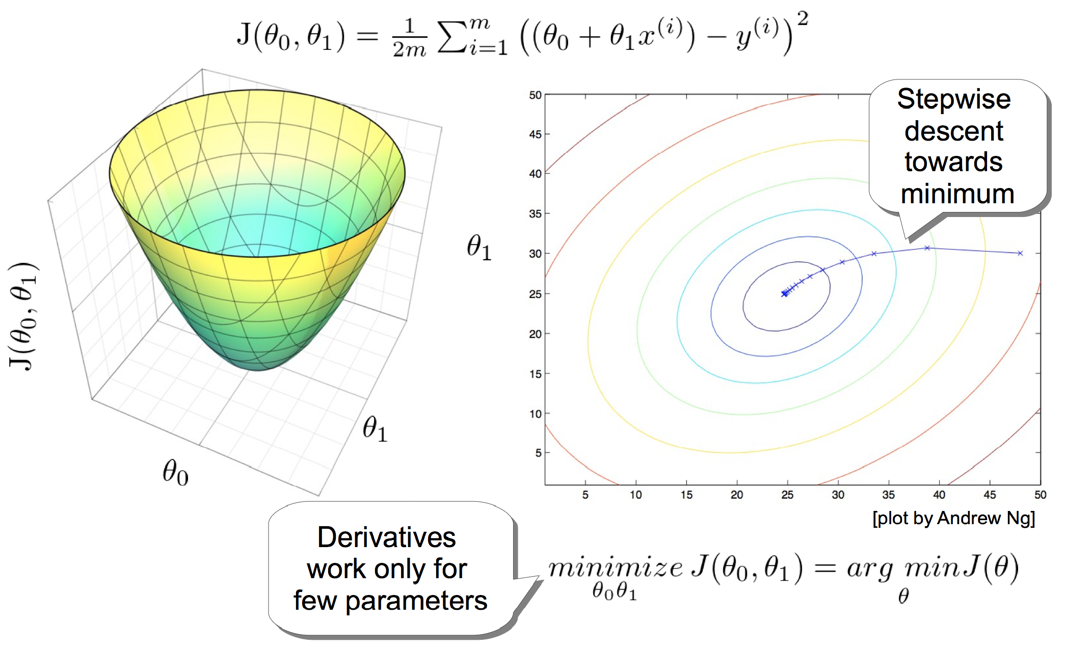
Optimizing Cost with Gradient Descent

Slide 13
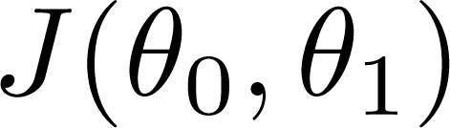


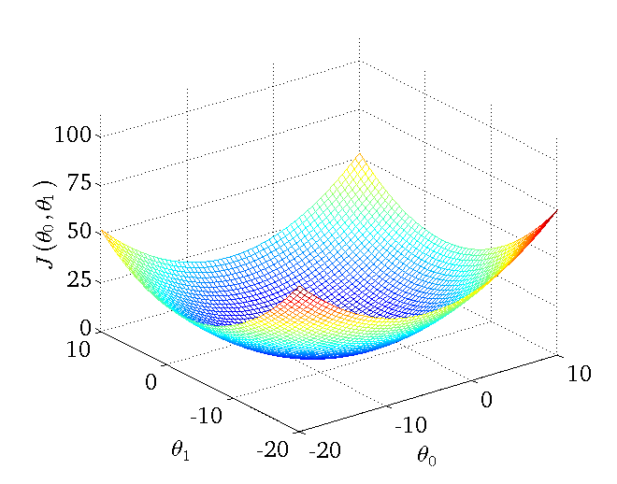
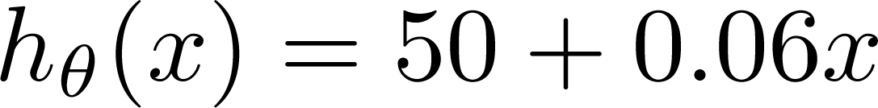
(for fixed , this is a function of x)
(function of the parameters )
Price ($)
in 1000’s
Size in feet² (x)

Slide 14
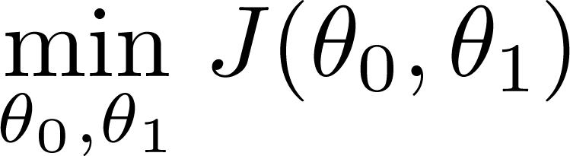
Have some function
Want to
Outline:
Start with some
Keep changing to reduce until we hopefully end up at a minimum
How?

Slide 15
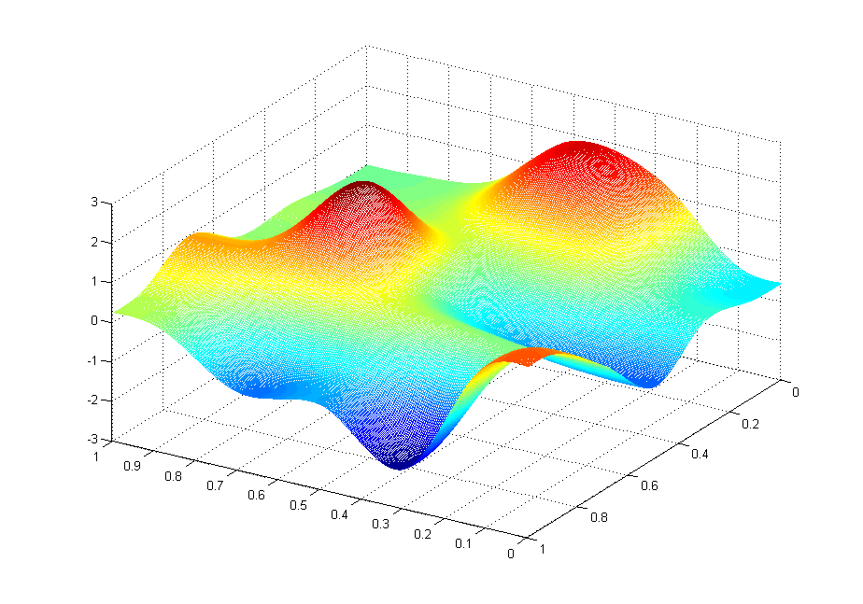
0

Slide 17
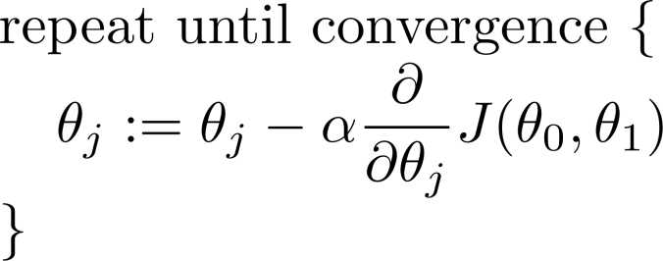
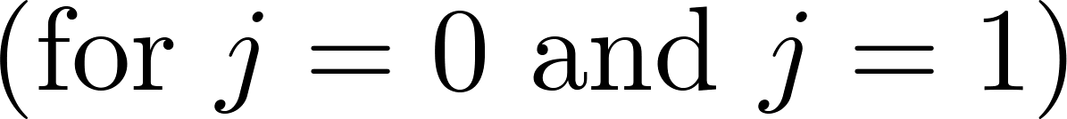
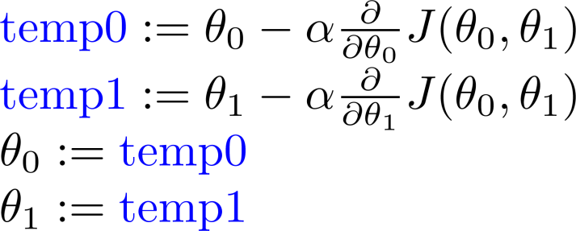
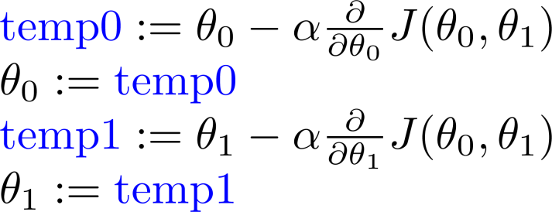
Gradient descent algorithm
Correct: Simultaneous update
Incorrect:

Slide 18
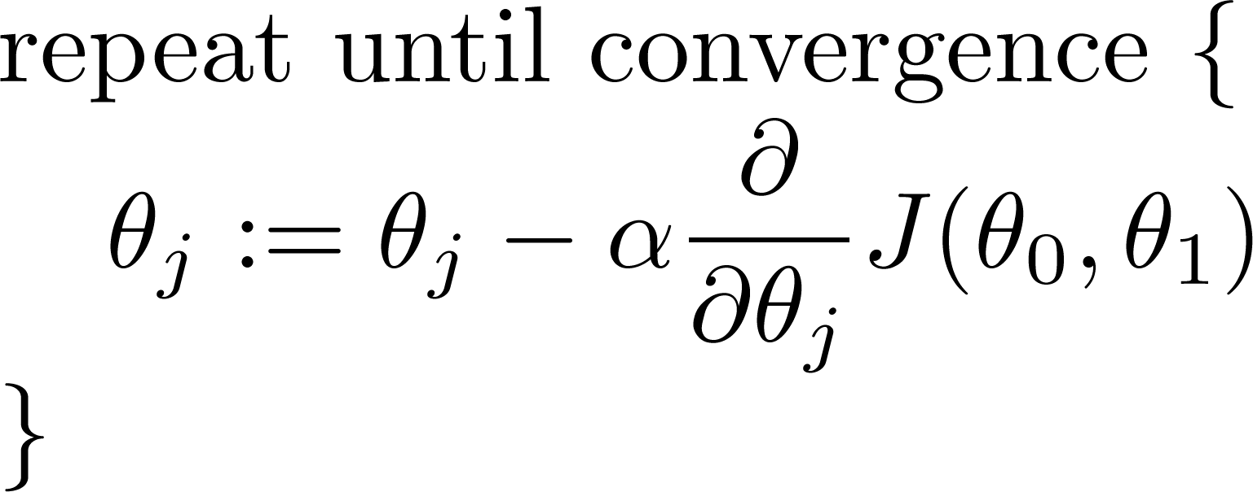
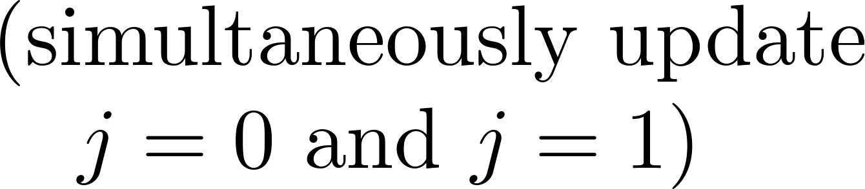
Gradient descent algorithm
learning rate
derivative
Notes:
Show concave function going back and forth

Slide 19
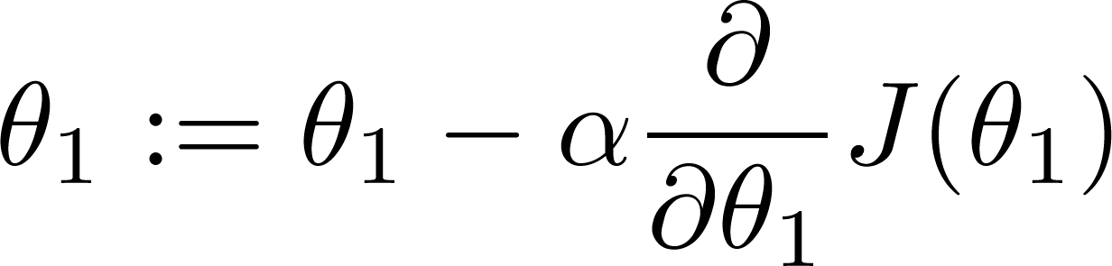
If α is too small, gradient descent can be slow.
If α is too large, gradient descent can overshoot the minimum. It may fail to converge, or even diverge.

Slide 20

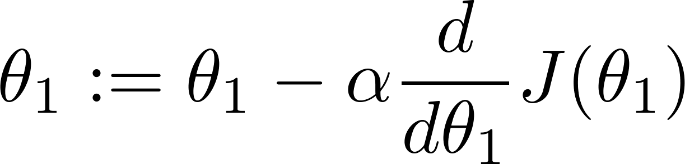
at local optima
Current value of

Slide 21
Gradient descent can converge to a local minimum, even with the learning rate α fixed.
As we approach a local minimum, gradient descent will automatically take smaller steps.
Gradient gets smaller as learning rate stays constant

Slide 22
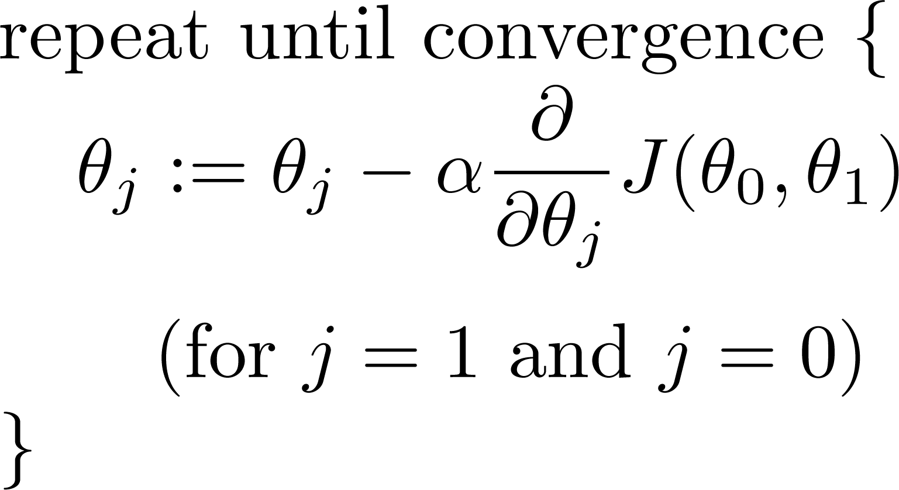
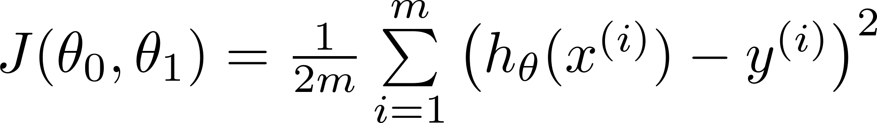
Linear regression with one variable
Gradient descent algorithm
Linear Regression Model

Slide 23
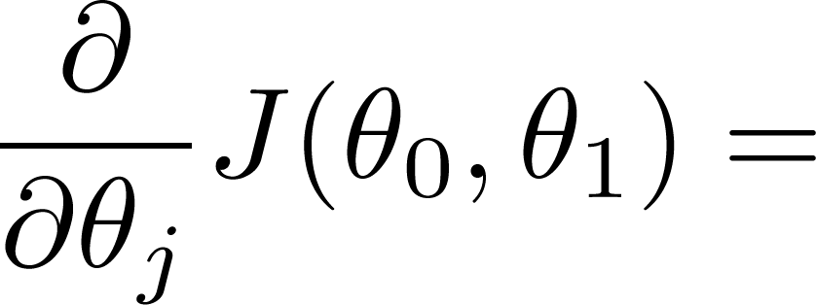

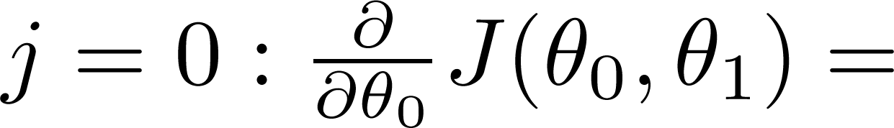

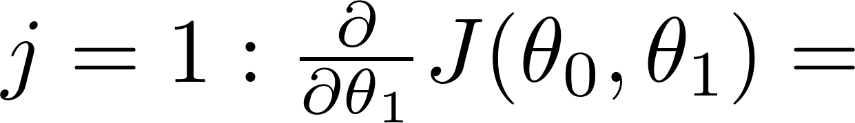
Finding steepest gradient of
Linear regression L2 cost function

Slide 24
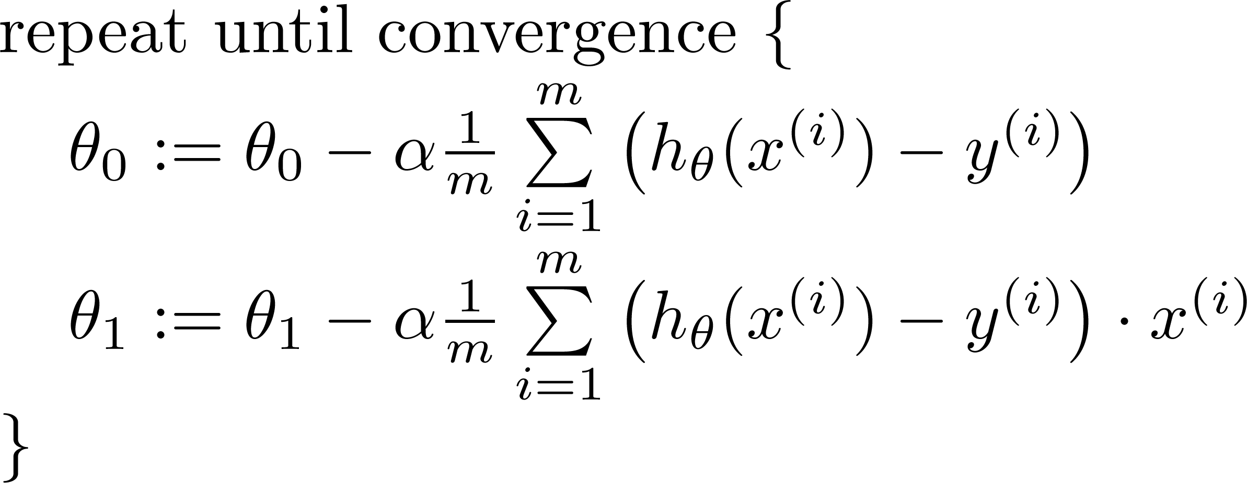

Gradient descent algorithm
update
and
simultaneously

Slide 25
J(Θ₀, Θ₁)
Θ₁
Θ₀

Slide 26
Convex function

Slide 27
“Batch” versus “Online” Gradient Descent
“Batch”: Each step of gradient descent uses all the training examples.
“Online”: Each step of gradient descent uses a training example at a time.

Slide 28
Multiple features (variables).
Size (feet²) | Number of bedrooms | Number of floors | Age of home (years) | Price ($1000)
2104 | 5 | 1 | 45 | 460
1416 | 3 | 2 | 40 | 232
1534 | 3 | 2 | 30 | 315
852 | 2 | 1 | 36 | 178
… | … | … | … | …

Slide 29
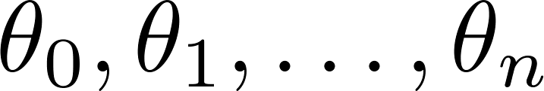
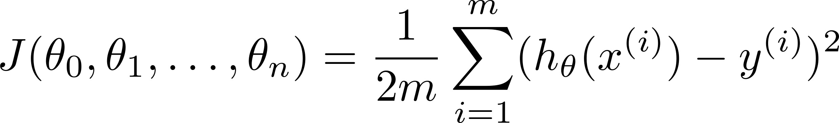

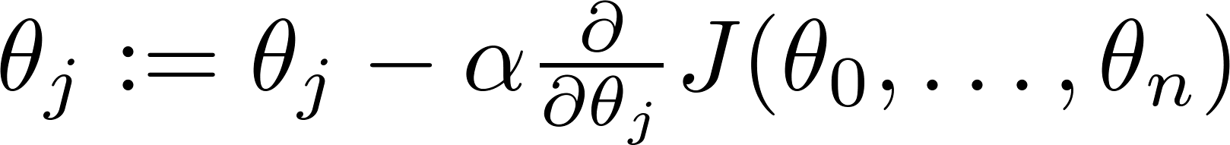

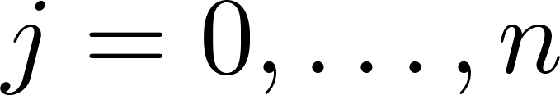
Hypothesis:
Parameters:
Cost function:
Gradient descent:
Repeat
(simultaneously update for every )

Slide 30

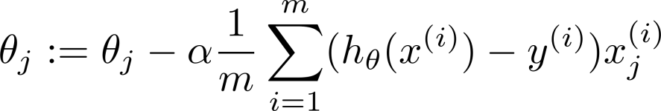
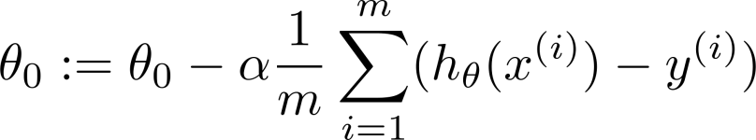



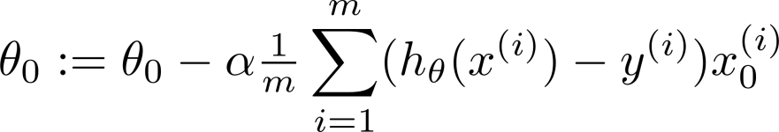
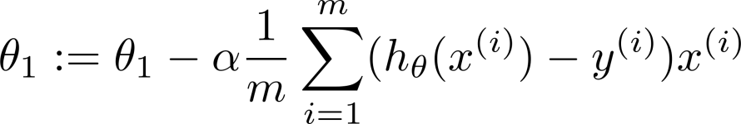
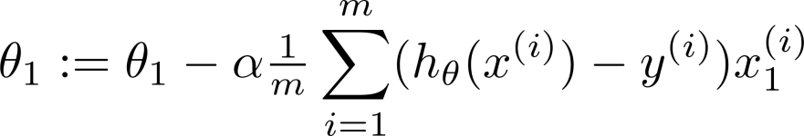

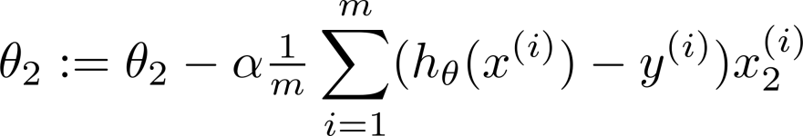
New algorithm :
Gradient Descent
Repeat
Previously (n=1):
Repeat
(simultaneously update for
)
(simultaneously update )
Notes:
Add x0 as 1

Slide 31
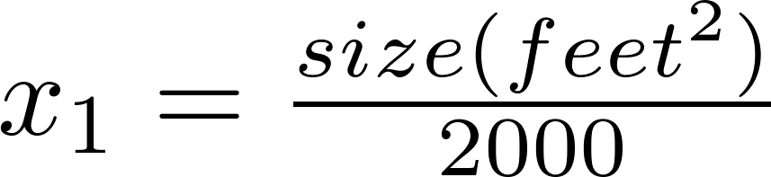


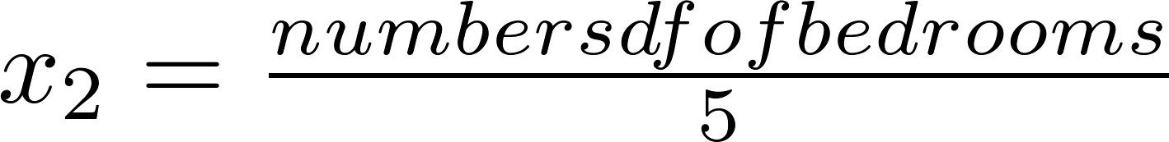
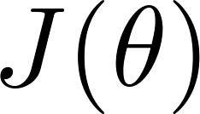


Feature Scaling
Idea: Make sure features are on a similar scale.
E.g. = size (0-2000 feet²)
= number of bedrooms (1-5)
size (feet²)
number of bedrooms
Notes:
Left draw skinning contour plot on right draw 0<x<1 symmetric contour plot
Or -1 to 1 range

Slide 32



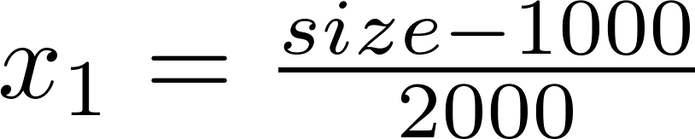
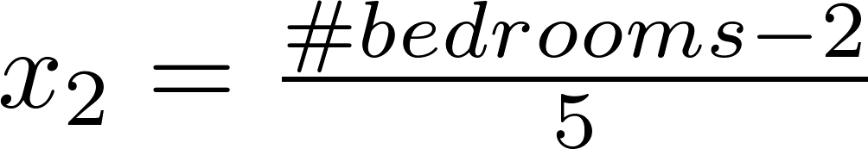


Mean normalization
Replace with to make features have approximately zero mean (Do not apply to ).
E.g.
Z-score (standard score) normalization
Standard score is the signed number of standard deviations by which the value of an observation or data point is above the mean value.
Min-max (0-1) normalization

Slide 33
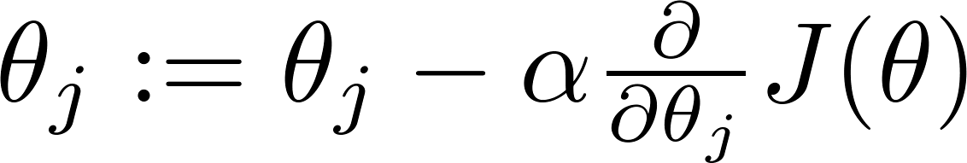

Gradient descent
“Debugging”: How to make sure gradient descent is working correctly.
How to choose learning rate .

Slide 34
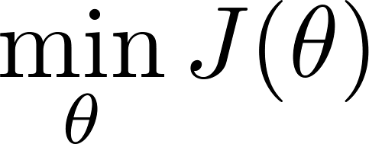
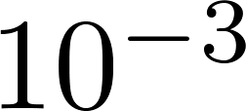
Making sure gradient descent is working correctly.
Example automatic convergence test:
Declare convergence if decreases by less than in one iteration.
No. of iterations

Slide 35
Summary:
If is too small: slow convergence.
If is too large: may not decrease on every iteration; may not converge.
To choose , try
STOP FIRST LECTURE

Slide 36

Housing prices prediction
Notes:
Replace x1 and x2 with area

Slide 37





Polynomial regression
Price
(y)
Size (x)

Slide 38
Choice of features
Price
(y)
Size (x)

Slide 39

Least squared
provides analytic
solution with one
predictor

Slide 40


Slide 41






Normal equation:
Method to solve for analytically.
Intuition: If 1 parameter
(for every )
Solve for

Slide 42









Examples:
 | Size (feet²) | Number of bedrooms | Number of floors | Age of home (years) | Price ($1000)
1 | 2104 | 5 | 1 | 45 | 460
1 | 1416 | 3 | 2 | 40 | 232
1 | 1534 | 3 | 2 | 30 | 315
1 | 852 | 2 | 1 | 36 | 178
1
Size (feet²) | Number of bedrooms | Number of floors | Age of home (years) | Price ($1000)
2104 | 5 | 1 | 45 | 460
1416 | 3 | 2 | 40 | 232
1534 | 3 | 2 | 30 | 315
852 | 2 | 1 | 36 | 178
3000 | 4 | 1 | 38 | 540
Normal equation
https://en.wikipedia.org/wiki/Linear_least_squares_(mathematics)
Notes:
Pop-up Quiz

Slide 43



Show derivation notebook
is inverse of matrix .
numpy.linalg.solve(a, b)
http://docs.scipy.org/doc/numpy-1.10.1/reference/generated/numpy.linalg.solve.html
theta = np.linalg.solve(X, y)
Assumes X is not singular, and is square
Matlab/Octave:
pinv(X’*X)*X’*y

Slide 44



Slide 45


training examples, features.
Gradient Descent
Normal Equation
Need to choose .
Needs many iterations.
No need to choose .
Don’t need to iterate.
Works well even when is large.
Need to compute
Slow if is very large.

Slide 46



What if is non-invertible?
Redundant features (linearly dependent).
E.g. size in feet²
size in m²
Too many features (e.g. ).
Delete some features, or use regularization.

Slide 47


^{Problem:} considering different cities for opening a new outlet. The chain already has trucks in various cities and you have data for profits and populations from the cities.
You would like to use this data to help you select which city to expand to next.

Slide 48

^{Visualize data}

Slide 49

^{Run linear regression}
Theta found by gradient descent: -3.630291 1.166362
For population = 35,000, we predict a profit of 4519.767868
For population = 70,000, we predict a profit of 45342.450129

Slide 50





Assessing the accuracy of model coefficients
Linear regression with residual term. Represents what we can’t explain with our model.
RSS measures the amount of variability that is left unexplained after performing the regression
TSS (Total sum of squares) measures the total variance when measuring the response y.
R² amount of variance explained by our model
The RSE is an estimate of the standard deviation of ε. It is basically the average amount that the response will deviate from the true regression line.

Slide 51


Least square approach
The least squares approach chooses β₀ and β₁ to minimize the RSS. Using some calculus, one can show that the minimizers are:

Slide 52


^{Saving and plotting theta}

Slide 53
Notes on:
Feature Scaling
Nonlinear Regression
Optimizing Cost using derivatives
Demo gradient descent algorithm
-> 08_linear_regression.ipynb

Slide 54
STOP LECTURE 2

