Slide 1
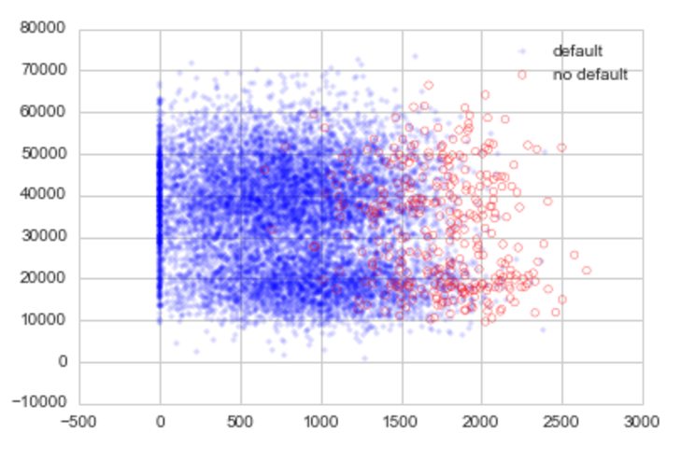
Cross Validation,
Regularization and Overfitting,
Assessing model effectiveness
Jay Urbain, PhD
Credits: Hastie and Tibshirani, Andrew Ng, Stanford;

Slide 2
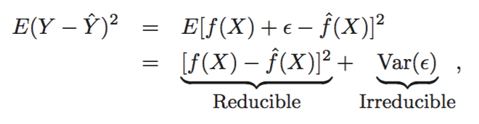
Data has inherent variance that does not have predictive value
Necessitates the need for training, validation, and test sets.
Training set – Learn model
Validation set – tune model
Test set – evaluate tuned model

Slide 3

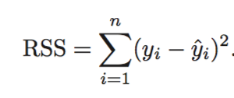

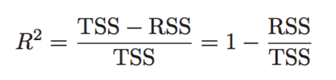
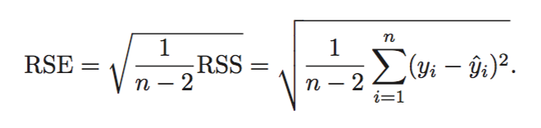
Assessing the accuracy of regression model coefficients
Linear regression with residual term. Represents what we can’t explain with our model.
RSS measures the amount of variability that is left unexplained after performing the regression
TSS (Total sum of squares) measures the total variance when measuring the response y.
R² amount of variance explained by our model
The RSE is an estimate of the standard deviation of ε. It is basically the average amount that the response will deviate from the true regression line.

Slide 4
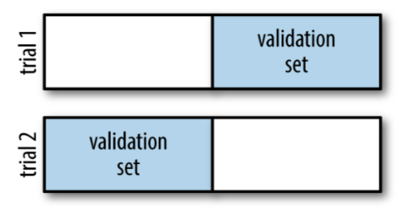
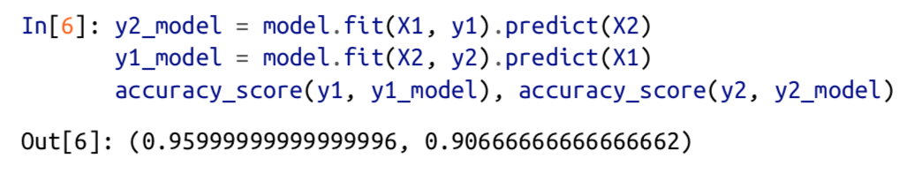
Model validation via cross-validation
One disadvantage of using a holdout set for model validation is that we have lost a portion of our data to the model training.
One way to address this is to use cross-validation—i.e., to do a sequence of fits where each subset of the data is used both as a training set and as a validation set.
Combine with average

Slide 5
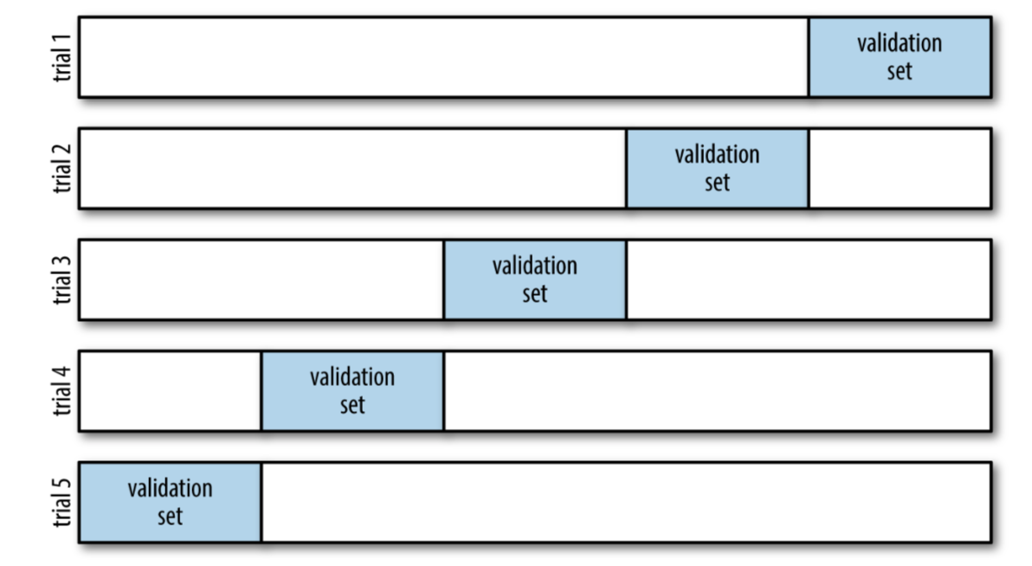
5-Fold Cross Validation
from sklearn.cross_validation import LeaveOneOut scores = cross_val_score(model, X, y, cv=LeaveOneOut(len(X)))
Combine with average

Slide 6
Selecting the best model
If our estimator is underperforming, how should we move forward? There are several possible answers:
Use a more complicated/more flexible model
Use a less complicated/less flexible model
Gather more training samples
Gather more data to add features to each sample
The answer to this question is often counterintuitive.
Sometimes using a more complicated model will give worse results, and adding more training samples may not improve your results!
The ability to determine what steps will improve your model is what separates the successful machine learning practitioners from the unsuccessful.

Slide 7
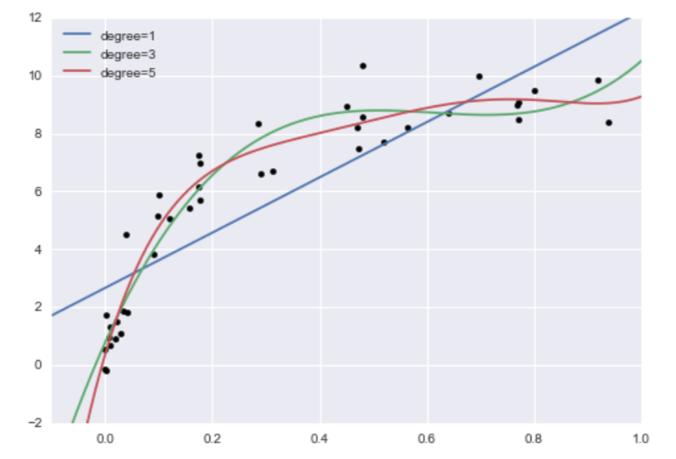
3 Different Polynomial Models Which is the best model?

Slide 8
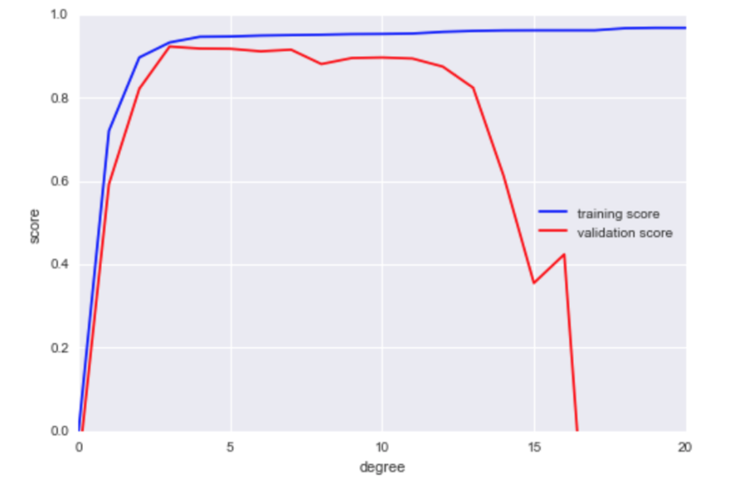
Training vs. validation Scores

Slide 9
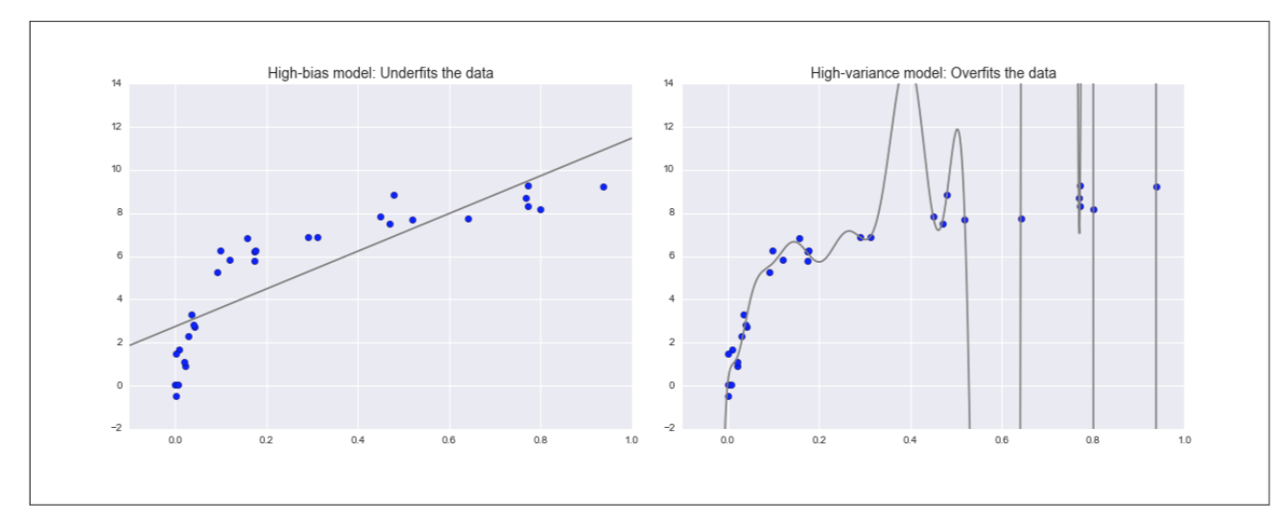
The bias–variance trade-off
Fundamentally, the question of “the best model” is about finding a sweet spot in the trade-off between bias and variance.

Slide 10
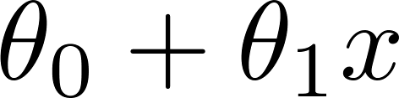
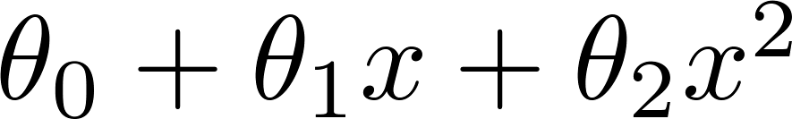
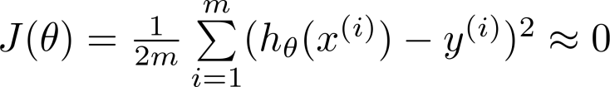
Example: Linear regression (housing prices)
Price
Price
Price
Size
Size
Size
Overfitting: If we have too many features, the learned hypothesis may fit the training set very well ( ), but fail to generalize to new examples (predict prices on new examples).
Notes:
Overfitting with linear regression
Using our house pricing example again Fit a linear function to the data - not a great model
This is underfitting - also known as high bias Bias is a historic/technical one ­ if we're fitting a straight line to the data we have a strong preconception that there should be a linear fit
In this case, this is not correct, but a straight line can't help being straight! Fit a quadratic function
Works well
Fit a 4th order polynomial
Now curve fit's through all five examples
Seems to do a good job fitting the training set But, despite fitting the data we've provided very well, this is actually not such a good model
This is overfitting - also known as high variance Algorithm has high variance
High variance - if fitting high order polynomial then the hypothesis can basically fit any data Space of hypothesis is too large

Slide 11
Example: Linear regression (housing prices)
Price
Price
Price
Size
Size
Size
Underfit, high bias
Overfit, high variance
Overfitting: If we have too many features, the learned hypothesis may fit the training set very well ( ), but fail to generalize to new examples (predict prices on new examples).
Notes:
Overfitting with linear regression
Using our house pricing example again Fit a linear function to the data - not a great model
This is underfitting - also known as high bias Bias is a historic/technical one ­ if we're fitting a straight line to the data we have a strong preconception that there should be a linear fit
In this case, this is not correct, but a straight line can't help being straight! Fit a quadratic function
Works well
Fit a 4th order polynomial
Now curve fit's through all five examples
Seems to do a good job fitting the training set But, despite fitting the data we've provided very well, this is actually not such a good model
This is overfitting - also known as high variance Algorithm has high variance
High variance - if fitting high order polynomial then the hypothesis can basically fit any data Space of hypothesis is too large

Slide 12
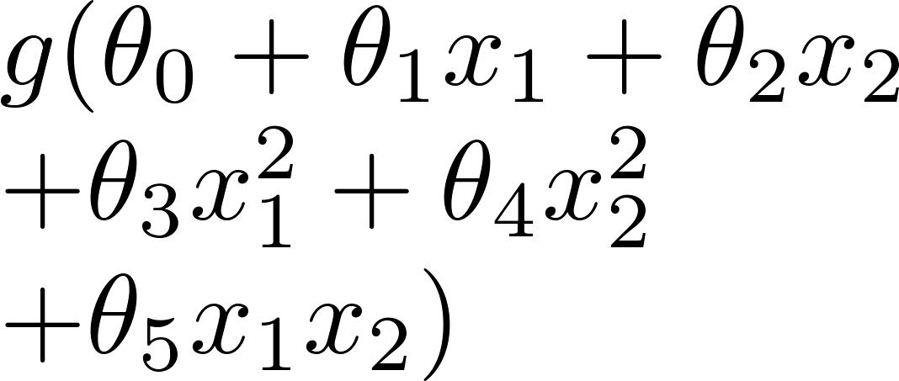
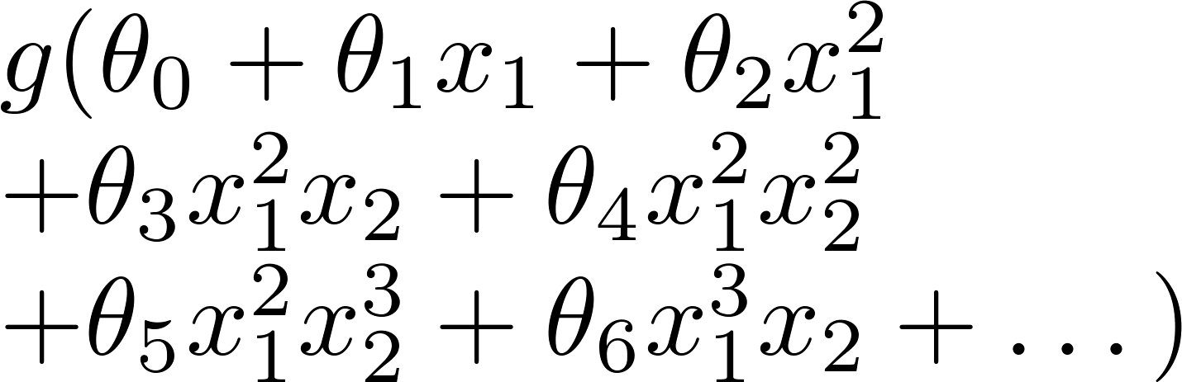
Example: Logistic regression
x₂
x₂
x₂
x₁
x₁
x₁
( = sigmoid function)

Slide 13
Example: Logistic regression
x₂
x₂
x₂
x₁
x₁
x₁
( = sigmoid function)
Underfit, high bias
Overfit, high variance
Low model complexity ← → High model complexity
Notes:
Later we'll look at identifying when overfitting and underfitting is occurring Earlier we just plotted a higher order function - saw that it looks "too curvy" Plotting hypothesis is one way to decide, but doesn't always work
Often have lots of a features - here it's not just a case of selecting a degree polynomial, but also harder to plot the data and visualize to decide what features to keep and which to drop If you have lots of features and little data - overfitting can be a problem
How do we deal with this? 1) Reduce number of features
Manually select which features to keep Model selection algorithms are discussed later (good for reducing number of features) But, in reducing the number of features we lose some information
Ideally select those features which minimize data loss, but even so, some info is
lost 2) Regularization
Keep all features, but reduce magnitude of parameters θ Works well when we have a lot of features, each of which contributes a bit to predicting y

Slide 14






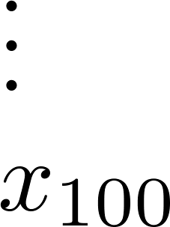
Addressing overfitting:
size of house
no. of bedrooms
Price
no. of floors
age of house
average income in neighborhood
Size
kitchen size

Slide 15


Addressing overfitting:
Options:
Reduce number of features.
Manually select which features to keep.
Model selection algorithm.
Regularization.
Keep all the features, but reduce magnitude/values of parameters .
Works well when we have a lot of features, each of which contributes a bit to predicting .

Slide 16


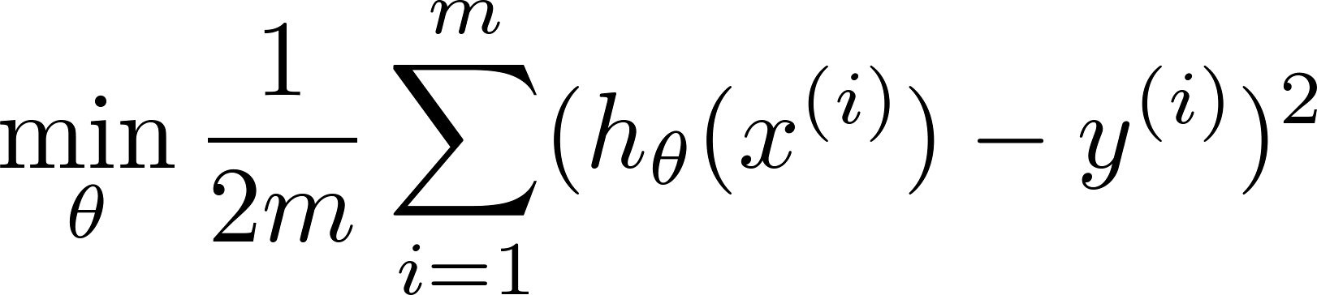
Intuition
Price
Price
Size of house
Size of house
Suppose we penalize and make , really small.
+ 1000 * Θ₃ + 1000 * Θ₄

Slide 17
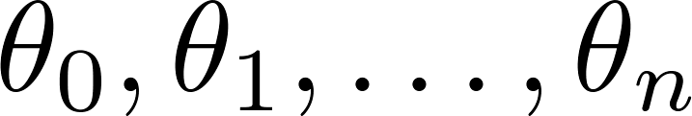
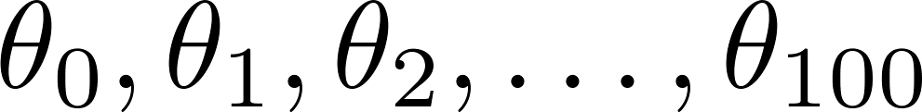
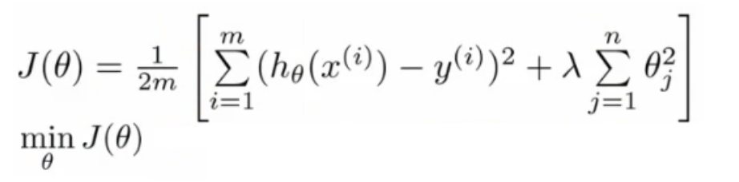
Regularization.
Small values for parameters
“Simpler” hypothesis
Less prone to overfitting
Housing:
Features:
Parameters:
Do not penalize bias term
Notes:
With regularization, take cost function and modify it to shrink all the parameters Add a term at the end
This regularization term shrinks every parameter

Slide 18
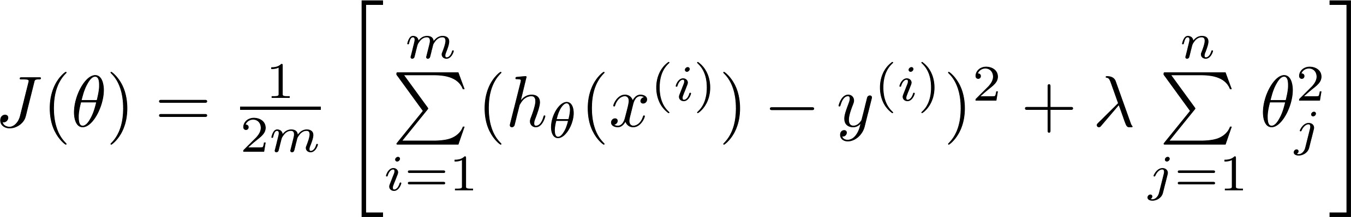
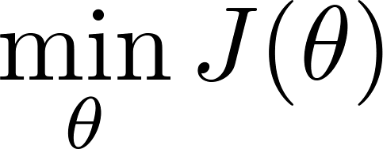
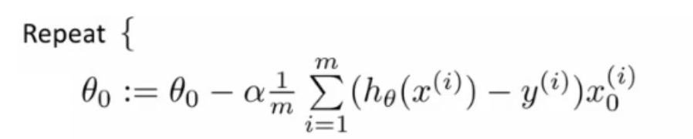
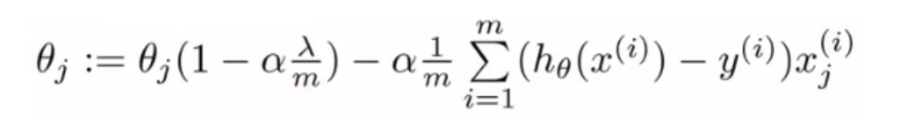

Regularized linear regression.
Price
Usually < 1
Size of house

Slide 19


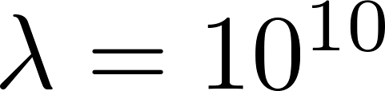
In regularized linear regression, we choose to minimize
What if is set to an extremely large value (perhaps for too large for our problem, say )?
Algorithm fails to eliminate overfitting.
Algorithm results in underfitting. (Fails to fit even training data well).
Gradient descent will fail to converge.

Slide 20
In regularized linear regression, we choose to minimize
What if is set to an extremely large value (perhaps for too large for our problem, say )?
Price
Size of house
Notes:
Get a straight line from the y-intercept

Slide 21

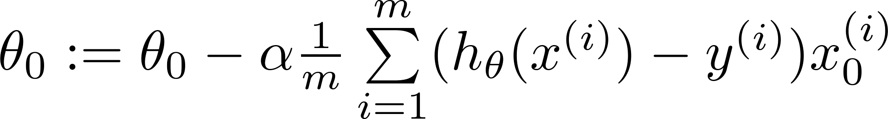

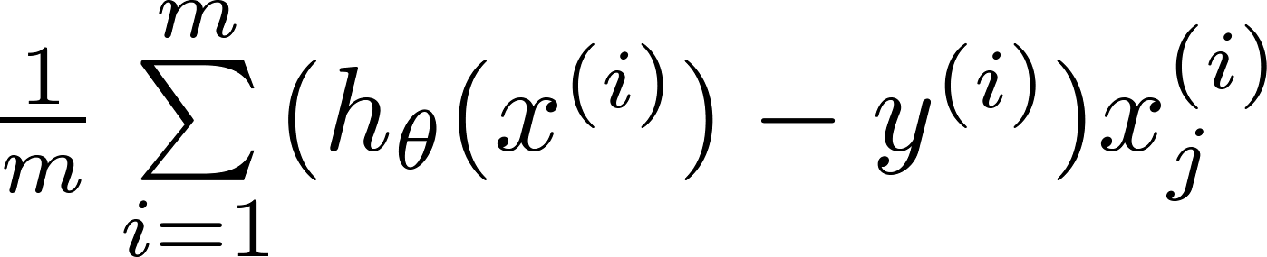


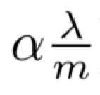
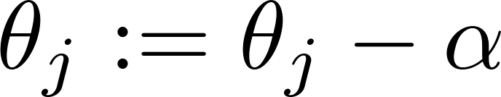


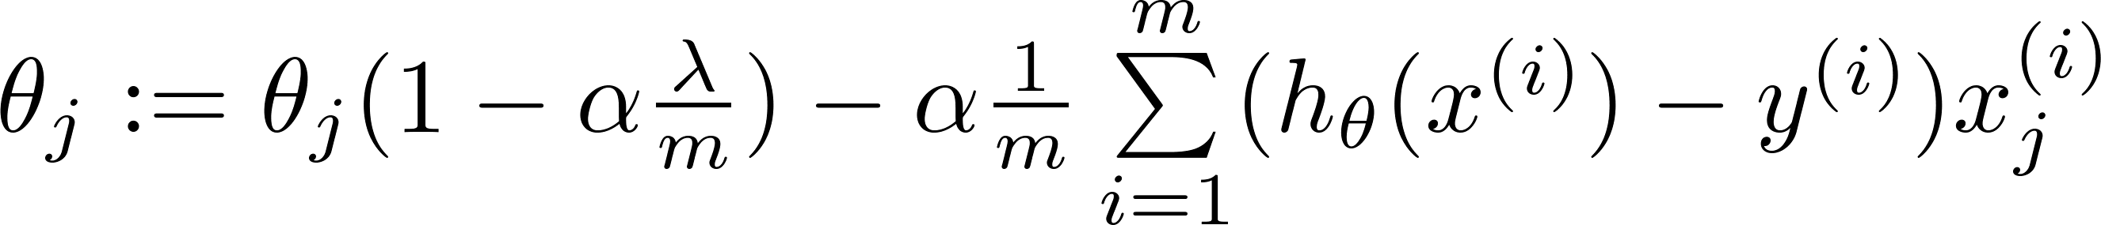
Gradient descent
Repeat

Slide 22
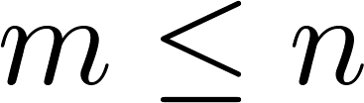
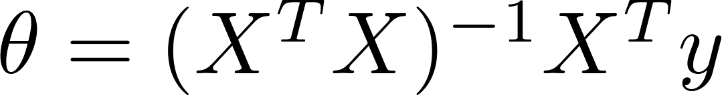

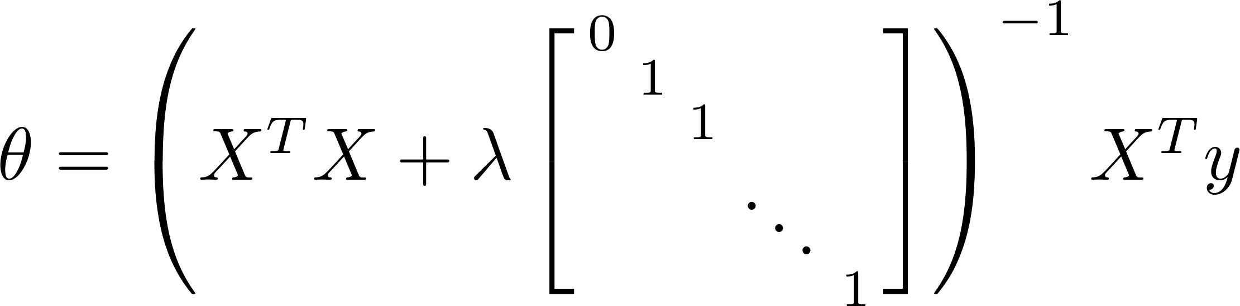
Non-invertibility for Normal Equation
Suppose ,
(#examples) (#features)
If ,

Slide 23
L1 and L2 Regularization Methods
A regression model that uses L1 regularization technique is called Lasso Regression and model which uses L2 is called Ridge Regression.

Slide 24
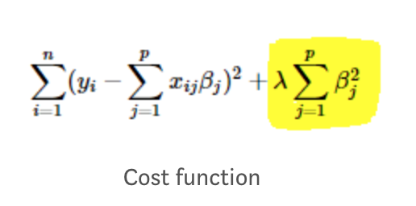
Ridge regression
Ridge regression adds “squared magnitude” of coefficient as penalty term to the loss function. Here the highlighted part represents L2 regularization element.
if lambda is zero you are back to OLS.
If lambda is very large then it will add too much weight and it will lead to under-fitting. So it’s important how lambda is chosen. This technique works very well to avoid over-fitting issue.

Slide 25
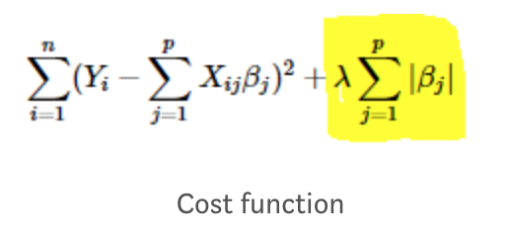
Lasso Regression
Lasso Regression (Least Absolute Shrinkage and Selection Operator) adds “absolute value of magnitude” of coefficient as penalty term to the loss function.
If lambda is zero then we will get back OLS whereas very large value will make coefficients zero hence it will under-fit.

Slide 26
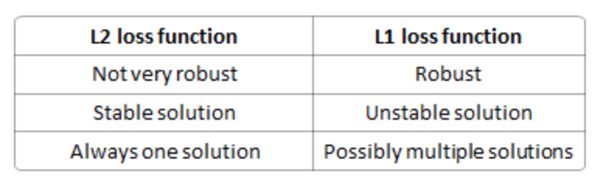
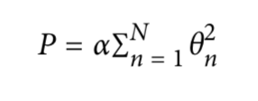
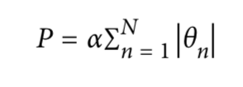
Ridge vs. Lasso Regression
Key difference: Lasso shrinks the less important feature’s coefficient to zero thus, removing some feature altogether. So, this works well for feature selection in case we have a huge number of features.

Slide 27
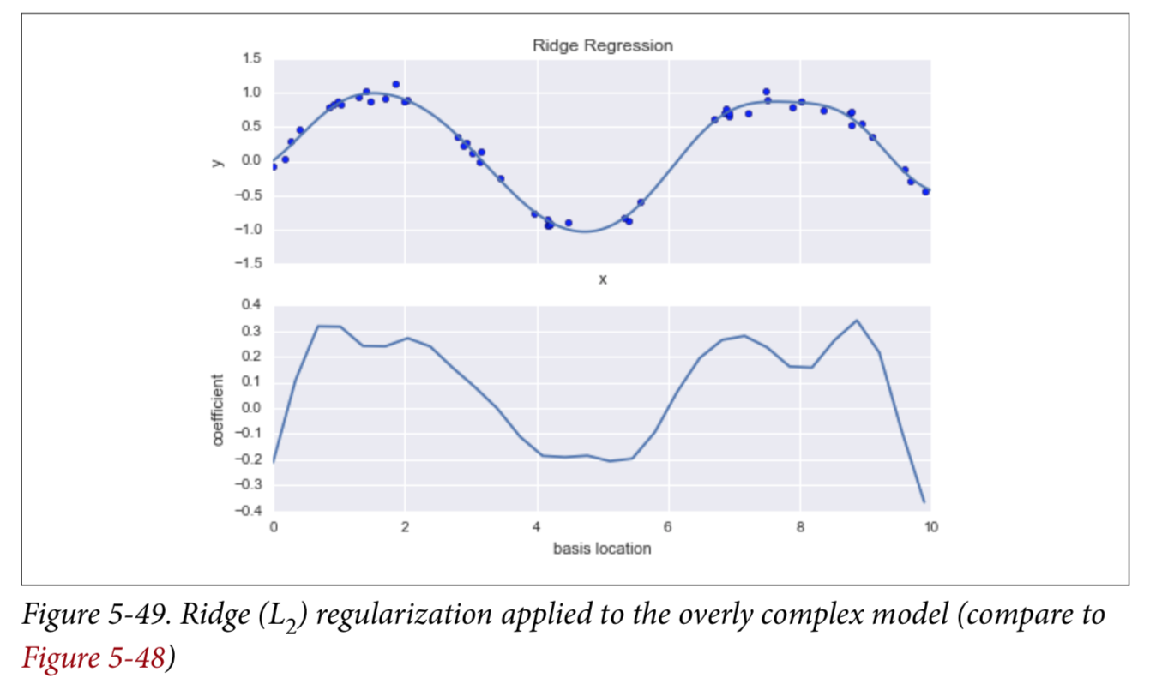
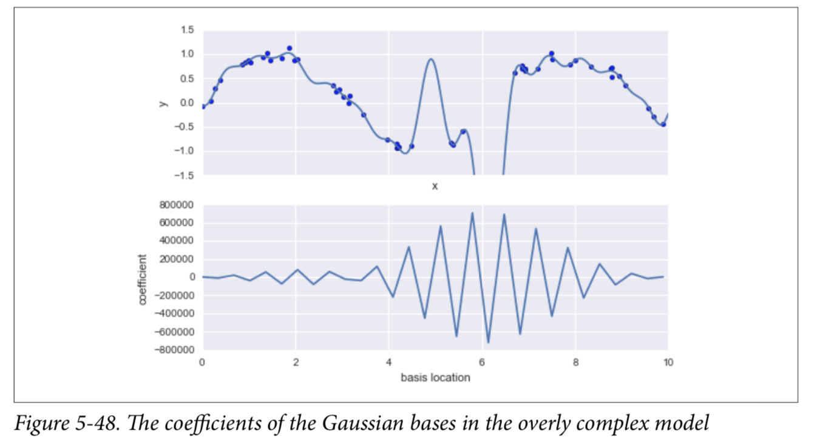
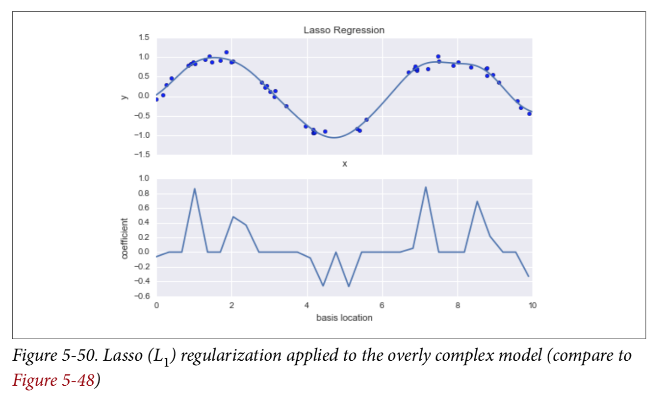
No regularization (below) L2 (upper right) L1 (lower right)

Slide 28
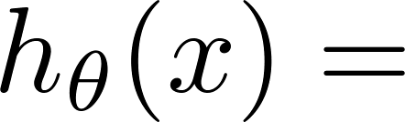
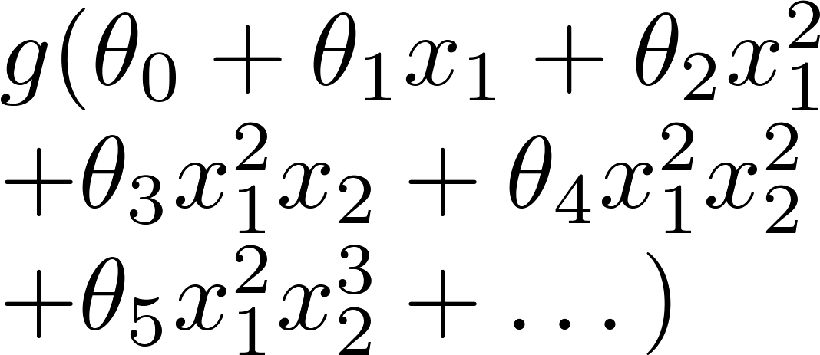
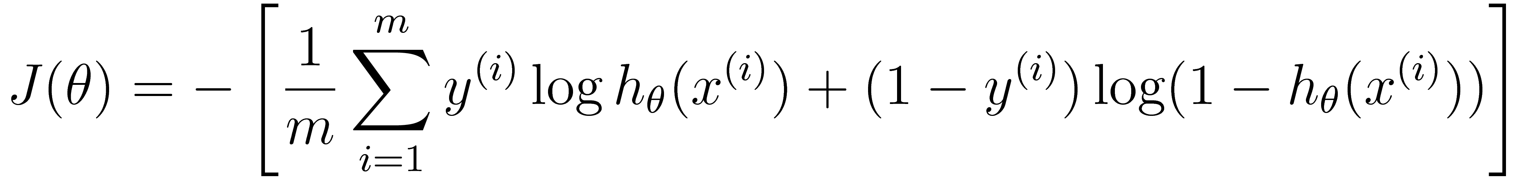
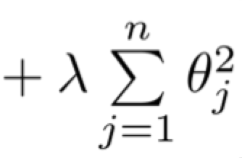
Regularized logistic regression.
x₂
x₁
Cost function:

Slide 29
Gradient descent
Repeat

Slide 30
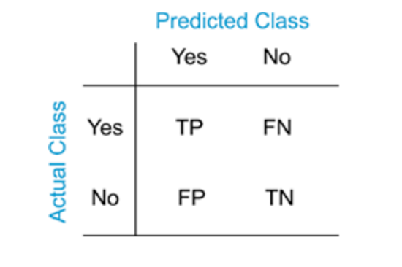
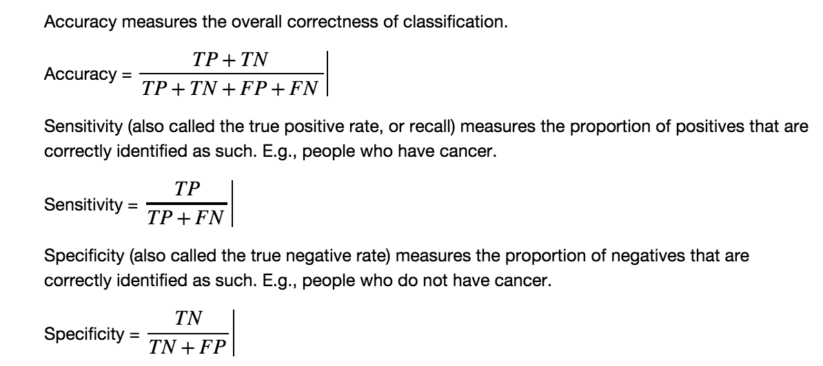
Assessing the performance of classification
model coefficients
Precision = TP/(TP + FN)
Recall = TP/(TP + FN)
F1 = 2*Precision*Recall/(Precision + Recall

