Slide 1
Model Evaluation and Metrics
Jay Urbain, PhD

Slide 2
Topics
Regression
Assessing the accuracy of model coefficients
RMSE – Root Mean Squared Error
Classification
Confusion matrix
ROC Curve

Slide 3

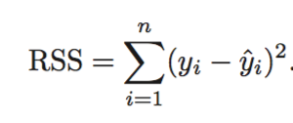

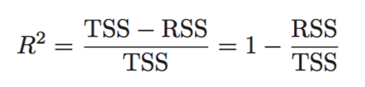
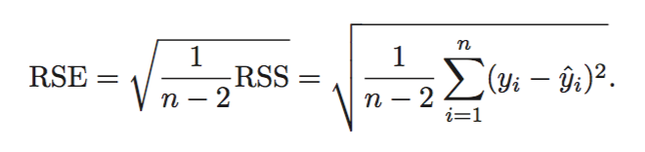
Assessing the accuracy of model coefficients
Linear regression with residual term. Represents what we can’t explain with our model.
RSS measures the amount of variability that is left unexplained after performing the regression
TSS (Total sum of squares) measures the total variance when measuring the response y.
R² amount of variance explained by our model
The RSE is an estimate of the standard deviation of ε. It is basically the average amount that the response will deviate from the true regression line.

Slide 4
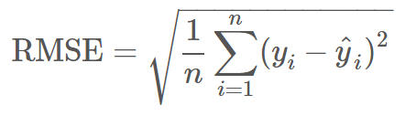
Root Mean Squared Error
Used for regression problems
Square root of the mean of the squared errors
Easily interpretable (in the “y” units)
“Punishes” larger errors
Other: absolute error

Slide 5
Root Mean Squared Error
Example:
y_true = [100, 50, 30]
y_preds = [90, 50, 50]
RMSE = np.sqrt((10**2 + 0**2 + 20**2) / 3) = 12.88

Slide 6
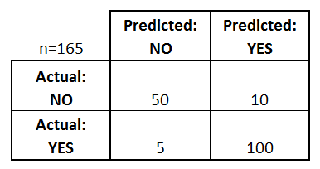
Confusion Matrix: table to describe the performance of a classifier
How many classes are there?
How many patients?
How many times is disease predicted?
How many patients actually have the disease?
Example: Test for presence of disease
NO = negative test = False = 0
YES = positive test = True = 1

Slide 7
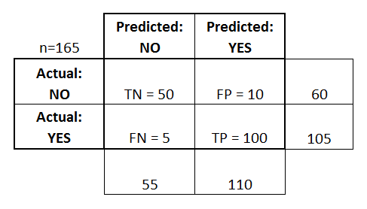
Confusion Matrix: table to describe the performance of a classifier
Basic Terminology:
True Positives (TP)
True Negatives (TN)
False Positives (FP)
False Negatives (FN)
Accuracy:
Overall, how often is it correct?
(TP + TN) / total = 150/165 = 0.91
Misclassification Rate (Error Rate):
Overall, how often is it wrong?
(FP + FN) / total = 15/165 = 0.09

Slide 8
Confusion Matrix: table to describe the performance of a classifier
Sensitivity:
When actual value is positive, how often is prediction correct?
TP / actual yes = 100/105 = 0.95
“True Positive Rate” or “Recall”
False Positive Rate:
When actual value is negative, how often is prediction wrong?
FP / actual no = 10/60 = 0.17
Specificity:
When actual value is negative, how often is prediction correct?
TN / actual no = 50/60 = 0.83

Slide 9
ROC Curve
Every email is assigned a “spam” score by our classification algorithm. To actually make our predictions, we choose a numeric cutoff for classifying as spam.
An ROC Curve will help us visualize how well our classifier is doing without having to choose a cutoff!
Email Number | Score | True Label
5 | 0.99 | Spam
8 | 0.82 | Spam
2 | 0.60 | Spam
1 | 0.60 | Ham
7 | 0.48 | Spam
3 | 0.22 | Ham
4 | 0.10 | Ham
6 | 0.02 | Ham

Slide 10
ROC Curve
ROC Curve
Email Number | Score | True Label
5 | 0.99 | Spam
8 | 0.82 | Spam
2 | 0.60 | Spam
1 | 0.60 | Ham
7 | 0.48 | Spam
3 | 0.22 | Ham
4 | 0.10 | Ham
6 | 0.02 | Ham
TPR
FPR

Slide 11
ROC Curve
https://www.dataschool.io/roc-curves-and-auc-explained/
TPR: When actual value is spam, how often is prediction correct?
FPR: When actual value is ham, how often is prediction wrong?
Email Number | Score | True Label
5 | 0.99 | Spam
8 | 0.82 | Spam
2 | 0.60 | Spam
1 | 0.60 | Ham
7 | 0.48 | Spam
3 | 0.22 | Ham
4 | 0.10 | Ham
6 | 0.02 | Ham
Cutoff | TPR (y) | FPR (x) | Cutoff | TPR (y) | FPR (x)
0 |  |  | 0.50
0.05 |  |  | 0.65
0.15 |  |  | 0.85
0.25 |  |  | 1

Slide 12
ROC Curve
TPR: When actual value is spam, how often is prediction correct?
FPR: When actual value is ham, how often is prediction wrong?
Email Number | Score | True Label
5 | 0.99 | Spam
8 | 0.82 | Spam
2 | 0.60 | Spam
1 | 0.60 | Ham
7 | 0.48 | Spam
3 | 0.22 | Ham
4 | 0.10 | Ham
6 | 0.02 | Ham
Cutoff | TPR (y) | FPR (x) | Cutoff | TPR (y) | FPR (x)
0 | 1 | 1 | 0.50 | 0.75 | 0.25
0.05 | 1 | 0.75 | 0.65 | 0.5 | 0
0.15 | 1 | 0.5 | 0.85 | 0.25 | 0
0.25 | 1 | 0.25 | 1 | 0 | 0

Slide 13
ROC Curve
Q: Would the ROC Curve (and AUC) change if the scores changed, but the ordering remained the same?
A: Not at all! The ROC Curve is only sensitive to rank ordering and does not require calibrated scores.
Email Number | Score | True Label
5 | 0.99 | Spam
8 | 0.98 | Spam
2 | 0.97 | Spam
1 | 0.97 | Ham
7 | 0.96 | Spam
3 | 0.95 | Ham
4 | 0.94 | Ham
6 | 0.93 | Ham

