Slide 1
Prepared for: SPORTS JAM
April 28, 2025

Slide 2
GAGANDEEP KANTA
PROJECT GLADIATOR – Group 6

Slide 3
SPORTS JAM Overview
Project Name : Sports Jam Selenium Automation
Objective:
The objective of this project is to automate the testing process for Sports Jam, a leading e-commerce platform specializing in sports and fitness equipment in India. This automation aims to ensure a seamless user experience by rigorously verifying the platform's features, functionalities, and UI consistency.
Website Overview:
https://sportsjam.in/ is an Indian e-commerce platform specializing in sports and fitness equipment. The website offers a wide range of sports gear, fitness products, and accessories tailored to athletes and fitness enthusiasts.

Slide 4
Modules
Home Page Module _ SportsJamNavBarFitness
Gym Accessories
Gym Gloves
Brand
Now Shopping By
Add to cart
Cart Icon
View Cart
Shopping Cart
Proceed to Checkout

Slide 5
Modules
2. Home Page Module _ SportsJamUserIcon
Log In
Create an account
Firstname and Lastname
Email and Password
Create an account
Logout
Login Email and Login Password
Sign In

Slide 6
Software Requirements
Programming Language: Java
Automation Tool: Selenium WebDriver
Build Tool: Maven
Test Framework: TestNG & Cucumber-J Unit
Logging: Log4j
Reporting: Extent Reports
Version Control: GitHub

Slide 7
Hardware Requirements
Processor: Intel i5/i7 or AMD equivalent
RAM: 8GB or higher
Storage: Minimum 100GB SSD
Operating System: Windows, MacOS, or Linux
Browser Support: Chrome, Firefox, Edge

Slide 8
Automation Feature
Navigation (Footer links , Internal links , Main navbar menu)
Content Accessibility(Informative Guides , Expert Blogs , Updates & Announcements)
Request Features(Virtual Try-On , Subscription services)
Enhanced Search Functionality(sports gear, fitness products, equipment brands, and exclusive deals)

Slide 9
Utilities
Base – Manages WebDriver setup and browser configurations.
ExcelReader – Extracts test data from Excel files to support data-driven testing.
LoggerHandler – Logs errors, warnings, and execution details for monitoring and debugging.
Screenshot – Captures screenshots for debugging and detailed reporting of failed test cases.
Reporter – Generates test execution reports using Extent Reports with formats like Excel, PDF,
HTML, and PNG.
WebDriverHelper – Provides robust utility functions for advanced Selenium operations, including
clicking, hovering, dynamic scrolling, and explicit waits.

Slide 10
Architecture of Hybrid Framework
Inputs to runner
Environment
Browser
Suite
Driver
Environment
Properties
Suite File
Log Files
Runner.exe
Test
Spreadsheet
Action
Keywords
Object
Repository
Results
Application Under Test

Slide 11


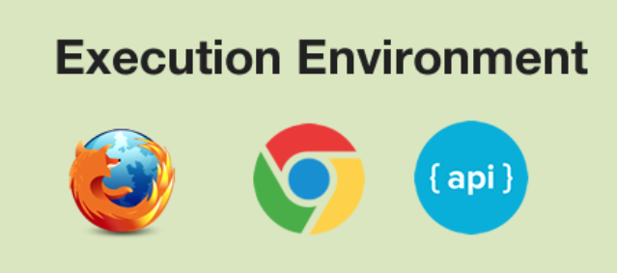
Architecture of BDD Framework
Cucumber – BDD Framework
src/main/resources
src/test/java
Project directory
src/test/java
Results
Selenium Functions
Utility Functions
Page Objects
Step Definitions – Hooks Class
Test Runner
Feature Files
Config Files
Utility Functions
Selenium Functions
Cucumber Reports

Slide 12
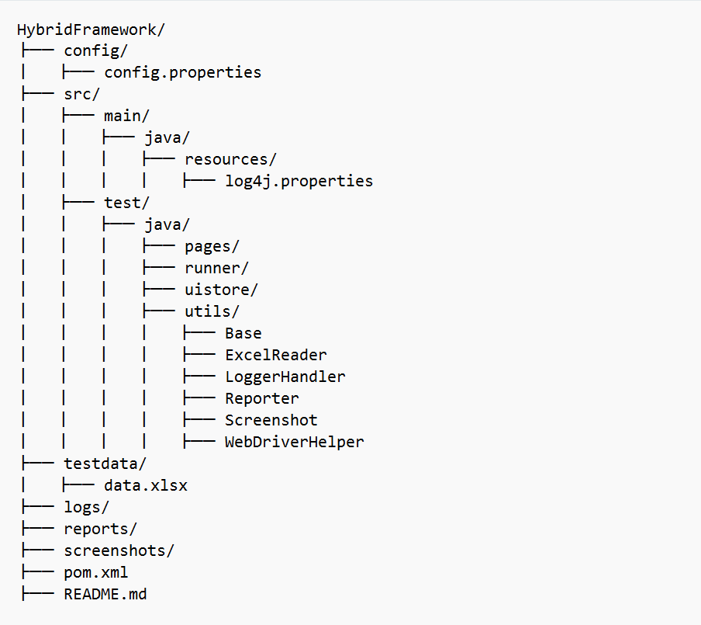
Folder Structure of Hybrid Framework

Slide 13
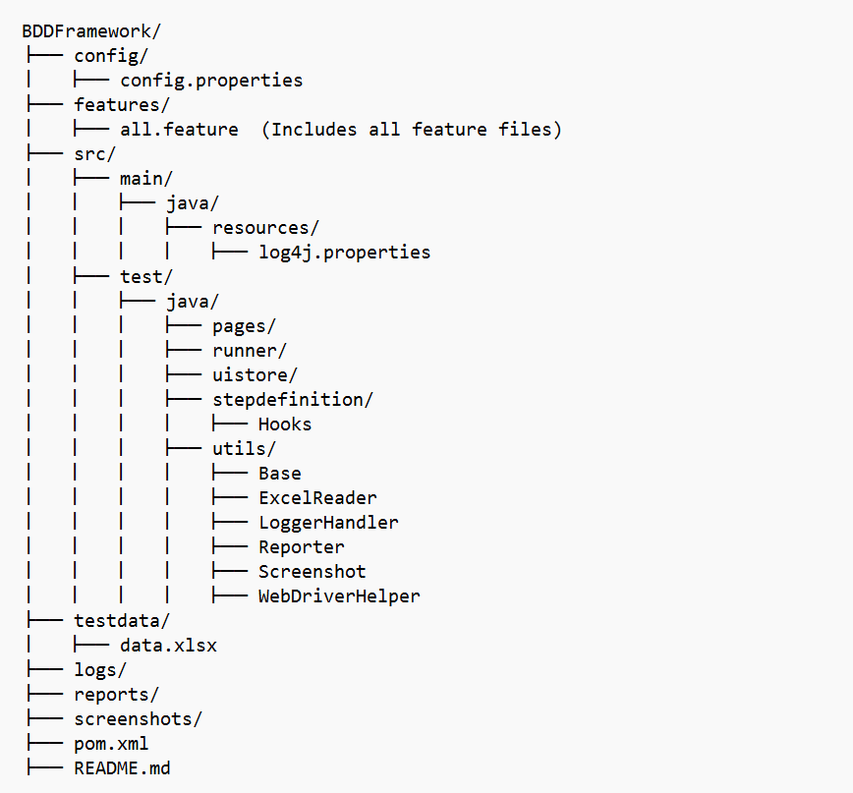
Folder Structure of BDD Framework

Slide 14
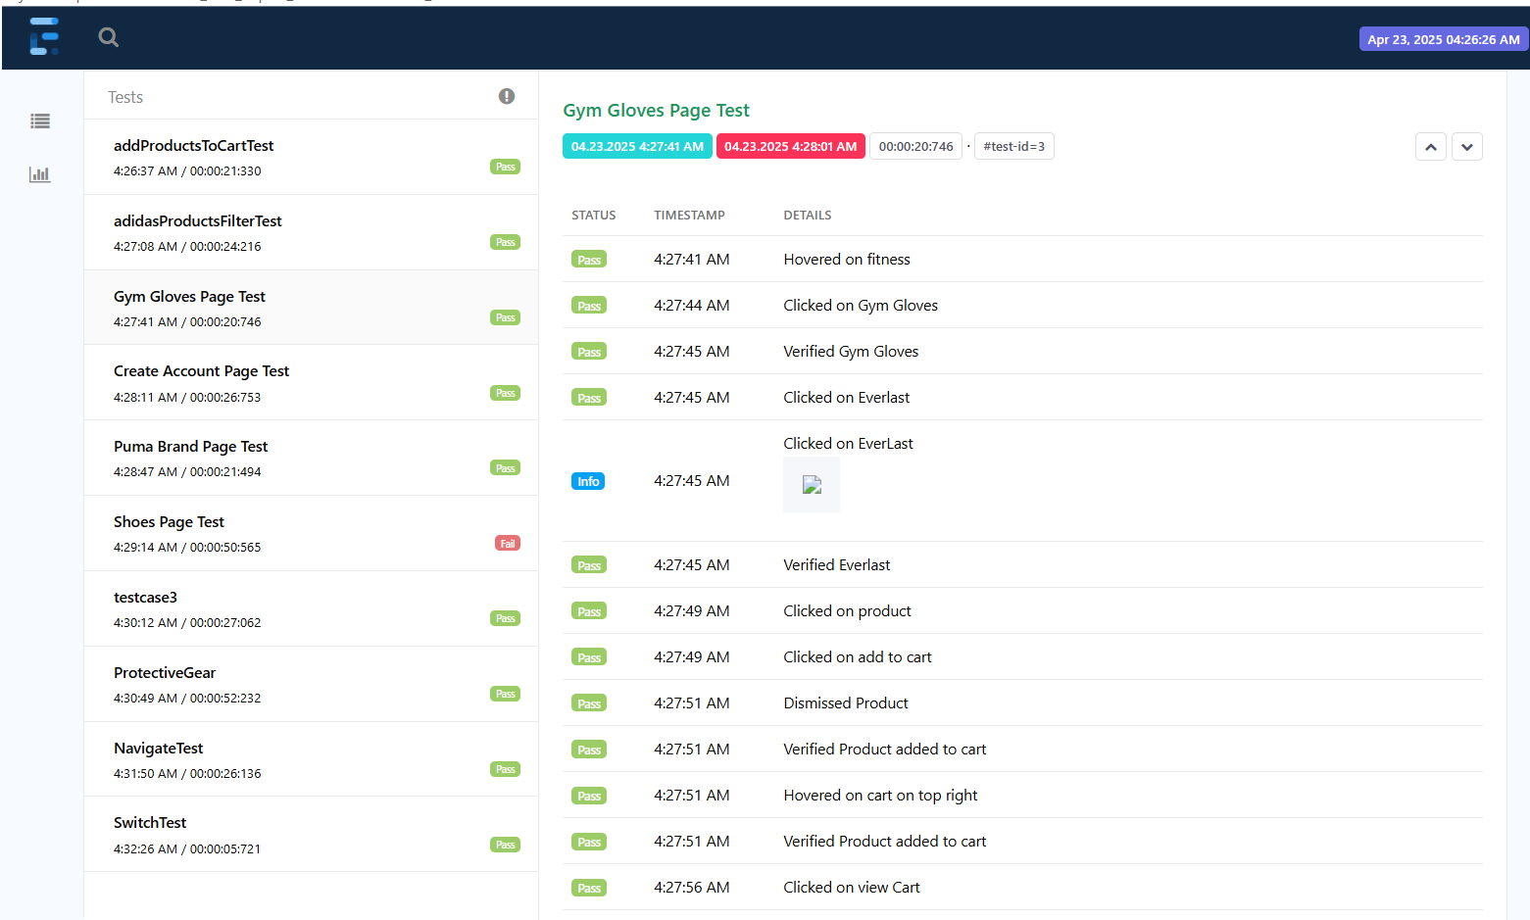
Extent Report Screenshot (Module 1)

Slide 15
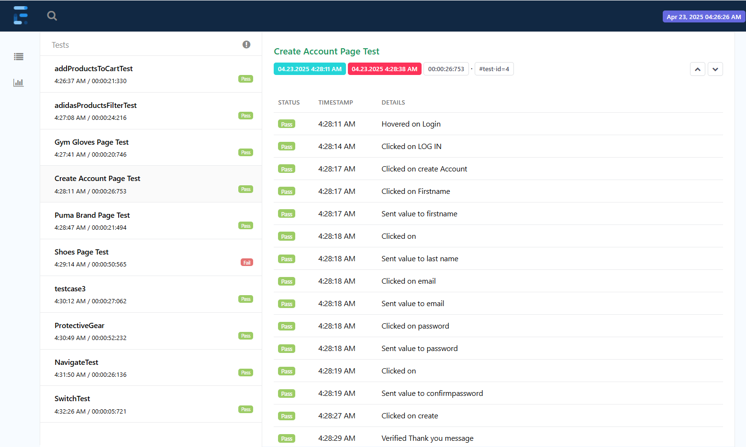
Extent Report Screenshot (Module 2)

Slide 16
Test Cases
Serial Number | Name | No. of Test Cases Hybrid (Platform) | No. of Test Cases BDD (Platform) | No. of Test Cases Hybrid (Manual) | No. of Test Cases BDD (Manual)
1 | Gagan D | 02 | 02 | 17 | 17

Slide 17
THANK YOU

