Slide 1
SQL and Databases: Project Report
FOUR WHEELS
By: Gagandeep Kaur DAE-International-July24

Slide 2
Business Overview
Total Revenue
Total Orders
Total Customers
Avg. rating
124.71 M
1000
994
3.065
Last Qtr Revenue
Last Qtr: Num of Orders
Avg Days to Ship
% Good Feedback
23.34 M
199
105
20.464

Slide 3
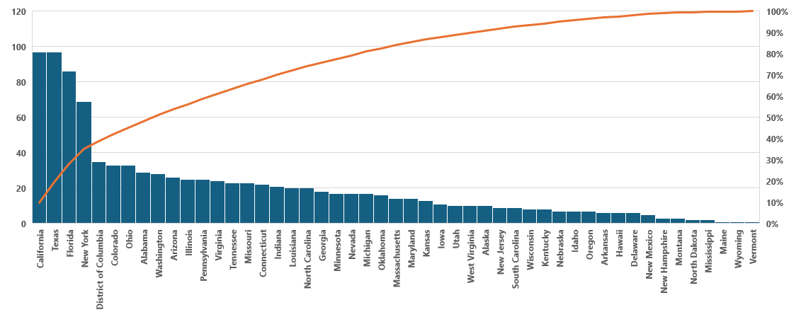
Distribution of Customers across States

Slide 4
Top 5 states based on number of customers

Slide 5
Average Customer by Quarter
Customer rating feedback exhibits decreasing trend through all the quarters.

Slide 6
Trend of Customer Satisfaction
~59% of customers provided “Very good” or “Good” feedback in Q1, which drastically reduced to 21% in Q4.
~21% Customer provided “Very bad “ and 10% “Bad” feedback in Q1” which then increased to 59% in Q4.
There’s a visible trend of drop in positive feedback by customers in every quarter from Q1 to Q4 and an increase in negative feedback

Slide 7
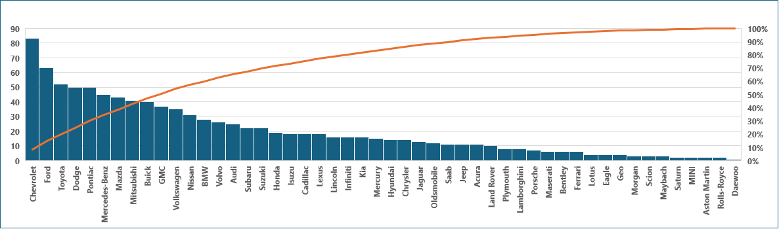
Top Vehicle makers preferred by customers
The top 5 vehicle makers preferred by customers are Chevrolet, Ford, Toyota, Dodge and Pontiac.

Slide 8
Most preferred vehicle make in each state
State | Vehicle_maker
Alabama | Dodge
Alaska | Chevrolet
Arizona | Pontiac
Arizona | Cadillac
Arkansas | Suzuki
Arkansas | Chevrolet
Arkansas | Pontiac
Arkansas | Volkswagen
Arkansas | Mitsubishi
Arkansas | GMC
California | Ford
California | Dodge
California | Audi
California | Nissan
California | Chevrolet
Colorado | Chevrolet
Connecticut | Chevrolet
Connecticut | Mercury
Connecticut | Maserati
Connecticut | Volvo
Delaware | Mitsubishi
District of Columbia | Chevrolet
Florida | Toyota
Georgia | Toyota
Hawaii | Ford
Hawaii | Toyota
Hawaii | Pontiac
Hawaii | Nissan
Hawaii | Cadillac
Hawaii | GMC
State | Vehicle_maker
Idaho | Dodge
Illinois | Ford
Illinois | GMC
Illinois | Chevrolet
Indiana | Mazda
Iowa | Chrysler
Iowa | Chevrolet
Iowa | Hyundai
Iowa | Isuzu
Iowa | Dodge
Iowa | Mazda
Iowa | Porsche
Iowa | Jeep
Iowa | Ford
Iowa | Pontiac
Iowa | Subaru
Kansas | GMC
Kansas | Lexus
Kansas | Buick
Kansas | Mercedes-Benz
Kansas | Suzuki
Kansas | Honda
Kansas | Dodge
Kansas | Volkswagen
Kansas | Ford
Kansas | Mazda
Kansas | Maserati
Kansas | Nissan
Kansas | Saab
Kentucky | Acura
State | Vehicle_maker
Kentucky | Audi
Kentucky | Ram
Kentucky | Volvo
Kentucky | Pontiac
Kentucky | Nissan
Kentucky | Mercedes-Benz
Louisiana | BMW
Louisiana | Nissan
Louisiana | Ford
Louisiana | Pontiac
Louisiana | Kia
Maine | Mercedes-Benz
Maryland | Ford
Massachusetts | Dodge
Massachusetts | Chevrolet
Michigan | Ford
Minnesota | GMC
Mississippi | Dodge
Mississippi | Toyota
Missouri | Chevrolet
Montana | Chevrolet
Montana | Mitsubishi
Montana | Dodge
Nebraska | Chevrolet
Nebraska | Mercedes-Benz
Nebraska | Volkswagen
Nebraska | Nissan
Nebraska | Pontiac
Nebraska | Toyota
State | Vehicle_maker
Nebraska | Cadillac
Nevada | Pontiac
New Hampshire | Chrysler
New Hampshire | Lincoln
New Hampshire | Lexus
New Jersey | Mercedes-Benz
New Jersey | Hyundai
New Mexico | Dodge
New York | Toyota
New York | Pontiac
North Carolina | Volvo
North Dakota | Hyundai
North Dakota | Ford
Ohio | Chevrolet
Oklahoma | Toyota
Oklahoma | Ferrari
Oklahoma | Mazda
Oregon | Toyota
Pennsylvania | Toyota
South Carolina | Acura
South Carolina | Buick
South Carolina | BMW
South Carolina | Kia
South Carolina | Mazda
South Carolina | Mitsubishi
South Carolina | Dodge
South Carolina | Jaguar
South Carolina | Isuzu
Tennessee | Mazda
Texas | Chevrolet
State | Vehicle_maker
Utah | Maybach
Utah | Volkswagen
Utah | Isuzu
Utah | Subaru
Utah | Lincoln
Utah | Chevrolet
Utah | Oldsmobile
Utah | Pontiac
Utah | Dodge
Utah | Buick
Vermont | Mazda
Virginia | Ford
Washington | Chevrolet
West Virginia | Mercedes-Benz
Wisconsin | Pontiac
Wisconsin | Chevrolet
Wisconsin | Acura
Wisconsin | Mazda
Wisconsin | Nissan
Wisconsin | Cadillac
Wisconsin | Dodge
Wisconsin | Honda
Wyoming | Buick

Slide 9

Revenue Metrics

Slide 10
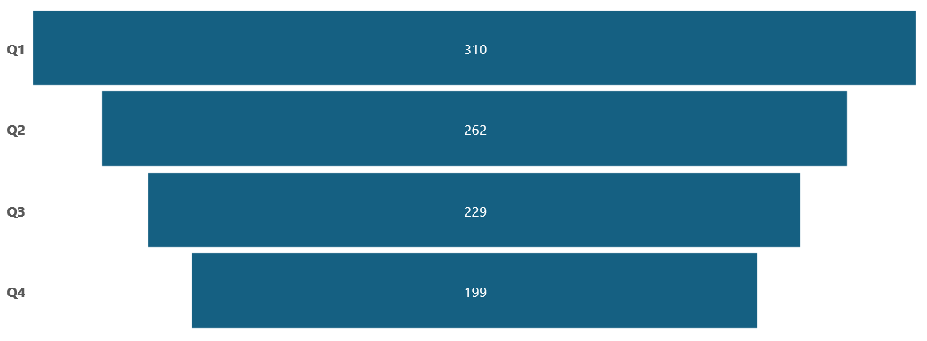
Trend of purchases by Quarter
Total number of purchase of cars in Q4 has dropped to199 as compared to 310 in Q1

Slide 11
Quarter on Quarter % change in Revenue
Revenue in Q4 drops to 20% down as compared to Q1.
Revenue in Q1 was approx 39.4 M and in Q4 approx. 23.34M

Slide 12
Trend of Revenue and Orders by Quarter
There is significant drop in revenue as well as orders in every quarter when compared with previous quarter.
Last quarter Revenue was around 23M

Slide 13

Shipping Metrics

Slide 14
Average discount offered by Credit Card type
Discount offered by credit card is in range of 0.58%-0.64%
Max discount is being offered by Lancer credit card and Min discount is being offered by Diners-Club-International

Slide 15
Time taken to ship orders by Quarter
Numbers of days to ship order has shown significant increase in every quarter.
Average numbers of days to ship has almost tripled in Q4 as compared to numbers of days taken in Q1.

