Slide 1
MVC AND ITS FEATURES
By :- Gagandeep Singh

Slide 2
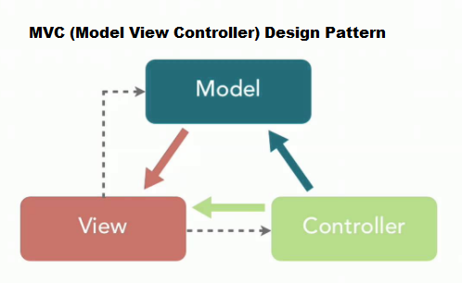
What is MVC…?
1. Model – View – Controller.
2. It is a software design pattern for developing web applications.
3. It is a software architecture pattern which separates the representation of
information from the user's interaction with it.
4. The MVC model defines web applications with 3 logic layers:
a. Model Logic → Business Layer
b. View Logic → Display Layer
c. Controller Logic → Input Control.

Slide 3
LIVE PROJECT FOR ASP.NET MVC DEMONSTRATION
GitHub Link:- https://github.com/gagandeepsingh77/Aapna

Slide 4
Model
1. It is also known as domain or business layer, which defines the logic and computation that manipulate and process the data.
2. It is lowest level of the pattern which is responsible for managing and maintaining the data.
3. It responds to the request from the view and it also responds to instructions from the controller itself.
4. Model Logic ensures the integrity of data and allows to derive it.
5. The Model contains all of the application business logic, validation
logic, and database access logic.
6. Model represents the application core, i.e. a list of database records.

Slide 5
VIEW
1. View displays the data i.e. the database records.
2. View Logic represents the model in a suitable format to interact and
access the data, usually called “User Interface”.
3. A View requests information from the model, that it needs to generate
an output representation, i.e it is an application that user can see.
4. MVC is often seen in web applications, where the view is the HTML page.
5. A major purpose of view objects is to display data from the application’s
model objects and to enable editing of data.
6. On basis of data transfer mechanism ASP.NET MVC views are categorized
as two types:- Dynamic view and Strongly typed view.

Slide 6
controller
1. The Controller is the part of the application that handles user
interaction.
2. Controller act as a mediator between view and model. it is responsible
to control the data transmission between the model and the view.
3. Its main function is to read data from a view, control user input, and
send input data to the model.
4. It handles the user actions and may invoke changes on the model and
view.
5. In ASP.NET MVC the Controller is a class derived from the base class
System.Web.Mvc.Controller which contains a public method called
Action Methods.

Slide 7
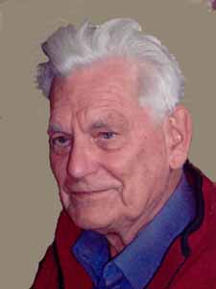
HISTROY OF MVC
Trygve Reenskaug introduced MVC in the 1970s and formulated the model-view-controller pattern for Graphic User Interface software design in 1979 while visiting the Xerox Palo Alto Research Center.
In the 1980s, Jim Althoff and other implemented a version of MVC for the Smalltalk-80 class library.
MVC was expressed as a general concept, in a 1988 article The Journal of Object Technology.
The use of MVC pattern in web applications grew after the introduction of NeXT’s WebObjects in 1996, which was originally written in Objective-C.

Slide 8
5. The MVC oattern subsequently evolved and give rise to variants such as
Hierarchical Model-View-Controller, Model-View-Adapter,Model-View-
Presenter and Model-View-Viewmodel.
6. Later framework for Java, such as Spring, continued the strong bond
between Java and MVC.
7. The introduction of the frameworks Django for Python and Rails for Ruby,
both of which had a strong emphasis on rapid development, incrresed
MVC’s popularity.
8. ASP.NET MVC is a web application framework developed by Microsoft
that implements the Model-View-Controller pattern, was first introduced
in 2007.
9. ASP.NET Core has since been released (in 2016) unified ASP.NET, ASP.NET
MVC, ASP.NET Web API, and ASP.NET Web Pages.

Slide 9
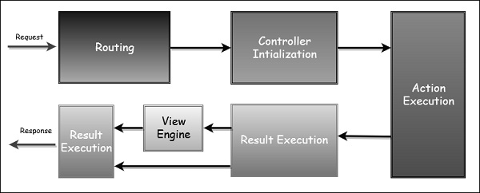
ASP.NET MVC REQUEST LIFE CYCLE
REQUEST FROM THE BROWSER
PERFORM HANDLING
CREATE MVC REQUEST HANDLER
CREATE AND EXECUTE CONTROLLER
INVOKE ACTION
EXECUTE RESULT
RESPONSE TO BROWSER
INVOKE ACTION
EXECUTE RESULT
RESPONSE TO BROWSER

Slide 10
HOW asp.net MVC WORKS…?
1. The User performs an action on the Web Browser or an interface.
2. The Web Browser takes the input event from the user interface in some
way e.g. user presses a button.
3. IIS determines that Request needs to be process by ASP.NET .
4. UrlRoutingModule gets a chance to act on the request as any standard
HTTP Module.
5. UrlRoutingModule checks if the request path matches with the routes
configured with the application.

Slide 11
6. UrlRoutingModule gets the IHttpHandler from the corresponding route’s
IRouteHandler.MvcRouteHandler is the default route handler for ASP.NET
MVC.
7. In response to GetHttpHandler, MvcRouteHandler returns MvcHandler
which implements IHttpHandler.
8. IRouteHandler executes ProcessRequest method of MvcHandler passing
the current HTTPContext.
9. MvcHandler uses IControllerFactory to obtain an instance of Icontroller
using the controller name in the request path. DefaultControllerFactory
is the default IControllerFactory in ASP.NET MVC .
10. MvcHandler invokes Execute method on the controller.

Slide 12
11. Controller executes the method corresponding to the action specified
in the request path.
12. Action method can optionally add data to the ViewData dictionary
and returns the instance of type ActionResult.
13. ExecuteResult method of ActionResult is executed passing the
ControllerContext.
14. ViewResult locates the corresponding view using configured view
engine. WebFormViewEngine is the default view engine for ASP.NET
MVC.
15. ViewResult invokes Render method on Iview.
16. Response is given to the Web Browser, and view gets its own data from

Slide 13
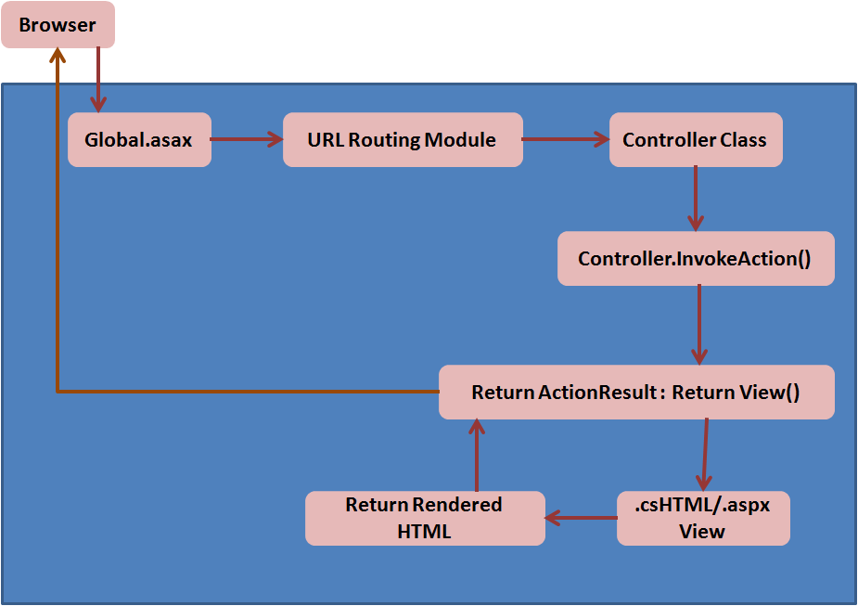
the model. The model has no direct knowledge of the view.
17. The user interface waits for further user interactions, which begins the
cycle anew.
FLOW OF ASP.NET MVC

Slide 14
EXAMPLE :-
Basically, every website is made up of HTML, CSS and it is viewed in the browser. The separation from HTML and CSS is two parts of the MVC pattern.
The HTML is the Model which handles the knowledge of the website, in other words the actual content.
The CSS is the View, the dumb presentation layer that sets colours or font sizes.
The Browser is the Controller and manipulates data through forms or Javascript.

Slide 15
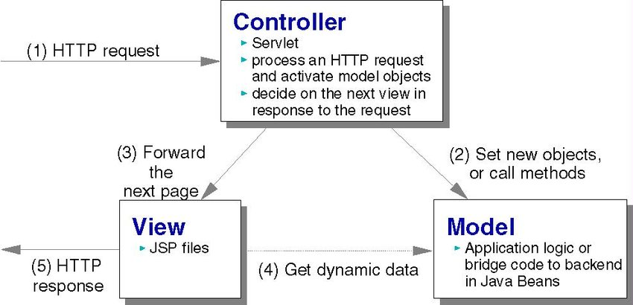
Working of mvc in web application
Although originally MVC is developed for personal computing but later on has been widely adapted as an architecture for World Wide Web applications in all major programming language.
Several application framework have been created that enforce the pattern.

Slide 16
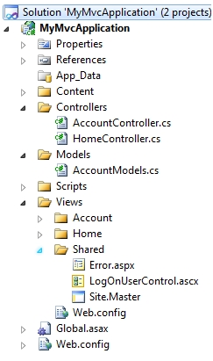
Features of mvc
PARALLEL DEVELOPMENT :- When we create either ASP.NET MVC application or Empty ASP.NET MVC application in Microsoft Visual Studio we will notice that the Visual Studio IDE creates the folders named Controllers, Views and Models by default and adds it to the solution. The model, controller and view have to be physically separated into different files.

Slide 17
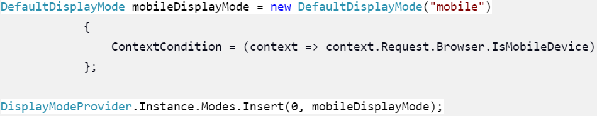
In major organizations a project constitutes a separate UI team for
designing the UI, a Dev team to write the core .NET code and also a data
team (managing the model). The main advantage of this loosely coupled
architecture is that it allows the different teams of a project to work on its
own area without any dependency from another team.
2. DISPLAY MODES :- This MVC feature enables the developers to have
different sets of views for each device and load them based on who is
accessing the web application. This is required when the requirement is to
change the view, content, control look or the operations different from
device to device.

Slide 18
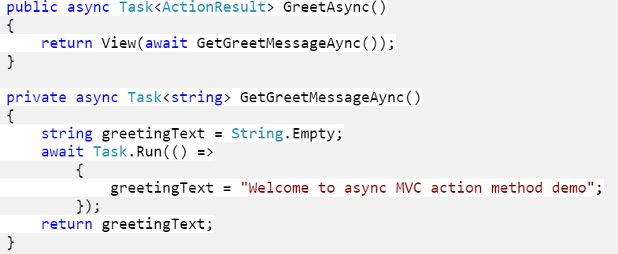
3. Support for Asynchronous Technique :- MVC also supports an
asynchronous technique, which helps developers to develop an
application that loads very fast.An asynchronous request takes the same
amount of time to process as a synchronous request.However during an
asynchronous call, a thread isn't blocked from responding to other
requests while it waits for the first request to complete. Therefore,
asynchronous requests prevent request queuing and thread pool growth
when there are many concurrent requests that invoke long-running
operations.An asynchronous controller action method will return a Task of
ActionResult and will use async / await keywords.

Slide 19
4. SEARCH ENGINE OPTIMIZATION WITH ASP.NET MVC :- A powerful
URL-mapping component that lets you build applications that have
comprehensible and searchable URLs. URLs do not have to include
file-name extensions, and are designed to support URL naming patterns
that work well for search engine optimization (SEO) and representational
state transfer (REST) addressing.
5. MODIFICATION DOES NOT EFFECT ENTIRE MODEL :- For any web
application, the user interface tends to change more frequently than
even the business rules of the .net development company. It is obvious
that you make frequent changes in your web application like changing
colors, fonts, screen layouts, and adding new device support for mobile
phones or tablets. Moreover, Adding a new type of view are very easy in
the MVC pattern because the Model part does not depend on the views
part. Therefore, any changes in the Model will not affect the entire
architecture.

Slide 20
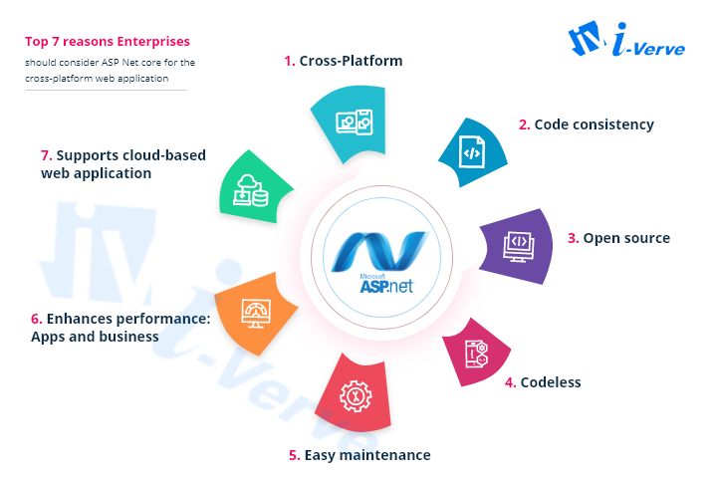
6. Support for Cloud Deployment :- The modular architecture of the
ASP.NET Core MVC framework allows us to deploy to the cloud. It means
that we can easily develop applications with ASP.NET Core MVC’s
support that is ready to be deployed on the cloud.
7. Developing Cross-Platform Applications :- The biggest advantage
that a developer can draw from ASP.NET Core MVC is that it allows him
to develop cross-platform applications. The framework does not only
support Windows but also other platforms such as Mac and Linux. The
developers get the support from Visual Code Studio Code to develop
applications in Linux and Mac OS.

Slide 21
WHY MVC OVER WEB FORMS…?
ASP.NET MVC is based on the MVC design pattern which provides us the facility to create an application fast, easily and full control. It is not a substitute of Web Forms but it is a new technology which keeps update with new web technologies.
Web form applications introduced the event-driven approach and also introduced View State and post-back. View state affects the performance of the application. The developer does not have any control of the rendering of the server control.
Also, the Page lifecycle of an ASP web form is too complex. In a web form application, a single class displays the user interface and handles the user controls.
The Separation of Concern has not been fit with web form based
applications. Also automated testing is very difficult in a post-back.

Slide 22
ADVANTAGES AND DISADVANTAGES OF MVC
ADVANTAGES :-
1. Each MVC object has different responsibilities.
2. The development progresses in parallel.
3. Easy to manage and maintain your app code.
4. All classes and object are independent of each other.st-
5. It support Test-Driven-Development i.e support for Unit Testing.
6. Easier to update the application.
DISADVANTAGES :-
1. The model pattern is little complex.
2. It is little difficult to use MVC as like modern user interface.
3. Inefficiency of data access in view.

Slide 23
AN OPINION
The MVC structure is very flexible. MVC is not easy to understand, it is an architecture that divides our software into smaller components. This division enables readability and modularity as well it makes easier the testing part.
Even though it is very popular and it does have some disadvantages, the main one is complexity.
Although with the segeration of code the MVC model ends up showing higher development speed (up to three times faster).
It is a great tool to help limit code duplication, and allow easy maintenance of the application.
The MVC paradigm is helpful during the initial planning phase of the application since it gives the developer an outline of how to arrange their ideas into actual code.

Slide 24
REFERENCES
https://www.c-sharpcorner.com/UploadFile/85ed7a/Asp-Net-mvc6-features/
http://www.dotnet-stuff.com/tutorials/aspnet-mvc/features-of-asp-net-mvc
Microsoft Docs :- ASP.NET MVC overview.

Slide 25
THANK YOU…!!!

