Slide 1
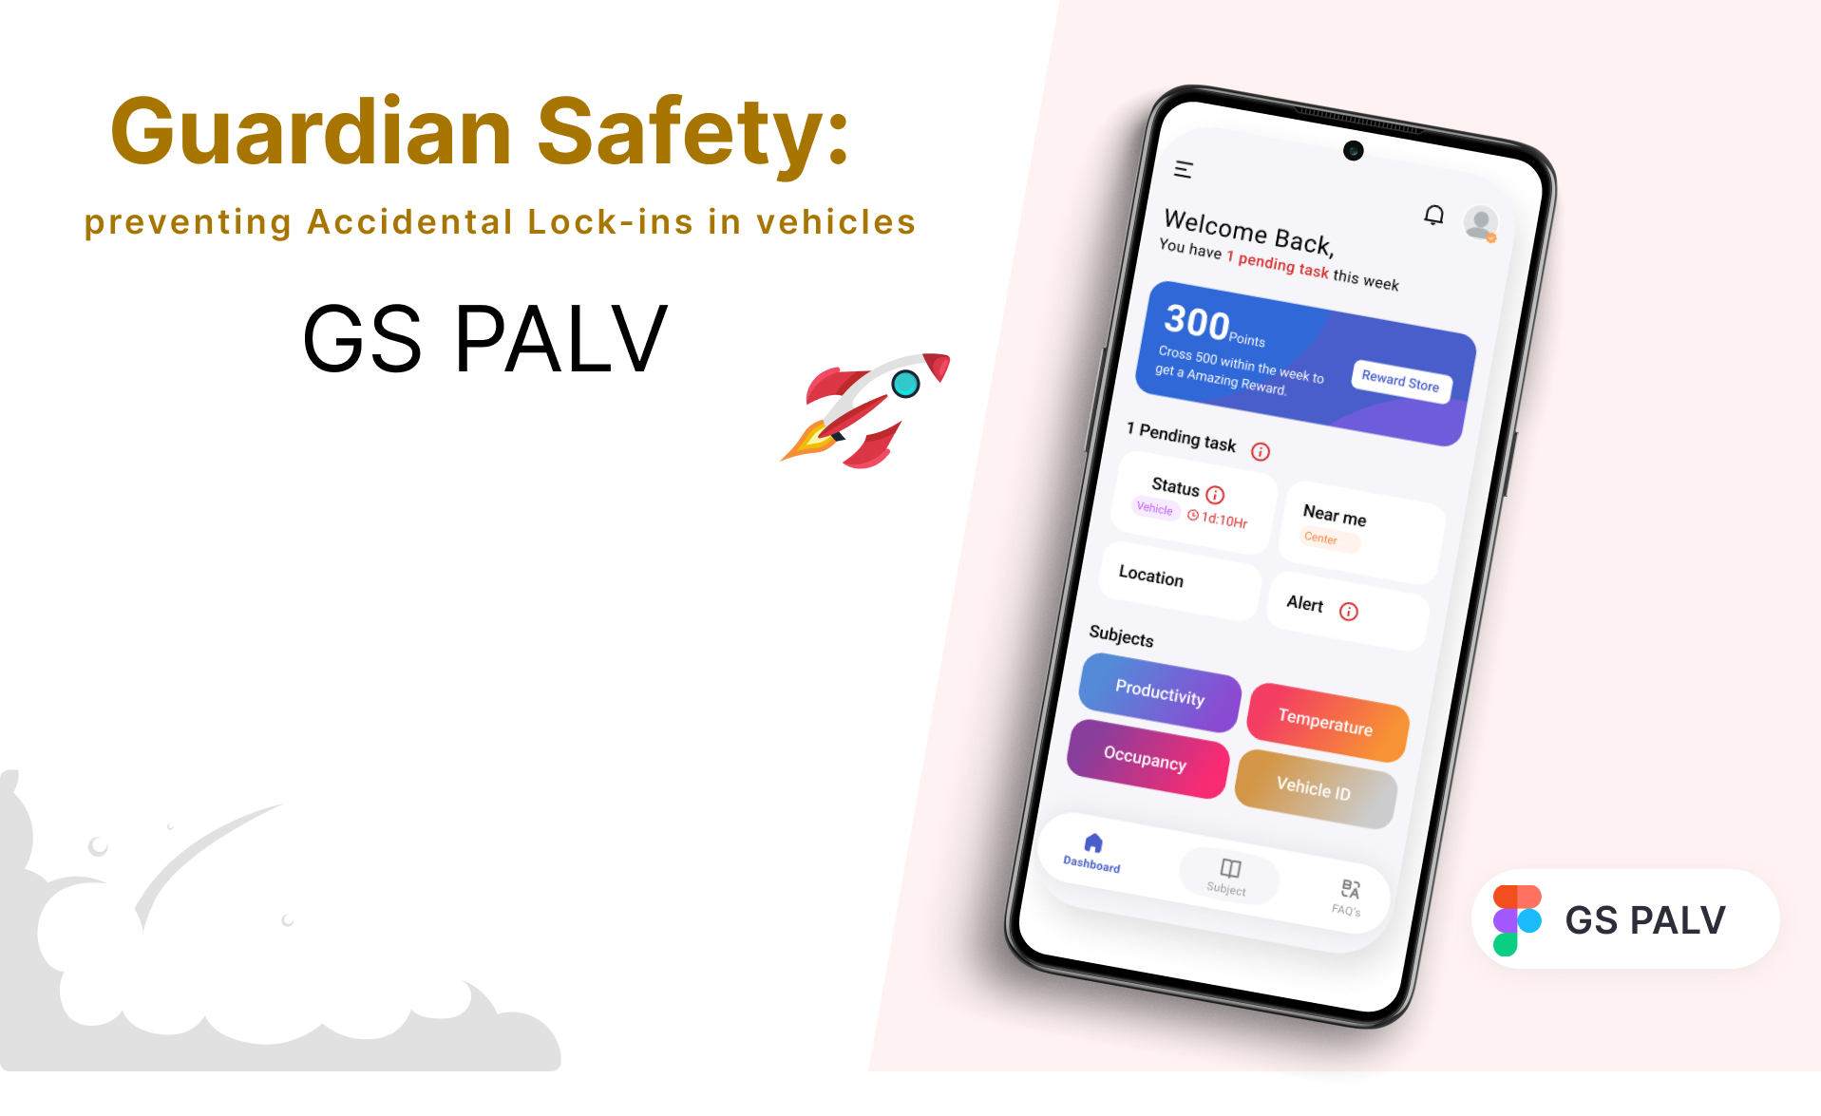
Name: Gagan Deep Gupta
Email: gagandeepgupta02@gmail.com
Problem Statement: Accidental lock-ins of children and pets in vehicles are distressing and potentially life-threatening situations. These incidents occur more frequently than we might realize, especially in hot or cold weather, and can lead to severe health risks. Developing a comprehensive solution to address this issue is of utmost importance.

Slide 2

Project Description:
This project's core objective is to develop a sophisticated system to prevent accidental lock-ins in vehicles, with a primary focus on protecting children and pets. Key components include smart sensors with a connected mobile app for real-time monitoring, AI-driven predictive modeling for proactive warnings, and advocacy for vehicle safety legislation. In addition, an educational campaign, collaboration with stakeholders, and continuous data analysis ensure a comprehensive solution. The project strives to reduce accidents, emotional distress, and promote responsible vehicle ownership, ultimately enhancing the safety of vulnerable occupants.
Highlight the problem:
1.Life-Threatening Emergencies:Vulnerable occupants (children and pets) face life-threatening situations when accidentally locked inside vehicles, particularly in extreme weather conditions.
2.Emotional Distress:Caregivers and vehicle owners experience severe emotional distress when they inadvertently leave loved ones inside a vehicle, often resulting in long-lasting trauma.
3.Legal Consequences:Accidental lock-ins can lead to legal consequences for caregivers, compounding the emotional distress and financial burdens.
4.Strain on Emergency Services:Frequent emergency calls to rescue locked-in occupants strain emergency services, diverting resources from other critical situations and causing undue stress on responders.
5.Missed Technological Advancements:The ongoing problem highlights a critical gap in vehicle safety, preventing the realization of potential technological advancements in preventing accidental lock-ins.
6.Lack of Awareness:Limited public awareness about the dangers of accidental lock-ins and responsible vehicle ownership perpetuates the problem, putting more lives at risk.

Slide 3
Smart Sensors
Mobile App
AI-Powered Predictive Modeling
Legislation Advocacy
Public Awareness Campaign
Collaboration and Integration
Data-Driven Improvement:
IDEA/IMPLEMENTATION –
The solution operates on six independent and correlated stages
1.Smart Sensors and Mobile App: Implementing smart sensors in vehicles to detect occupants and connect to a user-friendly mobile app for real-time monitoring.
2.AI-Powered Predictive Modeling: Utilizing AI algorithms to forecast potential lock-in scenarios and provide proactive warnings to caregivers.
3.Legislation Advocacy: Advocating for legislation mandating the integration of lock-in prevention systems in vehicles, ensuring a systemic approach to the problem.
4.Public Awareness Campaign: Creating an educational campaign to raise awareness and encourage responsible vehicle ownership among the general public.
5.Collaboration and Integration: Collaborating with automobile manufacturers and key stakeholders to integrate safety technology and promote the project's mission.
6.Data-Driven Improvement: Collecting and analyzing data on lock-in incidents to continuously enhance the system's effectiveness.

Slide 4
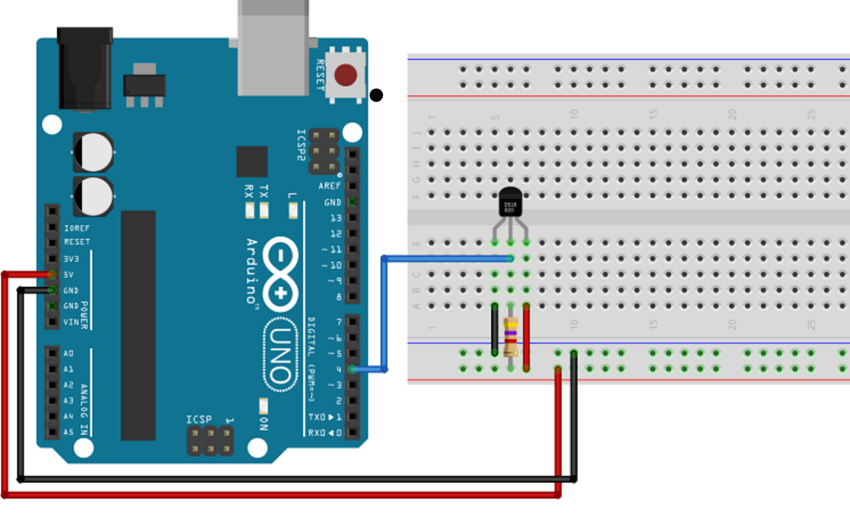
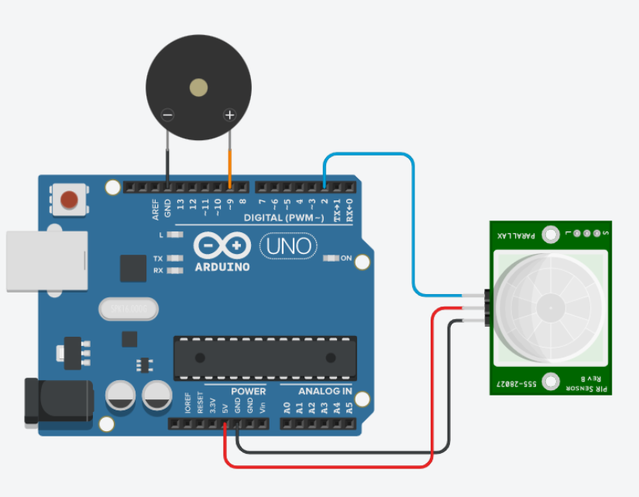
Smart Sensor
1. Arduino Temperature Sensor
2. Arduino Motion Sensor

Slide 5
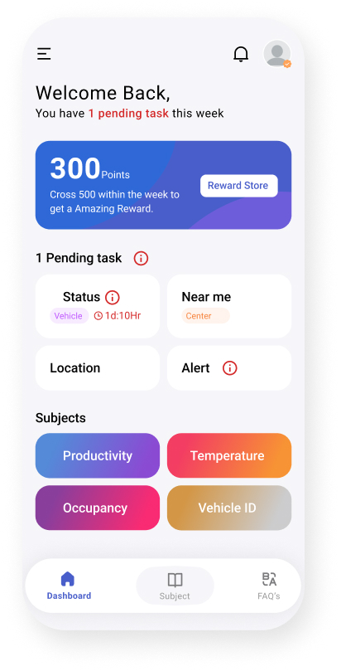
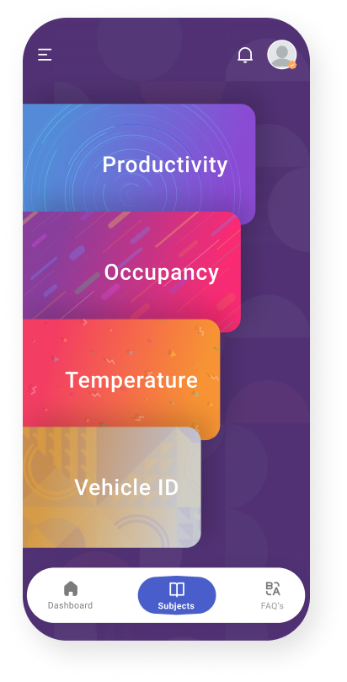
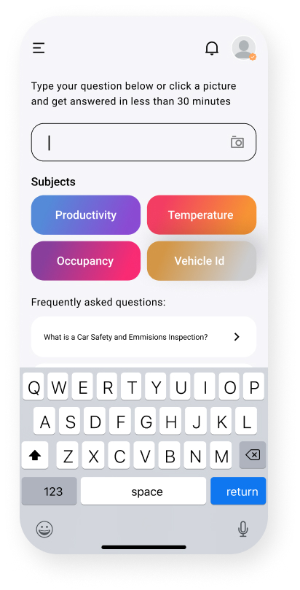
Mobile App

Slide 6

Public Awareness Campaign
Create and implement an educational campaign to raise awareness about the dangers of accidental lock-ins and promote responsible vehicle ownership.

Slide 7

Collaboration and Integration
Expanded Resources: Partnerships provide additional financial, technical, and human resources, enabling the project to achieve its goals more effectively.
Diverse Expertise: Collaboration with different organizations brings a wide range of expertise, contributing to the project's success by addressing various aspects of the issue.
Broader Audiences: Partnerships extend the project's outreach to diverse audiences, reaching more caregivers, pet owners, and relevant stakeholders.
Credibility and Trust: Partnering with reputable organizations lends credibility to the project, making it more trustworthy and convincing for the public.
Amplified Impact: Joint campaigns, coordinated efforts, and shared networks amplify the project's message and advocacy efforts, ultimately increasing its overall impact.

Slide 8

Testing and Validation
Rigorous testing and validation processes include functional, user, simulation, environmental, data accuracy, security, interoperability, regulatory compliance, field, and third-party assessments. These ensure system functionality, user-friendliness, accuracy, safety, and compliance while allowing continuous improvement and obtaining regulatory approvals and certifications as needed.

Slide 9
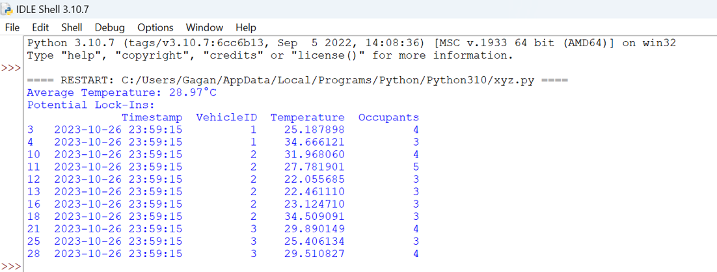
Output

Slide 10
Thank you

