Slide 1

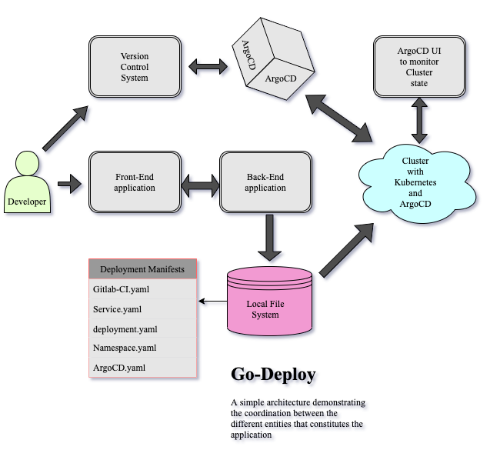
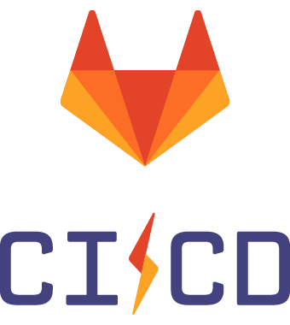
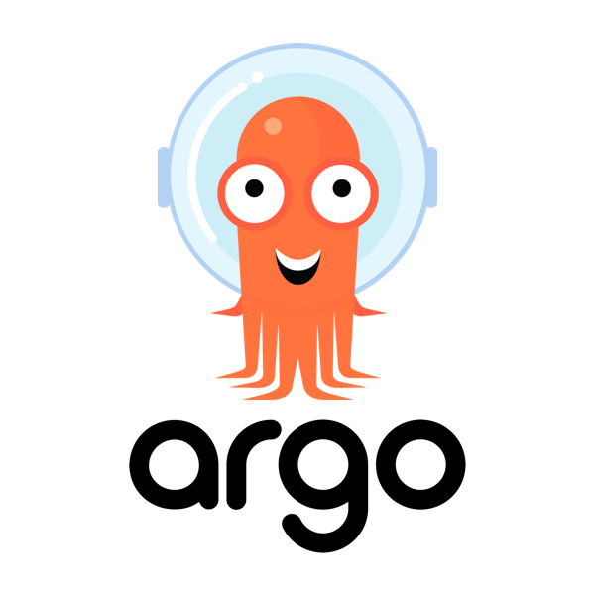

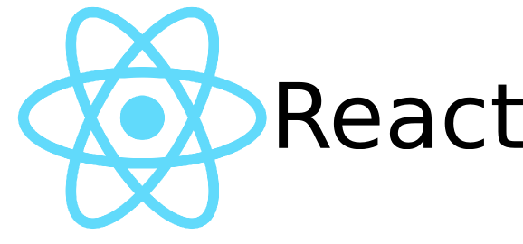
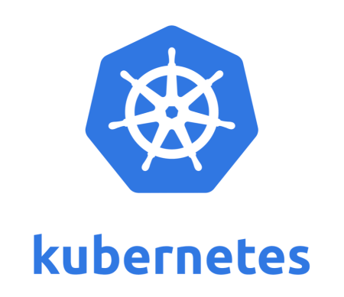

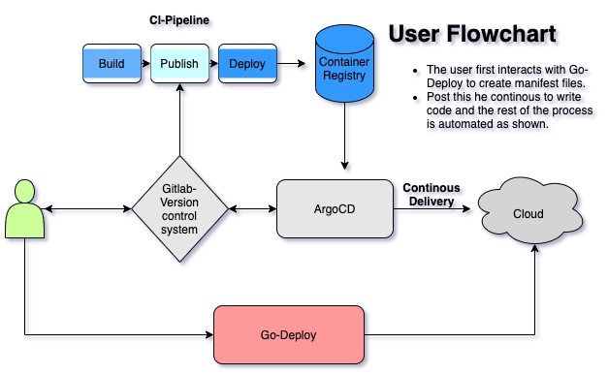
Go-Deploy
By Gagan Hegde
Faculty Advisor: Dr. M. Mustafa Rafique
Deployments made Easy
Motivation
System Architecture
Develop an application that can achieve end to end application delivery using the state of the Art GitOps methodology.
Understand the latest trends and strategies in application deployments and delivery.
Compare different Continuous integration technologies and device the best method to integrate a CI pipeline with a version control system.
Understand the use and benefits of cloud native software like ArgoCD and Kubernetes.
Better my understanding of cloud and kubernetes architecture.
Front-end:
The front end is designed using React JS, it contains separate tabs to create the deployment, service, and namespace yaml files. In addition, it also contains the initial manifest set-up page after a tutorial describing the necessary steps required to continue.
Back-end:
The Backend is written in Go, it exploits different Kubernetes/Docker API’s to create the right YAML manifest files for you. The front end interacts with the backend using JSON POST requests to create the necessary manifests in the path chosen.
Cluster:
In this implementation a version of minikube was used to test deployments made using ArgoCD which is a cluster that runs on the local System, however since this is a cloud native implementation, this service will run on any cloud service.
The cluster has an installation of argoCD which deploys six different pods including the ArgoCD server and the ArgoCD controller.
The controller tests for changes to the Git-Repo and updates cluster state based on the state of the Git-Repository.
The ArgoCD server exposes the UI of ArgoCD to monitor cluster state and visualise different services on the cluster.
Problem Statement
Evaluation
The latency between development and deployment with the waterfall cycle is mitigated using the GitOps strategy.
The benefits of version control systems such as commit shas, commit logs, security and more recently integrated CI/CD tools had not been leveraged to achieve end to end application delivery using Git as the sole source of truth.
Developers were often restricted by the unidirectional flow of the waterfall cycle, making small changes to the state of the cluster often took a longer duration than necessary.
Git-Lab CI | Tekton Pipelines | Jenkins
Have complete control over the Gitlab repository, aids with security of code, variables and manifest files. | Need to separately integrate security measures like sealed secrets for access-token safety. | Need to integrate security features to the pipeline externally.
Integrated with the repository, less complex pipeline files. | More complex pipeline files. | More complex pipeline files.
Can use the inbuilt container registry to store images for cluster state update. | Increased dependency on external image registries like docker, Quay etc. | Dependency on external image repositories.
Process Methodology
Technologies
The user interacts with the Go-Deploy application giving the input with the namespace to which the deployment should occur and the name of the GitLab repository.
The application creates the necessary manifests in the namespace/deployment folder.
The Developer can continue writing code and collaborating with other developers using GitLab and every commit to the choice of revision creates an end-to-end pipeline that can be manipulated based on the user's needs.
The rest of the process is automated, the state of the cluster to which the deployment occurs is matched to the state of the Github repository because of the CRD’s and CI pipeline files generated by the Go-Deploy application.
The user can further visualise the cluster state based on the ArgoCD UI exposed by the ArgoCD server.
The interface of Go-Deploy can be used to create additional service, deployment, and namespace files in the path chosen before. The use of Go-Deploy makes it easy to create a simple starter kit for end-to-end application delivery which is highly “Kustomizable”.
Conclusion
There are a number of tools in the industry that cater to the DevOps methodologies for application delivery.
There are few that create an integrated delivery tool for E2E application delivery using the novel GitOps approach.
With the benefits of version control and the seamless continuous delivery incorporated using ArgoCD we create an application capable of altering cluster state with a simple merge request.
Future Work
Increased capability of the application to customise pipelines based on a wide variety of programming languages can be incorporated.
Creation of the plethora of different Yaml manifests in the deployment/namespace file should be supported by the tool.
Integration of CI tests can be included in the UI to reduce manual intervention

