Slide 1
SOCIAL MEDIA
BY GANESH NAIK AND PAVAN NAIK

Slide 2
Content
Introduction
What is Social Media?
How Social Media Works
Some Examples of Social Media
Types of Social Media
Usage graph
Advantages & Disadvantages
Conclusion

Slide 3
Introduction
Social media is a medium that is growing quite fast nowadays because of its user-friendly characteristics.
Social media platforms like Facebook, Twitter, Instagram, etc. are allowing people to unite with each other across distances.
Today’s generation is particularly one of the most aggressive users of social media.

Slide 4
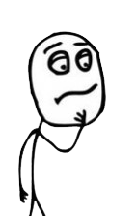
What is social media?
Social Media can be defined as an array of internet-based platforms, which promotes and enhance the sharing of information.
Some of the most common types of social media are websites and applications focused to microblogging, forums, social bookmarking, social creation, social networking and Wikipedia.

Slide 5

How social media works?
Social media sites start with a user creating a profile, usually by providing a name and an email address.
Once a profile has been created, users can create and share content. For instance, an Instagram user with a new account can take a picture and share it on their profile with a caption.
Social media often uses "feeds" that allow users to scroll through content.

Slide 6
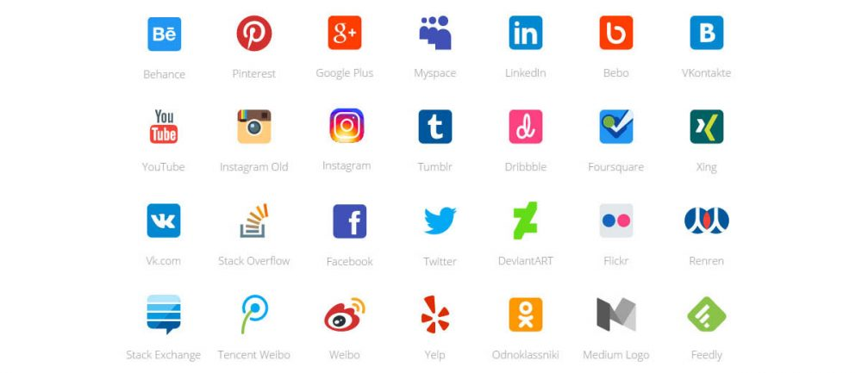
Some Examples Of Social Media

Slide 7
Types Of Social Media
1. Social News The users are allowed to post news links to the outside articles on the social news websites.
Example: Reddit.
2. Social Networks The users are allowed to connect and share with the people having similar interests and backgrounds on a social networking website.
Example: Facebook.
3. Media Sharing The users can share different types of media such as video and photos on the media share websites.
Example: YouTube.

Slide 8
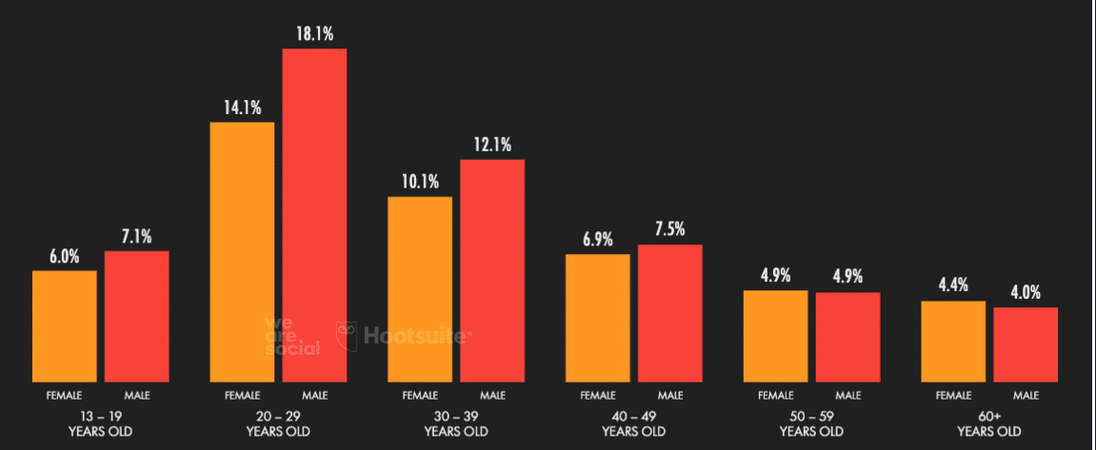
Percentage Usage Of Social Media By Age

Slide 9
ADVANTAGES & DISADVANTAGES
ADVANTAGES
DISADVANTAGES
Global connectivity
An excellent tool for education
Information & updates
Share a large amount of information daily
Trouble with privacy
Lack of emotional connect
Spreading of fake news
Addiction

Slide 10

CONCLUSION
Social media is a really convenient and important communicate network for all the people nowadays. We can use it to know friends and keep contact with friends that came from different countries. We can also share our ideas so quickly so that all the things could develop so fast because people could tell us their ideas and we could improve it immediately.But everything should be in a limit and on our control.

Slide 11
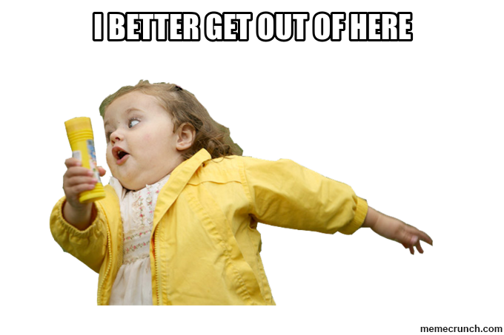
THANK YOU

